Slide 1
CSE 438: Data Science For Practitioners Paper Review
Title: Ask Your Data—Supporting Data Science Processes by Combining AutoML and Conversational Interfaces
Authors: Sara Pidó, Pietro Pinoli, Pietro Crovari, Francesca Ieva, Franca Garzotto, Stefano Ceri
Published Year: 2023
Paper reviewed by: Md. Mahfujul Haque
ID: 20101388
Section: 01
Group: 14
ST - Mehnaz Ara Fazal
RA - Md Sabbir Hossain
Course Instructor: Annajiat Alim Rasel

Slide 2
Contents
Abstract Highlights | Slide 3
Introduction | Slide 4
State of the Art | Slide 5
Methods | Slide 6-9
Use Case – Genomic Data | Slide 10
Use Case – Stroke prediction Dataset | Slide 11
Evaluation – Automatic ML pipeline Executor | Slide 12-13
Evaluation – Translation into Executable Pipeline | Slide 14-15
Conclusion | Slide 16
Constraints | Slide 17
Synthesis | Slide 18

Slide 3
Abstract Highlights
DSBot addresses the scarcity of interdisciplinary education in Data Science.
Utilizes conversation interaction for non-experts in industry and academia.
Features: Neural network translation, domain-specific language, vast pipeline dictionary, conversational technology.
Empirical evaluations: BLEU score of 0.8 in translation, superior to TPOT in 19 out of 30 autoML datasets.

Slide 4
Introduction
Data Science's pivotal role in real-world problem-solving.
Accessibility challenges for domain experts.
GeCoAgent success in computational genomics.
DSBot introduction as an interactive ML tool for non-experts.
Focus on NLP, conversational tech, and AutoML.

Slide 5
State of the Art
Overview of three key areas: Automatic Code Generation, AutoML, Interactive Machine Learning.
Categorization of Automatic Code Generation tools.
Popular AutoML systems: Auto-WEKA, Auto-Sklearn, TPOT.
Evolution of Interactive ML platforms.
Emphasis on the need for tools bridging expert-non-expert gap.

Slide 6
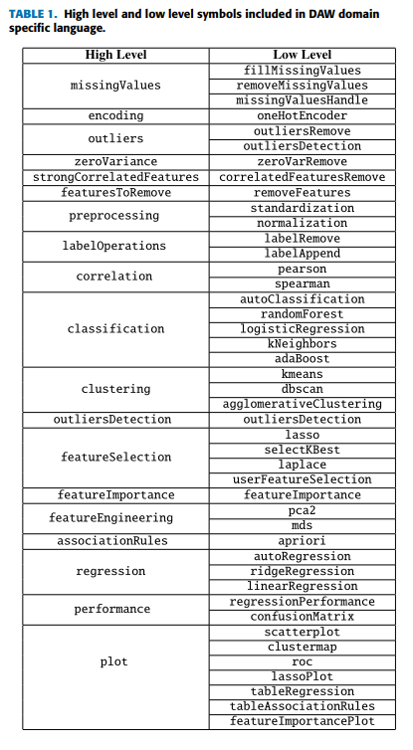
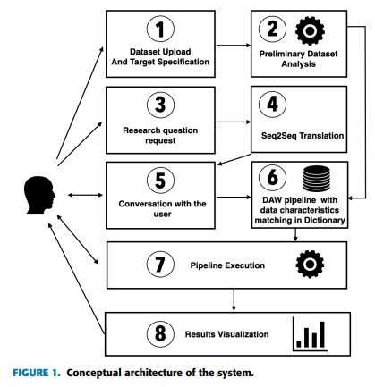
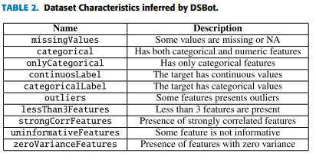
Methods
DSBot designed for specific data analysis tasks.
Eight main steps from dataset upload to result visualization.
Key Components: DAW DSL, Preliminary Dataset Analysis, Question Translation, Conversational Comprehension, Pipeline Dictionary, AutoClassification, AutoRegression, Architecture.
Emphasis on automation, domain-specific language, and user interactions.

Slide 7
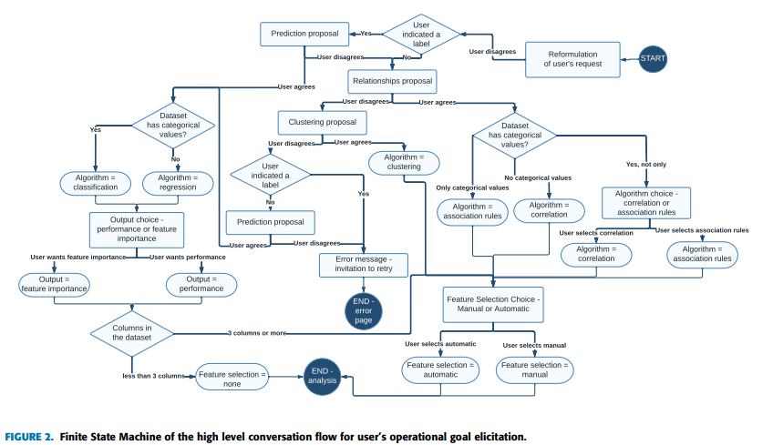

Slide 8
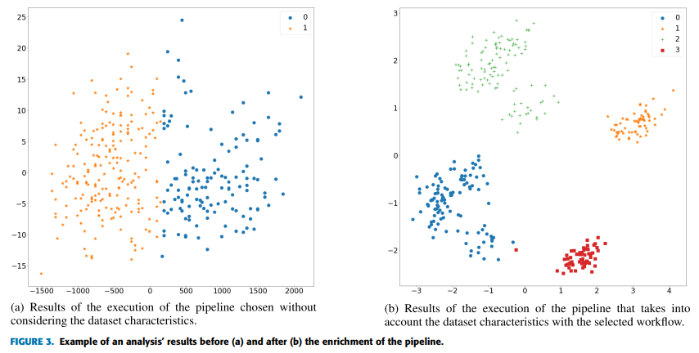

Slide 9
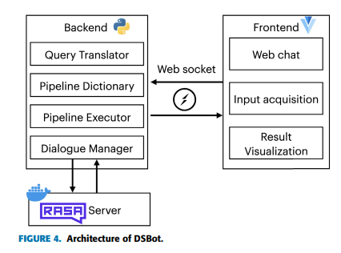

Slide 10
Use Case - Genomic Data
Dataset: Genomic data of breast cancer patients.
User's goal: Identify challenging breast cancer subtypes.
DSBot's steps: Dataset analysis, question translation, pipeline suggestion, user confirmation, execution, result visualization.
Emphasis on DSBot's applicability to specific domains.

Slide 11
Use Case - Stroke Prediction Dataset
Dataset: Stroke prediction dataset.
User's goal: Analyze for stroke prediction.
DSBot's conversation-based interaction.
User-requested feature importance analysis.
DSBot's domain-agnostic nature and focus on feature characteristics.

Slide 12
Evaluation - Automatic ML Pipeline Executor
Objective: Evaluate DSBot's accuracy and computation time.
Baseline: TPOT.
Results for classification and regression.
DSBot outperforms TPOT in multiple datasets with significantly shorter execution times.

Slide 13
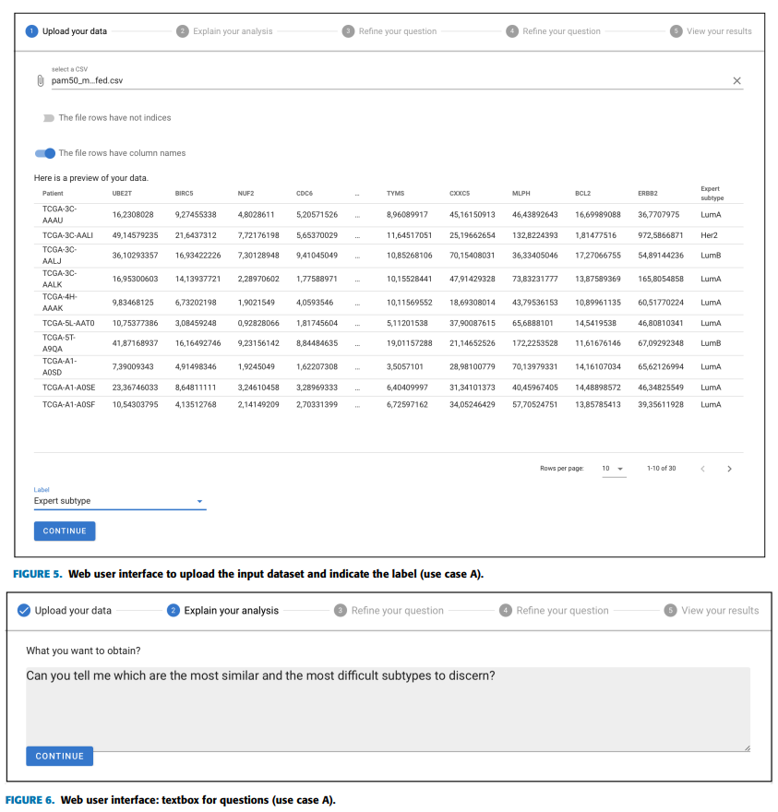
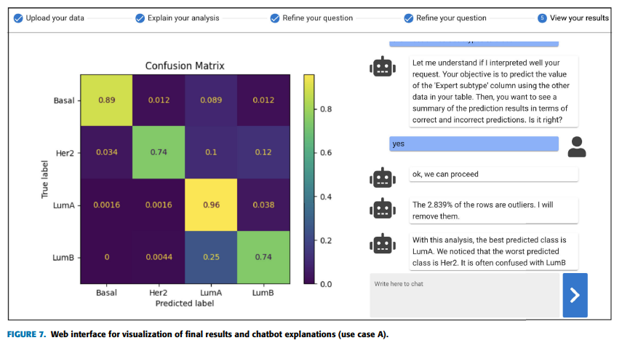

Slide 14
Evaluation - Translation into Executable Pipeline
Objective: Assess GPT-2-based translator.
BLEU score of 0.8 indicating high translation performance.
GPT-2's effectiveness in translating English to DAW.

Slide 15
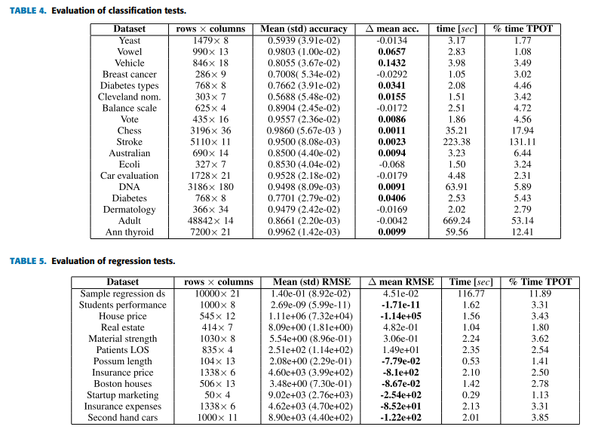

Slide 16
Conclusion
DSBot's key components: DAW DSL, Neural Network-based Translation, Matching Algorithm, Conversational Agent.
Empirical evidence of DSBot's potential through case studies.
Acknowledgment of areas for improvement.
Future developments: Enhanced conversational capabilities, automation of additional algorithms, supporting new analysis modules, and incorporating explainable AI techniques.
DSBot as a significant step toward democratizing data science.

Slide 17
Constraints:
Although DSBot exhibits great potential, it is limited by possible biases in machine learning models, particularly when addressing imbalanced datasets. Expanding supported pipelines and operations and improving machine learning model selection criteria may also be beneficial to the system.

Slide 18
Synthesis:
DSBot proves to be a potent and user-friendly instrument that democratizes data science by empowering non-specialists to carry out intricate analyses on their own. Its potential impact is demonstrated by its success in comparative evaluations and user-friendly interfaces. Still, admitting shortcomings draws attention to how difficult it is to maintain fairness and improve functionality. The paper presents DSBot as a developing solution for wider data science accessibility, with a focus on future developments, such as enhanced conversational capabilities and support for additional algorithms.

Slide 19
Thank You

