Slide 1
Extracting isosurfaces with VTK
VTK practicing exercice M. S. – 10/11/2015

Slide 2
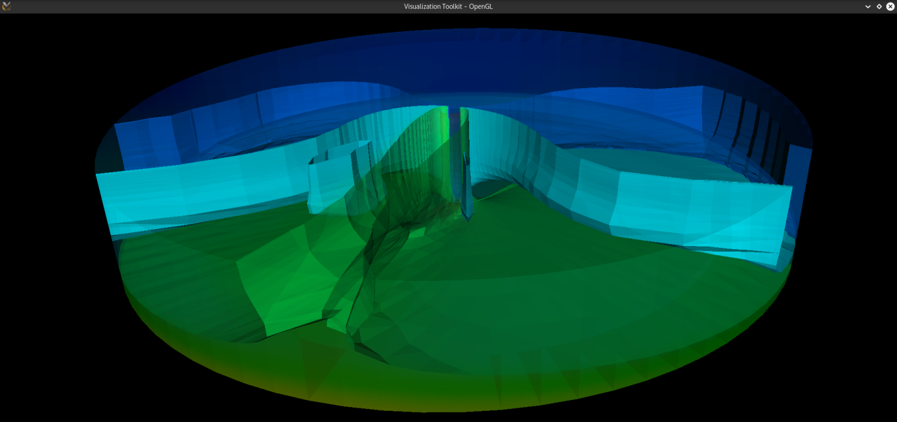
VTK – Visualization Toolkit
C++ class library
Aimed at scientific visualization
Exercise: isosurface extraction with VTK, 4 methods

Slide 3
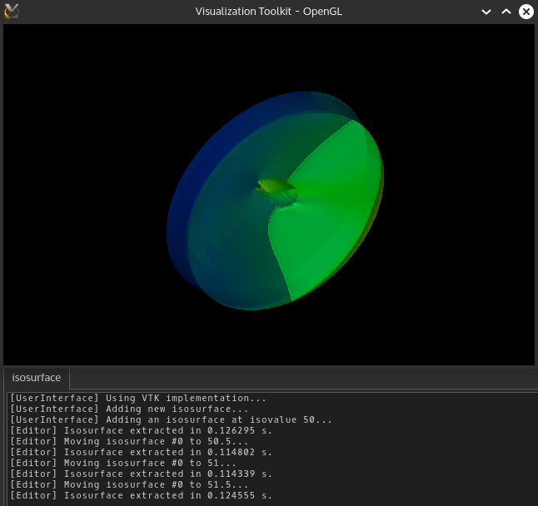
VTK
vtkContourGrid
0,120 sec

Slide 4
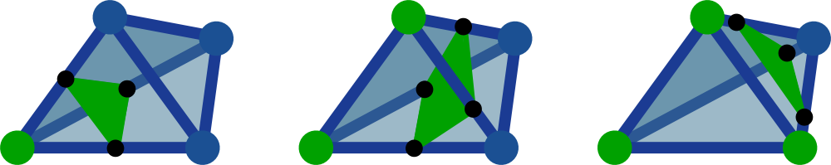
The naive way
Testing every cell
Building intersections on tetrahedra
4 points: reorientation

Slide 5
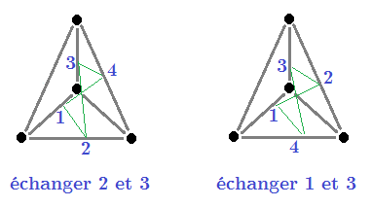
The naive way
Reversing tetrahedra: 2 cases

Slide 6
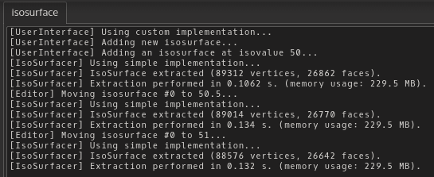
The naive way
0,124 sec
90k vertices

Slide 7
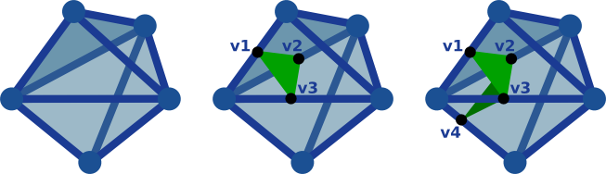
Removing reduncdant points
Memoization: remembering intersections for cell neighbors
Alternative: remembering intersections for vertex neighbors

Slide 8

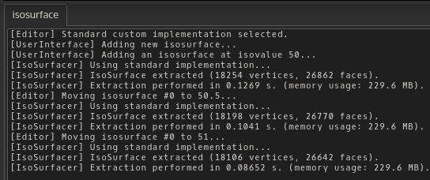
Removing reduncdant points
Neighbors: 0,131 sec 18k vertices
Points: 0,106 sec 18k vertices

Slide 9
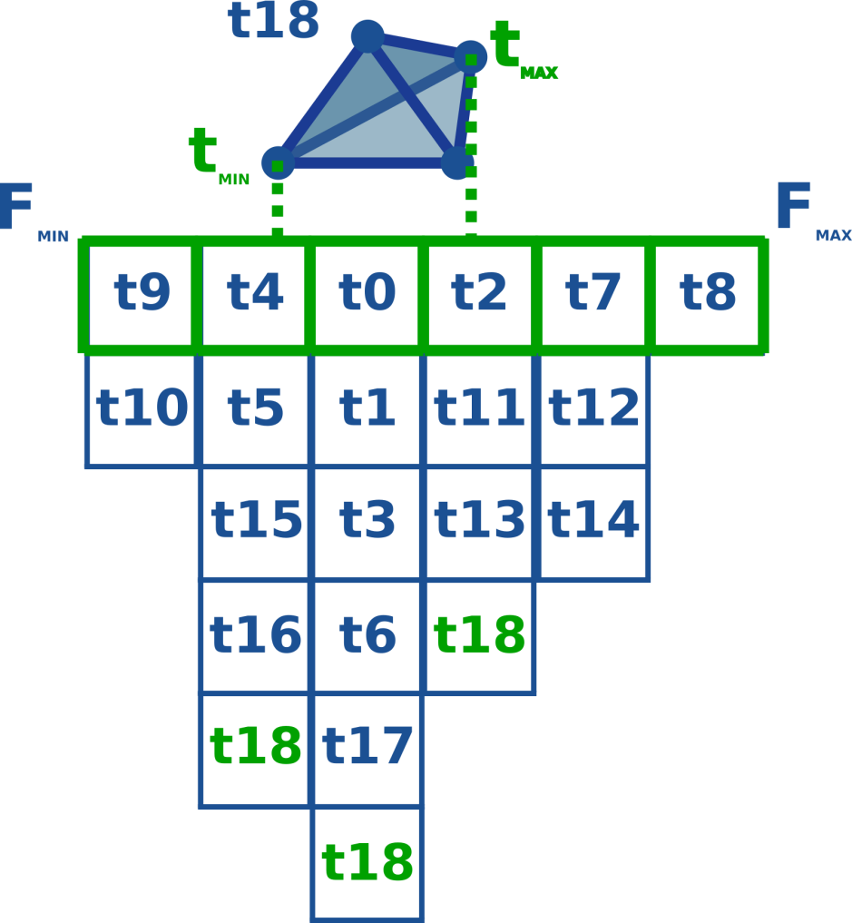
Enhanced extraction
Indexing tetrahedra according to their extremal values

Slide 10

Enhanced extraction
0,063 sec
18k vertices

Slide 11

Optimal extraction
Extract isosurface on neighbors starting at a cell
Select the starting cell efficiently
Preprocessing: partition tetrahedra between saddle contours

Slide 12
Thanks

