Slide 1

CMR COLLEGE OF ENGINEERING & TECHNOLOGY
Kandlakoya, Medchal, Hyderabad - 501401
Department of Computer Science and Engineering
TEXT TO MORSE CODE TRANSLATOR
PRESENTED BY:
CHITRA BHANU REDDY GOPU- 20H51A05C4
RAHUL SAI RANGANATHAN -20H51A05J4
GALLA NITIN- 20H51A05N6
Under esteemed guidance of :
Ms.B Anuradha

Slide 2
Outline
Abstract
Introduction
Literature survey
Existed system
- Problems in existed system
Research Objective of Presentation
Problem Definition
Research work
- Proposed system architecture
- Methods
- Comparison of Proposed system with an existed system
Performance Measure
Results
Conclusion
Future Work

Slide 3
Abstract

Slide 4
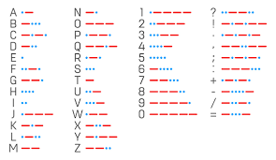
ABSTRACT
Morse code is a process of transmitting text information as a series of on-off tones and lights or clicks .If they use a tapping device recipient can understand the message without additional decoding equipment. Morse code is represented by the form of dits and dahs.
Morse code can be transmitted by using electric telegraph wire, light, and sound, through a different medium in different ways. Morse code is used for long-distance communication.
International Morse code was devised by European nations in 1851. It is the base for the Morse code to transmit or receive. Morse code is a character encoding and decoding scheme.

Slide 5
INTRODUCTION

Slide 6
Introduction
Communication through internet brings teams together. Three main parts of communication are sender, medium and receiver.
Now days, transmission of data over internet is not safe without any encryption method. All corporate sectors, banking sectors, government sectors and many other sectors are sharing their data through internet.
Hackers always try to attack on the transmitted data and try to recover the data. Various techniques are developed for providing the data security.
A Morse Code Translator is a translator that is used to convert normal text messages to Morse code and decode the Morse code to text.
one can easily convert the sentences, texts, distress messages, etc. to Morse Code and vice-versa.

Slide 7
Literature Survey

Slide 8

Existing system
Morse Code Trainer :
This is an app helping users to learn Morse Code. One can choose either transmitting or receiving mode to practice corresponding skill and receive the performing feedback immediately. It includes the functions
of letter training (both transmitting and receiving), word training (only transmitting), free mode, speed adjusting (WPM), sound effects adjusting and electronic handbook.

Slide 9

Existing system
Morse Code Translator :
This is an app allowing users to send short flashlight text messages using the International Morse Code.
The apps includes the features that the flashlight can transmits short messages of lights (Morse Code); there are some template stored in the database for emergencies. For example, SOS; allowing users to save new messages; changing frequency of the transmitted signal

Slide 10

Existing system
Morse Code Trainer :
This app allows users to input any text by keyboard or voice or select a commonly transmitted word or phrase. The app translates the received message and broadcast the translated text via camera flash.

Slide 11
Research Objective

Slide 12
Research objective
Our research objective is to translate Morse code to text and text to Morse code by using the web application. So, it gets easier for the common people to understand. By considering all the existing applications in mind we came up with an efficient solution.
To achieve this we have gone through online forums and other sources to find out a solution which is attractive and user friendly.

Slide 13
Problem Definition

Slide 14
Problem Definition
We know brief description of Morse code.We find out that every letter in the English alphabet has a Morse code Representation.This tells us it is highly likely we are going to have to be doing some sort of conversion of character into their Morse code and vice-versa.
We use the cross-reference characters in a given string and convert it into a string of Morse code.
A very piece of information here is that a concatenated string that is converted into its Morse code counter part is defined as transformation.We might have two phrases that when converted and concatenated,yield the same Morse code representation.
finally we are give information on what we need our function to return

Slide 15
Research Work

Slide 16
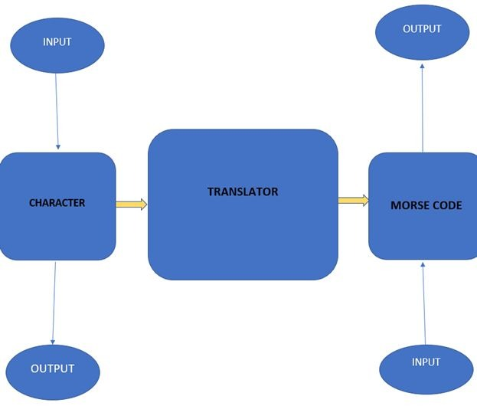
Proposed System Architecture

Slide 17
Performance Measure:
• Morse code generator helps you to encode and decode your text message for telecommunication. It helps you to transmit text messages for long-distance communication.
• We use Morse code converters in aerospace, amateur radio operators, military, and army forces for communication.
• Our Morse code converter is free and unlimited conversion allowed. Once you enter the text and click on encode, then it converts text to the Morse alphabet. If you want to convert Morse code to text, then click on decode. You can transmit text information for long-distance easily and securely..

Slide 18
Result Analysis
1. System takes input from the user in first text form or in Morse code, based on selected language.
2. The system then processes the text into Morse Code or Morse code into text.
3. The output is displayed in the second textbox.

Slide 19
Conclusion
This is the implementation of MORSE CODE translator using HTML,CSS and Js.
This system was designed to transmit message securely to long distance.
This design can be used in different areas like long communication, military, external affairs etc.
By using this system there is no need of tapping device for transmission .so this overcomes the security problems.

Slide 20
Future work
Morse code has high security as only skilled and learned persons can decode the information.
Morse code no longer remains only the language of dots and dashes used in telegraph but it has also found a great scope in the fields of aviation to communicate with the base station,
in navy to communicate with different ships, radio communication like the Amateur Radio.
Recently has proved to be a great boon and an important communication tool for the people with various disabilities to communicate.

Slide 21
References
https://ijarsct.co.in/Paper3243.pdf
https://www.ijsr.net/archive/v5i8/ART20161152.pdf
https://www.ijraset.com/research-paper/morse-code-translator-using-eye-blinks
https://www.researchgate.net/publication/343979632_A_Review_Paper_on_Cryptography_of_Modified_Caesar_Cipher

Slide 22
Thank You!

