Slide 1


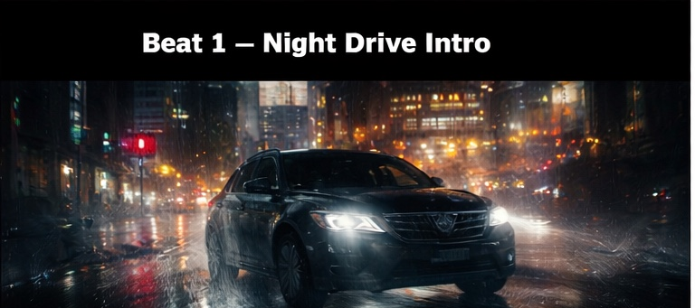
I have no words to say right now!!

Slide 2

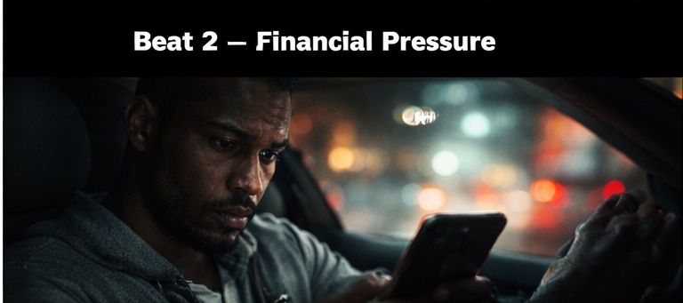
Logline
I have no words to say right now!!

Slide 3

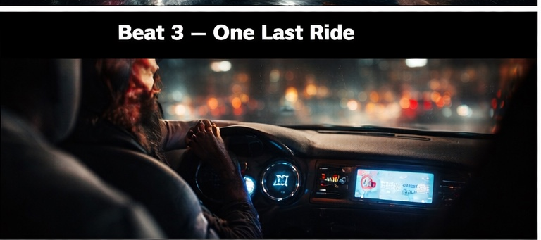
Synopsis
Final Render ready test

Slide 4
Protagonist
ELIAS

Slide 5
World
feature / fantasy satire comedy

Slide 6
Hook
I have no words to say right now!!

Slide 7
Conflict
Elias must navigate ridiculous power structures, inflated egos, and escalating chaos without losing the part of themselves that makes them dangerous.

Slide 8
Stakes
Elias must navigate ridiculous power structures, inflated egos, and escalating chaos without losing the part of themselves that makes them dangerous.

Slide 9
Tone
playful, witty, satirical, adventurous

Slide 10
Story Engine
Elias stumbles into a role far bigger than expected, and each attempt to survive the absurd rules of the kingdom only pulls the chaos closer.

Slide 11
Reversal
The truth behind the situation is different from what the protagonist first assumes.

Slide 12
Why This Movie
Elias stumbles into a role far bigger than expected, and each attempt to survive the absurd rules of the kingdom only pulls the chaos closer.

