Slide 1


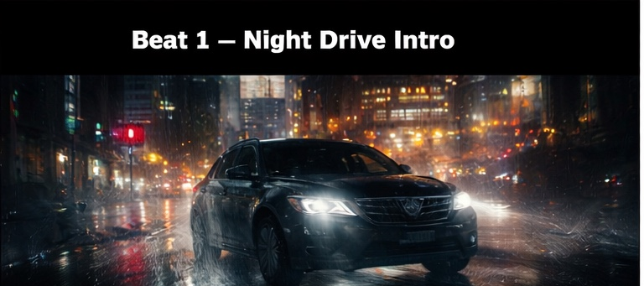
My logline!!!!

Slide 2

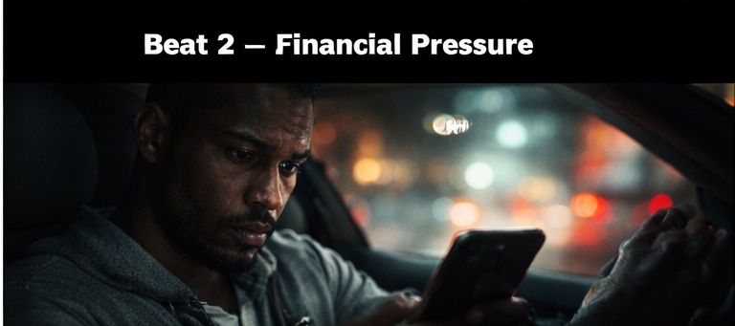
Logline
My logline!!!!

Slide 3

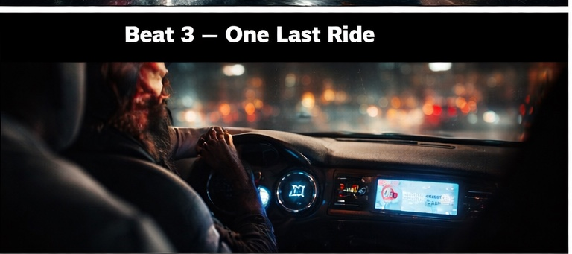
Synopsis
Synopsis Here.

Slide 4
Protagonist
HARRY

Slide 5
World
feature / action espionage thriller

Slide 6
Hook
My logline!!!!

Slide 7
Conflict
Harry must protect family, identity, and mission at once as secrets and escalating danger threaten to expose everything.

Slide 8
Stakes
Harry must protect family, identity, and mission at once as secrets and escalating danger threaten to expose everything.

Slide 9
Tone
propulsive, high-stakes, witty, cinematic

Slide 10
Story Engine
Harry is forced to balance a hidden life of danger with the illusion of normalcy, until escalating threats pull both worlds into collision.

Slide 11
Reversal
The hidden life meant to protect the protagonist's family becomes the very thing that puts them in danger.

Slide 12
Why This Movie
Harry is forced to balance a hidden life of danger with the illusion of normalcy, until escalating threats pull both worlds into collision.

