Slide 1



When STEVE is pulled into a tense situation he does not fully understand, he must navigate mounting pressure before everything collapses.

Slide 2


Logline
When STEVE is pulled into a tense situation he does not fully understand, he must navigate mounting pressure before everything collapses.

Slide 3

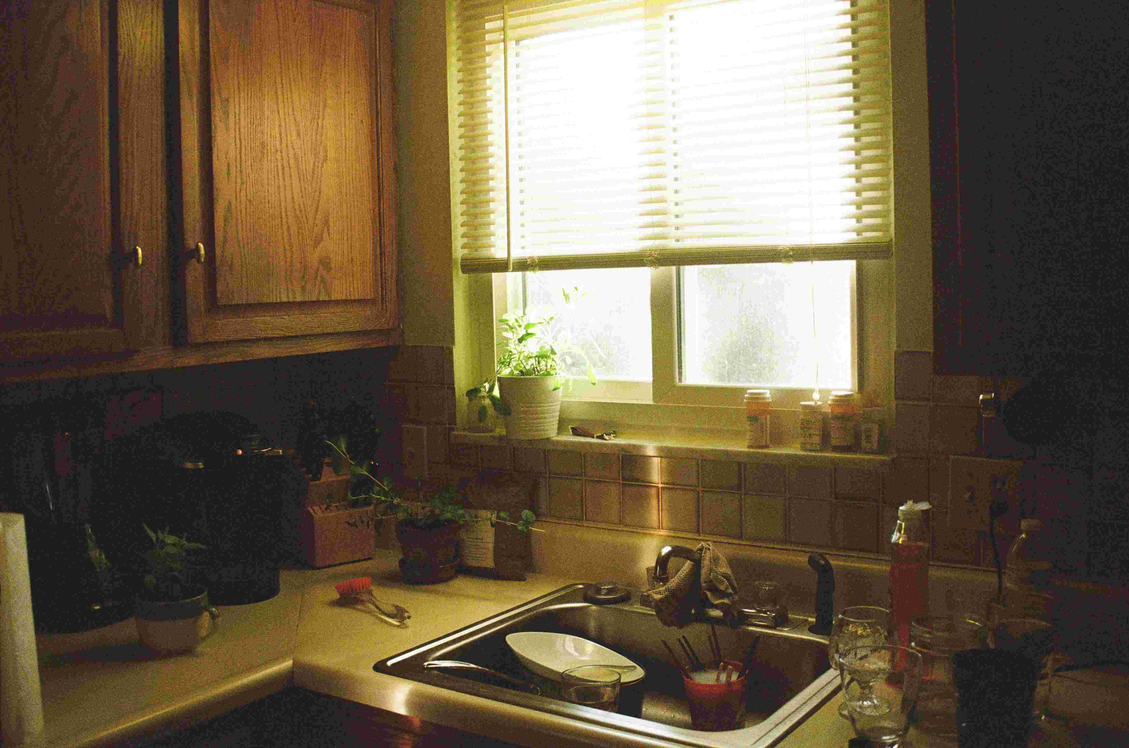
Synopsis
As pressure mounts around STEVE, incomplete information and rising tension force increasingly risky choices. What first appears to be one kind of threat gradually reveals itself to be something more complicated, pushing the story toward a reversal that challenges the protagonist's assumptions.

Slide 4

Protagonist
STEVE

Slide 5
World
feature / nightlife comedy

Slide 6
Hook
When STEVE is pulled into a tense situation he does not fully understand, he must navigate mounting pressure before everything collapses.

Slide 7
Conflict
Steve must navigate mounting pressure without fully understanding the situation.

Slide 8
Stakes
Steve must navigate mounting pressure without fully understanding the situation.

Slide 9


Tone
chaotic, funny, awkward, energetic

Slide 10
Story Engine
Steve tries to keep one wild night under control, but every bad decision turns the evening into a bigger social disaster.

Slide 11

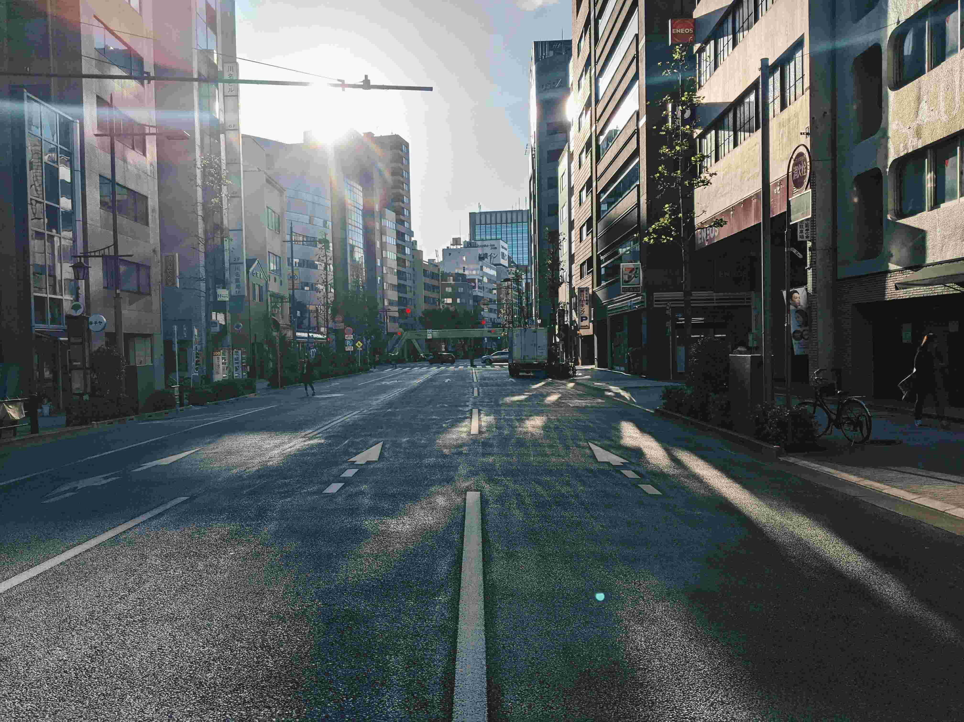
Reversal
The truth behind the situation is different from what the protagonist first assumes.

Slide 12
Why This Movie
Steve tries to keep one wild night under control, but every bad decision turns the evening into a bigger social disaster.

