Slide 1



When MAXIMUS is pulled into a tense situation he does not fully understand, he must navigate mounting pressure before everything collapses.

Slide 2


Logline
When MAXIMUS is pulled into a tense situation he does not fully understand, he must navigate mounting pressure before everything collapses.

Slide 3

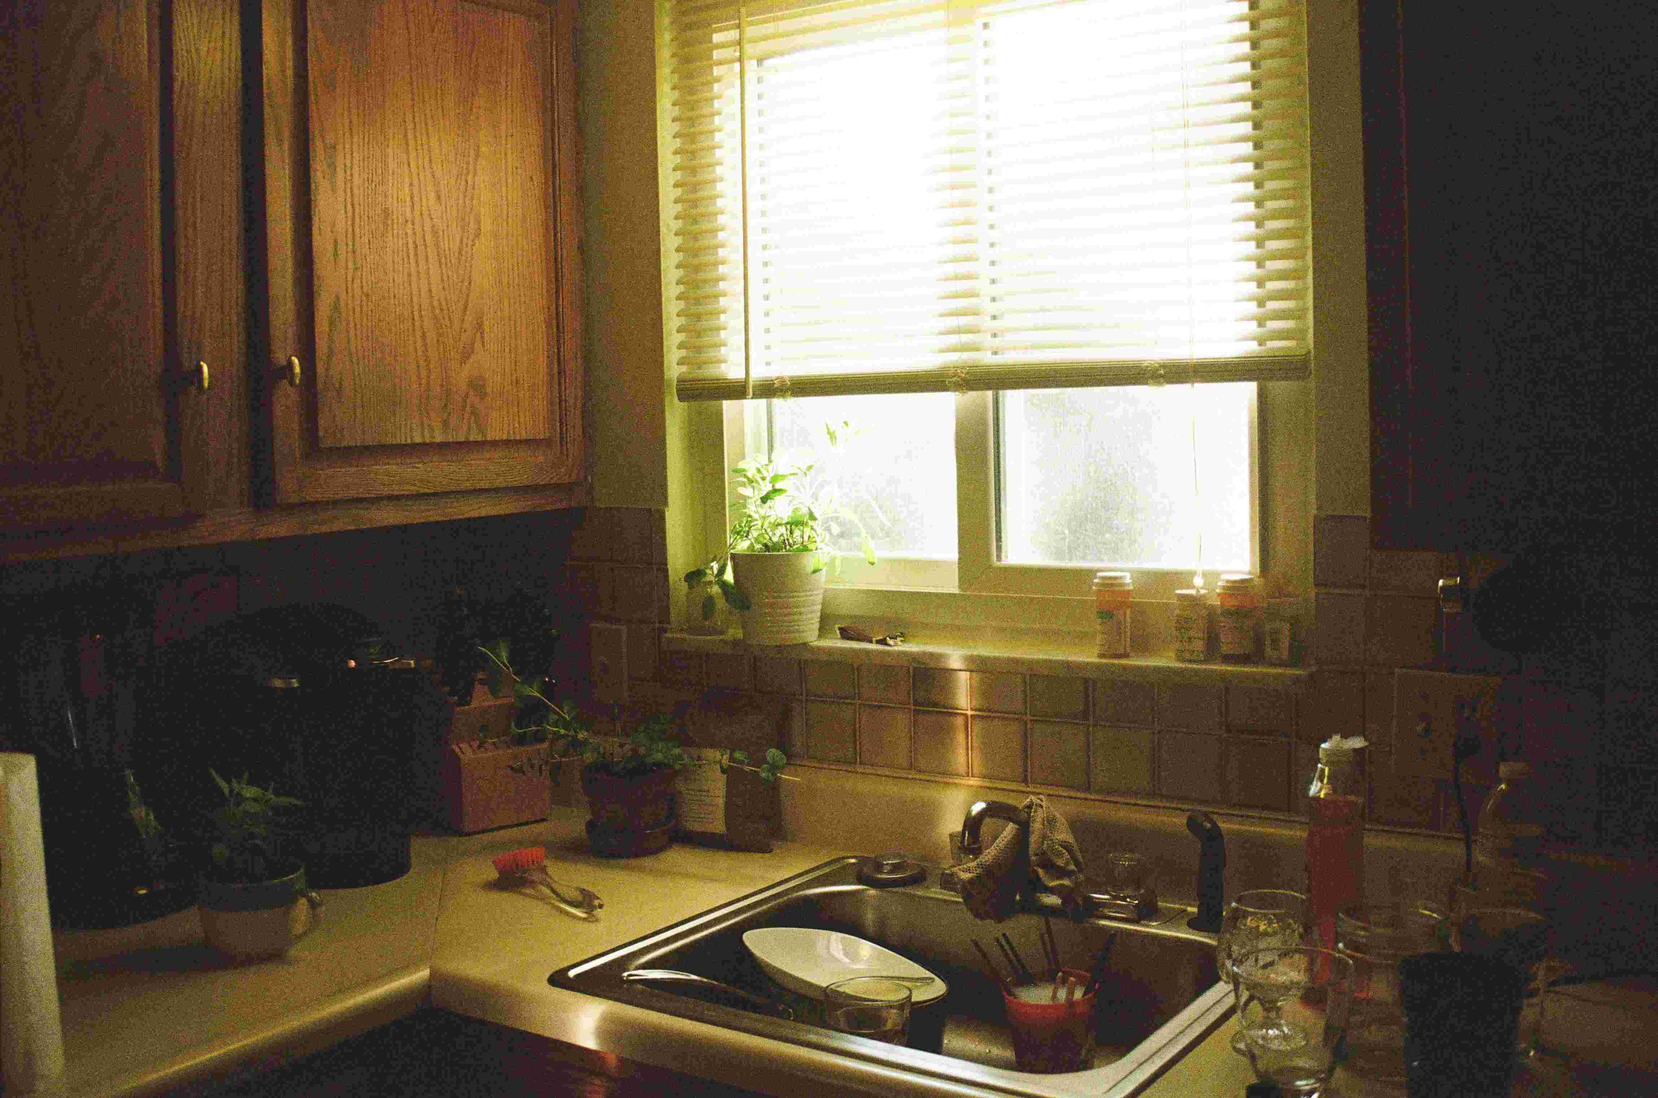
Synopsis
As pressure mounts around MAXIMUS, incomplete information and rising tension force increasingly risky choices. What first appears to be one kind of threat gradually reveals itself to be something more complicated, pushing the story toward a reversal that challenges the protagonist's assumptions.

Slide 4

Protagonist
MAXIMUS

Slide 5
World
feature / fantasy satire comedy

Slide 6
Hook
When MAXIMUS is pulled into a tense situation he does not fully understand, he must navigate mounting pressure before everything collapses.

Slide 7
Conflict
Maximus must navigate ridiculous power structures, inflated egos, and escalating chaos without losing the part of themselves that makes them dangerous.

Slide 8
Stakes
Maximus must navigate ridiculous power structures, inflated egos, and escalating chaos without losing the part of themselves that makes them dangerous.

Slide 9


Tone
playful, witty, satirical, adventurous

Slide 10
Story Engine
Maximus stumbles into a role far bigger than expected, and each attempt to survive the absurd rules of the kingdom only pulls the chaos closer.

Slide 11


Reversal
The truth behind the situation is different from what the protagonist first assumes.

Slide 12
Why This Movie
Maximus stumbles into a role far bigger than expected, and each attempt to survive the absurd rules of the kingdom only pulls the chaos closer.

