Slide 1
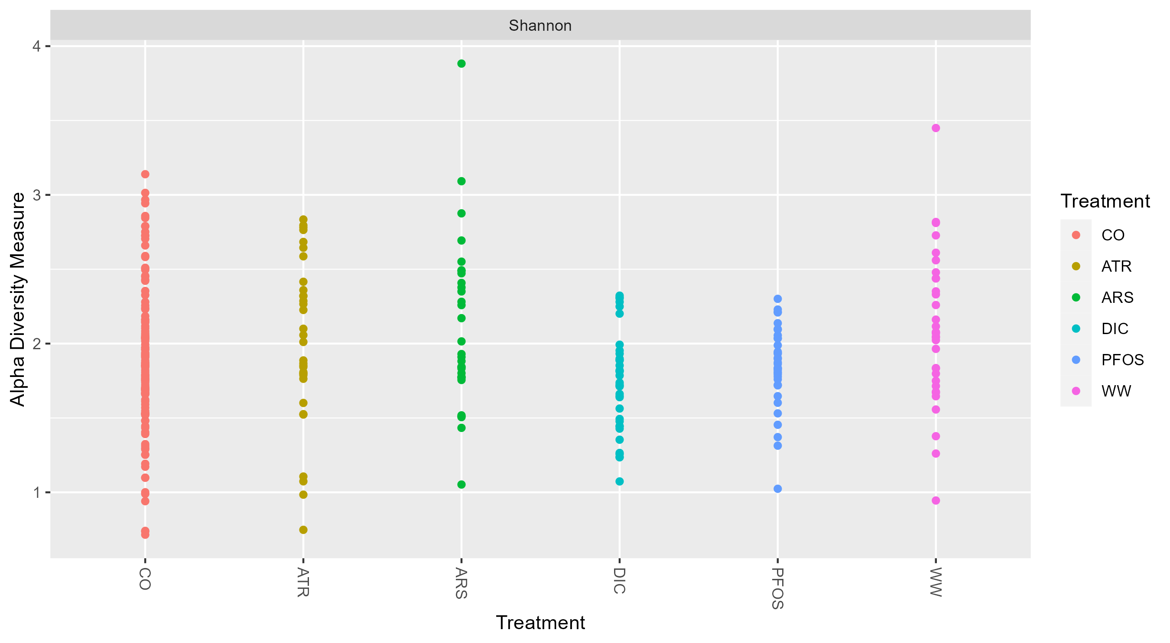

Slide 4
PCoA; taxa(Genus)
0.050
Genotype
LR2_36_1
LRV_0_1
0.025
LRV_12_3
Axis.2 [14.1%]
LRV_8-5_3
0.000
Treatment
CO
-0.025
ZNE
-0.03
0.00
0.03
0.06
Axis.1 [61.3%]
Bray-Curtis-dist.
w.uni-dist

