Slide 1
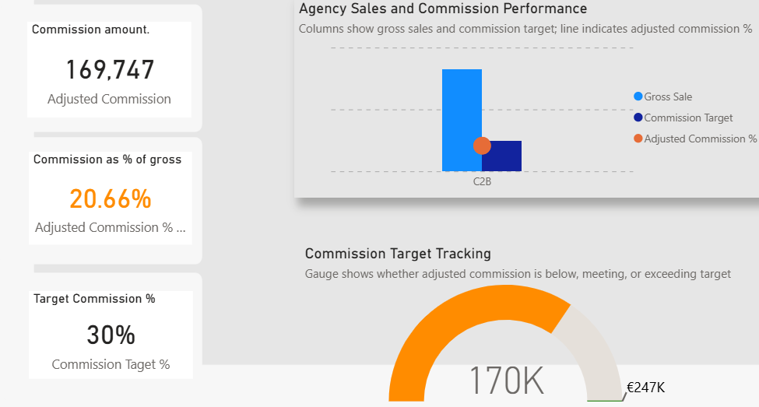
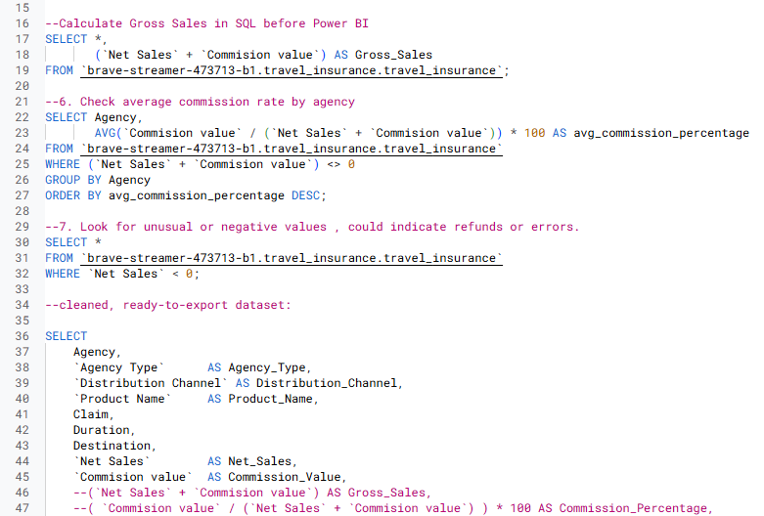

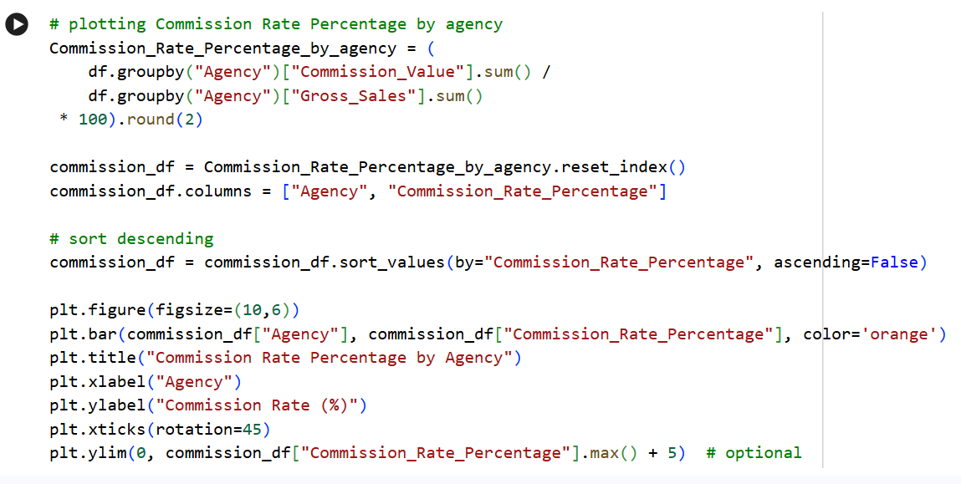
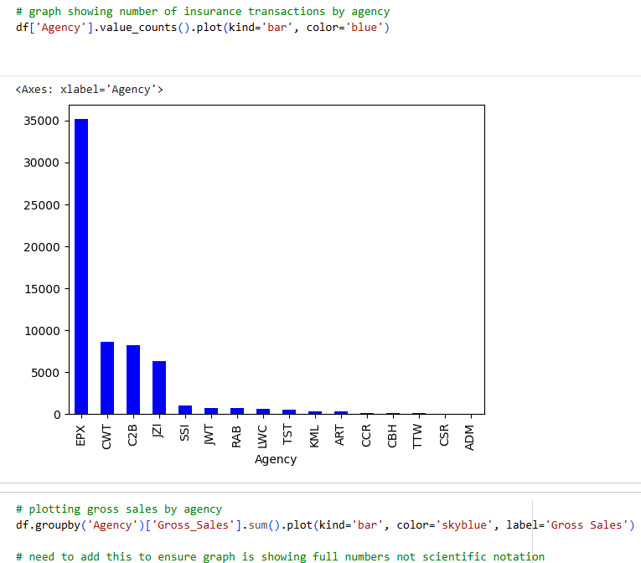
Analyzing & Optimizing Commission Structures in Travel Insurance
Maddalena Niedda

Slide 2
Index
Contex
Business question
Why it matters
Workflow
EDA
Key insights
Recommendations

Slide 3
Context
Travel insurance data analysis
Focus on Sales and Commissions
The challenge: No standard base for commissions

Slide 4
Business Questions
Are current commission rates consistent and sustainable?
Would a standard 30% commission improve profitability?

Slide 5
Why It Matters
• Commissions vary widely - no standard
•Predictable commissions = predictable profit
•Transparency across agencies
Notes:
- If we can predict commissions, we can predictable profits, improving forecasting and financial planning.
- If commissions rule are consistent and transparent, we can ensure fairness across agencies (etical reason).
- Large commission variability makes it hard to benchmark performance or determine standards.

Slide 6
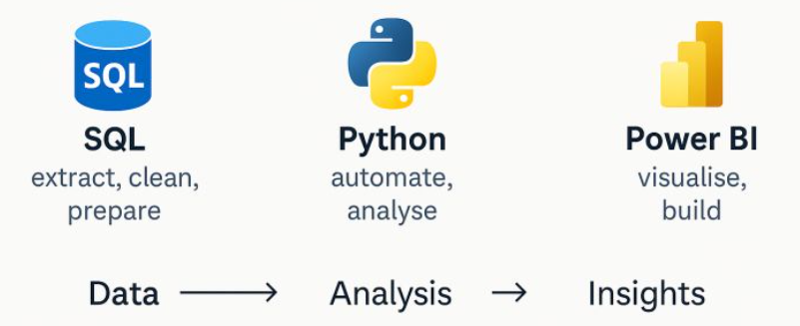
Workflow

Slide 7




Row data SQL

Slide 8
--Extract dataset
SELECT * FROM ‘travel_insurance’;
Extract dataset
--Look for unusual or negative values, could indicate refunds or errors!
SELECT *
FROM `travel_insurance`
WHERE `Net Sales` < 0;
Look for anomalies
-- Assign new columns names
SELECT
Agency,
`Agency Type` AS Agency_Type,
`Distribution Channel` AS Distribution_Channel,
`Product Name` AS Product_Name,
Claim,
Duration,
Destination,
`Net Sales` AS Net_Sales,
`Commision value` AS Commission_Value,
Gender,
Age
FROM `travel_insurance`
ORDER BY Agency;
Standardize columns names

Slide 9


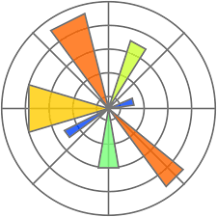

SQL Python

Slide 10
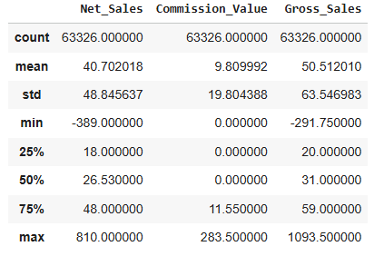
# Import pandas library/ for data manipulation and analysis
import pandas as pd
# Load the CSV file
df = pd.read_csv('/content/travel insurace clean.csv')
Load extracted data
and
Import Python libraries
#matplotlib library / for visuals
import matplotlib.pyplot as plt
Explore descriptive statistics
# Exploratory Data Analysis (EDA)
df.describe()
Clean data
# drop columns I don't need
df=df.drop(['Age','Gender','Destination','Duration','Claim'], axis=1)

Slide 11
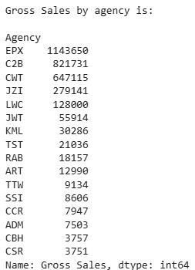
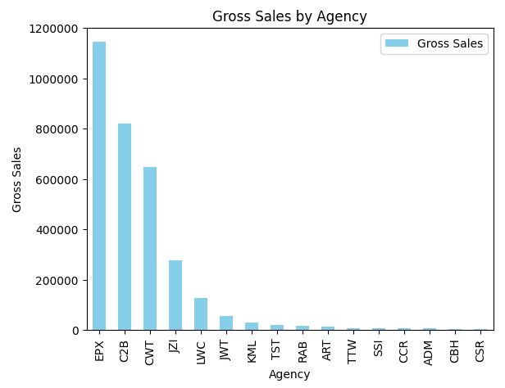
Create new
column
#create Gross_Sales column
df['Gross_Sales']= df['Net_Sales'] + df['Commission_Value']
#Group Gross_Sales by Agency
Gross_by_agency= df.groupby('Agency')['Gross_Sales'].sum().sort_values(ascending=False).astype(int)
print(f'Gross Sales by agency is:\n {Gross_by_agency}')
Apply grouping
# plotting gross sales by agency
df.groupby('Agency')['Gross_Sales'].sum() .sort_values(ascending=False).plot(kind='bar', color='skyblue', label='Gross Sales')
# full numbers not scientific notation
plt.ticklabel_format(style='plain', axis='y')
plt.ylabel('Gross Sales')
plt.title('Gross Sales by Agency')
plt.legend()
plt.show()
Visualize data

Slide 12
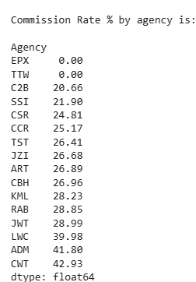
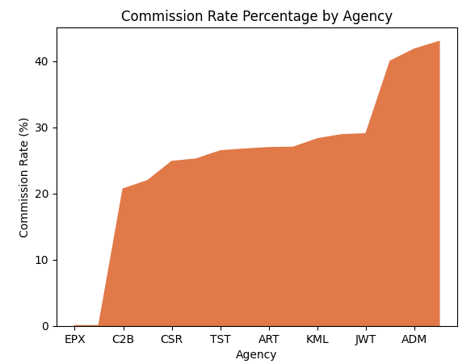
Commission_Rate_Percentage_by_agency = (
df.groupby("Agency")["Commission_Value"].sum() /
df.groupby("Agency")["Gross_Sales"].sum()
* 100).round(2).sort_values(ascending=True)
# print
print(f'\nCommission Rate % by agency is:\n\n{Commission_Rate_Percentage_by_agency}')
Explore measure
# plotting Commission Rate Percentage by agency
Commission_Rate_Percentage_by_agency = (
df.groupby("Agency")["Commission_Value"].sum() /
df.groupby("Agency")["Gross_Sales"].sum()
* 100).round(2).sort_values(ascending=True).plot(kind=‘area', color=' ‘#E17949 ', label='Gross Sales')
plt.title("Commission Rate Percentage by Agency")
plt.xlabel("Agency")
plt.ylabel("Commission Rate (%)")
plt.show()
Visualize data
Export data
# CSV export
df. to_csv('travel insurance final.csv', index=False)

Slide 13

Python Power BI
Cockpit

Slide 14


Travel Insurance Cockpit
Dashboard shows how current travel insurance commissions rates are highly inconsistent.
These visuals make it easy to identify agents who may be over-compensated and to understand the differences in commission levels across agencies.
💡By standardizing commissions at a 30% benchmark and using Power BI to monitor variances in real time, the business can make more efficient, ethical decisions. 💡
This page is designed to help quickly understand and test how changes in commission rates influence key financial
metrics.
How to use this tool:
Move the What-If parameter (slider) to simulate different commission values or percentages.
Charts and tables update instantly to show variation of commission value compared to gross sales and suggested commission target (30%).
Apply "Agency" filter to evaluate commission impact at different levels.

Slide 15

Power Bi embedded here
Notes:
Dashboards: 3 charts and 1 table.

Slide 16
Power Bi embedded here
Notes:
Interactive tool for decision making

Slide 17
Key Insights
Commissions differ significantly
Profit stabilizes near 30% commission level
What-if scenario shows impact clearly
Notes:
- Some commissions fall far above or below what would normally be expected.

Slide 18
Final Recommendation
Adopt standard commission target of 30% of gross sales
— Protects margins
— Fair across agencies
Promote real-time monitoring through use of cockpit

Slide 19
Thank You
Questions?

