Slide 1
Core Java
Objects as Method Arguments and Return Types
LEVEL – PRACTITIONER

Slide 2
About the Author
Created By: | Renjith(t-renjith)/Shanmu (105110)
Credential Information: | Trainer/Sr Architect
Version and Date: | 1.0, February 7th 2012
Cognizant Certified Official Curriculum
Notes:
For tde animators:
tdis screen content needs to be rendered in tde flash, no animations needed.

Slide 3









Icons Used
Hands on Exercise
Questions
Tools
Coding Standards
Test Your Understanding
Case Study
Best Practices & Industry Standards
Demonstration
Workshop

Slide 4
Objectives
After completing this chapter you will be able to understand:
The need for passing objects as arguments
How to pass objects as method arguments
How to return an object from a method

Slide 5
A Problem Developer Faces
Scenario: Assume you are developer and you need to create a method which accept the user details which includes the Name , Address ,Age ,Employment details and several other details. The method should calculate and return the tax rate and tax amount based on the user’s age and salary and store the employee and tax details in database. The method should return user name and the tax.
Question: How can you pass all the details into the method as an argument ?
Answer: We can pass it as arguments to the method like
Method(String name ,String address ,int age…………………..)
Disadvantages:
This makes the method complex as the number of arguments increases.
Any new user details addition will result in a change in the method name.
We cannot return more than one value from a method.
What is the solution?
Solution is passing objects as method arguments and returning objects as return value

Slide 6
Types of methods argument
Passing Primitive Data Type : Passing the primitive type data as method argument. Example: int, double, float etc.
Passing objects are argument : In this case we pass objects as arguments to the method. Example: UserVO, ArrayList, Map
In this session we are going to learn on how to pass objects to methods?

Slide 7
Passing objects as method argument
Objects are passed as arguments to the method
Can make change only to the state of the object
Doesn’t make any change to the reference variable hence we say that this mechanism is not exactly same as “Pass-By-Reference” in C programming.
Since the state changes are done in objects some people argue this indirectly achieves “Pass by reference ”.
Can be used with constructors also.
Next slide explains how the state of objects changes when passed as arguments.

Slide 8
Passing Objects How it works?
Consider a class named MyClass with two fields a and b.
Heap Memory
MyClass obj=new MyClass();
aMethod(obj);
Address: 1001
Object Created
a=0
b=0
a=30
b=40
When the method aMethod is invoked by passing obj as argument. Now obj1 in the invoked method contains the memory address value 1001 .
The obj contains the object memory address 1001 as value which is the address of the newly created object.
void aMethod(MyClass obj1)
{
obj1.a=30;
obj1.b=40;
}
Since obj1 contains the address 1001 , any changes in the state of this will also change the state of obj in the calling method.
So changes done to the obj1 state a=30 and b=40 will also change the state of obj.

Slide 9
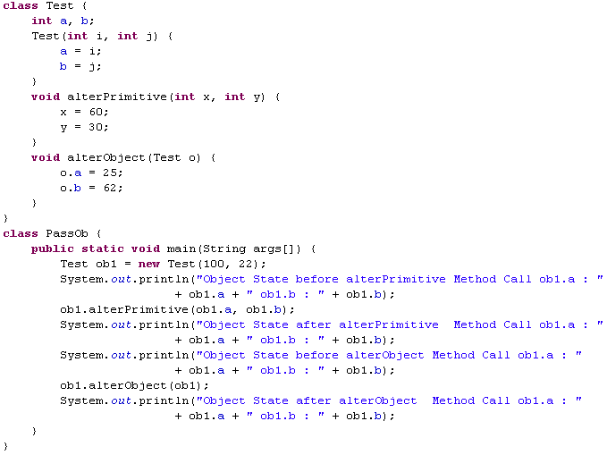
Passing Object Argument Example
Accepts two primitive type values and tries to modify it.
Method accepts an object reference of the type Test and modifies the object’s State
Passes the object members as primitive data
Passes the object as an argument
We will see how object passing works with help of the following code.
Open SDE, develop the following code and run it.

Slide 10
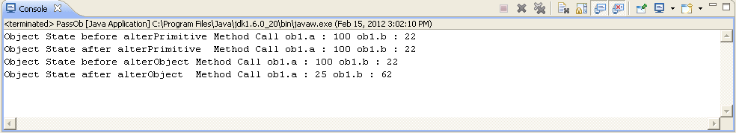
What is the Output?
The values will be same before and after the method call when passed as primitive type argument.
The state of the object is seen to be changed because we are passing the reference or the address of the object and making alteration in that memory area.

Slide 11
Returning Objects from a Method
Instead of returning primitive data type from a method, we can return objects from a method.
Works similar to methods with primitive return type.
The return type should be either of class type or any of it’s super classes/implemented interfaces.
The methods can also return Collection objects like ArrayList, Map etc which you will learn in the later sessions.
Advantage:
If you need to return multiple values the values can be defined in a value object and returned.

Slide 12


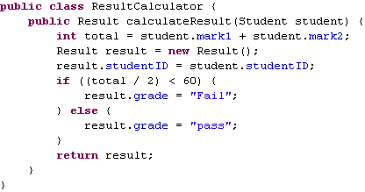
Returning Objects- Example
Note the methods return type is Result Object
Method accepts a Student object , calculates the result based on the marks , loads the result into a Result object and returns it.

Slide 13
Lend a Hand – Objects as argument and return
Objective: In this lend a hand we will familiarize how objects can be passed as an argument to a method and how objects can be returned by methods.
Scenario : We are asked to develop a method which accepts the details of an student, which includes the marks of three subjects. The method should calculate the total mark and should rate the student pass/fail based on the average marks
If average >40 { Pass }
Else { Fail }
Components
Student Class : To hold the student details
Result Class : To hold the student results
ResultCalculator class : Contains method to calculate the total mark and result of the student
MainClass class: Drives the application

Slide 14
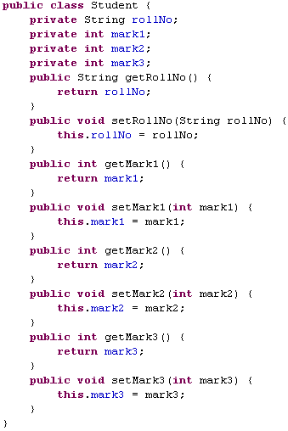
Lend a Hand-Develop Student Class
Add the Accessor methods:
The methods starting with get and set are called accessor methods used for accessing the private members of the class.
The method starting with “set” is known as the setter used for setting the argument value to the member variable .
The method starting with “get” is known as the getter used for retrieving the value of the variable.

Slide 15
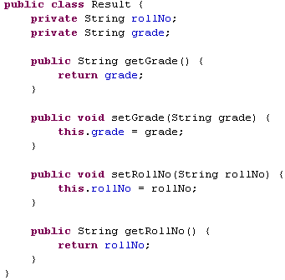
Lend a Hand- Develop Result Class

Slide 16
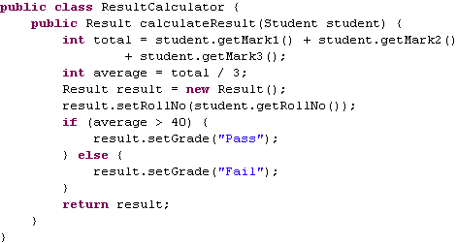
Lend a Hand : Develop Result Calculator class

Slide 17
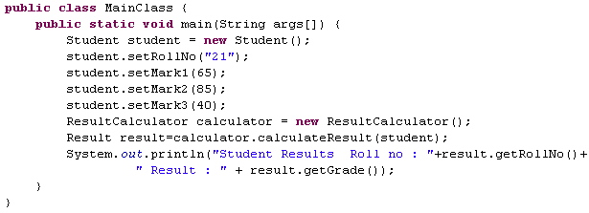
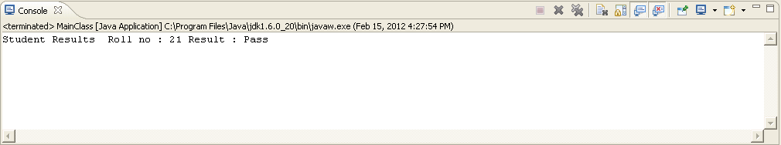
Lend a Hand : Develop MainClass class
Output

Slide 18
Core Java
You have successfully completed -
Objects as Method Arguments and Return Types

