Slide 1
Core Java
Java Object Casting
LEVEL – PRACTITIONER

Slide 2
About the Author
Created By: | Sangeetha Mohan(139944)
Credential Information: | Associate - Projects
Version and Date: | 1.0, Jan 09th 2012
Cognizant Certified Official Curriculum
Notes:
For the animators:
This screen content needs to be rendered in the flash, no animations needed.

Slide 3









Icons Used
Hands on Exercise
Questions
Tools
Coding Standards
Test Your Understanding
Case Study
Best Practices & Industry Standards
Demonstration
Workshop

Slide 4
Objectives
After completing this chapter you will be able to:
Perform Object Casting.
Understand about Upward/down casting.
Learn about Instance of operator.

Slide 5
What is a “Type”?
What is a “Type”?
When an object instance is created from a class, you say that the object instance is “type” of the class and its super classes
Example:
Student jack = new Student();
Jack is of type Student
Jack is also of type “Person” if Student extends Person.
Since all classes extends super class “Object”, Jack is also of type “Object”.

Slide 6
Casting recap
We have already learnt, how to cast primitives.
Let us now learn How to cast objects?
A quick recap on Casting?
Casting is the process where one type of object/primitive/wrappers in converted into another object of the same family.
Same family here refers to the objects which are in the same inheritance chain.

Slide 7
Casting Objects
What is Object Casting?
Instances of classes can be cast into instances of other classes, with one restriction. “The source and destination classes must be related by inheritance”
That is destination class must be a subclass of the source class. This is referred to as explicit casting.
Syntax:
<SubClassObject> = (SubClassName) <SuperClassObject>
Example: Assume Student class extends Person class.
Person personObject = new Person();
Student studentObject = new Student();
studentObject = (Student) personObject;// Casting done

Slide 8
What is upward casting?
Casting is not required for upward transformation. i.e. when assigning a Object of subclass to a variable of super class.
This is referred to as Implicit Casting.
Example: Assume Student class extends Person class.
Person personObject = new Person();
Student studentObject = new Student();
personObject = studentObject; // No Casting done

Slide 9
Implicit Casting Example
Object Hierarchy
Object
Examples of Implicit Casting (or) No casting required,
CollegeStudent collegeStudent = new CollegeStudent();
Student student = collegeStudent;
Person person = collegeStudent;
Object object = collegeStudent;
extends
Person
extends
Student
extends
CollegeStudent

Slide 10
Explicit Casting Example
Object Hierarchy
Object
Examples of Explicit Casting:
Person person1 = new Student();
Student student = (Student) person1 ;
Person person2 = new CollegeStudent();
CollegeStudent collegeStudent = (CollegeStudent) person2 ;
extends
Person
extends
Student
extends
CollegeStudent

Slide 11
Exceptions while Casting Objects
Consider the below class hierarchy,
Vehicle
Vehicle carObj = new Car();
Vehicle busObj = new Bus();
Car carObj2 = (Car)busObj;
extends
extends
Car
Bus
This statement does not throw compilation error, but during runtime an error is thrown, since Car does not extend Bus
Exception thrown during runtime
How to avoid Run time Errors when casting?
Use Instance Of Operator.

Slide 12
Instance Of Operator
You can check the type of the object instance using instanceof operator before the type casting.
Syntax: <Object 1> instanceof <Object 2>
This checks whether the object 1 is part of the inheritance hierarchy of Object 2.
Example:
Vehicle carObj = new Car();
Vehicle busObj = new Bus();
if(busObj instanceof Car){
Car carObj2 = (Car)busObj;
}
Do the casting after the type is verified.
In the above case, only if the instanceof expression returns true the casting is done.

Slide 13
Lend a hand – Object Casting
Objective: Let us get some practice on Object Casting.
In the Inheritance session, we created a super class BankAccount with two subclasses NRIAccount and SeniorCitizenAccount
The super class BankAccount had depositMoney, withdrawMoney and applyFixedDeposit methods.
The applyFixedDeposit method was overridden in the NRIAccount and the SeniorCitizenAccount class.
Now, let us create a class CastingDemo.java with a main method that performs the below three operations on Object Casting.
Problem # 1: Implicit Casting – Develop a method implicitCasting() and perform the below,
Create object instance of the NRIAccount class (O1) (created in Inheritance session).
Create a variable of BankAccount (V1) class.
Assign the NRIAccount object (O1) to BankAccount variable (V1).
It can be observed that explicit casting is not required here.
Invoke the applyFixedDeposit method on BankAccount Object (V1).

Slide 14
Lend a hand – Object Casting
Problem # 2: Explicit casting- Implement this in a method explicitCasting()
Create a NRIAccount object of type BankAccount (O1)
Create a variable V1 of NRIAccount.
Set the depositAmount of the BankAccount object (O1) to 3500
Assign the BankAccount object (O1) to NRIAccount variable (V1)
It can be observed that explicit casting is required here.
Invoke the depositMoney method on NRIAccount variable (V1)
Problem # 3: Use of instance of Operator – implement this in a method tryInstanceOf().
Create 2 objects (O1,O2) of NRIAccount and one object of SeniorCitizenAccount (O3) (All objects should be of type BankAccount)
Check if Object O1 is an instance of NRIAccount Object using the instanceOf operator
If so, then assign O2 to O1
Else print a message “Cannot typecast O1 to NRIAccount
Check if Object O3 is an instance of NRIAccountObject using the instanceOf operator
If so, then assign O2 to O3
Else print a message “Cannot typecast O3 to NRIAccount

Slide 15
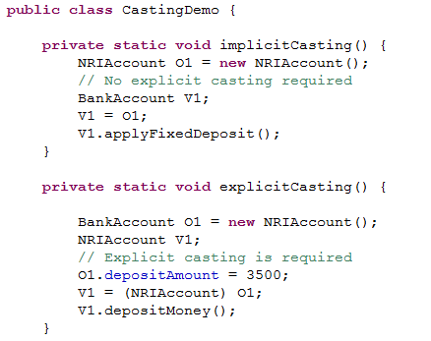
Lend a hand Solution– Object Casting
Solution
Casting not needed.5
Explicit casting needed.
Solution continued in next slide

Slide 16
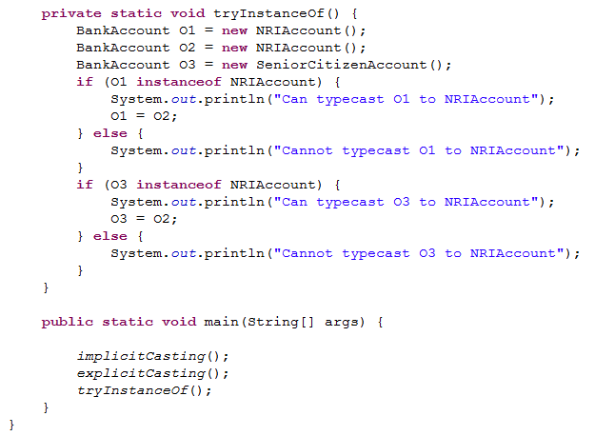
Lend a hand Solution – Object Casting (cont)
Solution (Contd)

Slide 17
Core Java
You have successfully completed -
Object Casting

