Slide 1
Core Java
Java Util Package
LEVEL – PRACTITIONER

Slide 2
About the Author
Created By: | Ashok Kumar Kanuparthi(g-Ashok3)/ Shanmu (105110)
Credential Information: | Trainer/ Sr Architect
Version and Date: | 1.0, January 13th 2012
Cognizant Certified Official Curriculum
Notes:
For the animators:
This screen content needs to be rendered in the flash, no animations needed.

Slide 3









Icons Used
Hands on Exercise
Questions
Tools
Coding Standards
Test Your Understanding
Case Study
Best Practices & Industry Standards
Demonstration
Workshop

Slide 4
Objectives
After completing this session, you will be able to :
Using the classes in java.util package.
Using Date utilities.
Working with Calendar.

Slide 5
Date and Calendar Objects
Date objects are used for representing dates and times data types.
They are available under java.util package.
To work with date and time in java we need to use one of the below mentioned classes
java.util.Date
java.util.Calendar

Slide 6
Date and Calendar Usage
java.util.Date:
Use this type if you need to store a date value.
Example: Sat, 12 Aug 1995 13:30:00
java.util.Calendar: Use this class if you just need to,
Perform date calculations like adding days or months to another date
Check the day is a weekday (monday, tuesday etc.).
Convert dates and times between time zones.

Slide 7
How to use Date class?
How to instantiate Date?
Date mydate = new Date();
This represents the current date/Time. If you print the myDate value it will display the current date and time.

Slide 8
Lend a Hand – Creating Dates
Create a class DateDemo with a main method that performs the below actions
Create a Date object.
Prints the date.
Develop this program in SDE and get yourself familiarized with Date.

Slide 9
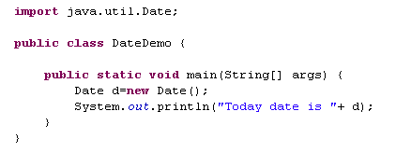
Lend a Hand Solution- Creating Dates
Develop the program as mentioned below.

Slide 10
Date class API’s
Return Type | METHOD | DESCRIPTION
long | getTime() | Used for retrieving the time.
void | setTime(long) | Used for changing the object’s time.
int | compareTo (Date anotherDate) | Compares two Dates and returns 0 if equal, <0 if the argument date Is after this date, > 0 otherwise.
String | toString() | Used for generating a String representation in a fixed format
boolean | after (Date when) | Tests if this date is after the specified date.
boolean | before (Date when) | Tests if this date is before the specified date
Note: Most other Date methods are deprecated.

Slide 11

Lend a Hand – Date
Refer the Java documentation and choose the right API’s for doing the below exercise.
Create a class DateDemo inside the package com.date.demos.
Create a main method and implement the following logic.
Problem #1 : Create two Dates using the Date Constructor and compare two dates.
Date 1: January 15 2012.
Date 2: July 15 2011.
Solution: “First Date id after second”
Problem #2 : Convert date 1 to string,
Solution: Date in the following format
“dow mon dd hh:mm:ss zzz yyyy”

Slide 12
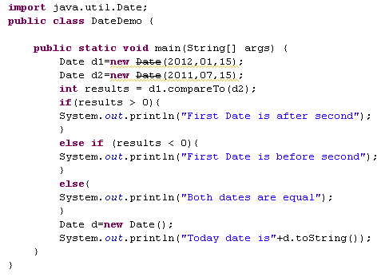
Lend a Hand Solution –Date
IMPORTANT NOTE: We have used a deprecated constructor in the demo. Usage of deprecated API’s to be avoided. Alternative is Calendar API we will learn about it shortly.
Date in year,month,date format.
Output:
First Date is after second
Today date is Thu Jan 19 16:43:23 GMT+05:30 2012

Slide 13
Formatting date in Java
What is Date Formatting?
Converting to is Date formatting
Date is converted to a proper format using DateFormat, SimpleDateFormat classes.
Format of the date can be formatted based on the end user's Locale.
Example of Locale:
Americans write date as 4/20/09 i.e. month/date/year, whereas
Indians write date as 20/4/09 i.e date/month/year
Advantage of these classes:
We can display date in any format which we need.
Sat Jan 14 12:53:28 IST 2012
14/01/2012
Unformatted Date
Formatted Date

Slide 14
Formatting date in Java
Formatting the date can be done in two ways:
Option I: Using Predefined formats.
Option II: Using Customized formats.
The DateFormat class allows you to format dates and times with predefined styles.
The SimpleDateFormat class allows you to format dates and times with customized styles.

Slide 15
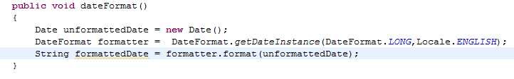
Using DateFormat for formatting dates
Formatting Date using the DateFormat class is a two-step process.
Step 1: Create a formatter with the getDateInstance method.
DateFormat object = new DateFormat.getDateInstance(Style,Locale);
Where, Style – is the style with which the date needs to be formatted.
Locale – is the locale with which the date needs to be formatted.
Step 2: Invoke the format method, which returns a String containing the formatted date.
String formattedDate= object.format(Date unformattedDate);
Example:
This prints the date in this format “January 18, 2012”.
Style changed to short will print the date in format “1/18/12”

Slide 16
Some Predefined Format
List of Styles:
Below is the output format for different styles and locale English.
STYLE | Output Format
DEFAULT | Jan 18, 2012
SHORT | 1/18/12
MEDIUM | Jan 18, 2012
LONG | Jan 18, 2012
FULL | Wednesday, January 18, 2012

Slide 17
Lend a Hand – Date Format
Refer the Java documentation and choose the right API’s for doing the below exercise.
This will help you understand the ways of formatting dates.
Create a class DateFormatDemo with a main method that performs the below actions
Create a Date object with current Date
Prints the date specific to UK locale using styles
Long
Full
Short
Prints the date specific to US locale using styles,
Long
Full
Short

Slide 18
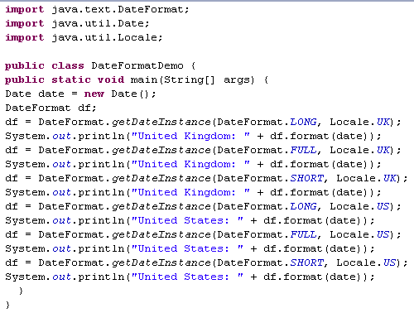
Lend a Hand Solution –Date Format
Output:
United Kingdom: 19 January 2012
United Kingdom: Thursday, 19 January 2012
United Kingdom: 19/01/12
United States: January 19, 2012
United States: Thursday, January 19, 2012
United States: 1/19/12

Slide 19
Simple Date Format
What is SImpletDateFormat class?
SimpleDateFormat is a concrete class for formatting and parsing dates.
This is used for formatting dates based on some user defined custom formats.
Example of Custom Formats:
dd/mm/yyyy
mm/dd/yy hh:mm:ss

Slide 20
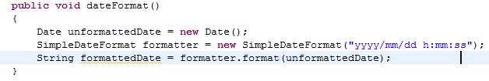
SimpleDateFormat
How to format date using SImpleDateFormat class?
Step 1: Instantiate SimpleDateFormat class to specify a pattern string.
SimpleDateFormat object= new SimpleDateFormat( String pattern);
Where, pattern - Determines the format of the date and time.
Step 2: Format the date using the SimpleDateFormat object.
String formattedDate = object.format(Date unformattedDate);
Example:
This prints the date in this format “2012/09/18 9:09:002”.
Similarly the date format can be changed.

Slide 21
Patterns in SimpleDateFormat
Here are some patterns that can be used with SimpleDateFormat:
LETTER | DATE OR TIME COMPONENT | EXAMPLES
G | Era designator | AD
y | Year | 1996, 96
M | Month in year | July, Jul, 07
D | Day in year | 189
E | Day in week | Tuesday; Tue
d | Day in month | 10
h | Hour in am/pm (1-12) | 12
For more on Date Format Pattern Syntax refer:
http://docs.oracle.com/javase/tutorial/i18n/format/simpleDateFormat.html

Slide 22
Examples of SimpleDateFormat
Date and Time Pattern | Result
"yyyy.MM.dd G 'at' HH:mm:ss z" | 2001.07.04 AD at 12:08:56 PDT
"EEE, MMM d, ''yy" | Wed, Jul 4, '01
"h:mm a" | 12:08 PM
"yyyyy.MMMMM.dd GGG hh:mm aaa" | 02001.July.04 AD 12:08 PM
"EEE, d MMM yyyy HH:mm:ss Z" | Wed, 4 Jul 2001 12:08:56 -0700

Slide 23
Lend a Hand –SimpleDateFormat
Refer the Java documentation and choose the right API’s for doing the below exercise.
This will help you understand the ways of formatting dates using SimpleDateFormat:
Create a class CustomDateFormat with a main method that performs the below actions
Create a Date object with current Date
Format the current date and print in the following formats.
AD Wed 2012/01/18 9:19:05
9:23:38 2012/01/18
9:24:42 2012/01/18 Wed
Wednesday, 18 January 2012 21:25:20
Wed, 18 Jan 2012 21:26:15 +0500

Slide 24
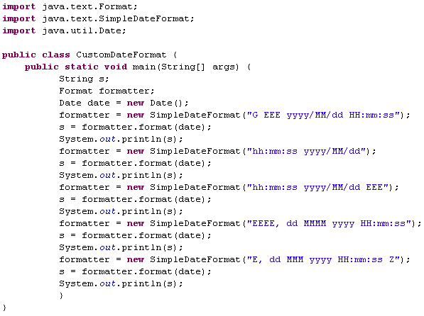
Lend a Hand Solution- SimpleDateFormat
String pattern
This ‘h’ is for hour in am/pm (1-12)
This ‘H’ is hour in day (0-23)

Slide 25
Lend a Hand –String to Date
Refer the Java documentation and choose the right API’s for doing the below exercise.
Let us develop a program to convert string to Date object:
Create a class StringToDate with a main method that performs the below actions,
Declares three integer variables date, month, year with values 01,01,2015 respectively.
Create a string object by concatenating those three variables.
Convert the concatenated string to a date in format “dd/MM/yyyy“.

Slide 26
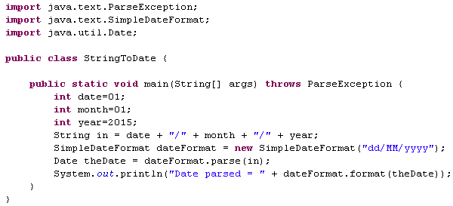
Lend a Hand-String to Date
Parses text from a string to produce a Date.
Output:
Date parsed = 01/01/2015

Slide 27
Calendar Class
Calendar Class:
Calendar is an abstract base class used for converting, processing date values.
Subclasses of calendar interpret a date according to the rules of a specific calendar system.
One such class is GregorianCalendar class.

Slide 28
Lend a Hand –Calendar
Refer the Java documentation and choose the right API’s for doing the below exercise.
Lets understand the API’s of Calendar object,
Create a class CalendarDemo with a main method that performs the below actions
Creates a Calendar instance.
Uses get method with appropriate static fields as arguments to extract the following from the current date.
year,
date,
day of week
day of month,
hour of the day,
minute,
Second
milliseconds.

Slide 29
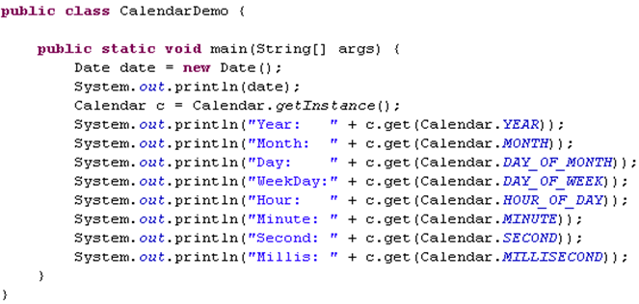
Lead a Hand-Calendar Class
These are static int fields.
Output:
Fri Dec 09 17:09:45 GMT+05:30 2011
Year: 2011
Month: 11
Day: 9
WeekDay:6
Hour: 17
Minute: 9
Second: 46
Millis: 281

Slide 30

Time To Reflect
Associates to reflect the following before proceeding.
What is the class you use for processing dates?
How to create customized format?
What class can we use for formatting dates based on locales?

Slide 31
Core Java
You have successfully completed –
Util package and Properties class

