Slide 1
Core Java
Java Interfaces
LEVEL – PRACTITIONER

Slide 2
About the Author
Created By: | Sangeetha Mohan(139944)
Credential Information: | Associate - Projects
Version and Date: | 1.0, Jan 09th 2012
Cognizant Certified Official Curriculum
Notes:
For the animators:
This screen content needs to be rendered in the flash, no animations needed.

Slide 3









Icons Used
Hands on Exercise
Questions
Tools
Coding Standards
Test Your Understanding
Case Study
Best Practices & Industry Standards
Demonstration
Workshop

Slide 4
Objectives
After completing this chapter you will be able to:
Define and create an Interface
Implement an interface.
Understand the usage of interfaces
Differentiate interface and abstract classes
Use interface as a type.
Use Inheritance among interface.
Understand Interface and polymorphism.

Slide 5

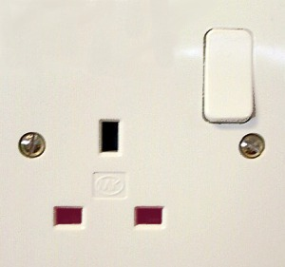
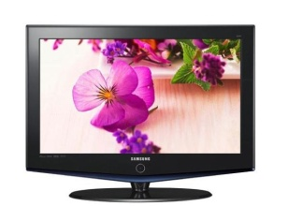

Interface
What is an Interface?
uses
Plug Point is a interface which helps different devices to connect to the electrical line to draw power
uses
uses
So interface is a common protocol that all devices need to adhere for them to operate.
In software terminology the interface is an contract between the class and the outside world, and this contract is enforced at the build time by the compiler

Slide 6
Interface
What is an Interface?
When all methods in a class are abstract, the class can be declared as an Interface
An Interface defines a contract for classes to implement the behavior. similar to the plug pint defines the contract for all devices to draw power from electricity lines.

Slide 7


Interface in real world
Scenario: Taking the passport example if in the issuance both the verification of photo identity and final approval process needs to be performed by the local offices. The head office at Delhi defines only the protocol/ process for photo identity verification process and approval but the actual process will be performed by the local offices.
Delhi Office,
Defines a protocol/process that all local passport office should follow for verifying the photo identity & final approval.
Bangalore,
Adheres to the protocol and performs photo identification using ration card.
Approves the document as slated by the HO.
Chennai,
Adheres to the protocol and performs photo identification using driver license.
Approves the document as slated by the HO.
Passport Head Office,
Delhi
Passport Office,
Bangalore
Passport Office,
Chennai

Slide 8
Analogy between Interface and Passport office
Passport Head Office
Interface
Local passport Offices
Sub Class
Photo Identity Verification
Protocol: interface methods
NOTE: No people can directly reach Delhi head office for passport application rather they should always go to the local offices in appropriate cities which will follow the process defined by head office to issue passport.
Similarly Interface cannot be instantiated only the classes implementing it can be instantiated and the implemented methods invoked.

Slide 9
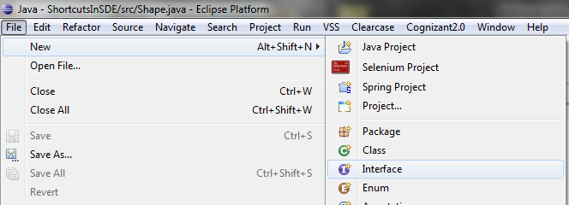
Develop an Interface
How to create an Interface?
To create an interface, the ‘class’ keyword should be replaced with the ‘interface’ keyword
To create a Shape interface, instead of
public class Shape
public interface Shape
To create an Interface using SDE, select
File → New → Interface

Slide 10
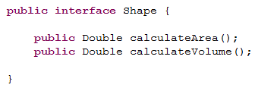
How to implement an Interface?
How to implement an Interface?
Step 1: Create an Interface
The ‘interface’ keyword is used instead of the ‘class’ keyword
Abstract Methods

Slide 11
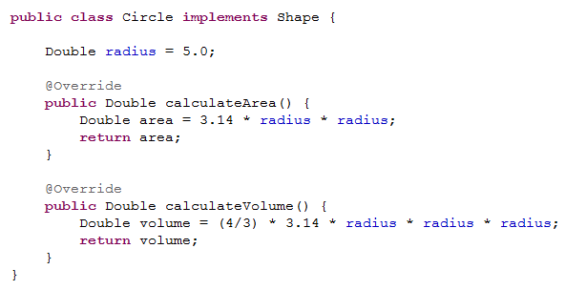
How to implement an Interface? (cont)
How to implement an Interface?
Step 2: Create the implementation class using the ‘implements’ keyword
‘implements’ keyword is used to indicate that class Circle is the implementation class for the interface ‘Shape’
The actual implementation logic for the methods in the interface is provided in this class
Similarly, other shape objects can be created by interface programming by implementing generic Shape interface.

Slide 12
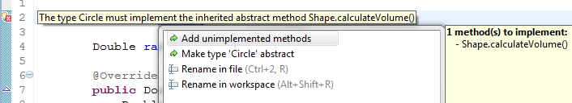
Implementing Interface
Some facts about Implementing Interfaces
A Class can implement any number of interfaces.
When your class tries to implement an interface, always make sure that you implement all the methods of that interface, or else, you would get the following error at compile time:
Implementing class can have its own methods (which are not present in the Interface class).
Implementing class can also extend a single super class or abstract class.

Slide 13
Why do we use Interfaces?
Reason #1:
To reveal the programming interface of an object without revealing its implementation:
This is the concept of encapsulation, hiding implementation from consumers.
Analogy to remote example: Only the plug point is exposed. The method of drawing current using the internal wiring of the electrical appliance is not known to the user
The implementation can change without affecting the caller of the interface
Analogy to remote example: Any changes required to the wiring in the plug point can be done without any changes in the TV/Fan/Ipod Dock
The caller does not need the implementation at compile time
Analogy to remote example: The manufacture of the plug point is not related to the manufacture of TV/Fan/Ipod Dock

Slide 14
Why do we use Interfaces?
Reason #2:
To have unrelated classes implement similar methods (behavior)
The blueprint of the classes will be defined in the interface and all the classes implementing that interface must follow the same blue print (implement the same methods from the interface)
Analogy to the remote example:
All the electrical appliances should adhere to the norms specified by the plug point. Ex. Voltage range from – 220V to 240V

Slide 15
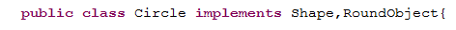
Why do we use Interfaces?
Reason #3:
To model multiple inheritance:
A class can implement multiple interfaces while it can extend only one class.
Example:
The concrete class Circle can implement two(or more) interfaces Shape and RoundObject.
Here, the class Circle should implement all the methods declared in both the interfaces
The Java programming language does not support multiple inheritance, but interfaces provide an alternative

Slide 16
Lend a hand - Interfaces
Let us all create interfaces and implementation classes:
Create an interface IVehicle with the below methods:
drive();
turnLeft();
brake();
2. Create another interface IPublicTransport with a method
getNumberOfPeople();
3. Create a class MotorisedVehicle.java with a method checkMotor() which prints the message “The motor of the vehicle is in good condition”
4. Create a class Car.java which extends the MotorisedVehicle class and implements the IVehicle interface. This method should print appropriate messages in the implemented methods. (Ex. “The car is in brake mode” etc)
5. Create a class Train.java which implements both the IVehicle and IPublicTransport interfaces. The implemented methods should print appropriate messages (Ex. “The train is turning left” etc)

Slide 17
Lend a hand Solution - Interfaces
Solution:
Refer to the “Resources” section of this Session for the attachment “Interface_LAH1.zip”
The interface naming convention for the interface is, it starts with “I” depicting interface.
Example: IBankAccount, IEmployee.

Slide 18
Interfaces Vs Abstract Classes
Interface | Abstract Classes
All methods of an interface are implicitly abstract, they can only have method declaration. | Abstract classes can have both abstract (method declaration) and concrete methods (methods with implementation).
Can only define constants which are by default public final static. Example: int COUNTRY_CODE=1; | Fields with values can be declared. Fields with values declared in abstract classes can be changed in sub class
A class can implement several interfaces. | A class may extend only one abstract class.
Interface definition begins with keyword “interface”, so it is of type interface. | Abstract classes begins with keyword “abstract class”, so it is of type class.
Interface have no implementation and needs to be ‘implemented’. | Abstract classes needs to be extended.

Slide 19
Interfaces Vs Abstract Classes
When to use Interfaces?
Interfaces can be used when common functionalities have to be implemented differently across multiple classes. The user can mandate the use of these common functionalities to all the classes that implement the interface.
When to use abstract classes?
Abstract classes can be used when
some implemented functionalities are common between classes (this reduces duplicate code)
some functionalities need to be implemented in sub classes that extend the abstract class
Point to remember: A concrete class can extend only one super class whether that super class is either concrete or abstract class.
But, a concrete class can implement multiple interfaces and at the same time extend one super class

Slide 20

Interface as a Type
How to instantiate an interface?
You cannot create an instance from an Interface.
You can only define an Interface type and assign it to the instance of the concrete class which implemented the interface

Slide 21
Interface as a Type
Interface as a Type:
When you define a new Interface, you are defining a new reference type.
If you define a reference variable whose type is an Interface, then any object you assign to it must be an instance of the class that implements the interface
Example:
Person class implements the IPerson interface. You can do:
IPerson piVar = new Person();
Interface Type
Reference variable of type interface
Instance of class that implements the interface

Slide 22
Lend a Hand – Declaring Interface reference
Let us now learn to invoke methods of an interface implementation using the same code that we have developed for IVehicle.
Let us learn how to do the below things:
Invoke the drive and brake methods of the car object
Invoke the checkMotor method on the car object
Invoke the drive and brake methods of the train object
Invoke the getNumberOfPeople on the train object

Slide 23
Lend a Hand – Declaring Interface reference
To Invoke the brake methods of the car object,
Step 1: Create a InterfaceDemo.java class with a main method to perform all the required actions
Step 2: Create a reference variable of the IVehicle Interface
IVehicle vehicleObj1
Step 3: Assign the reference variable to an instance of the Car Object
IVehicle vehicleObj1 = new Car();
Step 4: Invoke the drive and brake methods using the interface reference variable
vehicleObj1.drive();
It is your turn to do the rest of the coding !!
Hint: The checkMotor method can be called only on the Car object and
The getNumber of people can be called on the Train object with reference variable pointing to the IPublicTransport interface

Slide 24
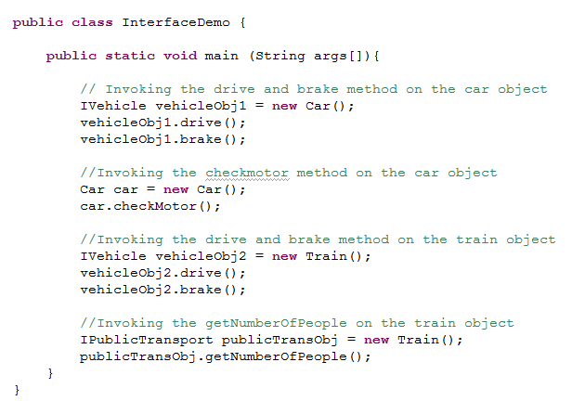
Lend a Hand Solution - Interface
Solution:

Slide 25
Interface Vs Class
Differences between Interface and a Class:
The methods of an interface are all abstract methods, they cannot have bodies.
You cannot create an instance from an interface.
For Example:
IPerson piVar = new IPerson(); will throw an ERROR
An interface can only be implemented by other classes or extended by other int.erfaces

Slide 26

Tim’s faces a problem again
Tim, a Java developer from Cognizant has a problem !!
He has developed an interface called IVehicle which can
drive and brake.
There are 50 classes which implement this interface.
His client has now asked him to include a 3rd method called accelerate of his concrete classes
If Tim makes this change in IVehicle interface, then all 50 classes will break because they do not implement all methods of interface anymore
How can Tim enforce this new method in his 25 classes alone without disturbing the other classes?

Slide 27

Tim’s Solution
Use Inheritance of Interfaces
Solution: Create a new Interface IAdvancedVehicle that extends the IVehicle interface and add the new method in the new interface.
Now, users of your code can choose to continue to apply the old interface or upgrade to the new interface.
People who use the old interface IVehicle, need not change their code as the interface is untouched.

Slide 28
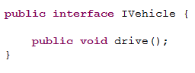
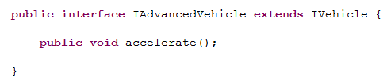
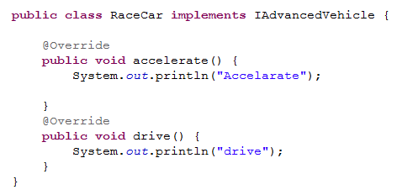
Inheritance among Interfaces
Inheritance among Interfaces:
Even though interfaces are not part of the class hierarchy, they can have inheritance relationship among themselves.
IVehicle
extends
IAdvancedVehicle
implements
RaceCar

Slide 29
Interface and Polymorphism
Interface and Polymorphism:
Interfaces exhibit polymorphism, because interfaces can be used for declaring reference and based on the type of object instance created and injected into the reference the appropriate objects will be triggered.
Example:
ICar car1= new Honda();
ICar car2= new BMW();
car1.drive();
car2.drive();
Based on the objects (Honda,BMW) created and injected into the interface reference (car1, car2) the appropriate objects method will be invoked.

Slide 30
IS-A and HAS-A Relationship
Java represents two types of relationship
Relationship
Implemented as inheritance
Translates into reference variables
IS-A
HAS-A
Circle IS-A shape Cow IS-A animal
Car HAS-A wheel
Library HAS-A book

Slide 31
Using IS-A relationship
IS-A relationship:
When one class inherits from another, you say that the subclass extends the super class.
When you want to know if one thing should extend another, use the IS-A test.
Examples for IS-A relationship:
Triangle IS-A Shape
Green IS-A Color
Do not apply inheritance if the sub class and super class do not pass the IS-A test

Slide 32
Using IS-A relationship
IS-A relationship:
The IS-A test works anywhere in the inheritance tree
Vehicle
Note: The IS-A relationship works in only one direction
Example:
Car IS-A vehicle makes sense, but
Vehicle IS-A car does not make sense
extends
Car IS-A Vehicle
Car
RaceCar IS-A Car
extends
Race Car
RaceCar IS-A Vehicle

Slide 33
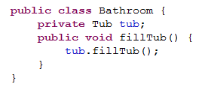

Using HAS-A relationship
HAS-A relationship:
When two classes are related by not through inheritance, then you say that the two classes are joined by HAS-A relationship
Example:
Bathroom HAS-A tub
Tub HAS-A bubble
The HAS-A relationship can be translated into reference variables.

Slide 34

IS-A and HAS-A Game
Time to play a game:
Rules of the game:
1. In the next slide you will see an assortment of words.
2. Match the words such that they either have a IS-A or HAS-A relationship
3. Beware: There can be multiple levels of relationship such as
Vehicle→ Car→ RaceCar
4. List down all the combinations in the below format
Vehicle IS A Car
BathTub HAS A bubble

Slide 35
IS-A and HAS-A Game
Square
Game
Tyre
Subject
Title
Laptop
Animal
Dog
Car
Name
Tail
Shape
Scrabble
Person
Electronic Item
Building
House
Driver
Maths
Book

Slide 36

Time To Reflect
Associates to reflect the following topics before proceeding.
What is an Interface?
How to implement the interface?
Why do we use interfaces?
Difference between interface and abstract classes?
How to test if inheritance is required?

Slide 37
Core Java
You have successfully completed -
Interfaces

