Slide 1
Core Java
Scanner Class
LEVEL – PRACTITIONER

Slide 2
About the Author
Created By: | Ashok Kumar Kanuparthi(g-Ashok3)
Credential Information: | Trainer
Version and Date: | 1.0, January 15th 2012
Cognizant Certified Official Curriculum
Notes:
For the animators:
This screen content needs to be rendered in the flash, no animations needed.

Slide 3









Icons Used
Hands on Exercise
Questions
Tools
Coding Standards
Test Your Understanding
Case Study
Best Practices & Industry Standards
Demonstration
Workshop

Slide 4
Objectives
After completing this chapter you will be able to:
Work with Scanner API

Slide 5

Scanner Class
What good is a video game if you are not allowed to provide any input?
You all know to display text on the console from a java program, but how can you take an input from a user?
Use Scanner Class

Slide 6
Scanner Class
Prior to Java 1.5, getting input from the console involved some complex steps.
Java 1.5 introduced the Scanner class which simplifies console input.
It can also be used to read from files and Strings.
It also can be used as a pattern matching utility.
Scanner is available in the java.util package.

Slide 7
How Scanner Works?
How Scanner works?
The Scanner class parses input from the source into tokens by using delimiters to identify the token boundaries.
Example: John,Tim,Adam,Jack
Token 1: John Token 2: Tim Token 3: Adam ….
The default set of delimiters consists of the whitespace characters, space, tab, newline and carriage return.
Scanner will read a line of input from its source.
Syntax:
Scanner <object name>= new Scanner(System.in);
System.in is an InputStream used to receive data inputs from console using the keyboard.

Slide 8

Scanner API’s
Result | Method | Description
String | next() | Finds and returns the next token from the input as a string.
int | nextInt() | Scans the next token of the input as an int.
Long | nextLong() | Scans the next token of the input as a long.
Short | nextShort() | Scans the next token of the input as a short.
Important: InputMismatchException can be thrown if you try to get the next token using a next method that does not match the type of the token.

Slide 9
How to work with Scanner Class
Let us learn on how to use the Scanner class to read user input
Step 1: Create an instance of Scanner class.
Scanner inp = new Scanner(System.in);
Step 2: User name retrieved as input from the console, Invoke the nextLine() method in the following way
String userName = inp.nextLine();
Step 3: Age retrieved as input from the console, Invoke nextInt() method in the following way.
Int age = inp.nextInt();

Slide 10
Lend a Hand - Scanner Class
Problem Statement: Develop a java program which requests the user to enter the user name and his age and print a message welcoming the user
Develop a class ScannerDemo with a main method that performs the below operations
The program should display the message in console “Enter your name” once the user has entered the name.
The program should display the message “Enter your age”
Once the user has entered the age.
The program should display a welcome message as mentioned below,
“Welcome <user name>, Your age is <user age>”

Slide 11
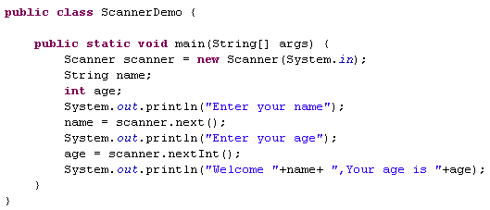
Lend a hand Solution -Scanner Class
Solution:
To read String as input
To read int as input.

Slide 12
Core Java
You have successfully completed - Scanner API.

