Slide 1
Core Java
JDBC
Part III
LEVEL – PRACTITIONER

Slide 2
About the Author
Created By: | Madhava/Sangeetha(139944)
Credential Information: | Trainer/Associate
Version and Date: | 1.0, Jan 13 , 2012
Cognizant Certified Official Curriculum
Notes:
For the animators:
This screen content needs to be rendered in the flash, no animations needed.

Slide 3









Icons Used
Hands on Exercise
Questions
Tools
Coding Standards
Test Your Understanding
Case Study
Best Practices & Industry Standards
Demonstration
Workshop

Slide 4
Objectives
After completing this chapter you will be able to,
What is a Callable Statement?
How to use Callable statement to execute stored procedure?
What is Oracle Meta Data?

Slide 5
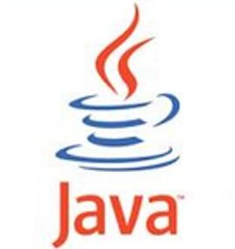
Time to Think!
How do you execute Stored Procedures from java programs?
How do you execute SQL’s from java programs?
Prepared statement is used to execute queries.
Queries – Select, Insert, Update
Java Program
Callable statement is used to
execute stored procedures.
Stored Procedures
So lets all learn how to use callable statement in this session.

Slide 6
What is a Callable Statement?
Callable statement is a type of JDBC statement which is used to invoke a database SQL stored procedure or a function from Java applications.
java.sql.CallableStatement is the interface provided by Java to invoke database stored procedures.
java.sql.CallableStatement interface extends java.sql.PreparedStatement interface.
Click on the below link for the APIs of CallabaleStatement Interface
http://docs.oracle.com/javase/6/docs/api/java/sql/CallableStatement.html

Slide 7
How to invoke a stored procedure?
Steps to invoke a stored procedure from a Java program:
Invoke the Connection.prepareCall and create a CallableStatement object for the stored procedure to be executed.
Invoke the CallableStatement.setXXX methods to pass input (IN) parameters to the stored procedure.
Invoke the CallableStatement.registerOutParameter method to register the stored procedures output (OUT) parameters or input and output (INOUT)parameters.
Invoke the CallableStatement.executeUpdate method to invoke the stored procedure.
Invoke the CallableStatement.getXXX methods to retrieve values from the OUT parameters or INOUT parameters.

Slide 8
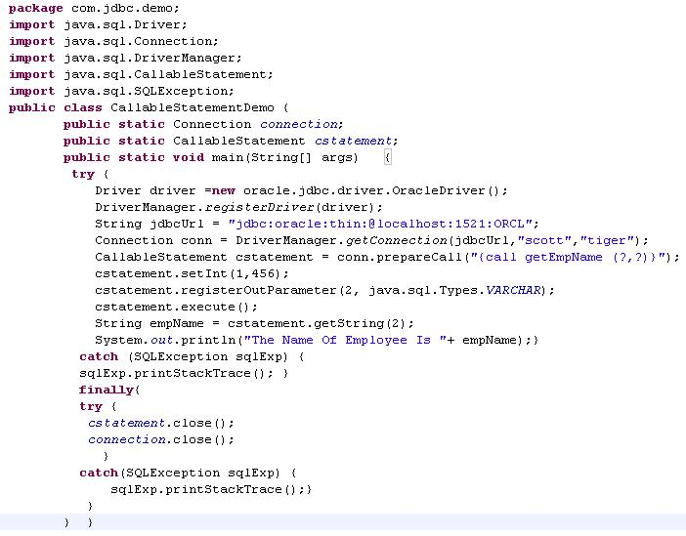
Example: How to invoke a stored procedure?
This executes a stored procedure which accepts a employee id “456” and returns the employee name.
IMPORTANT:
Always close the statement and connection in finally block.
Exception print stack trace has been used for demo purpose in real world it needs to be logged . You will learn logging in advance Java.

Slide 9
Lend a Hand – Invoking stored procedure.
Prerequisites: Use the Course_Info table which was created during oracle sessions.
Problem Statement # 1: Develop a Stored Procedure “getCourseDuration” which will take course code as input and returns course duration and a message as output parameters based on the logic mentioned below.
Logic: If the Course_Duration is greater than 30 days return a message ‘Long Term Course’ else it should return ‘Short Term Course’.
Problem Statement # 2: Develop a java class named “CourseDurationDemo” with a main method which will invoke the stored procedure and display the course duration and the message returned.

Slide 10
Lend a Hand Solution - Develop Stored procedure
Solution # 1:
CREATE OR REPLACE PROCEDURE Get_Course_Duration(CourseCode IN Varchar2,Duration OUT Number,Message OUT Varchar2) AS
BEGIN
SELECT Course_Duration INTO Duration from Course_Info where Course_Code=CourseCode;
IF Duration>20 THEN
Message:='Long Term Course';
ELSE
Message:='Short Term Course';
END IF;
END;

Slide 11
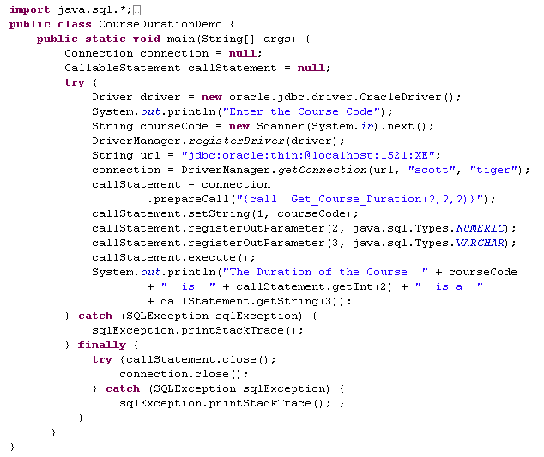
Lend a Hand Solution: Java Program
Solution # 2:

Slide 12

Lend a Hand – Executing the Program
Step 1 : Execute the Stored Procedure from the Oracle * Plus Command Line Window.
Step 2 : Run the Java Program and enter a course code.
Step 3 : The below output will be show in the console

Slide 13
Lend a Hand – Invoking oracle functions
Prerequisites: Use the Course_Info table which had already been created.
Objective: Learn to trigger oracle function from java program.
Problem Statement # 1: Develop a Stored Function “Get_Course_Message” which will take course code as input parameter, create a message using the course information and return the message as mentioned below.
Message Format: The Function Should return “Duration of ' + <Course_Name> + ' is ‘ + <Course_Duration>”.
Problem Statement # 2: Develop a java class named “CourseMessageDemo” with a main method which will invoke the oracle function and print the message returned.

Slide 14
Lend a Hand-Creating Function
Solution # 1:
CREATE OR REPLACE FUNCTION Get_Course_Message (Course_Id IN Varchar2) RETURN Varchar2 AS
C_Name Varchar2(30);
C_Duration Number(3);
BEGIN
Select Course_Name,Course_Duration into C_Name,C_Duration from Course_Info where Course_Code=Course_Id;
return ‘Duration Of ' || C_Name || ' is '|| C_Duration || ‘ days’ ;
END;

Slide 15
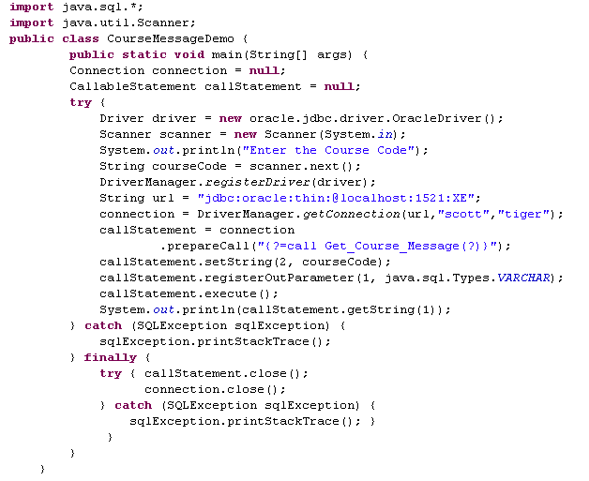
Lend a Hand-Solution
Solution # 2:

Slide 16

Lend a Hand – Executing the program
Step 1 : Execute the Stored Function from the Oracle * Plus Command Line Window.
Step 2 : Run the Java Program and enter the course code.
Step 3 : The below output will be show in the console

Slide 17

Lets wear the thinking cap.
There could be some requirement in projects where the application needs to understand the table/column definitions existing in a database.
How do we retrieve the table information?
Solution is to use Meta Data information.

Slide 18
What is JDBC Metadata?
JDBC meta data is a dictionary which holds the information about the tables and columns in a database.
Example: The metadata of any table provides the information about the column names, column data type and constraint created on the tables.
JDBC metadata
Database Meta Data
Result Set Meta Data

Slide 19
java.sql.DatabaseMetaData
The java.sql.DatabaseMetaData interface used for accessing the meta data information about the database.
The DatabaseMetaData provides methods used for retrieving information about,
The schemas objects namely tables, views and columns.
The database objects namely users, drivers, stored procedures and functions.

Slide 20
How to access database meta data?
java.sql.DatabaseMetaData is the interface used for accessing the database meta data information.
The meta data object is created using the connection object’s getMetaData().
How to access database metadata?
String url=“jdbc:oracle:thin:@localhost:1521:orcl”
Connection con=DriverManager.getConnection(url,”scott”,”tiger”);
DatabaseMetaData dbmd = con.getMetaData();
Creates Meta data object.

Slide 21
Methods of java.sql.DatabaseMetaData
Method | Description
String getDriverName() | Returns the name of the driver.
String getURL() | Retrieves the URL for the DBMS.
String getSQLKeywords() | Retrieves a comma-separated list of all of the database's SQL keywords.
Click on the below link for the other APIs of DatabaseMetaData Interface
http://docs.oracle.com/javase/6/docs/api/java/sql/DatabaseMetaData.html

Slide 22
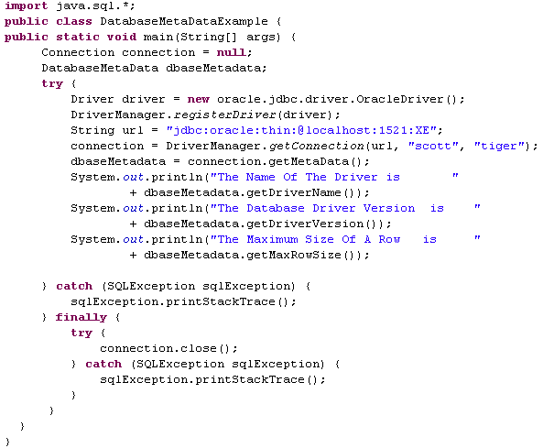

DatabaseMetaData Example
Output

Slide 23
java.sql.ResultSetMetaData
java.sql.ResultSetMetaData interface class provides information about ResultSet returned from a database query.
The ResultSetMetaData provides methods that retrieves information about,
The number of columns and their data types in the ResultSet.
The tables information of the ResultSet.
Names of the columns in the ResultSet.
Maximum display size for a given column in the ResultSet.
Other information's about the columns of the ResultSet.

Slide 24
How to access result set Meta data?
ResultSetMetaData is created using the ResultSet interface’s getMetaData() method.
How to access database metadata?
Statement statement=con.createStatement();
ResultSet resultSet=statement.executeQuery(“select * from emp”);
ResultSetMetaData rsmd = resultSet.getMetaData();

Slide 25
Methods of java.sql.ResultSetMetaData
Method | Description
int getColumnCount() | Returns the number of columns in the ResultSet
String getTableName(int column) | Returns the designated column's table name
String getColumnName(int column) | Returns the column name
getColumnType(int column) | Returns the column's SQL data-type index
Click on the below link for the APIs of ResultSetMetaData Interface
http://docs.oracle.com/javase/6/docs/api/java/sql/ResultSetMetaData.html

Slide 26
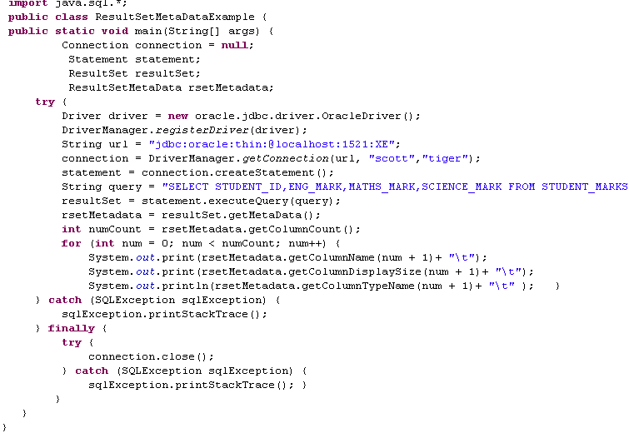

ResultSetMetaData Example
Output
Output

Slide 27
Core Java
You have successfully completed –
JDBC Part III

