Slide 1
Core Java
Java Annotations
LEVEL – PRACTITIONER

Slide 2
About the Author
Created By: | Renjith(t-renjith)/ Shanmu (105110)
Credential Information: | Trainer / Sr Architect
Version and Date: | 1.0, February 20th 2012
Cognizant Certified Official Curriculum
Notes:
For tde animators:
tdis screen content needs to be rendered in tde flash, no animations needed.

Slide 3









Icons Used
Hands on Exercise
Questions
Tools
Coding Standards
Test Your Understanding
Case Study
Best Practices & Industry Standards
Demonstration
Workshop

Slide 4
Objectives
After completing this chapter you will be able to understand:
What is an annotation?
Types of annotation.
How to create custom annotation?

Slide 5
What is an Annotation?
Annotations are metadata or data about data.
An annotation indicates that the declared element should be processed in some special way by a compiler, development tool, deployment tool or during runtime interpreters.
Starts with a “@” symbol
Example : @Override is an annotation that can be used with methods to inform the compiler that the method declared with this annotation should override the method in the parent class.
If the method fails to override (or) there is no similar method in the parent class , the compiler shows error.
Since the annotation provides some data about the method to the compiler it is referred to as metadata (or) data about data.

Slide 6
More on annotations
Introduced as a part of Java 1.5
Annotations can be either java built-in or user defined.
Built-in annotations are processed by the java compiler.
User defined annotations are processed by specific tools for example the annotations used in hibernate framework is processed by the framework.
Annotations have a number of uses, among them,
Information for the compiler - Annotations can be used by the java compiler to detect errors or suppress warnings.
Compile-time and deployment-time processing – Custom developed tools/software can use annotations to perform logic like generating code, generating XML files during compile time.
Runtime processing - Some annotations are used by interpreters to perform some logic such as intercept a HTTP request etc.

Slide 7
Need for annotation
Annotation enables “declarative programming” style:
Less coding because tool will generate the boiler plate code from annotations in the source code
Easier to change and maintain.
Annotation eliminates the need for maintaining “supporting files" that must be maintained along with the source files:
Example : Application configuration can be replaced with annotations in source files. Frameworks like Struts, Hibernate use this technique.

Slide 8
Java Built-In Annotations
Java defines seven built-in annotations.
Three are included in java.lang.
@Override,
@Deprecated,
@SuppressWarnings.
Four are imported from java.lang.annotation . These are used to annotate other annotations and hence are known as meta annotations.
@Retention,
@Documented,
@Target,
@Inherited.
Let us look at each annotations one by one.

Slide 9
@Override Annotation
This is a method level annotation.
Used to specify that a method should override a method in a super class.
Compiler will throw an error if there is no equivalent method in the base class.
Example:
class Parent {
public void sing(Type2 a, Type1 b) {//method implementation}
}
class Child extends Parent {
@Override
Public void sing(Type1 a, Type2 b) {//Overridden method implementation}
}
The compiler throws an error since the method sing annotated as @Override in Sub class is not actually overriding any parent class method cause of data type mismatch.

Slide 10
@Deprecated annotation
Indicates that the marked element is deprecated and should no longer be used.
The compiler will display a warning message during compilation when you use a deprecated item.
For Example: Consider the following code
@Deprecated
static void sayHello() {// implementation goes in here }
If we try to use the method sayHello() the compiler will show a warning that you are using a deprecated method.

Slide 11
@SuppressWarnings
Informs the compiler to suppress specific warnings that it could generate. Example: @SuppressWarnings(" unchecked ")
Suppresses type safety warnings on field definitions when not using generics.
To suppress more than one category of warnings, use the following syntax:
@SuppressWarnings({"unchecked", "deprecation"})
Used to suppress compiler warning related to the usage of collections without generics
Compiler Warnings
Categories
Deprecation
Unchecked
Used to suppress compiler warning related to the usage of deprecated methods.

Slide 12
How to define Annotation Type?
Annotation type definitions are similar to normal Java interface definitions:
An at-sign (@) precedes the interface keyword.
Each method declaration defines an attribute of the annotation type.
Method declarations must not have any parameters or a throws clause.
Return types are restricted to primitives, String, Class, enums, annotations, and arrays of the preceding types.
Methods can have default values which will be used when no value is explicitly specified. This is done using the default keyword.
Assume there is an annotation “@Author (authorName = “Arun”)”
Example : String authorName() default “Jack”; // if the author name is not mentioned in the annotation the value would be defaulted to Jack.
Note : User defined annotations may be manipulated by tools or using annotation readers using the Reflection API.

Slide 13
How to Define custom Annotation ?
Custom annotations can be created using @interface as given below
// A simple annotation type.
@interface Author{
String str();
String creationDate();
}
How to use the custom annotation ?
@Author (str = “Arun”, creationDate=“11/11/2011” )
public static void myMeth() { // …}
How to process custom annotations
Custom annotations can be processed by user defined tools which uses reflection API’s to read the annotation values.
Example : An application server can process the EJB annotations.

Slide 14
Few Custom Annotations In Frameworks
Object-relational mapping : @Entity, @Table, @Id, @OneToMany, etc.
Web services: @WebService, @WebMethod, etc.
Enterprise Java Beans (EJB): @EJB, @Remote
Event Handling: @Action, @ActionListenerFor
Junit testing: @Test
The respective framework will take care of processing the custome annotations.
Example: If annotation @EJB is used with the java class file the EJB container will consider the java class as a EJB and process it.

Slide 15
Types of Annotations
Marker annotations : Have no attributes
Examples:
@Override
@Deprecated
Single Value annotations: Have only one attribute
Example :
@Copyright( “2004, Dave Landers” )
@SuppressWarnings({“unchecked”, “deprecation” })
Multi-valued annotations: Have more than one attribute.
Example : @Review( reviewer=“Landers”, date=“4/1/2004”,
comment=“Close stream in finally block” )
Contains a single value- a String array

Slide 16
What is meta annotation?
This is annotation for annotation. Defines meta-data that can be applied to custom annotations at the time of definition.
@Retention
@Documented
@Target
@Inherited
Let us look at each annotations one by one.

Slide 17
@retention annotation
Specifies the retention policy of the user defined annotation.
A retention policy determines at what point an annotation is discarded.
Java defines three retention policies
SOURCE : An annotation with a retention policy of SOURCE is retained only in the source file and is discarded during compilation.
CLASS : Retained in the Java class file by the Java compiler and will be not be accessible through reflection API at runtime. This is the default retention policy. We need to use a byte code manipulation library to access the Annotations available in byte code. .
3. RUNTIME: Retained in the Java class file by the Java compiler and will be
accessible through reflection API at runtime
What is reflection?
Reflection is a feature that enables information about a class to be obtained at run time.

Slide 18
@retention annotation
Syntax: @Retention(retention-policy)
Here, retention-policy must be one of the retention policies discussed earlier.
If no retention policy is specified for an annotation, then the default policy of CLASS is used.
Example: Uses @Retention to specify the RUNTIME retention policy. Thus, the following annotation (MyAnnotation) will be available to the JVM during program execution.
@Retention(RetentionPolicy.RUNTIME)
@interface MyAnnotation {
String str();
int val();
}

Slide 19
@Documented annotation
The @Documented annotation indicates that the custom annotation should be processed by the “javadoc tool” and included in the generated HTML documentation.
Custom annotation ClassPreamble declared as document
ClassPreamble Annotation used in DocDemo class.
@Documented
@interface ClassPreamble
{
String author();
String date();
int currentRevision() default 1;
}
@ClassPreamble (
author = “Arun”, date =“11/11/2011", currentRevision = 6 )
public class DocDemo {
// class code goes here
}

Slide 20
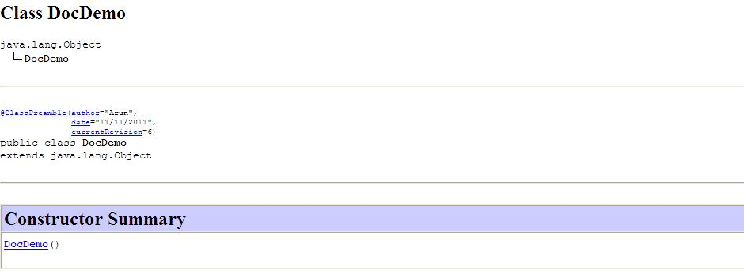
Generated Java documentation for Preamble annotation
The java doc generated for the DocDemo class.

Slide 21
@Target Annotation
The @Target Meta-Annotation specifies to which Java code element(s) the custom annotation can be applied. The element types are defined in the enum java.lang.annotation.ElementType which are as follows:
Element Type | Description
ElementType.PACKAGE | Specifies that the custom annotation applies to package.
ElementType.TYPE | Applies to class, interface, or enum.
ElementType.FIELD | Applies to the fields of a class.
ElementType.METHOD | Applies to the methods of a class.
ElementType.PARAMETER | Applies to the parameters of the method.
ElementType.CONSTRUCTOR | Applies to the constructors of the class.
ElementType.LOCAL_VARIABLE | Applies to the local variables.

Slide 22
Custom Annotation Declaration
@Target(ElementType.TYPE)
@Retention(RetentionPolicy.RUNTIME)
public @interface Version {
int major() default 1;
int minor() default 0;
String release() default "";
}
This defines an annotation “Version” which is processed during runtime (Retention policy) and can be applied on Class, Interface or Enum (Element type).

Slide 23
@Inherited
An annotation annotated with @inherited meta annotation Specifies that this annotation, when applied to a class, is automatically inherited by its subclasses. Applies only to annotations for classes.

Slide 24
Reflection
Reflection is a feature used by developers to gather information (method names, method attributes) about a class during run time.
The reflection API is contained in the java.lang.reflect package.
Can also be used to invoke methods in a class.
Methods of AnnotatedElement Interface are used by the reflection API to obtain the annotations from a Class, Method, Field, Constructor, or Package object.
For more details on AnnotatedElement
http://docs.oracle.com/javase/6/docs/api/java/lang/reflect/AnnotatedElement.html

Slide 25

Time To Reflect
Associates to quickly summarize the following before ending the session
What is the annotation used for suppressing the warning related to type checks?
What is a marker annotation?
What is the annotation used to make an annotation available at runtime alone?
How can one ensure that a custom annotation is used only with method attributes?
What annotation one can use to mark a method as obsolete?

Slide 26
Lend a Hand – Using Annotations
Objective: We are going to practice on how to use the java in built annotations in the java.lang package.
@Override
@Deprecated
@SuppressWarning

Slide 27
Lend a Hand : @Override Annotation
Problem Scenario : In an IT company HR management has introduced a new policy that for few designations the HR will pay a common basic salary. But for the higher designations the salary is calculated based on their respective designation level.
Assume that there are two designations “Programmer” and “Manager” the HR defines that all programmers should get only the basic salary. For Manager it will be 4 times as of the basic salary.
Steps to develop:
Step 1: Create a Employee class, the base class with a method calculateSalary() which returns the default salary which is 10000.
Step 2: Create two classes “Manager” and “Programmer” both extending the base class.
Step 3: Since the Manager designation has a different salary, the calculateSalary() methosd should be overridden.
Let us use the @override annotation to enforce the method to be overridden in the child class.

Slide 28
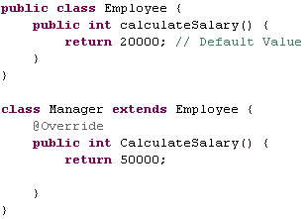
Lend a Hand-@Override annotation
Did you get any compilation error once you write the above code ?

Slide 29
Lend a Hand-@Override annotation
The compilation error occurs because the CalculateSalary method in the Manager class is annotated as @override but it is not actually overriding the calculateSalary method in Employee class.
@override annotation benefit: This will ensure that the child class method must override the parent class method. Changing the method CalculateSalary in Manager class to calculateSalary removes the compilation error.

Slide 30
Lend a Hand - @Deprecated and @SuppressWarnings
Problem Statement: Consider an application has a utility named Printer containing a method printString() which can accept a String and print it. When upgrading the application you have planned to create a new method printManyStrings() , since this can handle the printing of one or more string you plan to make the printString() obsolete.
Solution: Mark the printString() method as deprecated using the @Deprecated annotation.
Components to be Developed:
Printer class.
PrinterManager class : Uses the Printer class to print the String.

Slide 31
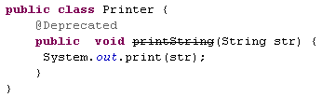
Lend a Hand : Printer class
Develop the Printer class as mentioned below.
@Deprecated annotation used to mark the method as deprecated.
DID YOU NOTICE: When using deprecated annotation the method name will be displayed as a strike (printString) in eclipse.

Slide 32
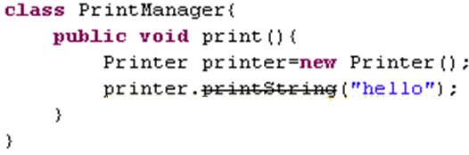
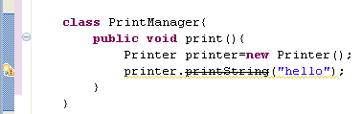
Lend a Hand – Print Manager class
DID YOU NOTICE: You will get a warning for using deprecated methods as shown below ?
Keep the mouse over the warning to get the warning details .
Example: “The method printString(String) from the type Printer is deprecated”.
Let us see how we can suppress this warning.

Slide 33
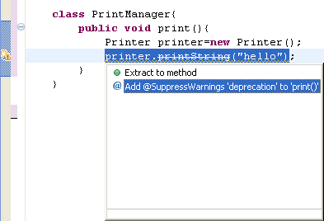
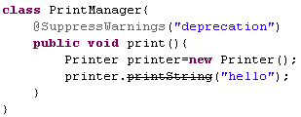
Lend a hand- Add @SuppressWarnings
Click the warning icon and select the option “Add @SuppressWarnings deprecation to …”
Final Solution
@SuppressWarnings annotation added.

Slide 34
Core Java
You have successfully completed –
Java Annotation

