Slide 1
Cloud Computing
Overview, Models & Providers
Richard Madden 30.03.2022

Slide 2
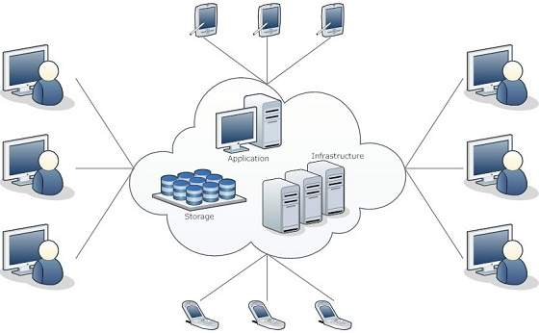
Introduction
The Cloud: This term originally referred to a network of computers. Was then used as a metaphor for the internet. Nowadays describes anything present at a remote location.
Cloud Computing: Manipulating, configuring and accessing hardware and software resources remotely.
Platform Independency: Organisations can operate without local data centres. Applications, infrastructure and storage can all be hosted on the cloud.

Slide 3
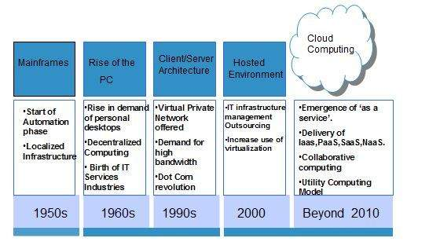
History
Huge growth in cloud computing within the last decade.
Industry giants such as Google, Amazon, Microsoft & IBM are among the biggest providers.
Latest trends in cloud computing include containers, serverless computing, cloud security, edge computing and high performance computing.
By 2020, the combined end-user spending on cloud services totalled $270 billion and 83% of organisations’ workload was stored on the cloud.

Slide 4
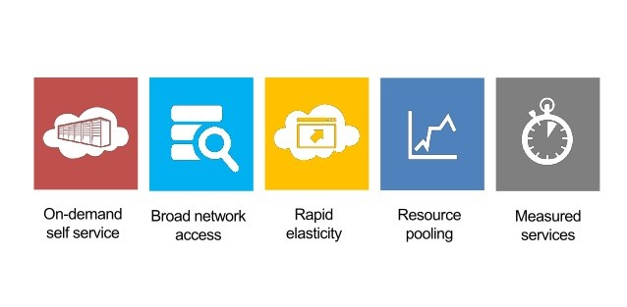
Essential Characteristics
On-demand Self Service: Users can unilaterally provision web services and resources when needed without requiring staff support from the cloud provider.
Broad Network Access: The cloud can be accessed over the web from anywhere and at any time.
Rapid Elasticity: Resources can be scaled horizontally and vertically to handle increased workload, providing the consumer with the illusion of unlimited provisioning capabilities.
Resource Pooling: Multiple tenants can share a pool of resources, providing location independence.
Measured Services: Users only pay for what they use in terms of storage, processing, bandwidth etc.

Slide 5
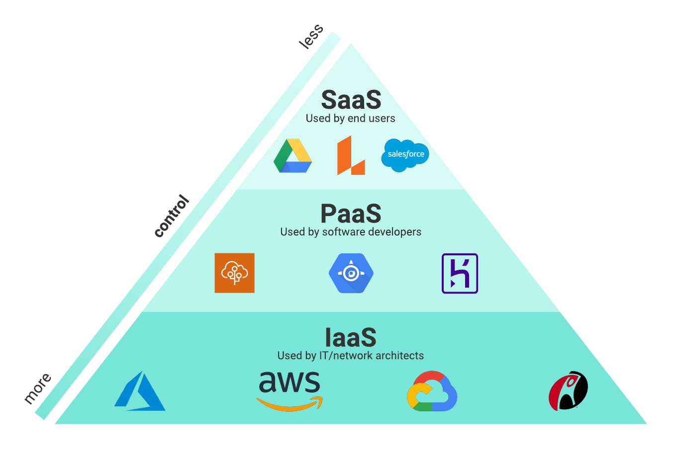
Service Models
Software-as-a-Service (SaaS): Provides end user with the capability to run applications on a cloud infrastructure.
Platform-as-a-Service (PaaS): Provides a framework that makes it easier and more efficient to build, customise and deploy applications.
Infrastructure-as-a-Service (IaaS): Provides access to storage, networking, servers and other computing resources via the cloud.

Slide 6
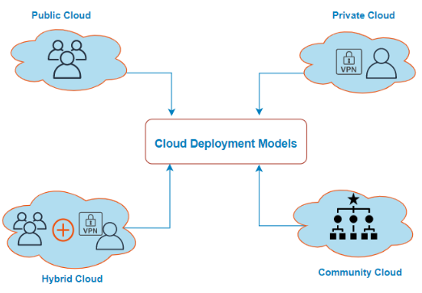
Deployment Models
Private Cloud: Provisioned for exclusive use by a single organisation comprising multiple consumers. Enhanced customisation and security.
Community Cloud: Provisioned for a group of organisations that have shared concerns.
Public Cloud: Provisioned for open use by the general public. Greater efficiency and cheaper costs.
Hybrid Cloud: Composition of two or more cloud infrastructures (private, community or public). Greater flexibility.

Slide 7
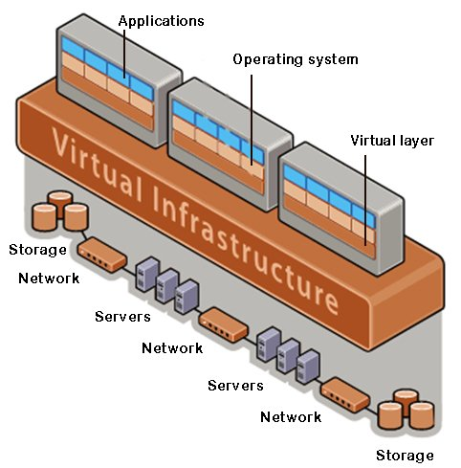
Virtualisation
Virtualisation: Splitting out operating systems (e.g. Windows, Linux) from the underlying hardware.
Cloud Virtualisation: Resources can be shared amongst multiple tenants. Customers are provided with a virtual environment in the cloud which can be software, hardware or any other resource and don’t need to consider the physical infrastructure themselves.
Hypervisor: Software that creates and runs virtual machines (VMs). It controls and monitors the process, memory and other hardware resources.
Benefits: Security, flexible operations and data transfer, economic savings and reduced risk of system failures.

Slide 8
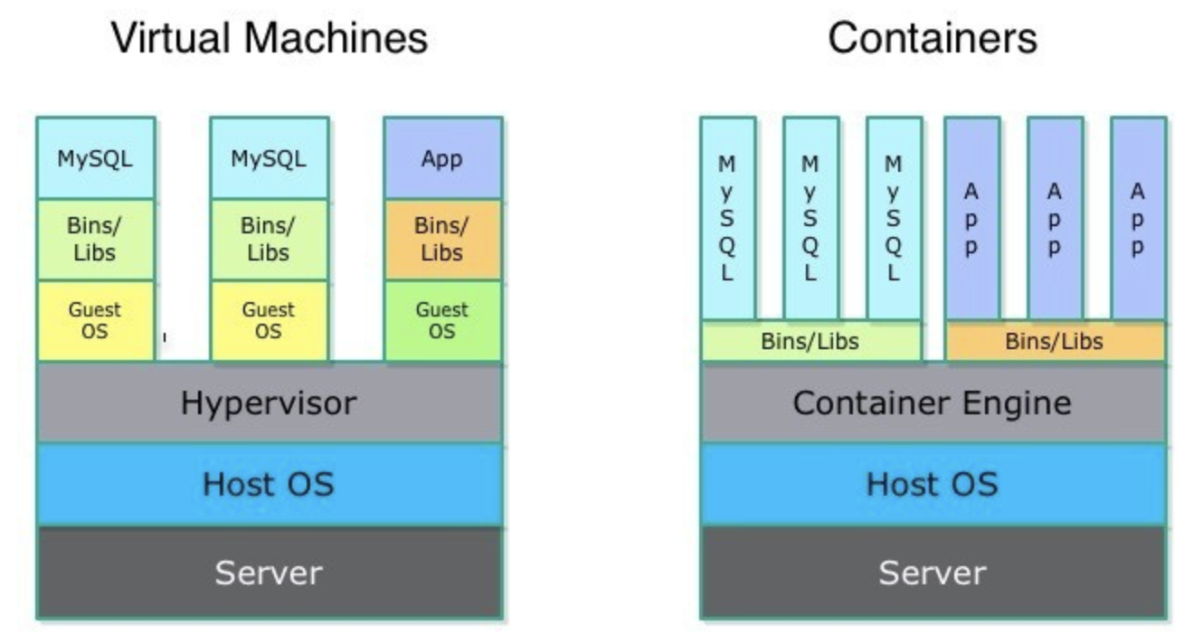
Containers
Containers: Packages of software that contain all of the necessary elements (i.e. specific programming language runtimes and libraries) to run in any environment.
VM Comparison: Containers are more lightweight than VMs, they virtualise at the OS level as opposed to the hardware level and use only a fraction of the memory VMs require. Useful analogy - VMs are like houses in that they’re fully self-contained whereas containers can be thought of as apartments that are built around shared infrastructure.
Benefits: Agile development, efficient operations and can run anywhere.
Open-source Platforms: Docker, Kubernetes.

Slide 9
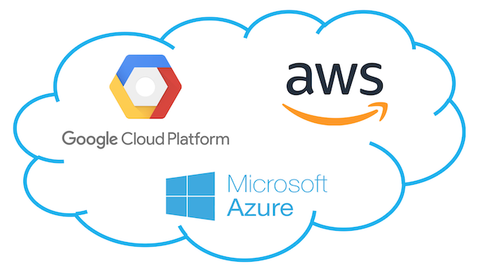
Service Providers
Amazon Web Services: Launched 2006 - 33% market share. 200+ services: Compute (EC2), Database (RDS), Storage (S3), Troubleshooting (CloudTrail), Monitoring (CloudWatch).
Microsoft Azure: Launched 2010 - 21% market share - 100+ services: Compute (Virtual Machines), Database (Azure SQL Database), Storage (Azure Blob Storage), Troubleshooting (Azure Operational Insights), Monitoring (Azure Application Insights).
Google Cloud Platform: Launched 2011 - 10% market share - 60+ services: Compute (Compute Engine), Database (SQL Database) Storage (Cloud Storage) Troubleshooting (Stackdriver Logging) Monitoring (Stackdriver Monitoring).
Other Big Players: Alibaba Cloud, IBM Cloud, Saleforce, Tencent Cloud, Oracle Cloud

Slide 10
