Slide 1





Slide 2




Slide 3



Slide 5





Slide 6



Slide 7

+
-

Slide 8
?
?
?

Slide 9

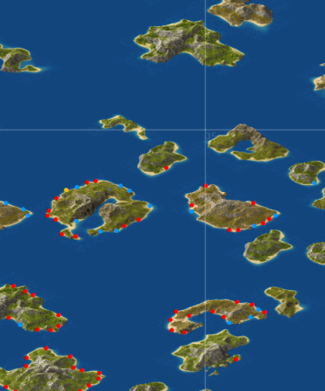




Slide 10


Slide 11
Gt

Slide 12




Slide 13



Slide 14



Slide 15






Slide 16


Slide 17





Slide 18
128 px
0/0
2/0
4/0
128 px
1/0
3/0
0/1
2/1
1/1
Island_x = x * 128
Island_y = y * 128, if x is even
Island_y = 64 + y * 128, if x is odd
data.islands()[i].y = (x&1)? y*128+64 : y*128;
data.islands()[i].x = x * 128;

