Slide 1
Group “Lucky Number” 7 [Maddie Izadi [0], Colby Carpenter [1], Firdosh Patel [2]]
Is there a Relationship between
Key Economic Indicators in the
Stock, Commodity and Currency Markets

Slide 2
Project analysis slide 2
OVERVIEW
STEP 5.
CONCLUSIONS
STEP 0.
QUESTIONS
PROJECT
STEP 4.
DATA ANALYSIS
STEP 1.
DATA SOURCES
STEP 3.
DATA CLEANING
STEP 2.
DATA EXTRACTION

Slide 3
Project analysis slide 2
QUESTIONS
STEP 0.
QUESTIONS
PROJECT

Slide 4
Project analysis slide 2
QUESTIONS/ANSWERS
WE ASKED THE FOLLOWING QUESTIONS:
Is there a relationship between Key:
Commodity and Stock Market Indicators
Currency and Stock Market Indicators
Commodity and Currency Market Indicators
WHY DID WE ASK THE ABOVE QUESTIONS?:
In the news / media, we often hear “experts” talking about these relationships.
We wanted to verify for ourselves, using actual data, and the tools we have learnt
in this class, whether these relationships do exist.
WERE WE ABLE TO ANSWER OUR QUESTIONS?:
Yes, we believe we were able to answer our questions.
We reviewed the past 10 years of data for 4 key relationships:
Brent Crude vs Dow Jones Industrial Average
Gold vs Dow Jones Industrial Average
Chinese Yuan/US Dollar Exchange Rate vs Dow Jones Industrial Average
Chinese Yuan/US Dollar Exchange Rate vs Gold
We ran Linear Regressions for the entire 10 year period, as well as for each individual year.

Slide 5
Project analysis slide 2
DATA SOURCES
PROJECT
STEP 1.
DATA SOURCES

Slide 6
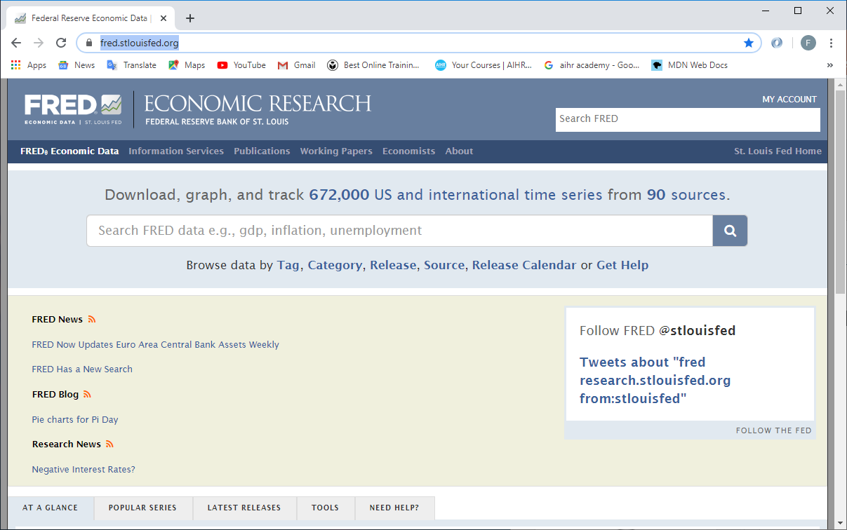
Project analysis slide 2
DATA SOURCES
We collected data for the following Key Indicators:
Stock Market
Dow Jones Industrial Average
S&P 500
NASDAQ
Willshire 500
Commodities Market
Brent Crude Oil
West Texas Intermediate Crude Oil
Henry Hub Natural Gas
Gold
Currency Market (Currencies for the Countries with highest 5 GDPs)
US Dollar vs Chinese Yuan
US Dollar vs Japanese Yen
US Dollar vs Euro
US Dollar vs Indian Rupee
We researched online and found the following website on Economic Research hosted by the Federal Reserve Bank of St. Louis (FRED Economic Data):
https://fred.stlouisfed.org/

Slide 7
Project analysis slide 2
DATA EXTRACTION
PROJECT
STEP 2.
DATA EXTRACTION

Slide 8
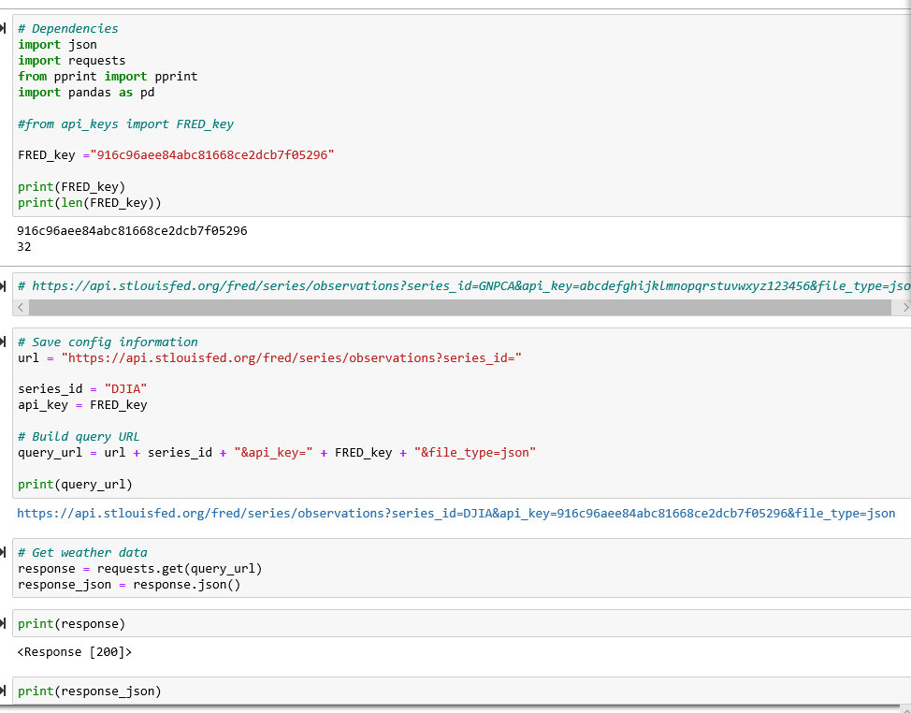
Project analysis slide 2
DATA EXTRACTION
We created an account on the FRED Economic Data website and requested an API Key.
We used the API Key to extract daily level data for the past 10 years for each of the 12 Key Economic Indicators identified by us.
We then merged the 12 individual datasets that were extracted into a single Data Frame.
The details of the data extraction process can be found in the attached Jupyter Notebook File called “00_Extraction_with_API.ipynb”.
Jupyter Notebook Code

Slide 9
Project analysis slide 2
DATA CLEANING
PROJECT
STEP 3.
DATA CLEANING

Slide 10
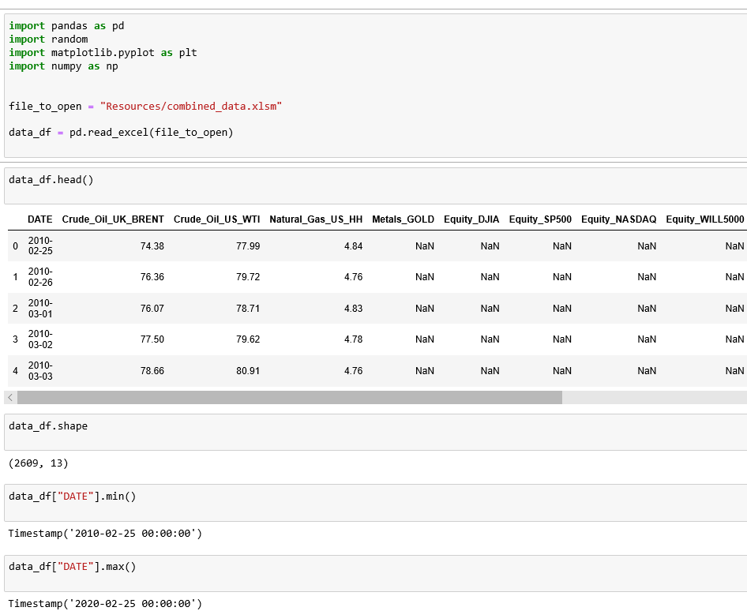
Project analysis slide 2
DATA CLEANING
We used PANDAS to explore the data that was extracted, and also to clean the data. We specifically took the following actions:
Converted the values from datatype string to float.
Deleted rows with N/A values.
Deleted rows with ZERO values.
Deleted rows with “.” values.
After we cleaned the data, we ended up with 2,436 rows (2,436 days of data) for each of the 12 indicators.
The details of the data extraction process can be found in the attached Jupyter Notebook File called “01_Exploration_and_Cleanup.ipynb”.
Jupyter Notebook Code

Slide 11
Project analysis slide 2
DATA ANALYSIS
PROJECT
STEP 4.
DATA ANALYSIS

Slide 12
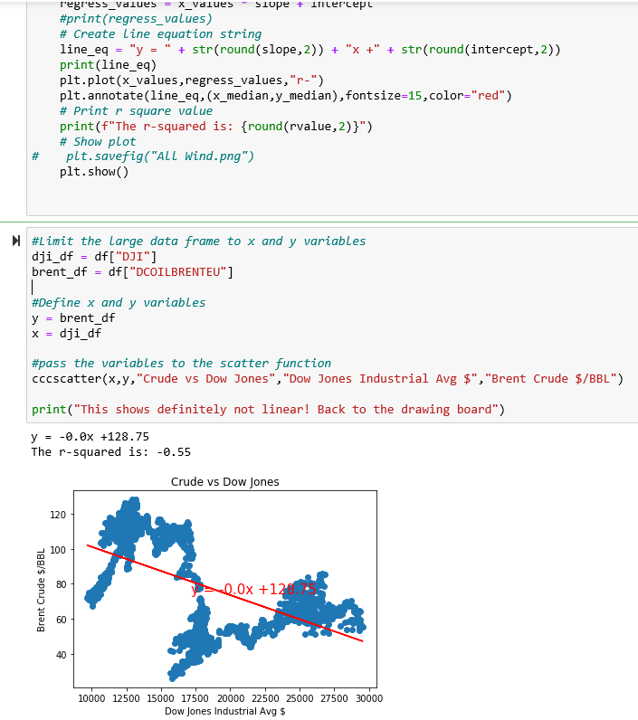
Project analysis slide 2
DATA ANALYSIS
We used PANDAS and MATPLOTLIB to analyze the data.
We used the following tools:
Scatter Plots
Linear Regressions
The details of the data extraction process can be found in the attached Jupyter Notebook File called “02_Analysis.ipynb”.
Jupyter Notebook Code

Slide 13
Project analysis slide 2
CONCLUSIONS
STEP 5.
CONCLUSIONS
PROJECT

Slide 14
CONCLUSIONS
ANALYSIS # 0:
Brent Crude Oil
vs
Dow Jones Industrial Average (2010 – 2020)

Slide 15
Project analysis slide 2
ANALYSIS # 0:
Brent Crude Oil vs Dow Jones Industrial Average (2010 – 2020)
When we consider the entire period of 2010-2020, there is no significant relationship between the price of Brent Crude Oil and the Dow Jones Industrial Average.
However, when we analyze the relationship by individual year, we can see a high R-Squared value between the price of Brent Crude Oil and the Dow Jones Industrial Average for the following years:
2010
2014
2016-2017
2020
CONCLUSIONS
In the Social Sciences, an R-Squared of >0.35 is considered meaningful.
https://condor.depaul.edu/sjost/it223/documents/correlation.htm

Slide 16
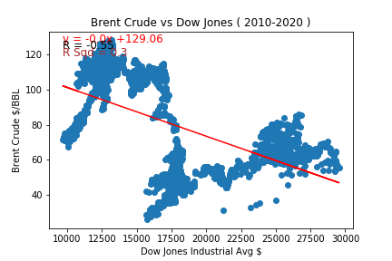
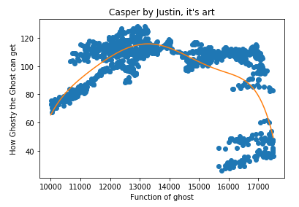

Project analysis slide 2
CONCLUSIONS
ANALYSIS # 0:
Brent Crude Oil vs Dow Jones Industrial Average (2010 – 2020)

Slide 17
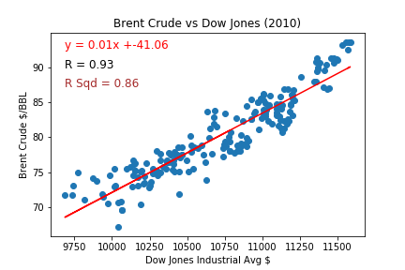
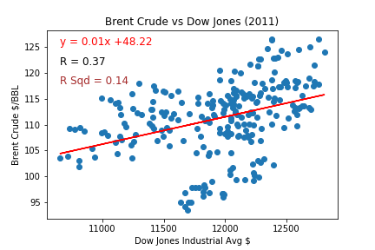
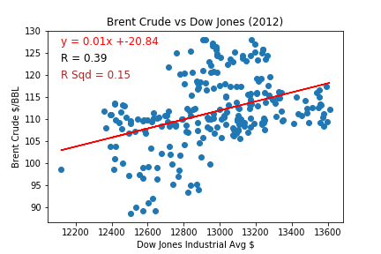
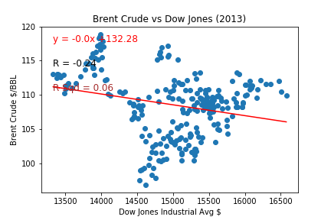
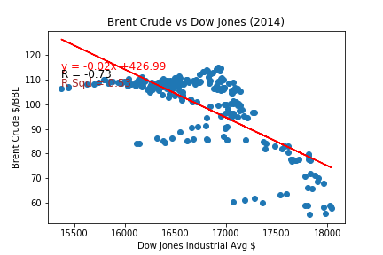
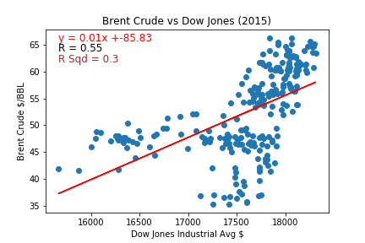
Project analysis slide 2
CONCLUSIONS
ANALYSIS # 0:
Brent Crude Oil vs Dow Jones Industrial Average (2010 – 2015)

Slide 18
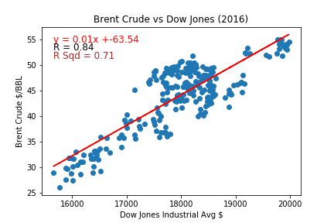
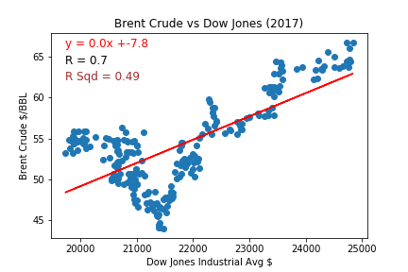
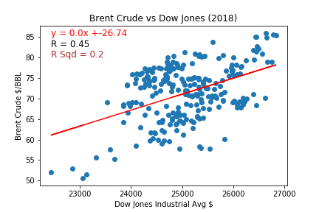
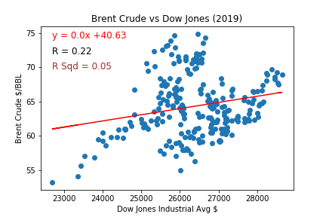
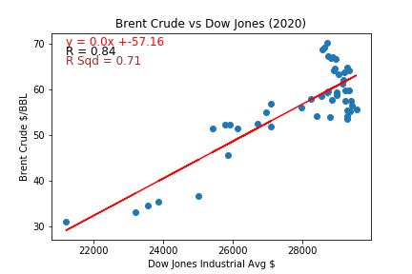
Project analysis slide 2
CONCLUSIONS
ANALYSIS # 0:
Brent Crude Oil vs Dow Jones Industrial Average (2016 – 2020)

Slide 19
CONCLUSIONS
ANALYSIS # 1:
Gold
vs
Dow Jones Industrial Average (2010 – 2020)

Slide 20
Project analysis slide 2
CONCLUSIONS
ANALYSIS # 1:
Gold vs Dow Jones Industrial Average (2010 – 2020)
When we consider the entire period of 2010-2020, there is no significant relationship between the price of Gold and the Dow Jones Industrial Average.
However, when we analyze the relationship by individual year, we can see a high R-Squared value between the price of Gold and the Dow Jones industrial Average for the following years:
2013
2019
2020
In the Social Sciences, an R-Squared of >0.35 is considered meaningful.
https://condor.depaul.edu/sjost/it223/documents/correlation.htm

Slide 21
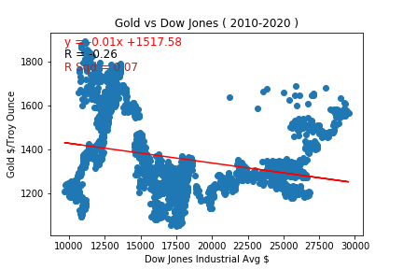
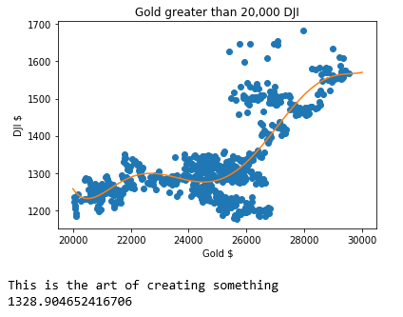

Project analysis slide 2
CONCLUSIONS
ANALYSIS # 1:
Gold vs Dow Jones Industrial Average (2010 – 2020)
Gold $/Troy Ounce
Down Jones Industrial Avg ($)

Slide 22
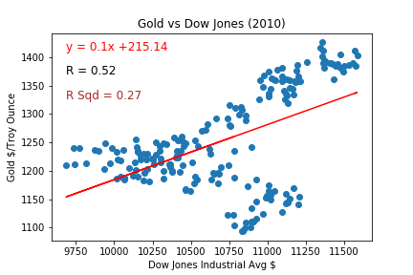
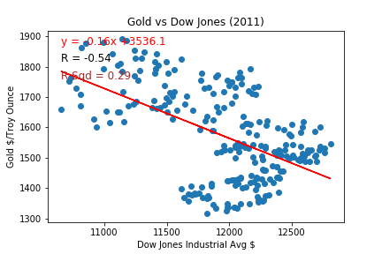
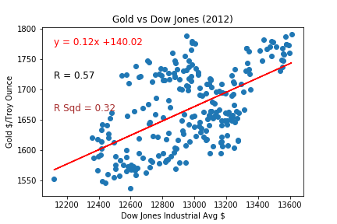
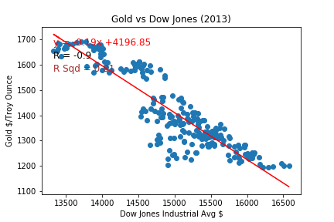
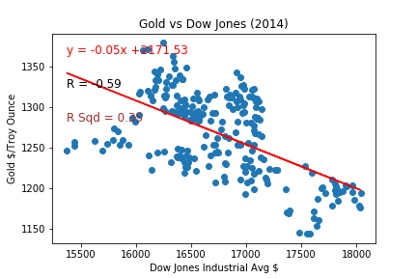
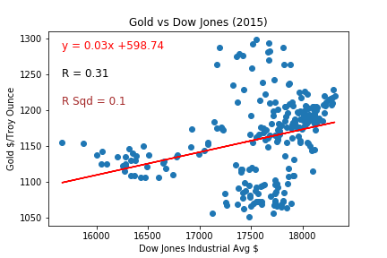
Project analysis slide 2
CONCLUSIONS
ANALYSIS # 1:
Gold vs Dow Jones Industrial Average (2010 – 2015)

Slide 23
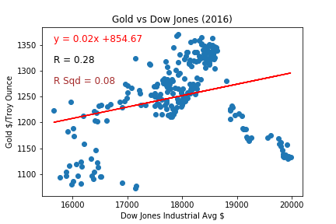
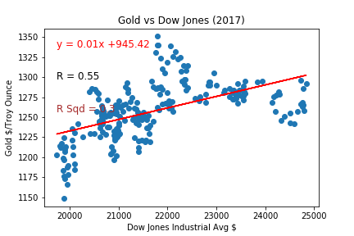
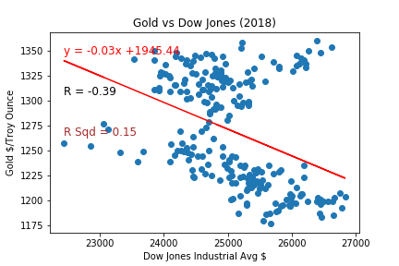
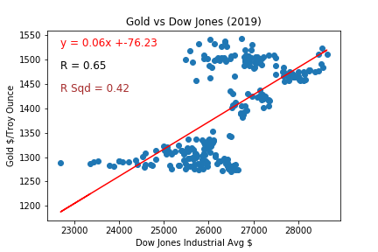
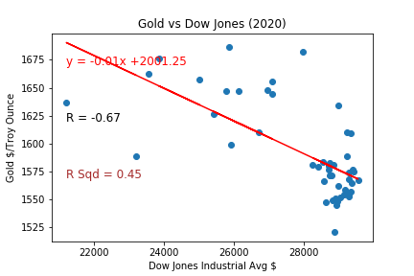
Project analysis slide 2
CONCLUSIONS
ANALYSIS # 1:
Gold vs Dow Jones Industrial Average (2016-2020)

Slide 24
CONCLUSIONS
ANALYSIS # 2:
Chinese Yuan / US Dollar
vs
Dow Jones Industrial Average (2010 – 2020)

Slide 25
Project analysis slide 2
CONCLUSIONS
ANALYSIS # 2:
Chinese Yuan / US Dollar vs Dow Jones Industrial Average (2010 – 2020)
When we consider the entire period of 2010-2020, there is no significant relationship between the Chinese Yuan / US Dollar Exchange Rate and the Dow Jones Industrial Average.
However, when we analyze the relationship by individual year, we can see a high R-Squared value between the Chinese Yuan / US Dollar Exchange Rate and the Dow Jones industrial Average for the following years:
2010
2013
2016
2017
In the Social Sciences, an R-Squared of >0.35 is considered meaningful.
https://condor.depaul.edu/sjost/it223/documents/correlation.htm

Slide 26
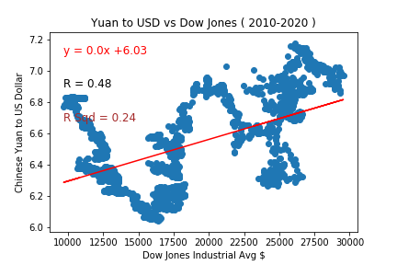

Project analysis slide 2
CONCLUSIONS
ANALYSIS # 2:
Chinese Yuan / US Dollar vs Dow Jones Industrial Average (2010 – 2020)

Slide 27
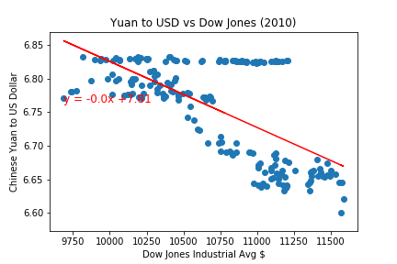
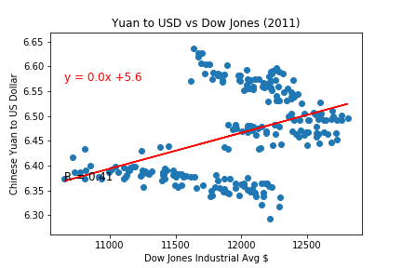
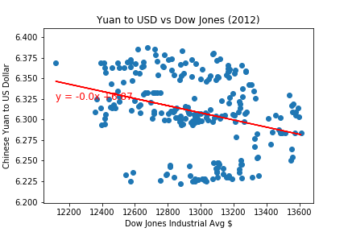
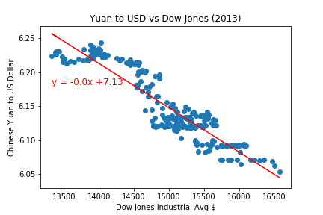
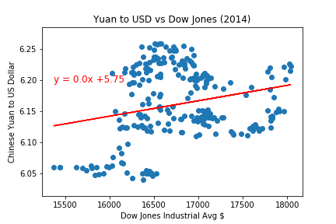
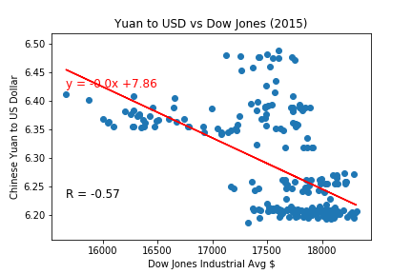
Project analysis slide 2
CONCLUSIONS
ANALYSIS # 2:
Chinese Yuan / US Dollar vs Dow Jones Industrial Average (2010 – 2015)

Slide 28
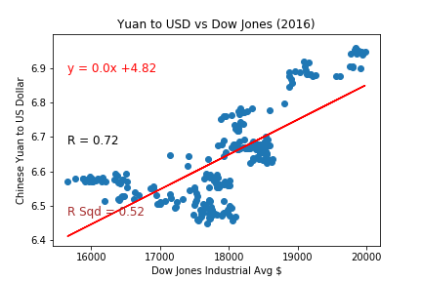
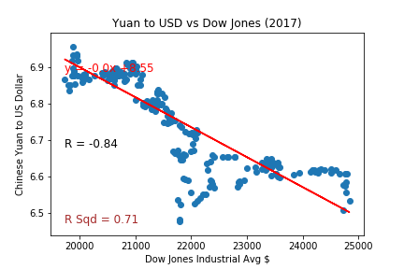
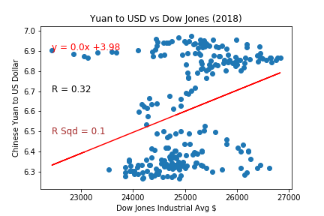
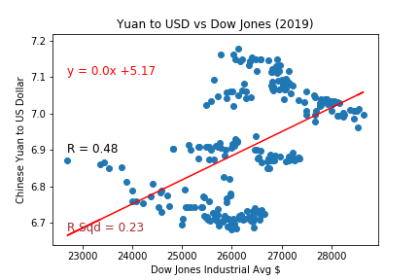
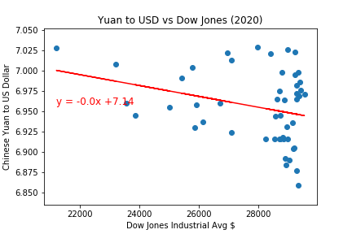
Project analysis slide 2
CONCLUSIONS
ANALYSIS # 2:
Chinese Yuan / US Dollar vs Dow Jones Industrial Average (2016 – 2020)

Slide 29
CONCLUSIONS
ANALYSIS # 3:
Chinese Yuan / US Dollar
vs
Gold
(2010 – 2020)

Slide 30
Project analysis slide 2
CONCLUSIONS
In the Social Sciences, an R-Squared of >0.35 is considered meaningful.
https://condor.depaul.edu/sjost/it223/documents/correlation.htm
ANALYSIS # 3:
Chinese Yuan / US Dollar vs Gold (2010 – 2020)
When we consider the entire period of 2010-2020, there is no significant relationship between the Chinese Yuan / US Dollar Exchange Rate and Gold.
However, when we analyze the relationship by individual year, we can see a high R-Squared value between the Chinese Yuan / US Dollar Exchange Rate and Gold for the following years:
2010 - 2013
2015
2017 - 2019

Slide 31
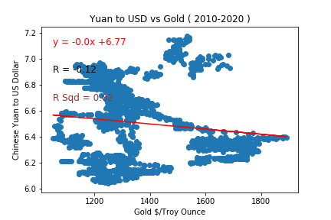
Project analysis slide 2
CONCLUSIONS
ANALYSIS # 3:
Chinese Yuan / US Dollar vs Gold (2010 – 2020)

Slide 32
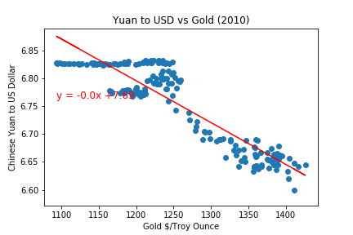
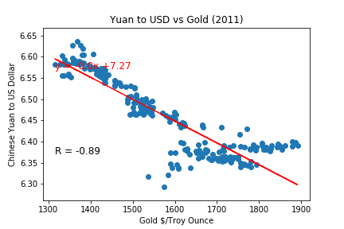
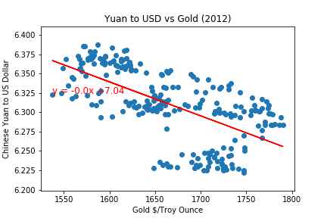
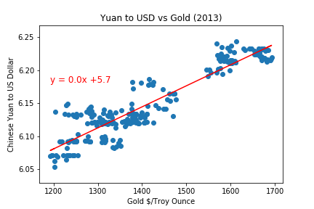
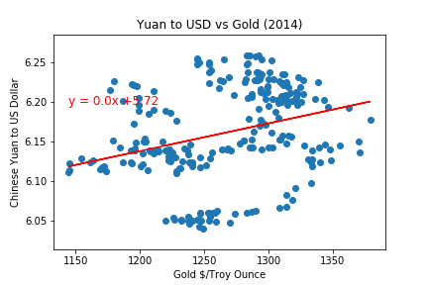
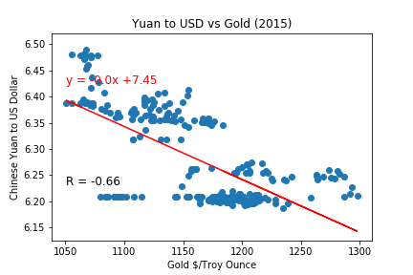
Project analysis slide 2
CONCLUSIONS
ANALYSIS # 3:
Chinese Yuan / US Dollar vs Gold (2010 – 2015)

Slide 33
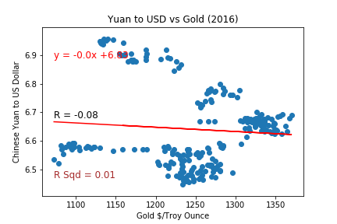




Project analysis slide 2
CONCLUSIONS
ANALYSIS # 3:
Chinese Yuan / US Dollar vs Gold (2016 – 2020)

Slide 34
Project analysis slide 2
MORE TIME!!
WHAT MORE COULD WE HAVE DONE IF WE HAD 2 ADDITIONAL WEEKS:
We would have been able to review other key relationships such as:
Euro / US Dollar Exchange Rate vs Chinese Yuan/US Dollar Exchange Rate
Euro / US Dollar Exchange Rate vs Brent Crude Oil
Indian Rupee / US Dollar Exchange Rate vs Brent Crude Oil
Japanese Yen / US Dollar Exchange Rate vs Brent Crude Oil
We would also have been able to review relationships for the daily percentage change (as opposed to the native values) between key economic indicators.

Slide 35
Brought to You By: Group “Lucky Number” 7 [Maddie Izadi [0], Colby Carpenter [1], Firdosh Patel [2]]

Slide 36




Now Taking Questions from the Audience

Slide 37
Thank You For Your Time

