Slide 1


Indago
By Maddie Gee, Keith Lobo, Duncan Pringle, Dillon Blyth and Lois Coughlin

Slide 2

Struggling with motivation as a student?
Need more incentives to meet your goals?
Do you love animals?
Welcome to Indago!
It is no secret many students experience procrastination, low motivation and poor time management due to unstructured workloads and competing priorities!

Slide 3
Prototype Demonstration
We will now give a quick demonstration of the prototype!

Slide 4
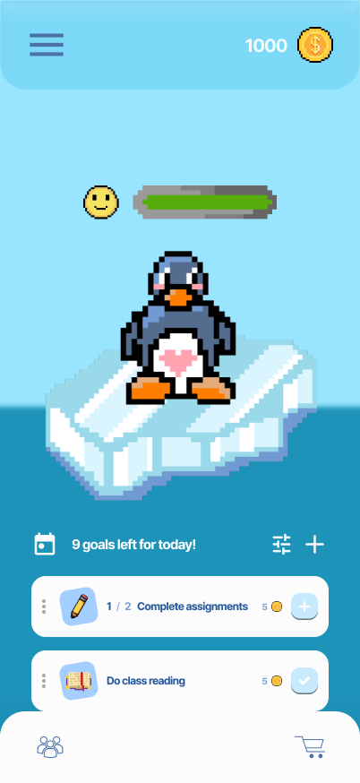

Design System Choices
Gamification: Coins and customisable accessories are used to gamify people's tasks and encourage them to earn their way to modifying their pet's appearance. This aims to help encourage people into enjoying their task and turn it into a habit.
Why animals? We decided to use animals as we feel it is something lots of students will want to see thrive, people often have a strong affection for animals, so why not use that to help them?
Our prototype uses shades of blue and white to portray a calming theme that gets people into a relaxed mindset, ready to start working on their projects and assignments.

Slide 5
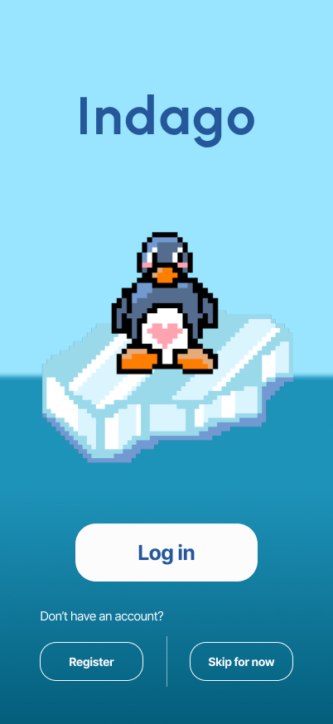
Design System Choices
Throughout the prototype, we've used rounded corners on most elements and buttons, giving a soft, playful look. We want the app to be easy on the eyes and not crowded with too many elements together, which can be overstimulating for some users.
Fonts: The title font seen on most pages is 'Urbanist', which we feel resonates with the brand identity as a rounded, not-too-formal font. We’ve used 'Inter' for the main body text of the prototype to give it a calm, humanist feeling (as described by Google Fonts).

Slide 6
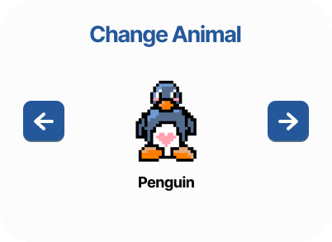
Design System Choices
Buttons have enough padding to make sure that users with disabilities that could make it difficult to tap smaller areas can easily click buttons.
Contrasting Colours: In order to ensure that important features are highlighted, we’ve used brighter, more descriptive colours to have them stand out (in this case, red for the log out button).
The pixel icons add an element of fun to the overall vibe of the app. Doing tasks can be fun!
Some buttons are playful, while also maintaining contrast with the background and enough padding to make sure clicking is accessible to all.

Slide 7





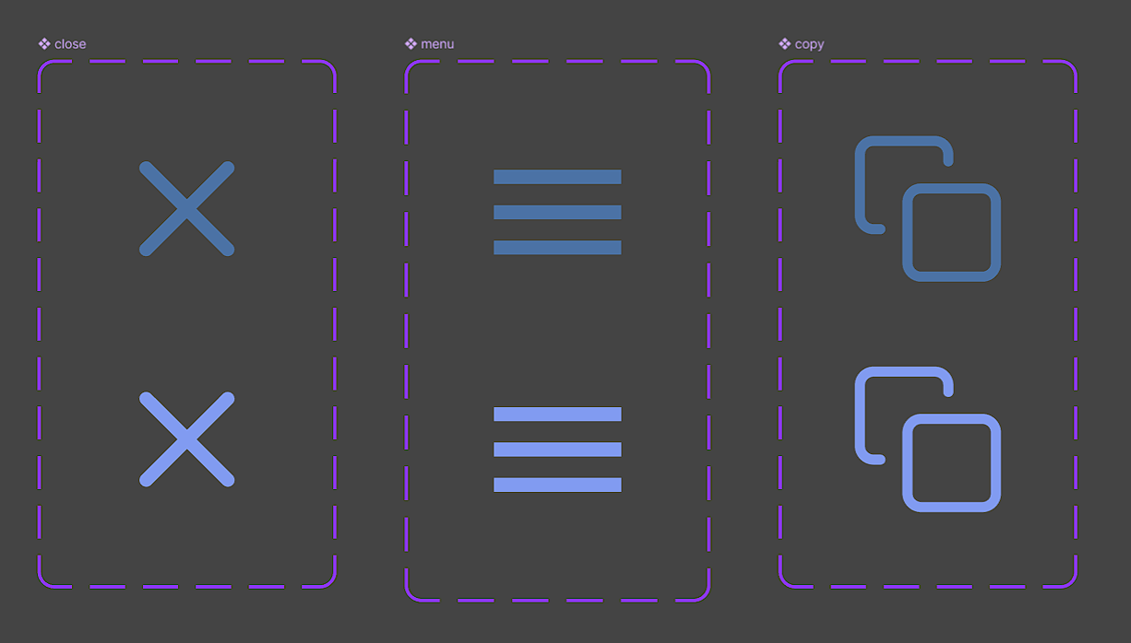
Figma Features Used
Assets were used to save time spent looking through different pages for unique assets
Used variants of buttons to create on-click animations (colour changes)

Slide 8
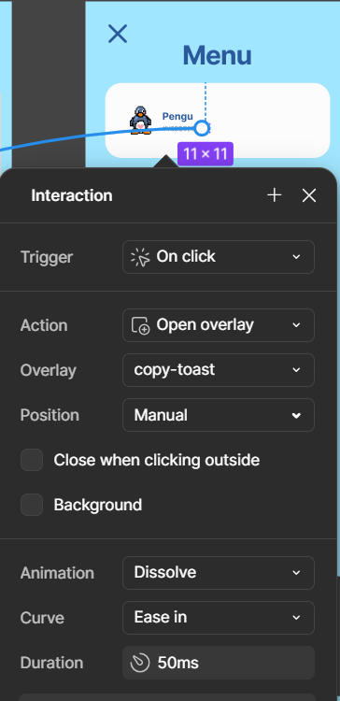
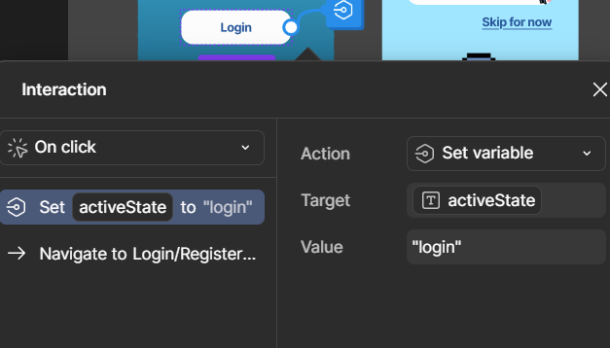
Figma Features Used
Interactions use different triggers and actions, with some changing variables to dynamically change pages and some overlays.

Slide 9
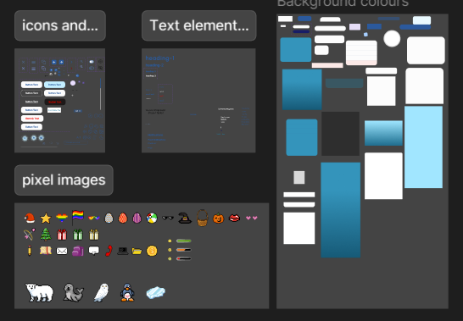
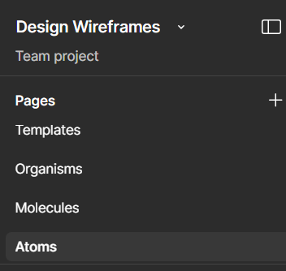
Figma Features Used
Different Pages were used to keep atomicity separate and simple
Each page was organised into sections to keep everything clear and useable

Slide 10
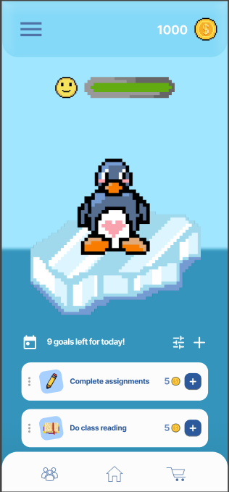
Figma Features Used
Annotation was used to keep communication easy, not always having to use a separate app
Used the scroll behaviour feature to give more emphasis on the elements that stay static on the screen.

Slide 11
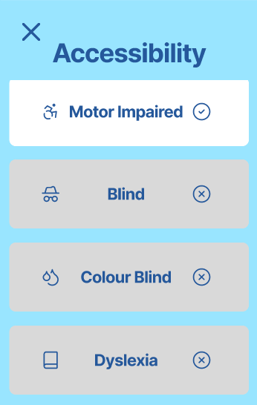
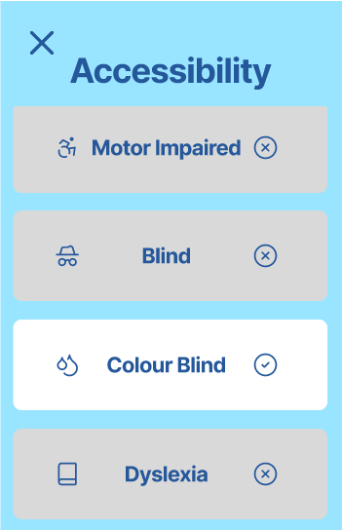
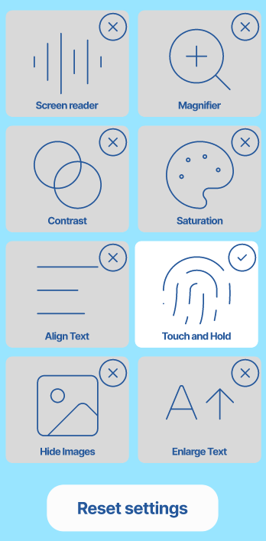
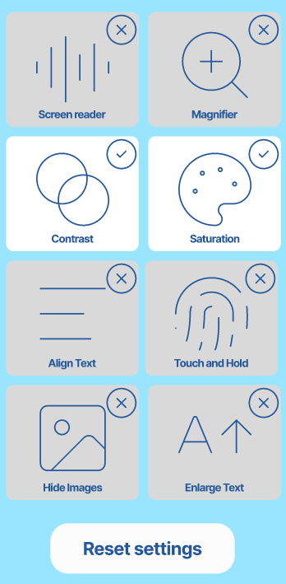
Accessibility Decisions
Although our app is accessible already
We decided to make Indago as accessible as possible because we wanted to design a solution for EVERY student.
Indago contains many accessibility options including:
Motor impaired: Touch and Hold
Blind: Screen Reader, Hide Images
Colour Blind: Contrast, Saturation
Dyslexic: Align Text

Slide 12
Thank you!
Please ask us any questions!

