Slide 1
Simulator
Andrew Wilkie Maddie Mackey

Slide 2
Idea
# intro of the
# a statement of the aspect we will be demonstrating
Notes:
Introduction of the topic and the aspect we will be demonstrating

Slide 3
Explanation
# explanation of the underlying computer science principles and algorithms
PID (Proportional Integral Derivate)

Slide 4
Demo!
# demonstrate the application itself, including an explanation of how the code implements the concepts presented

Slide 5
Discussion
# discussion of the wider applications of the topic beyond what we have demonstrated, from simple to complex and any potential developments currently under research and dev or being theorised.

Slide 6
Question Time
Ask away!
# only 5 minutes
# presentation needs to be 10 min (including the demo)
G(A)SP

Slide 7
Bruce notes ###DO NOT DISPLAY
Focus on the simulation, not necessarily the algorithms
Why we used pygame
Why python
Keep the style clean and appropriate (GC prospectus guide style)

Slide 8
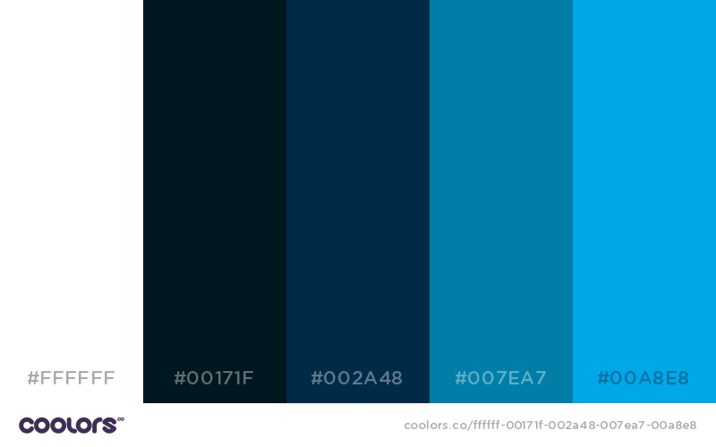
####Style
White (255, 255, 255)
Darkest (0, 23, 31)
Middle (0, 42, 71)
Light (0, 126, 167)
Lightest (0, 168, 232)

