Slide 1

Music Data Analysis and Song Recommendation
With Pyspark
Naga Sampath Maddineni , Sai Krishna Kaniganti, Sivanarayana Reddy Kesireddy, Praneeth Maleedu, Abhiram Reddy Pudi

Slide 2
Abstract
Project overview and primary objectives. Forecasting song popularity and suggesting analogous tracks based on attributes such as danceability, tempo, and energy.

Slide 3

Pyspark
Efficient Data Processing
Used PySpark DataFrames for loading and cleaning Spotify data (11,656 songs).
Leveraged distributed computing to speed up data processing across cluster nodes.
Machine Learning with PySpark MLlib
Applied Linear Regression and Random Forest models to predict song popularity.
Utilized K-Means Clustering and PCA for song grouping and dimensionality reduction

Slide 4
Data Collection and Description
Dataset from Spotify (2015-2023) with 11656 rows and 19 columns. Key features include popularity, acousticness, danceability, energy, and others.

Slide 5
Data Exploration and Cleaning
Analysis of popularity trends from 1921-2023, and exploration of key features. Cleaning process involved correcting data types and eliminating null values.

Slide 6
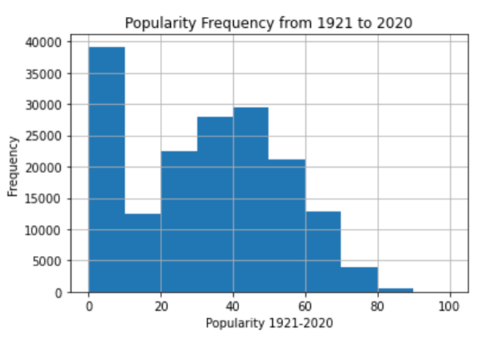
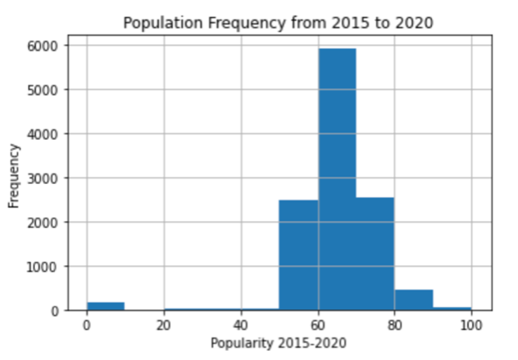
EDA
Popularity will be the dependent variable. Interesting, the popularity column from 1921 to 2015 has more zeros, averaging 31.55. Recently, from 2015 to 2020, the popularity column mean rose to 64.36.

Slide 7
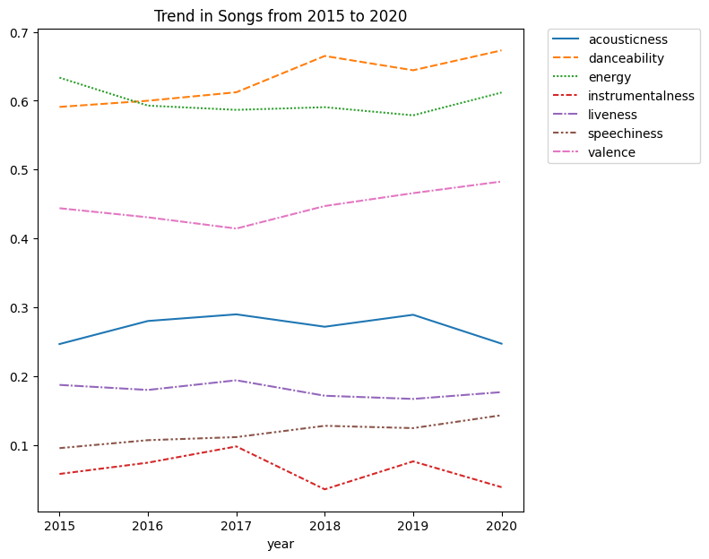
EDA
After reduction, the dataset has 11,656 rows and 19 columns. Music qualities from 2015 to 2020 are compared to see how trends alter. Acousticity, danceability, vitality, instrumentalness, liveness, speechiness, and valence are in figure. These variables are on the same scale, making the illustration clear. Danceability and speechiness rise, whereas energy and instrumentality fall.

Slide 8
Methodologies Overview
Used models: Linear Regression, Random Forest Regression, PCA, K-Means Clustering to analyze and predict song popularity and recommend songs.

Slide 9
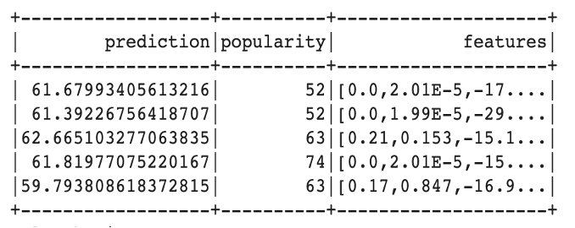
Linear Regression Model
Multiple linear regression using features: Danceability, Energy, Loudness, Explicit, and Key. RMSE: 10.5811.

Slide 10
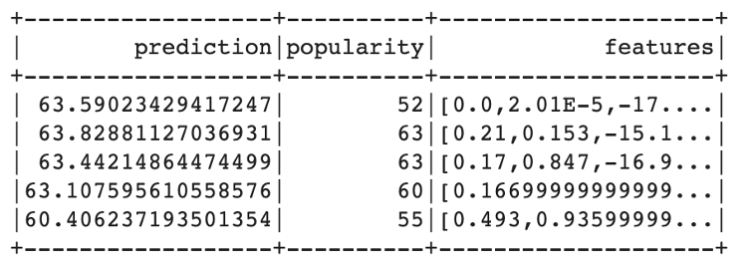
Random Forest Regression Model
Random forest regression with 20 decision trees, depth 5. RMSE: 10.4574. Comparison shows Random Forest performed better.

Slide 11
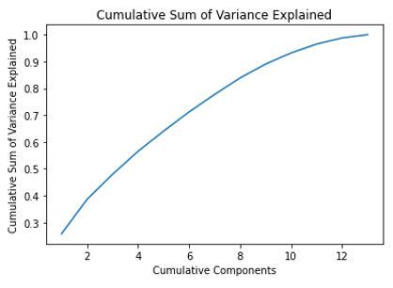
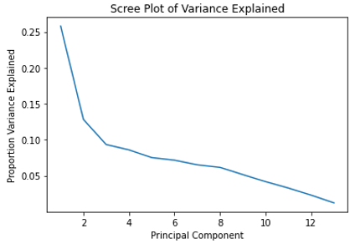
Principal Component Analysis (PCA)
PCA reduced data dimensions while retaining 93.18% of variance. Similar songs recommended using L2 distance from PCA scores.

Slide 12
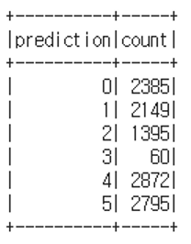
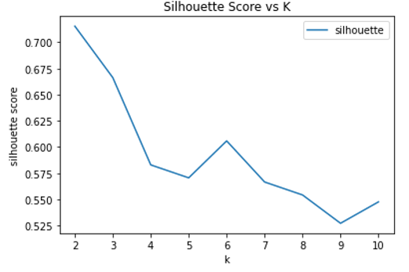
K-Means Clustering
K-Means clustering divided songs into 6 clusters. Silhouette analysis showed 6 clusters as optimal for classification.

Slide 13
Results Table & Comparison
Algorithm | RMSE | MSE
Linear regression | 10.757353 | 111.960440
Random Forest | 10.441410 | 109.023051
Random Forest outperformed Linear Regression in predicting the popularity. Thus, it generalizes well on new data, thus predicting the popularity of new song.
Key features affecting popularity came out to be danceability and loudness by using the feature scores in Decision tree nodes.

Slide 14
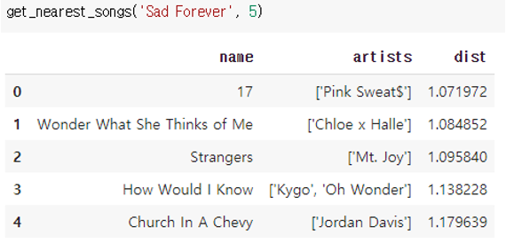
Recommendation System & Conclusion
PCA used for recommending similar songs, if a new song is given out that is recently released or a song with null popularity value, then its popularity can be calculated by Random Forest.
When the input is passed, PCA gives the top 5 recommended songs based on the calculated PCA scores and variances.
The K Means is used to clusters the songs into 6 types, thus can be used for recommending the songs from the same cluster
This concludes the successful implementation of recommendation system using PCA and we can implement it in real-life applications.

Slide 15
References
An Introduction to Statistical Learning with Applications in R (ISLR) by Gareth James, Daniela Witten, Trevor Hastie, Robert Tibshirani.
Apache Spark: The Definitive Guide by Chambers and Zaharia.
Dataset: The data set is taken from the Kaggle.
A comprehensive Guide for Music Recommendation Systems by J.A. McFee, D.P. W.Eills, S.H.L.D.Anwar, IEEE.

