Slide 1
Project Intro

Slide 2
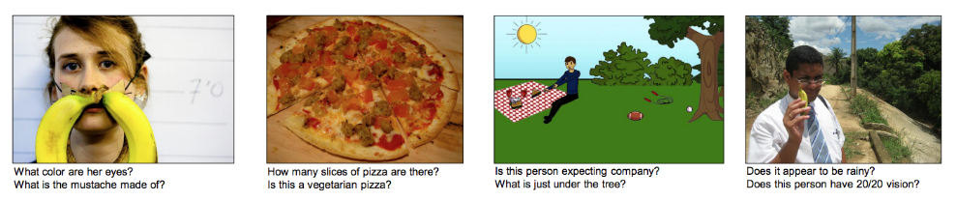
VQA: Visual Question Answering
VQA: Visual Question Answering (ICCV 2015)

Slide 3
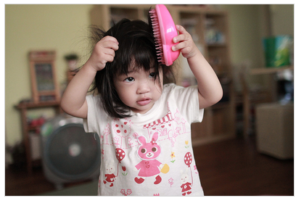
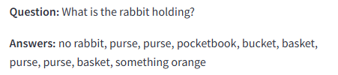

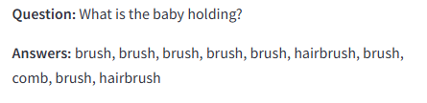

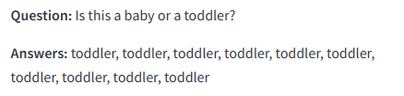

Question Types (i.e., Tasks)

Slide 4
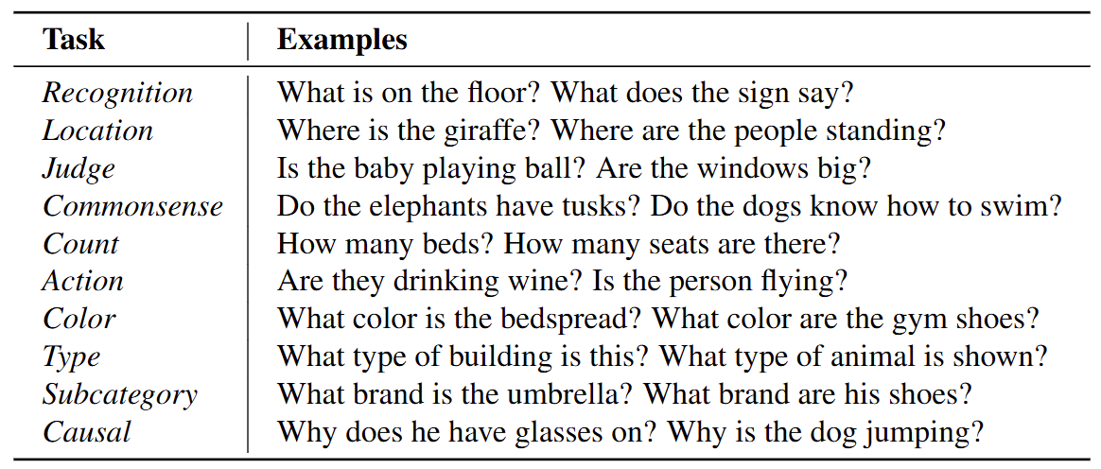
Question Types (i.e., Tasks)
The questions can be categorized into ten different types.
The types can be overlapping.

Slide 5
Composed Questions
Composed questions are a type of question that combine two or more different tasks.
Example:
  Question: What is the toddler doing with the pink tool she is holding against her head?
  Tasks combined: Recognition (identifying the object) + Judge (understanding the context of how it’s being used)
  Single Answer: "Brushing hair"

Slide 6
General Instructions
Observe the image carefully.
  Note objects, people, actions, and relationships in the scene.
  Identify multiple aspects that could be asked about (e.g., what someone is holding, what they are doing, where something is, or characteristics like color or type).
Identify the tasks to combine.
  Choose two or more tasks from the following categories:

Slide 7
General Instructions
3. Combine the tasks into a single natural question.
  Formulate a question that integrates the chosen tasks but is still answerable with one clear answer. No more than three words in one answer please.
  Ensure the question doesn’t split into multiple independent answers.
Check clarity and specificity.
  Make sure the question refers unambiguously to a specific object, action, or detail in the image.
Example:
  Question: What is the toddler doing with the pink tool she is holding against her head?
  Tasks combined: Recognition (identifying the object) + Judge (understanding the context of how it’s being used)
  Single Answer: "Brushing hair"

Slide 8
Your Task
Each group should annotate 50 composed QAs.
Each group should answer all composed QAs annotated by other groups.
Composed QAs must be human-annotated.
No AI is allowed for this part.
You will use AI in the second part of the project, so AI should not be used in the first part.
The quality of your annotations and answers will be evaluated by the professor, TAs, and some PhD students.

Slide 9
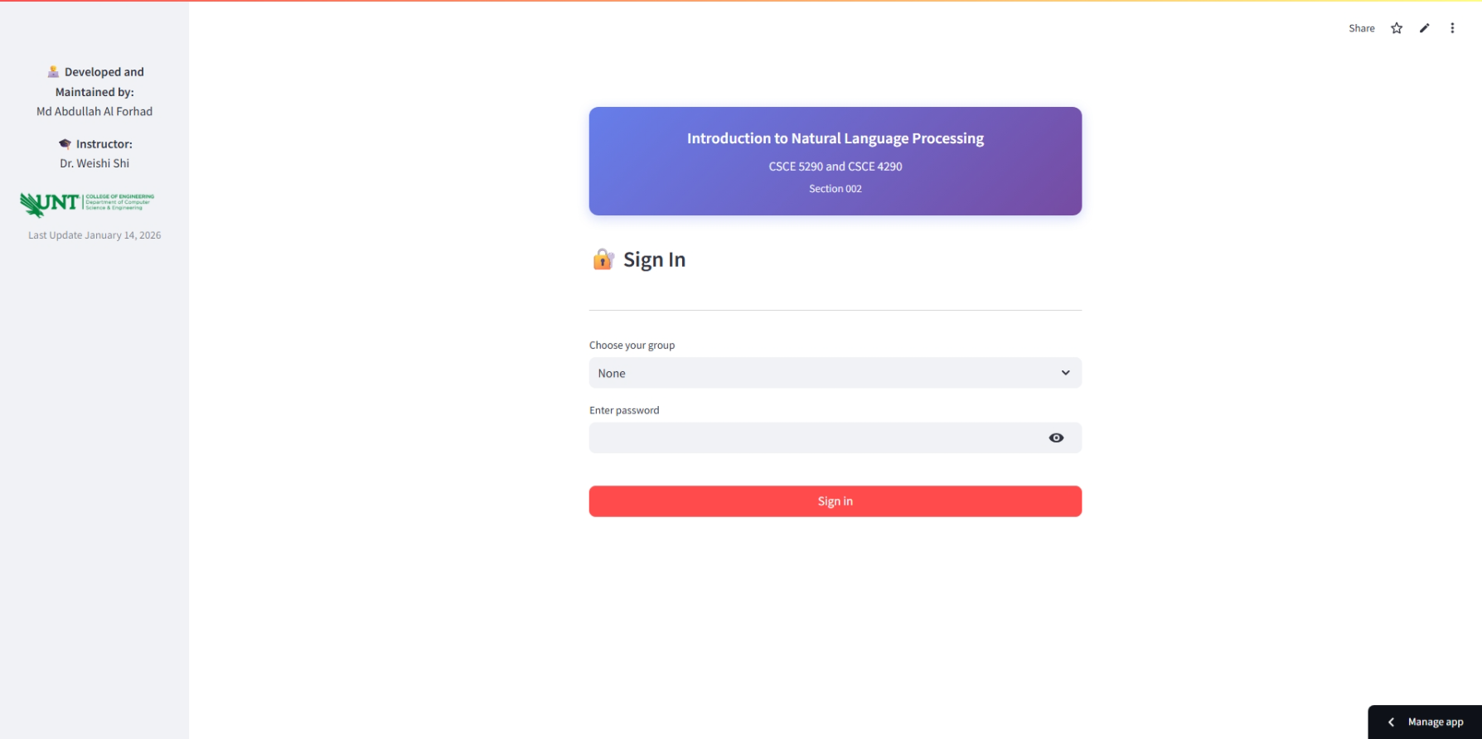
Landing Page
Choose your group and enter the password to sign in.
The password is “nlp_{GROUP}” (e.g., nlp_1 for Group 1).
Each group is assigned 200 unique images.

Slide 10
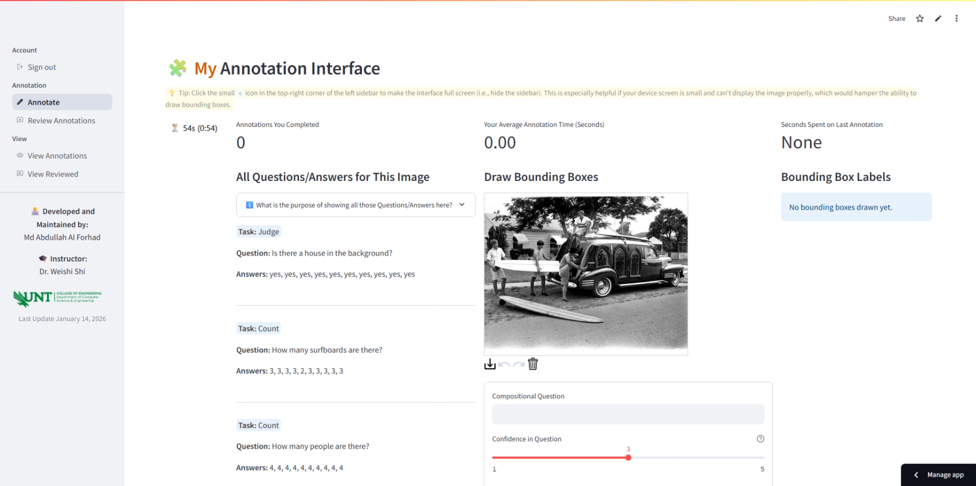
After signing in, you will see this page.
On the left sidebar, you will find different navigation options.

Slide 11
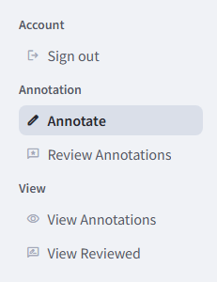
This is the page where you will complete your annotation.
On this page, you will see annotations completed by others,
and you will review their annotations.
This page displays the annotations you have completed.
This page displays annotations reviewed by you.

Slide 12
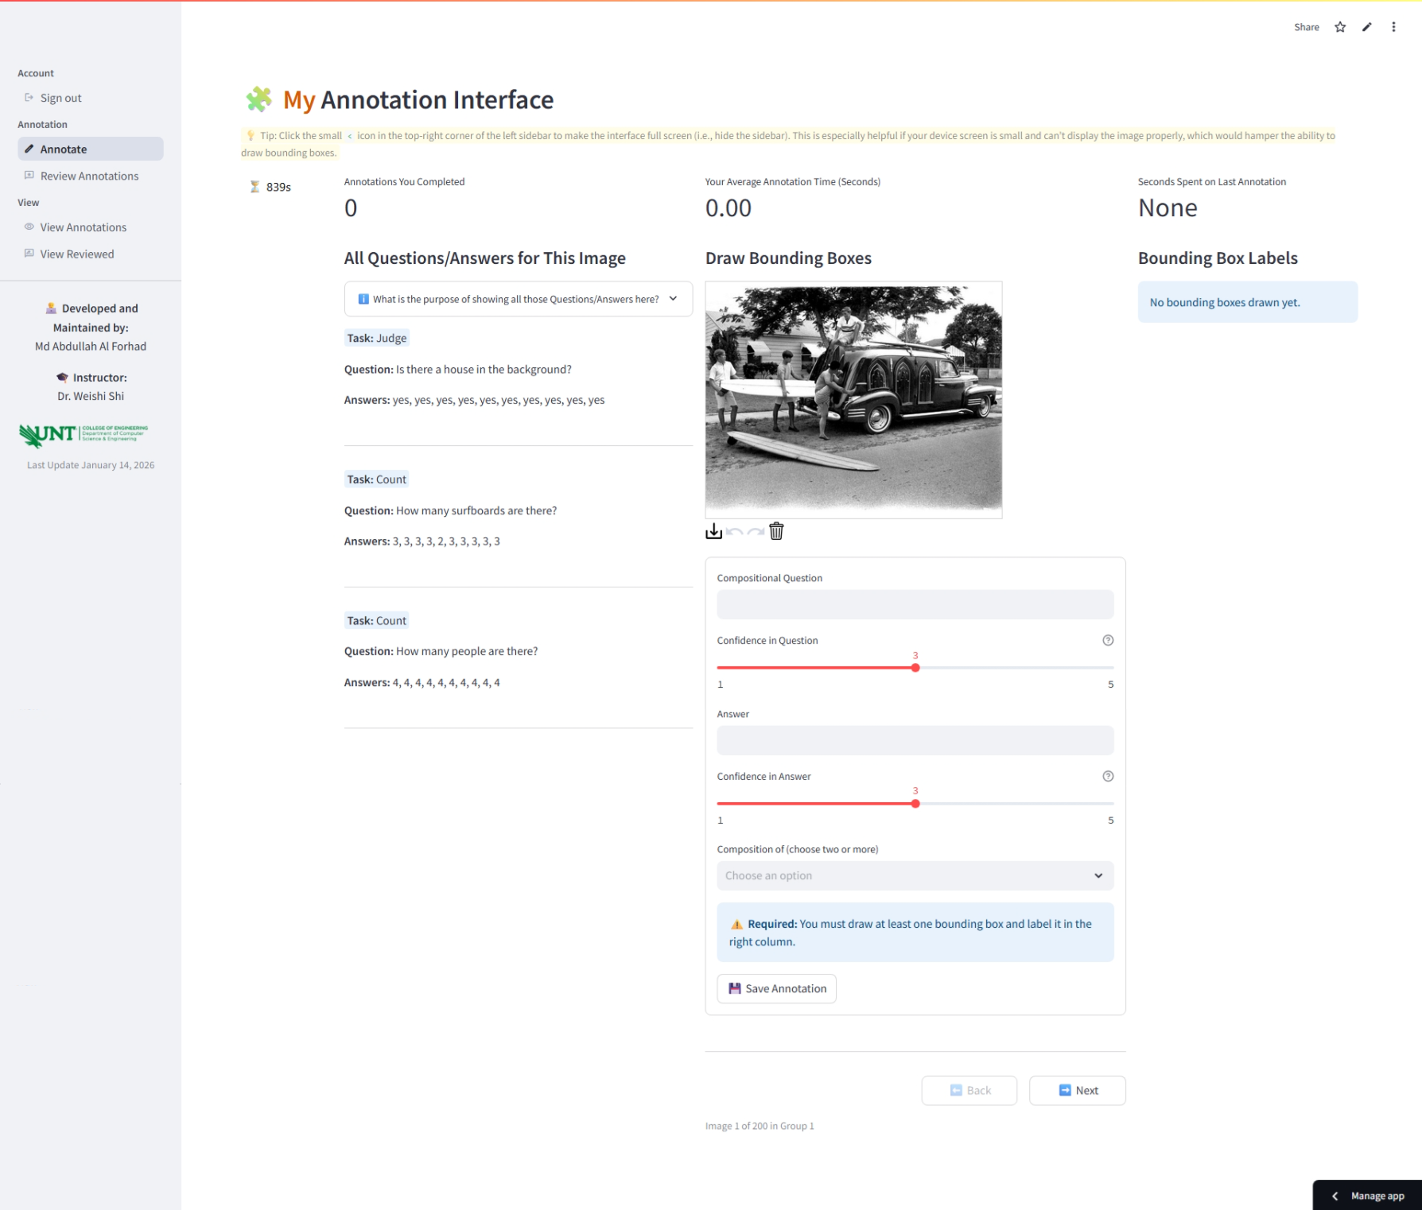
Click the < icon in the top-right corner of the left sidebar to make the interface full screen (i.e., hide the sidebar). This is especially helpful if your device screen is small and can’t display the image properly, which would hamper the ability to draw bounding boxes.
When you draw a bounding box on an image, you are required to assign a label. A label field will appear for each bounding box you create.

Slide 13
Click here to learn the purpose of displaying these QAs.
These are the single task questions available for the image. They are shown to assist you. Do not copy and paste these questions, as you are required to create composed QAs, not single-task QAs.

Slide 14
This is the annotation form. You will need to create a composed question that consists of at least two tasks. Then, select how confident you are that it is a high-quality question. Next, provide an answer and indicate how correct you believe the answer is. You must also select at least two tasks that belong to this question (more than two is allowed). Finally, you need to draw at least one bounding box and label it. The bounding box should highlight the part of the image that others need to focus on to answer the question if they do not see the answer.

Slide 15
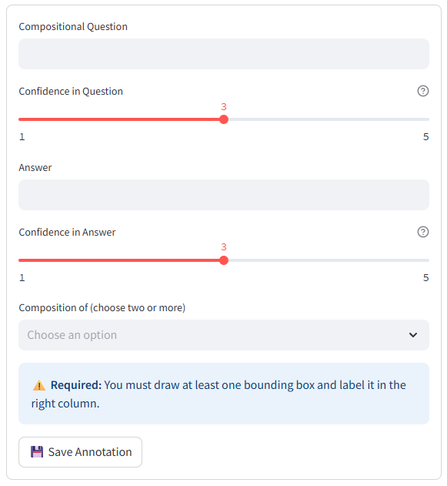
Annotation form
These ratings do not affect your project grade, so ensure you provide them accurately and fairly.
Your annotation and answer quality will be assessed by the professor and TAs, which will be used to determine your grade.

Slide 16
This information is for informational purposes only. There is no need to rush—annotation quality is the priority.
You can submit multiple composed questions for a single image by completing the form and clicking Submit multiple times if you can think of more than one question for that image.
You are assigned 200 unique images, so feel free to skip any image if you feel you cannot come up with composed questions.

Slide 17
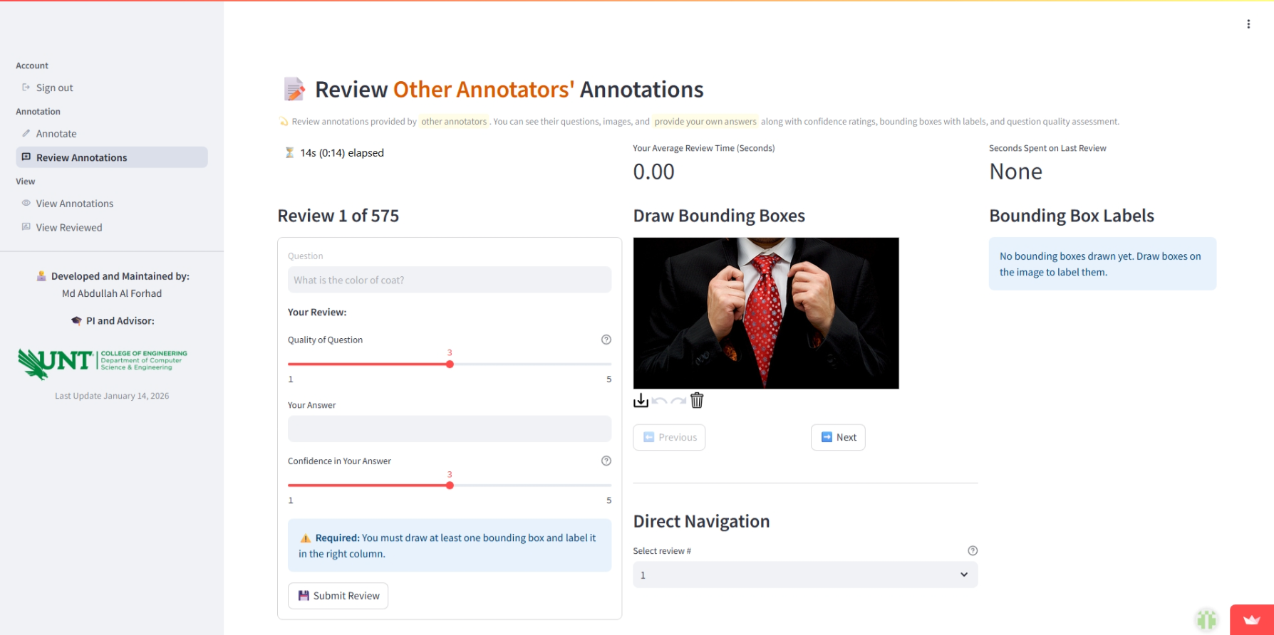
On this page, you will see annotations provided by others, excluding your own.
Question is read only.
You will need to provide an answer and indicate your confidence in its correctness. You should also rate the quality of the question. Additionally, you need to draw a bounding box on the part of the image you used to determine your answer and label it.If you believe multiple answers are possible, you may submit the form multiple times.

Slide 18
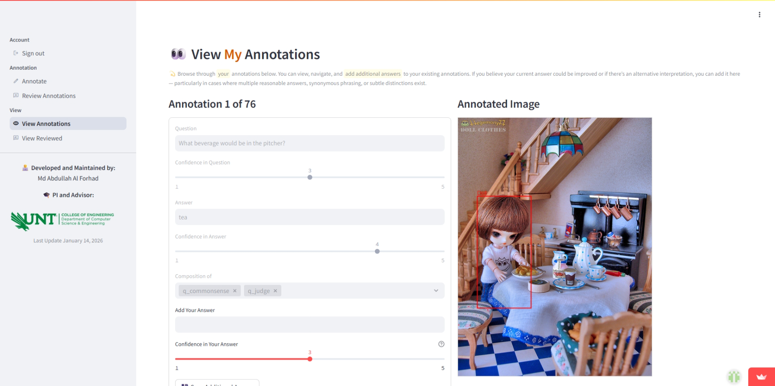
On this page, you will see all the annotations you have completed on the Annotate page. Here, you have the opportunity to submit additional answers to your annotated questions. If you believe your current answer could be improved, or if there is an alternative interpretation, you can add it here — especially in cases where multiple reasonable answers, synonymous phrasing, or subtle distinctions exist.

Slide 19
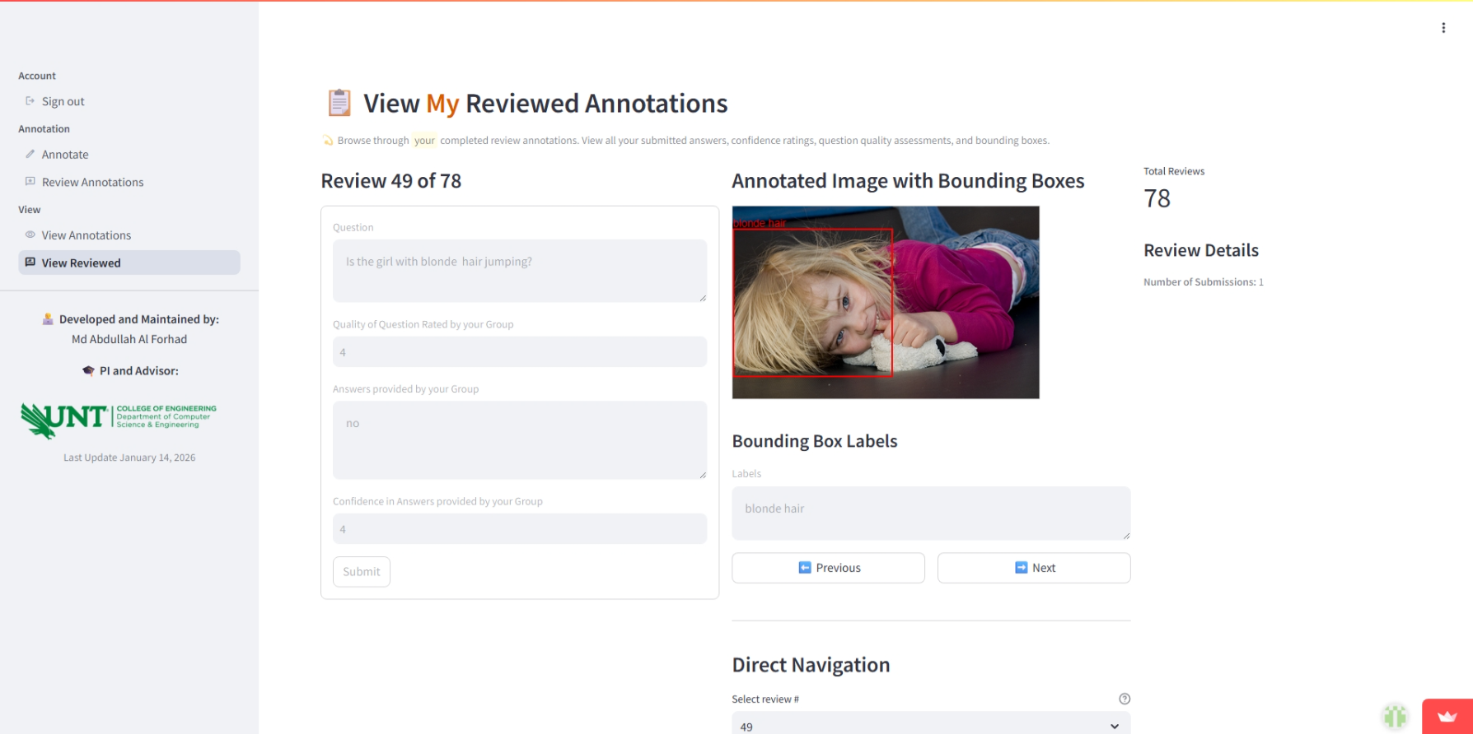
On this page, you will see all the annotations you have reviewed on the Review Annotations page.

Slide 20
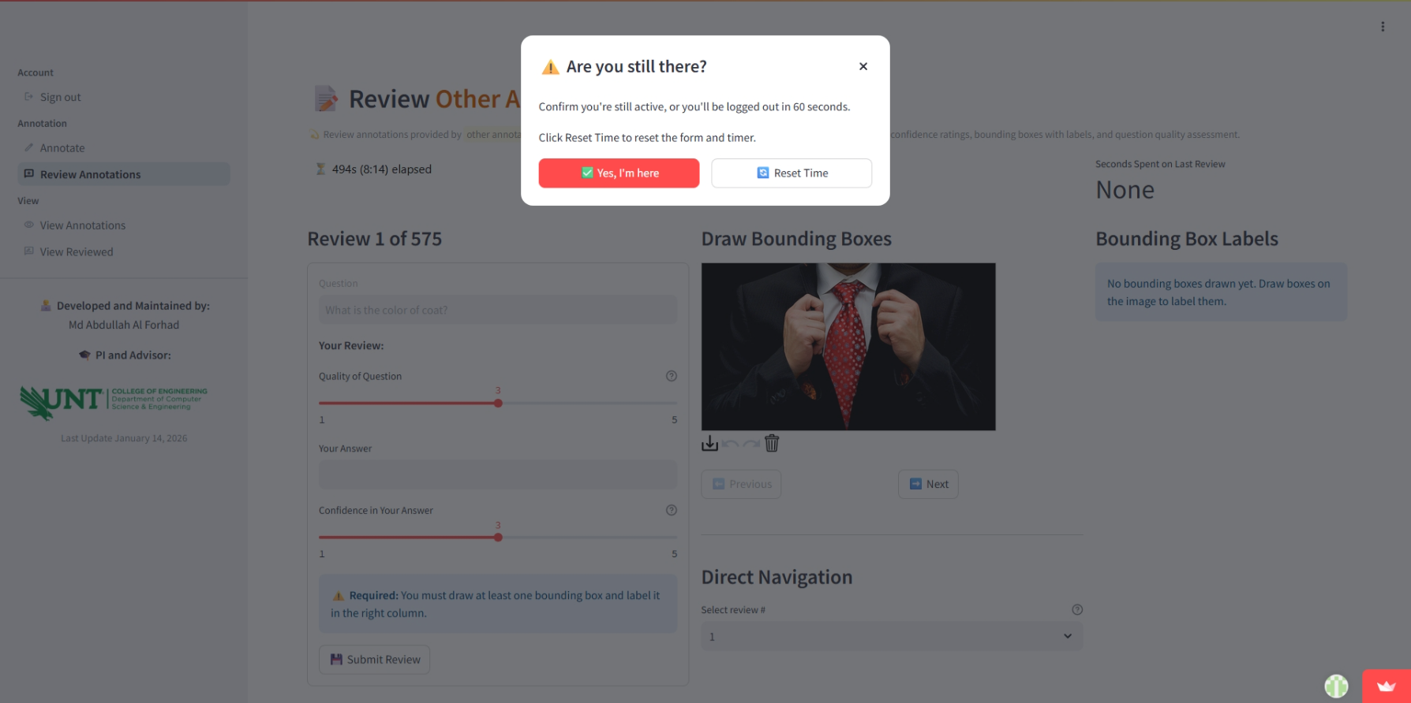
If you are inactive for 7 minutes, this message will appear. If you click “Yes, I’m here,” you can continue with the current timer. If you click “Reset time,” the timer will be set back to zero.
If no action is taken, you will be signed out after 60 seconds.

Slide 21
Questions?
link: https://annotate-nlp.streamlit.app/
Bugs: MdAbdullahAlForhad@my.unt.edu

