Slide 1

In Memory Cluster Computing with Apache Spark Open World Forum - OSDC Sam Bessalah - @samklr

Slide 2
What is Spark?
Fast and expressive cluster computing system compatible with Apache Hadoop
Improves efficiency through:
General execution graphs
In-memory storage
Improves usability through:
Rich APIs in Java, Scala, Python
Interactive shell
Up to 10× faster on disk, 100× in memory
2-5× less code
Notes:
Put high-level distributed collection stuff here?

Slide 3
Key Idea
Write programs in terms of transformations on distributed datasets
Concept: resilient distributed datasets (RDDs)
Collections of objects spread across a cluster
Built through parallel transformations (map, filter, etc)
Automatically rebuilt on failure
Controllable persistence (e.g. caching in RAM)

Slide 4
Operations
Transformations (e.g. map, filter, groupBy)
Lazy operations to build RDDs from other RDDs
Actions (e.g. count, collect, save)
Return a result or write it to storage
Notes:
You write a single program → similar to DryadLINQ
Distributed data sets with parallel operations on them are pretty standard; the new thing is that they can be reused across ops
Variables in the driver program can be used in parallel ops; accumulators useful for sending information back, cached vars are an optimization
Mention cached vars useful for some workloads that won’t be shown here
Mention it’s all designed to be easy to distribute in a fault-tolerant fashion

Slide 5

Example: Log Mining
Load error messages from a log into memory, then interactively search for various patterns
Base RDD
Transformed RDD
Cache 1
lines = spark.textFile(“hdfs://...”)
errors = lines.filter(lambda s: s.startswith(“ERROR”))
messages = errors.map(lambda s: s.split(“\t”)[2])
messages.cache()
Worker
results
tasks
Block 1
Driver
Action
messages.filter(lambda s: “foo” in s).count()
messages.filter(lambda s: “bar” in s).count()
Cache 2
. . .
Worker
Cache 3
Result: full-text search of Wikipedia in 0.5 sec (vs 20 s for on-disk data)
Worker
Block 2
Result: scaled to 1 TB data in 5 sec (vs 180 sec for on-disk data)
Block 3
Notes:
Add “variables” to the “functions” in functional programming

Slide 6
Fault Recovery
RDDs track lineage information that can be used to efficiently recompute lost data
Ex:
msgs = textFile.filter(lambda s: s.startsWith(“ERROR”))
.map(lambda s: s.split(“\t”)[2])
HDFS File
Filtered RDD
Mapped RDD
filter (func = _.contains(...))
map (func = _.split(...))

Slide 7
Behavior with Less RAM

Slide 8
Supported languages
Standalone programs can be written in Scala , Java or Python, but interactive shell is only Python(Ipython) & Scala (scala REPL/Shell)
Performance: Java & Scala are faster due to static typing, but Python is often fine

Slide 9
Learning Spark
Easiest way: the shell (spark-shell or pyspark)
Special Scala / Python interpreters for cluster use
Runs in local mode on 1 core by default, but can control with MASTER environment var:
MASTER=local ./spark-shell # local, 1 thread MASTER=local[2] ./spark-shell # local, 2 threads MASTER=spark://host:port ./spark-shell # cluster

Slide 10
First Stop: SparkContext
Main entry point to Spark functionality
Available in shell as variable
val sc = new SparkContext("hdfs://...")
In standalone programs, you’d make your own (see later for details)

Slide 11
Creating RDDs
# Turn a Python collection into an RDD
sc.parallelize([1, 2, 3])
# Load text file from local FS, HDFS, or S3
sc.textFile(“file.txt”)
sc.textFile(“directory/*.txt”)
sc.textFile(“hdfs://namenode:9000/path/file”)
# Use existing Hadoop InputFormat (Java/Scala only)
sc.hadoopFile(keyClass, valClass, inputFmt, conf)

Slide 12
Basic Transformations
nums = sc.parallelize([1, 2, 3])
# Pass each element through a function
squares = nums.map(lambda x: x*x) // {1, 4, 9}
# Keep elements passing a predicate
even = squares.filter(lambda x: x % 2 == 0) // {4}
# Map each element to zero or more others
nums.flatMap(lambda x: => range(x)) # => {0, 0, 1, 0, 1, 2}
Range object (sequence of numbers 0, 1, …, x-1)
Notes:
All lazy

Slide 13
Basic Actions
nums = sc.parallelize([1, 2, 3])
# Retrieve RDD contents as a local collection
nums.collect() # => [1, 2, 3]
# Return first K elements
nums.take(2) # => [1, 2]
# Count number of elements
nums.count() # => 3
# Merge elements with an associative function nums.reduce(lambda x, y: x + y) # => 6
# Write elements to a text file nums.saveAsTextFile(“hdfs://file.txt”)
Notes:
Launch computations

Slide 14
Some Key-Value Operations
pets = sc.parallelize( [(“cat”, 1), (“dog”, 1), (“cat”, 2)])
pets.reduceByKey(lambda x, y: x + y) # => {(cat, 3), (dog, 1)}
pets.groupByKey() # => {(cat, [1, 2]), (dog, [1])}
pets.sortByKey() # => {(cat, 1), (cat, 2), (dog, 1)}
reduceByKey also automatically implements combiners on the map side

Slide 15
Example: Word Count
lines = sc.textFile(“hamlet.txt”)
counts = lines.flatMap(line => line.split(“ ”)) .map(word => (word, 1)) .reduceByKey(_ + _)
“to” “be” “or”
(to, 1) (be, 1) (or, 1)
(be, 2) (not, 1)
“to be or”
“not” “to” “be”
(not, 1) (to, 1) (be, 1)
(or, 1)
(to, 2)
“not to be”

Slide 16
Other Key-Value Operations
visits = sc.parallelize([ (“index.html”, “1.2.3.4”), (“about.html”, “3.4.5.6”), (“index.html”, “1.3.3.1”) ])
pageNames = sc.parallelize([ (“index.html”, “Home”), (“about.html”, “About”) ])
visits.join(pageNames) # (“index.html”, (“1.2.3.4”, “Home”)) # (“index.html”, (“1.3.3.1”, “Home”)) # (“about.html”, (“3.4.5.6”, “About”))
visits.cogroup(pageNames) # (“index.html”, ([“1.2.3.4”, “1.3.3.1”], [“Home”])) # (“about.html”, ([“3.4.5.6”], [“About”]))

Slide 17
Other RDD Operators
map
filter
groupBy
sort
union
join
leftOuterJoin
rightOuterJoin
reduce
count
fold
reduceByKey
groupByKey
cogroup
cross
zip
sample
take
first
partitionBy
mapWith
pipe
save
...
More details: http://spark.incubator.apache.org/docs/latest/

Slide 18
Software Components
Spark runs as a library in your program (1 instance per app)
Runs tasks locally or on cluster
Mesos, YARN or standalone mode
Accesses storage systems via Hadoop InputFormat API
Can use HBase, HDFS, S3, …
Your application
SparkContext
Cluster manager
Local threads
Worker
Worker
Spark executor
Spark executor
HDFS or other storage

Slide 19
Task Scheduler
General task graphs
Automatically pipelines functions
Data locality aware
Partitioning aware to avoid shuffles
B:
A:
F:
Stage 1
groupBy
C:
D:
E:
join
Stage 2
map
filter
Stage 3
= RDD
= cached partition
Notes:
NOT a modified version of Hadoop

Slide 20
Advanced Features
Controllable partitioning
Speed up joins against a dataset
Controllable storage formats
Keep data serialized for efficiency, replicate to multiple nodes, cache on disk
Shared variables: broadcasts, accumulators
See online docs for details!

Slide 21
Getting Started
Download Spark: spark-project.org/downloads
Documentation and video tutorials: www.spark-project.org/documentation
Several ways to run:
Local mode (just need Java), EC2, private clusters

Slide 22
Cluster Execution
Easiest way to start is EC2:
Local Mode
Several options for private clusters:
Standalone mode (similar to Hadoop’s deploy scripts)
Mesos
Hadoop YARN
Amazon EMR: tinyurl.com/spark-emr

Slide 23
Example: PageRank
Good example of a more complex algorithm
Multiple stages of map & reduce
Benefits from Spark’s in-memory caching
Multiple iterations over the same data

Slide 24

Basic Idea
Give pages ranks (scores) based on links to them
Links from many pages ➔ high rank
Link from a high-rank page ➔ high rank
Image: en.wikipedia.org/wiki/File:PageRank-hi-res-2.png

Slide 25
Scala Implementation
val sc = new SparkContext(“local”, “PageRank”, sparkHome, Seq(“pagerank.jar”)) val links = // load RDD of (url, neighbors) pairs
var ranks = // load RDD of (url, rank) pairs
for (i <- 1 to ITERATIONS) {
val contribs = links.join(ranks).flatMap {
case (url, (links, rank)) =>
links.map(dest => (dest, rank/links.size))
} ranks = contribs.reduceByKey(_ + _) .mapValues(0.15 + 0.85 * _)
} ranks.saveAsTextFile(...)

Slide 26
PageRank Performance
Notes:
54 GB Wikipedia dataset

Slide 27
Other Iterative Algorithms
Time per Iteration (s)
Notes:
100 GB datasets

Slide 28
SHARK
Hive (SQL) queries on SPARK

Slide 29
Apache Hive
Puts structure/schema onto HDFS data
Compiles HiveQL queries into MapReduce jobs
Initially developed by Facebook
Very popular: 90+% of Facebook Hadoop jobs generated by Hive

Slide 30
Scalability
Massive scale out and fault tolerance capabilities on commodity hardware
Can handle petabytes of data
Easy to provision (because of scale-out)

Slide 31
But slow…
Takes 20+ seconds even for simple queries
"A good day is when I can run 6 Hive queries” - @mtraverso

Slide 32
Shark
Analytic query engine compatible with Hive
Supports Hive QL, UDFs, SerDes, scripts, types
A few esoteric features not yet supported
Makes Hive queries run much faster
Builds on top of Spark, a fast compute engine
Allows (optionally) caching data in a cluster’s memory
Various other performance optimizations
Integrates with Spark for machine learning ops

Slide 33
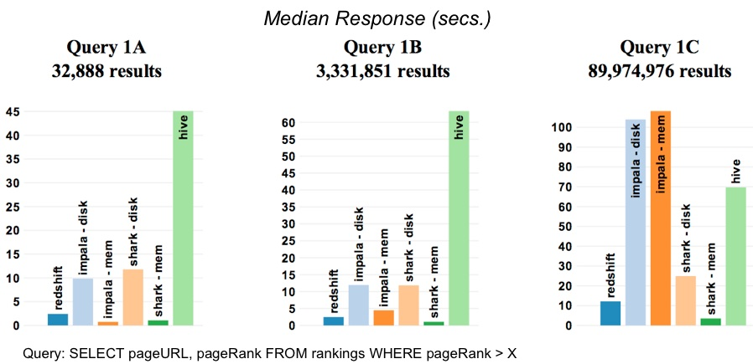
How Fast
Query on

Slide 34
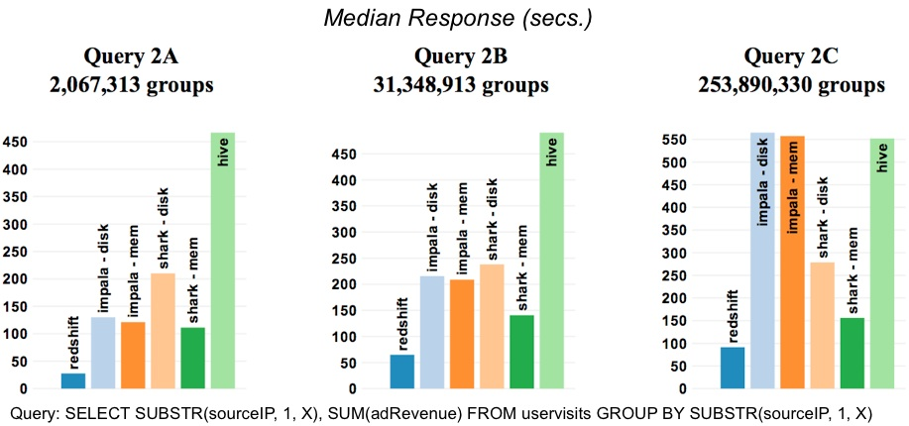
Aggregation

Slide 35
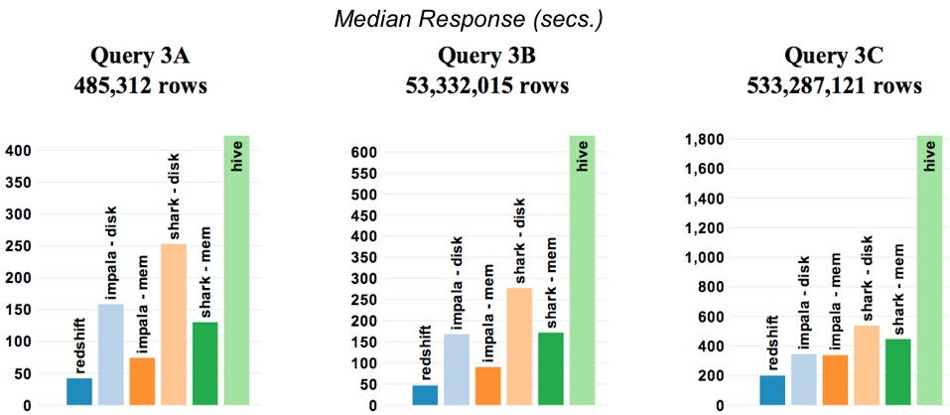
Joins

Slide 36
Data Types
Primitive types
TINYINT, SMALLINT, INT, BIGINT
BOOLEAN
FLOAT, DOUBLE
STRING
TIMESTAMP
Complex types
Structs: STRUCT {a INT; b INT}
Arrays: ['a', 'b', 'c’]
Maps (key-value pairs): M['key’]

Slide 37
Hive QL
Subset of SQL
Projection, selection
Group-by and aggregations
Sort by and order by
Joins
Sub-queries, unions
Hive-specific
Supports custom map/reduce scripts (TRANSFORM)
Hints for performance optimizations

Slide 38
Under the hood
A better execution engine
Hadoop MR is ill-suited for SQL (Look at Impala, Tez …)
Optimized storage format
Columnar memory store
Various other optimizations
Fully distributed sort, data co-partitioning, partition pruning, etc

Slide 39
Hive Architecture

Slide 40
Shark Architecture

Slide 41
SELECT
page_name,
sum(page_views) hits
FROM wikistats_cached
WHERE
page_name like "%berkeley%”
GROUP BY page_name
ORDER BY hits;

Slide 42


select page_name, sum(page_views) hits
from wikistats_cached
where page_name like "%berkeley%”
group by page_name order by hits;
filter (map)
groupby
sort

Slide 43
Columnar Memory Store
Column-oriented storage for in-memory tables
Yahoo! contributed CPU-efficient compression (e.g. dictionary encoding, run-length encoding)
3 – 20X reduction in data size

Slide 44
Ongoing Work
Code generation for query plan (Intel)
BlinkDB integration (UCB)
Bloom-filter based pruning (Yahoo!)
More intelligent optimizer (UCB & Yahoo! & ClearStory & OSU)

Slide 45
More Information
Hive resources:
https://cwiki.apache.org/confluence/display/Hive/GettingStarted
http://hive.apache.org/docs/
Shark resources:
http://shark.cs.berkeley.edu
https://github.com/amplab/shark

Slide 46
Spark Streaming
- Extends Spark capabilities to large scale stream processing.
- Scales to 100s of nodes and achieves second scale latencies
-Efficient and fault-tolerant stateful stream processing
- Simple batch-like API for implementing complex algorithms

Slide 47
Stateful Stream Processing
- Traditional streaming systems have a record-at-a-time processing model
- Each node has mutable state
- For each record, update state and send new records
- State is lost if node dies!
- Making stateful stream processing be fault-tolerant is challenging
Notes:
Traditional streaming systems have what we call a “record-at-a-time” processing model. Each node in the cluster processing a stream has a mutable state. As records arrive one at a time, the mutable state is updated, and a new generated record is pushed to downstream nodes. Now making this mutable state fault-tolerant is hard.

Slide 48
Discretized Stream Processing
live data stream
Spark
Streaming
Chop up the live stream into batches of X seconds
Spark treats each batch of data as RDDs and processes them using RDD operations
Finally, the processed results of the RDD operations are returned in batches
batches of X seconds
Spark
processed results

Slide 49
Discretized Stream Processing
live data stream
Spark
Streaming
Batch sizes as low as ½ second, latency of about 1 second
Potential for combining batch processing and streaming processing in the same system
batches of X seconds
Spark
processed results

Slide 50
Example – Get hashtags from Twitter
val tweets = ssc.twitterStream()
DStream: a sequence of RDDs representing a stream of data
Twitter Streaming API
batch @ t+1
batch @ t
batch @ t+2
tweets DStream
stored in memory as an RDD (immutable, distributed)

Slide 51
Example – Get hashtags from Twitter
val tweets = ssc.twitterStream()
val hashTags = tweets.flatMap (status => getTags(status))
new DStream
transformation: modify data in one DStream to create another DStream
batch @ t
batch @ t+1
batch @ t+2
tweets DStream
flatMap
flatMap
flatMap
hashTags Dstream
[#cat, #dog, … ]
new RDDs created for every batch
…

Slide 52
Example – Get hashtags from Twitter
val tweets = ssc.twitterStream()
val hashTags = tweets.flatMap (status => getTags(status))
hashTags.foreach(hashTagRDD => { ... })
foreach: do whatever you want with the processed data
batch @ t
batch @ t+1
batch @ t+2
tweets DStream
flatMap
flatMap
flatMap
hashTags DStream
foreach
foreach
foreach
Write to database, update analytics UI, do whatever you want

Slide 53

Example – Get hashtags from Twitter
val tweets = ssc.twitterStream()
val hashTags = tweets.flatMap (status => getTags(status))
hashTags.saveAsHadoopFiles("hdfs://...")
output operation: to push data to external storage
batch @ t
batch @ t+1
batch @ t+2
tweets DStream
flatMap
flatMap
flatMap
hashTags DStream
save
save
save
every batch saved to HDFS

Slide 54
Window-based Transformations
val tweets = ssc.twitterStream()
val hashTags = tweets.flatMap (status => getTags(status))
val tagCounts = hashTags.window(Minutes(1), Seconds(5)).countByValue()
sliding window operation
window length
sliding interval
window length
DStream of data
sliding interval

Slide 55
DStream Input Sources
Out of the box we provide
Kafka
HDFS
Flume
Akka Actors
Raw TCP sockets
Very easy to write a receiver for your own data source

Slide 56
Comparison with Storm and S4
- Spark Streaming: 670k records/second/node
- Storm: 115k records/second/node
- Apache S4: 7.5k records/second/node
Notes:
Streaming Spark offers similar speed while providing FT and consistency guarantees that these systems lack

Slide 57
One stack for different type of analysis
Ad-hoc Queries
Batch Processing
Stream Processing
Spark
+
Shark
+
Spark
Streaming

Slide 58
One stack for different type of analysis
Ad-hoc Queries
Batch Processing
Stream Processing
Spark
+
Shark
+
Spark
Streaming
MLBASE

Slide 59
One stack for different type of analysis
Ad-hoc Queries
Batch Processing
Stream Processing
Spark
+
Shark
+
Spark
Streaming
GraphX
MLBASE

Slide 60
One stack for different type of analysis
Ad-hoc Queries
Batch Processing
Stream Processing
Spark
+
Shark
+
Spark
Streaming
GraphX
MLBASE
TACHYON
BLINK DB

Slide 61
Current Status
Currently in the apache incubator
Recently shipped version 0.8 with contributions from 40+ contributors.
Focus on tools and performance.
Key contributions from Yahoo, Intel, ClearStory ….
http://spark.incubator.apache.org

Slide 63
Conclusion
Spark offers a rich API to make data analytics fast: both fast to write and fast to run
Achieves 100x speedups in real applications
Growing community with 20+ companies contributing
www.spark-project.org

