Slide 1
ADITYBot
Using Google’s Api.ai Project Associates
B.Aruna Kumari(14A91A12143)
M. Kiran Kumar(14A91A1219)
P.KeerthiSarika(14A91A1225)
Project Guide K.Roopa Lavanay(14A91A1210) Mr. A.Kalyan Chakravarthi M.Tech
Assistant professor
Information Technology Department

Slide 2
Introduction
Api.ai (formerly Speaktoit) is a developer of human–computer interaction technologies based on natural language conversations. The company is best known for creating the Assistant (by Speaktoit).
The process an API.AI agent follows from invocation to fulfilment is similar to someone answering a question, with some liberties taken of course.

Slide 3
EXISTING System
If user need any information about Infrastructure and any other information related college fees, about placements, faculty, department and other similar information about this college, We need to contact with the college management.
Disadvantages:
They may not get the information about the college by contacting only one person.

Slide 4
PRPOSED SYSTEM
The user can simply login with the messenger which we are integrated, contact with the Bot, and then they’ll ask any information about this college.
Advantage:-
By using this bot user can save his/her time. No need to contact with any management.
Response in Fraction of Seconds.

Slide 5
Modules
Used For Creating the Bot:
Agent
Intent
Try it out
Training
Json
User Interface
WebDemo(One-click Integration)

Slide 6
Creating bot & training
Create an Agent
Create an Intent
Train the Bot
JSON data

Slide 7
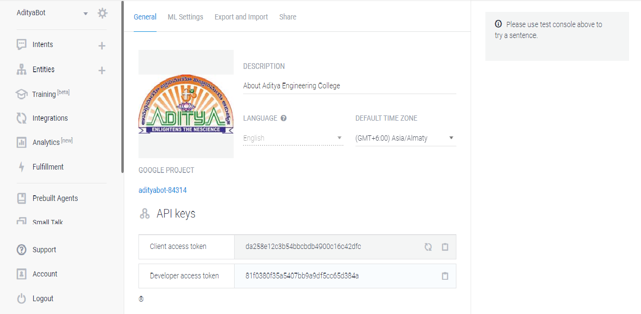
Create an agent

Slide 8
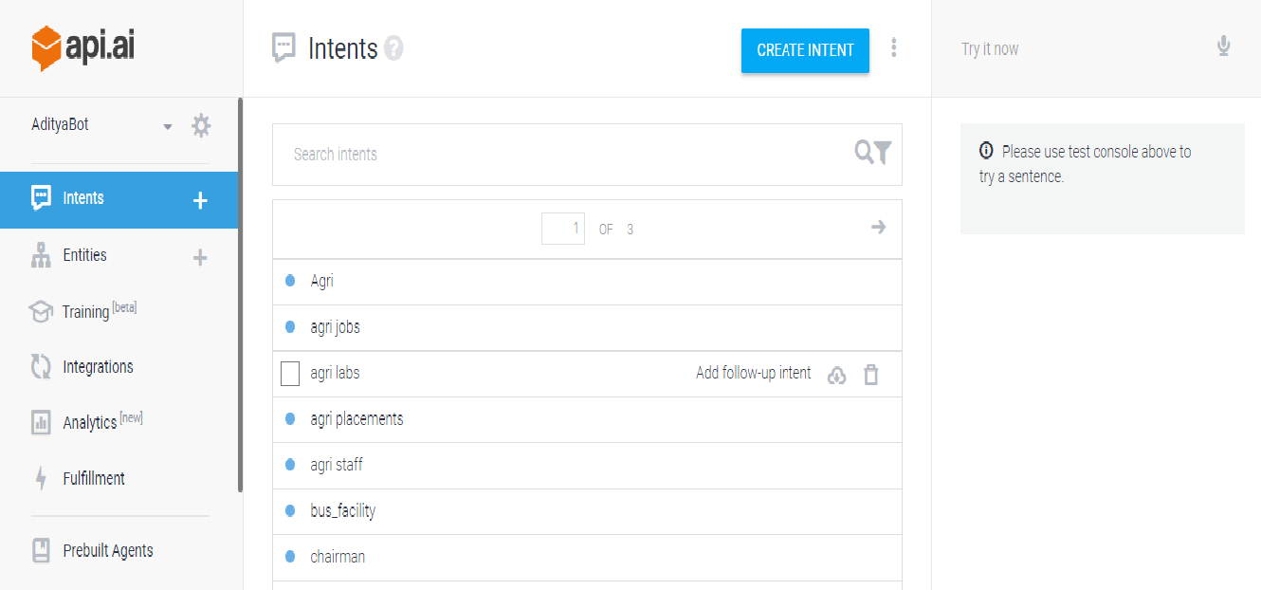
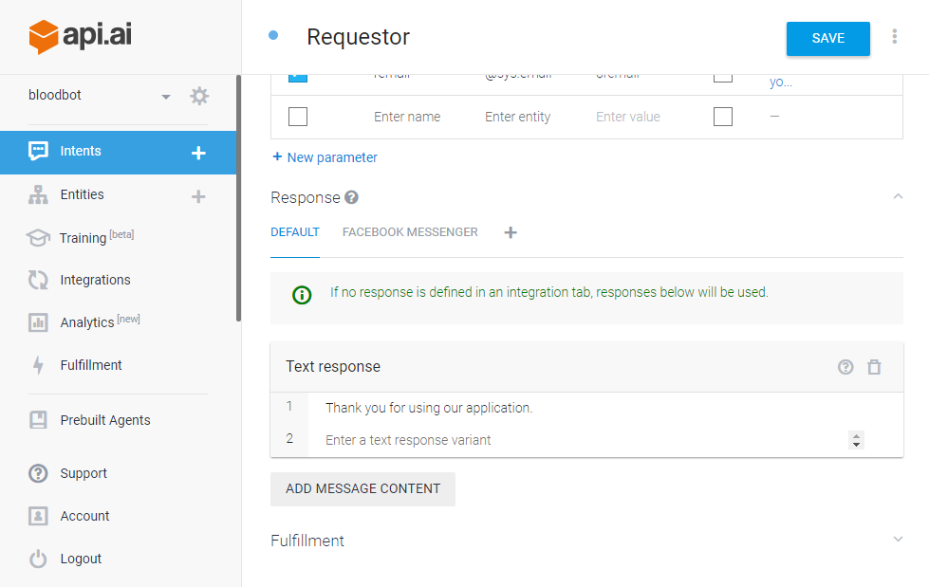
intents

Slide 9
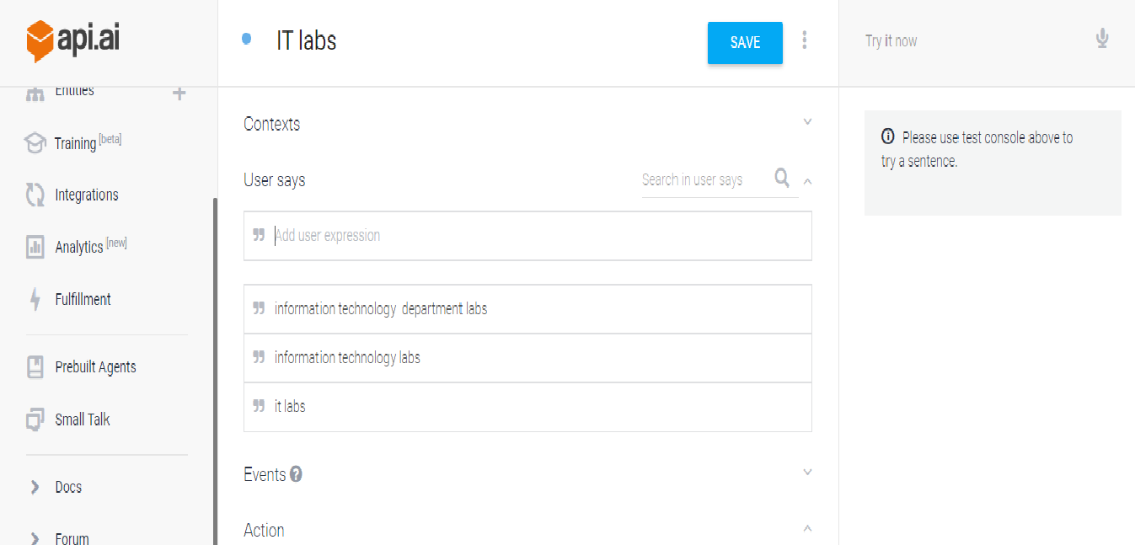
User expressions

Slide 10
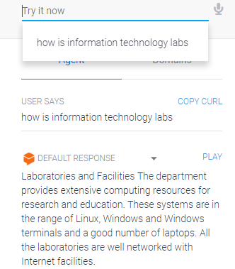
Try it out

Slide 11
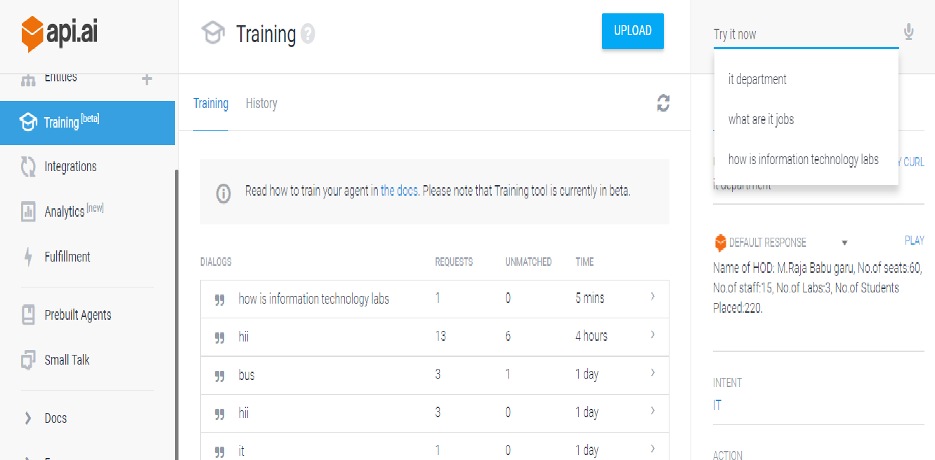
training

Slide 12
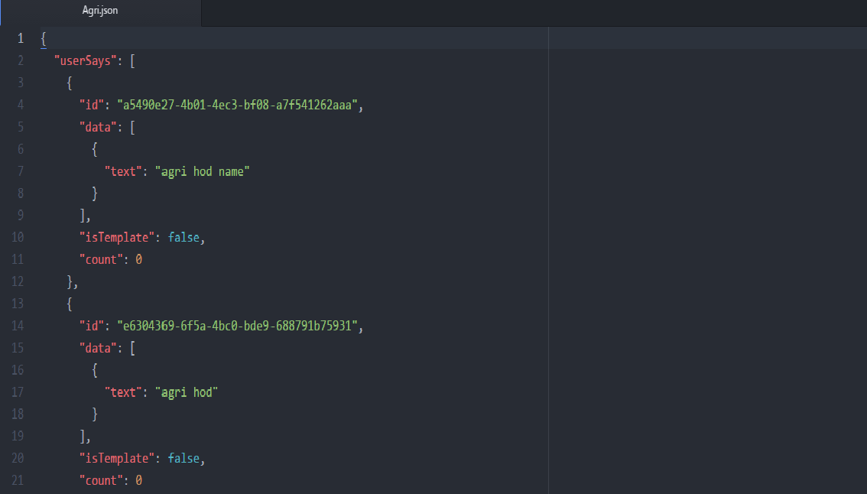
json

Slide 13
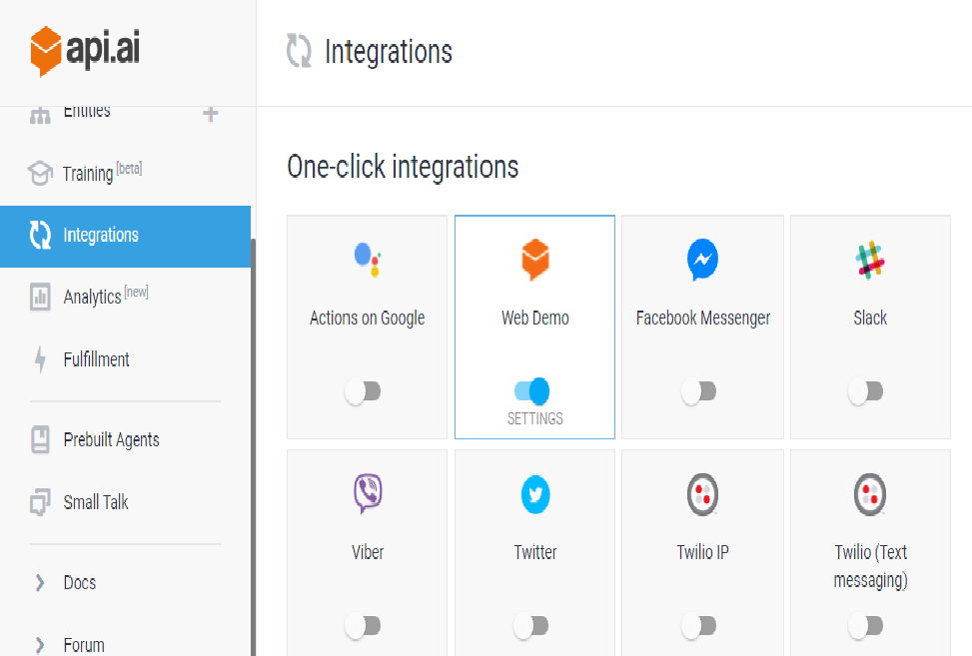
Integration

Slide 14
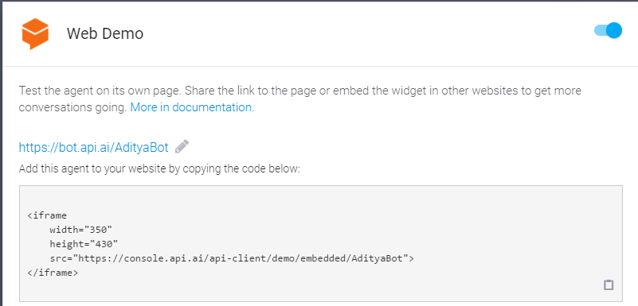
Webdemo Integration
Now go to Api.ai and click integration
Change the URL by adding your bot name
Start the bot

Slide 15
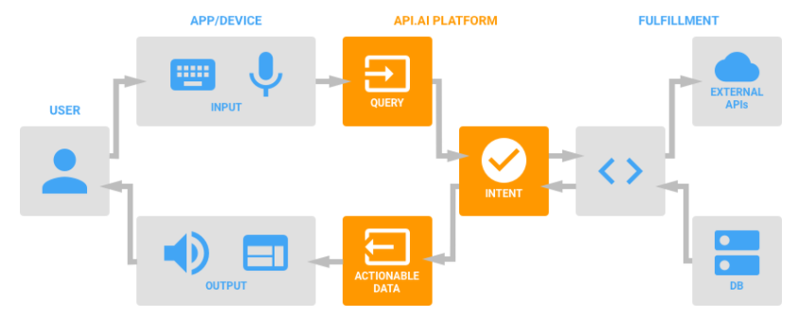
Block Diagram

Slide 16
conclusion
The main objective of this Bot is to provide the services to the user by giving the related information of our college in stipulated time.

Slide 17


