Slide 1
Academic​ ​Advisor​ ​Chatbot
Using IBM Watson
P.Srinivasarao
M.kiran Kumar
Syed Amaan Ali
Hidayathulla Baig

Slide 2
contents
Creating the Bot
Workspace
Entity
Intent
Try it out
User Interface
Slack

Slide 3
Creating bot
Watson is a question answering computer system capable of answering questions posed in natural language,developed in IBM's DeepQA project by a research team led by principal investigator David Ferrucci.Watson was named after IBM's first CEO, industrialist Thomas J. Watson.
Create an workspace
Create an Intents
Create an Entity

Slide 4
Create Workspace
The natural-language processing for the Conversation service happens inside a workspace, which is a container for all of the artifacts that define the conversation flow for an application.
A single Conversation service instance can contain multiple workspaces. A workspace contains the following types of artifacts:

Slide 5
Intents
An intent represents the purpose of a user's input, such as a question about business locations or a bill payment. You define an intent for each type of user request you want your application to support.

Slide 6
entities
An entity represents a term or object that is relevant to your intents and that provides a specific context for an intent.
Entities are of two types
System Entities
User Defined Entities

Slide 7
dialogs
A dialog is a branching conversation flow that defines how your application responds when it recognizes the defined intents and entities.
You use the dialog builder in the tool to create conversations with users, providing responses based on the intents and entities that you recognize in their input.

Slide 8
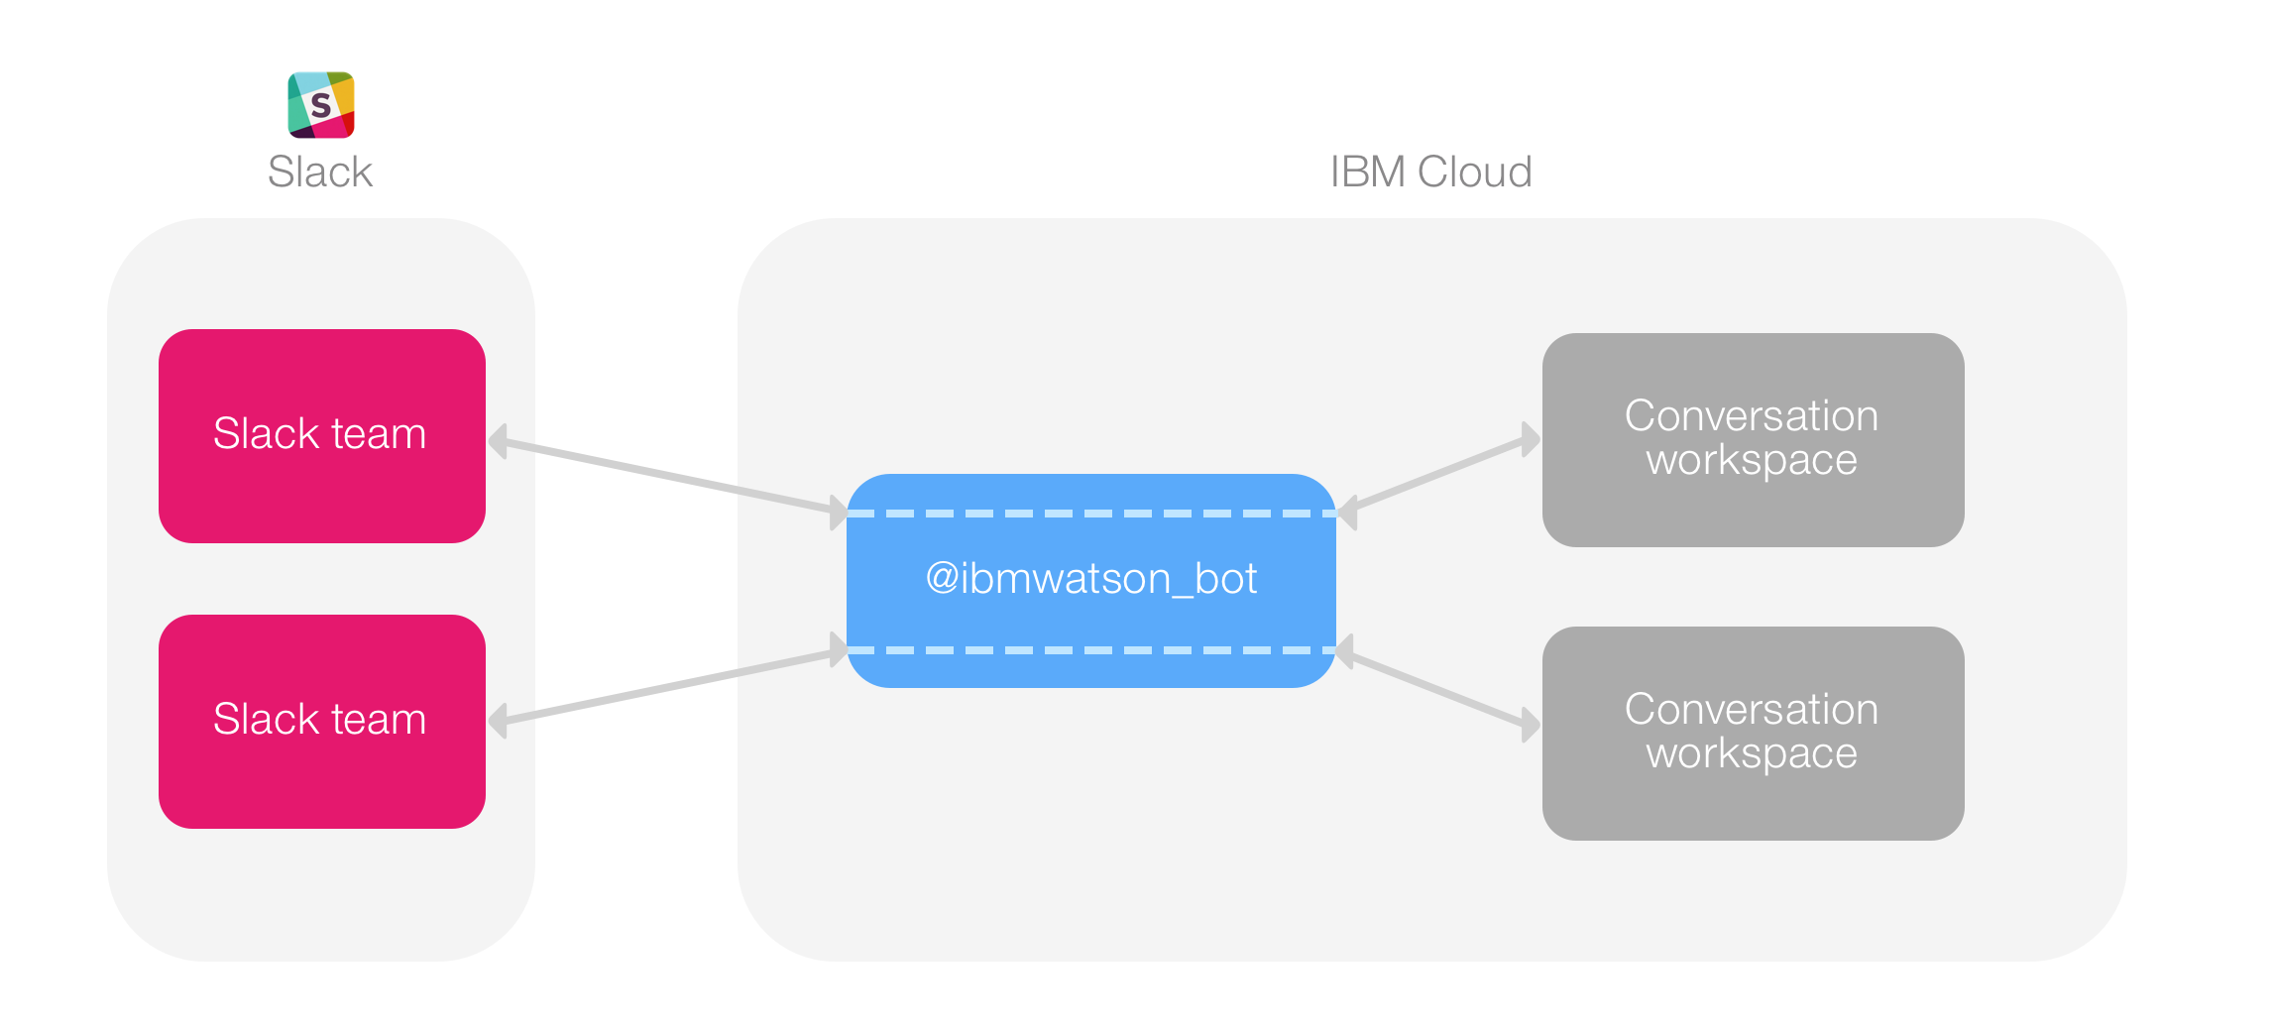
slack Integration
The test deployment tool uses the IBM® Cloud Functions service to deploy a prebuilt Slack application to your team as a bot user. This application handles communication with your Conversation workspaces.
Start the bot.

Slide 9
THANK
YOU

