Slide 1
Core Concepts
Java(Coffee Bean Name) by James Gosling
Initial Version Name(OAK- Tree name)
Implemented by Sun Micro-Systems
Currently Owned by Oracle

Slide 2
Java 3 Categories
J2SE is basically used for developing client side applications/programs(uses http protocol).
J2EE is used for developing server side applications/programs(uses http protocol).
J2ME is used for developing server side applications/programs(WAP protocol).
If you exchange the data between client and server programs (J2SE and J2EE), by default JAVA is having on internal support with a protocol called http.
J2ME is used for developing mobile applications. To develop J2ME applications we must use a protocol called WAP (Wireless Applications Protocol).

Slide 3
Features of Java
Simple
Platform independent
Architectural neutral
Portable
Multi threading
Distributed
Networked
Robust
Dynamic
Secured
High performance
Interpreted
Object Oriented Programming Language

Slide 4
1. Simple
JAVA is free from pointers hence we can achieve less development time and less execution time [whenever we write a JAVA program we write without pointers and internally it is converted into the equivalent pointer program].
Rich set of API (application protocol interface) is available to develop any complex application.
The software JAVA contains a program called garbage collector which is always used to collect unreferenced (unused) memory location for improving performance of a JAVA program.
JAVA contains user friendly syntax’s for developing JAVA applications.
Take Aways
No Pointers Concept unlike in C/C++
API - https://docs.oracle.com/javase/8/docs/api/
Garbage Collector(GC - To free up memory – Covered in JVM Architecture Diagram)

Slide 5
2. Platform Independent
A program or technology is said to be platform independent if and only if which can run on all available operating systems.
Each Operating system has its own understanding
DOS – Mozart
Unix – Elf(Embedded Linking Format)
When we write a C or C++ program on dos operating and if we try to transfer that program to Unix operating system, we are unable to execute since the format of these operating systems are different and more over the C, C++ software does not contain any special programs which converts one format of one operating system to another format of other operating system
JAVA will have a common data types and the common memory spaces on all operating systems and the JAVA software contains the special programs which converts the format of one operating system to another format of other operating system. Hence JAVA language is treated as platform independent language.
Take Aways
Runs in JVM and independent of Operating system
Windows - JVM(If I install JRE)
Unix – JVM(If I install JRE)
No Special Program required to Convert the Java code
JAVA language is platform independent, server independent, data base/product independent and language independent(English, Japanese, Chinese etc).

Slide 6
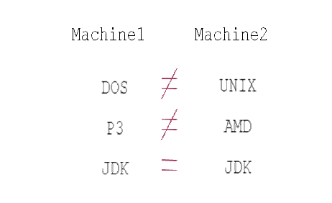
3. Architectural neutral
Architectural neutral which can run on any available processors in the real world
Take Aways
Independent of Processor the code is Running

Slide 7
4. Portable
Portability = Platform Independent + Architectural Neutral
Take Aways
C/C++ - Tightly coupled with Platform and Architecture

Slide 8
5. Multi-Threading
C/C++ - Single Threaded Programming Languages
Java/DOT NET – Multi Threaded Programming Languages
Take Aways
Thread – Is a process with flow
More than one thread operating in a single flow is multi-thread
Each thread carries its won work
Thread follows LifeCycle – Will cover later in detail

Slide 9
6. Distributed
A service is a said to be a distributed service which runs in multiple servers and that service can be accessed by n number of clients across the globe.
Take Aways
Developed by Using J2EE
Used by large scale Organizations

Slide 10
7. Networked
In real world we have two types of networks.
Un-trusted networks(LAN - J2SE)
Trusted networks(WAN- J2EE).
Take Aways
LAN – Java Application Runs in Single Server
Used by Small Organizations
WAN – Java Application Runs in Multiple Servers
Used by Large Scale Organizations

Slide 11
8. Robust
Any technology if it is good at two main areas it is said to be ROBUST
1 Exception Handling
2 Memory Allocation
JAVA is Robust because
JAVA is having very good predefined Exception Handling mechanism whenever we are getting exception we are having meaning full information.
JAVA is having very good memory management system that is Dynamic Memory (at runtime the memory is allocated) Allocation which allocates and deallocates memory for objects at runtime.
Take Aways
Exception Handling
Allocation and Deallocation of Memory at Runtime

Slide 12
9. Dynamic
Java is dynamic technology it follows dynamic memory allocation(at runtime the memory is allocated) and dynamic loading to perform the operations.
Take Aways
Dynamic Allocation of Memory
Dynamic Loading of Classes + Variables + Methods etc

Slide 13
10. Secured
To provide implicit security Java provide one component inside JVM called Security Manager.
Library in the form of java.security.* package.
Web security for web applications we are having JAAS(Java Authentication and Authorization Services) for distributed applications.
Take Aways
JVM will take care of Standalone
For Web Application/Enterprise Applications
Server
JAAS
LDAP/AD etc

Slide 14
11. High Performance
If any technology having features like Robust, Security, Platform Independent, Dynamic and so on then that technology is high performance.
Take Aways
Covered in Previous Slides

Slide 15
12. Interpreted
JAVA tech is both Interpretive and Completive by using Interpreter we are converting source code into byte code and the interpreter is a part of JVM.
Take Aways
Architecture in Next Slide

Slide 16
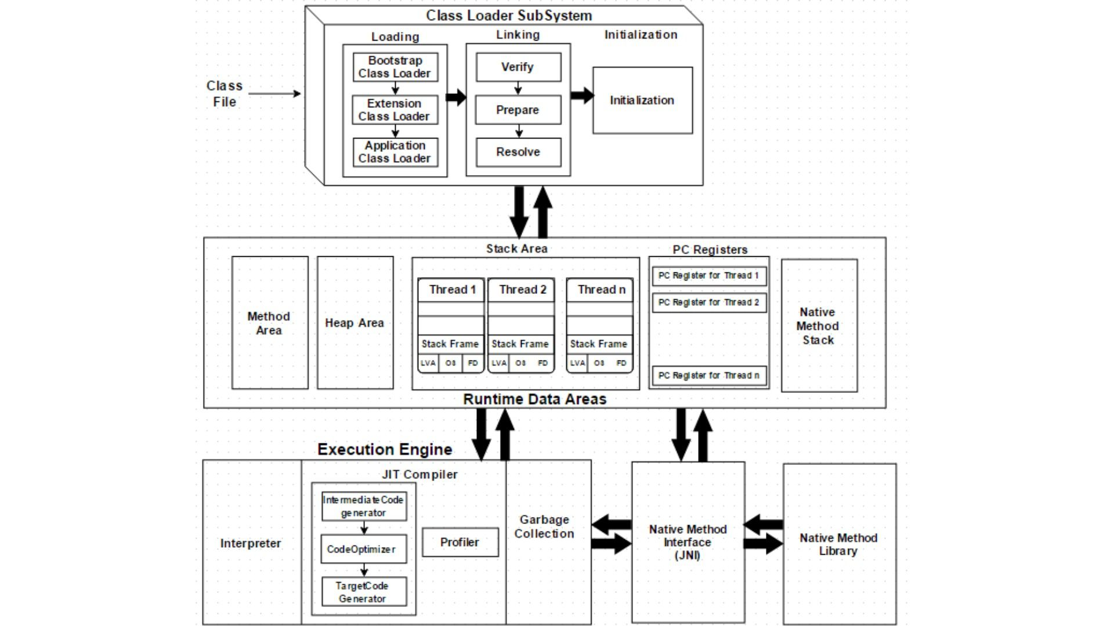
JVM Architecture & Components
JAVA tech is both Interpretive and Completive by using Interpreter we are converting source code into byte code and the interpreter is a part of JVM.
Take Aways
Architecture in Next Slide

Slide 17
13. Object Oriented
Java is object oriented technology because to represent total data in the form of object.
By using object reference we are calling all the methods, variables which is present in that class.
Class Test
{
Test t=new Test();
}
The total java language is dependent on object only hence we can say java is a object oriented technology.
Take Aways
Will write everything inside a Class
Access by using an Object
Object is nothing but an instance of a class
Test - is – Class
t –An Object of Test class
We can create multiple objects to a single class

Slide 18
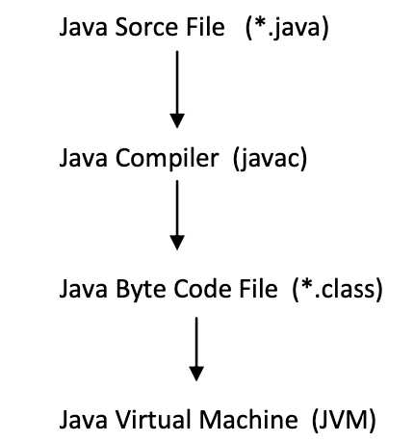
Java Class Execution - Flow

Slide 19
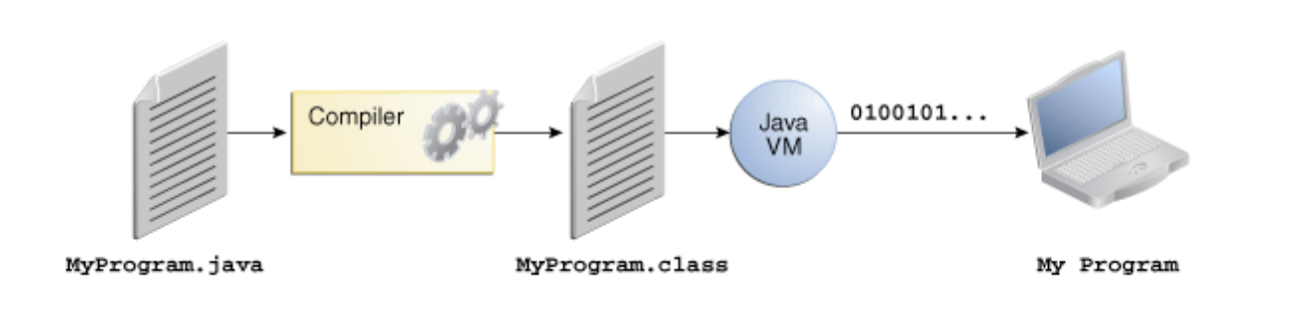
Flow – Contd.

Slide 20
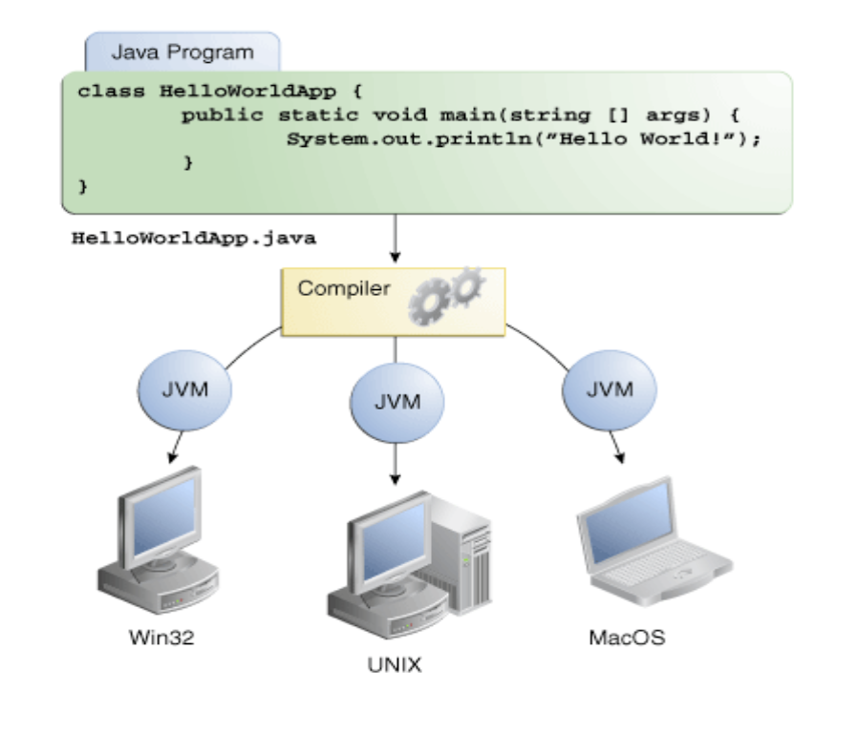
Flow – Contd.

Slide 21
OOPS Principles
Class.
Object.
Data Abstraction.
Data Encapsulation.
Inheritance.
Polymorphism.
Dynamic Binding.
Message Passing.

Slide 22
OOPS Principles - CLASS
A class is a way of binding the data and associated methods in a single unit
Syntax for defining a CLASS:
class <classname> {
Variable declaration;
Methods definition;
};
class is a keyword
Class contains two parts namely variable declaration and method definitions.
Variable declaration represents what type of data members which we use as a part of the class.
Method definition represents the type of methods which we used as the path of the class to perform an operation.
Class names are used for creating objects.

Slide 23
OOPS Principles – CLASS - Contd
In JAVA memory space for the data members will be creating on heap memory (Dynamic memory).
Memory space for methods will be creating on stack memory (that too when we call the methods).
All constants of any JAVA program is available in associative memory (retrieving data from associative memory is negligible).
The class definition exists only one time but whose objects can exists many number of times

Slide 24
OOPS Principles – OBJECT
In order to store the data for the data members of the class, we must create an object.
Instance (instance is a mechanism of allocating sufficient amount of memory space for data members of a class) of a class is known as an object.
Class variable is known as an object.
Grouped item (grouped item is a variable which allows us to store more than one value) is known as an object.
Value form of a class is known as an object.
Blue print of a class is known as an object.
Logical runtime entity is known as an object.
Real world entities are called as objects.
Note:
JAVA always follows dynamic memory allocation but not static memory allocation.
In order to create a memory space in JAVA we must use an operator called new. This new operator is known as dynamic memory allocation operator.

Slide 25
OOPS Principles – OBJECT - Syntax
<Clsname> objname = new <clsname ()>
Clsname represents name of the class.
Objname represents JAVA valid variable name treated as object.
New is called dynamic memory allocation operator.
Clsname () represents constructor.
The new operator will perform two standard actions. They are:
It allocates sufficient amount of memory space for the data members of the class.
It takes an address of the class and stored in the left hand side variable of syntax-1.

Slide 26
OOPS Principles – Data Abstraction
Hiding the internal implementation and highlighting the set of services
Ex:-
a. Bank ATM Screens (Hiding thee internal implementation and highlighting set of services like withdraw, money transfer, mobile registration).
b. Mobile phones (The mobile persons are hiding the internal circuit implementation and highlighting touch screen).
c. Syllabus copy (the institutions persons just highlighting the set of contents that persons provided the persons are not highlighting the whole content).
How we achieve Abstraction in JAVA
Abstract Classes
Interfaces

Slide 27
OOPS Principles – Data Abstraction - Contd
The way of representation the methods are divided into two types
1) Normal methods
2) Abstract methods
1. Normal methods
Normal method is a method which contains declaration as well as implementation.
Ex:-
Void m1()
{
---------
--------body;
---------
}
2. Abstract Methods:
The method which is having declaration but not implementations such type of methods are called abstract Method.
Hence every abstract method should end with “;”.
The child classes are responsible to provide implementation for parent class abstract methods.
Ex: -
void m1 (); ----------abstract method

Slide 28
OOPS Principles – Data Abstraction - Contd
Based on above representation of methods the classes are divided into two types
Normal classes
Normal class is a java class it contains only normal methods.
class Test{
void m1(){
body;}
void m2(){
body;}
void m3(){
Body;}}

Slide 29
OOPS Principles – Data Abstraction - Contd
2. Abstract Classes
Abstract class is a java class which contains at least one abstract method.
To specify the particular class is abstract and particular method is abstract method to the compiler use abstract modifier.
For the abstract classes it is not possible to create an object. Because it contains the unimplemented methods.
For any class if we don’t want instantiation then we have to declare that class as abstract i.e., for abstract classes instantiation (creation of object) is not possible.
Syntax:
Abstract class Test
{
void m1() { body; }
void m2() { body; }
Abstract void m3();
}
class Test
{
Abstract void m1();
Abstract void m2();
Abstract void m3();
}

Slide 30
OOPS Principles – Data Abstraction - Contd
The abstract class contains abstract methods for that abstract methods provide the implementation in child classes.
Example
If the child class is unable to provide the implementation for parent class abstract methods at hat situation we can declare that class is an abstract then take one more child class in that class provide the implementation for remaining method
Example
Note :-
we can take the any number of child classes but we have to provide the implementation for each and every abstract method.
For the abstract methods it is possible to provide any type of return type(void, int, char, Boolean…..)
Example
For the abstract methods it is possible to provide arguments.
Example
The abstract classes is java class it contains zero number of abstract methods. Even though class does not contain any abstract method still we can declare the class as abstract i.e. abstract class can contain zero number of abstract methods. The abstract classes it is not possible to create object.
Example

Slide 31
OOPS Principles – Data Encapsulation
Data encapsulation is the process of wrapping up on data and associated methods in a single unit
Data encapsulation is basically used for achieving data/information hiding i.e., security. - Will use Private Keyword
Encapsulation in Java provides an option of code-reusability.
Using encapsulation will help in making changes to an existing code quickly.
Unit testing a code designed using encapsulation is elementary.
Standard IDEs have the support of getters and setters; this makes coding even faster.
Syntax:
<Access_Modifier> class <Class_Name> {
private <Data_Members>;
private <Data_Methods>;
}
Example Using Setter/Getter for better understanding

Slide 32
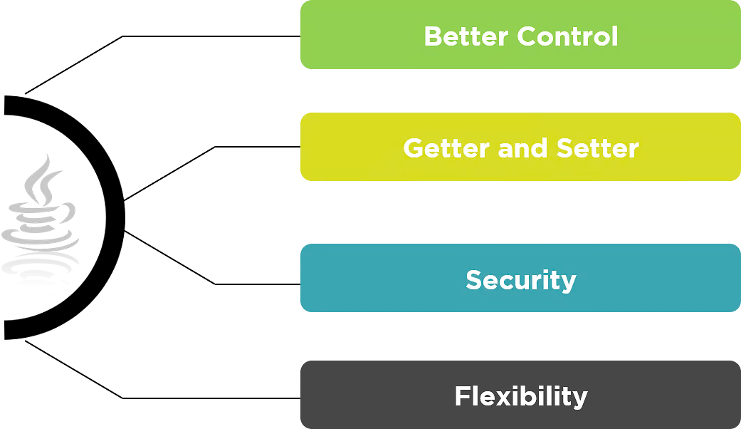
OOPS Principles – Data Encapsulation - Contd

Slide 33
OOPS Principles – Data Encapsulation - Contd
Better Control
Encapsulation provides ultimate control over the data members and data methods inside the class.
Getter and Setter
The standard IDEs provide in-built support for ‘Getter and Setter’ methods, which increases the programming pace.
Security
Encapsulation prevents access to data members and data methods by any external classes. The encapsulation process improves the security of the encapsulated data.
Flexibility
Changes made to one part of the code can be successfully implemented without affecting any other part of the code.

Slide 34
OOPS Principles – Data Hiding
Data hiding is a procedure done to avoid access to the data members and data methods and their logical implementation. Data hiding can be done by using the access specifiers. We have four access specifiers, which are as follows.

Slide 35
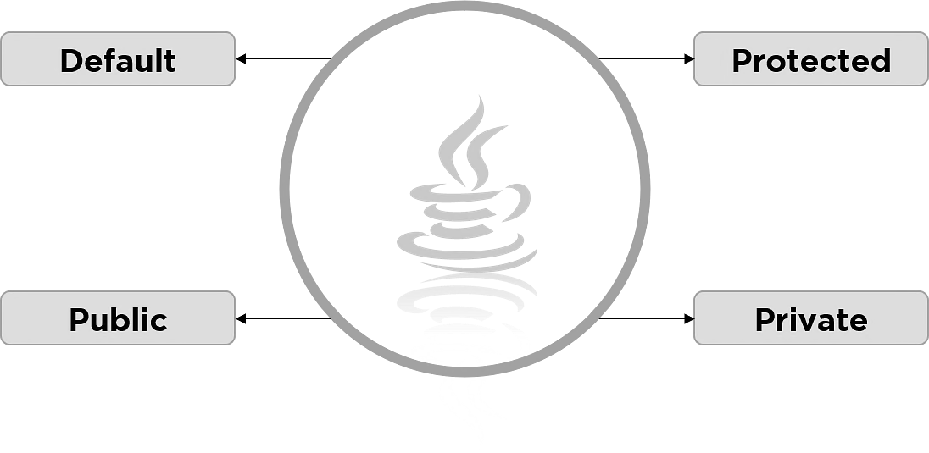
OOPS Principles – Data Hiding

Slide 36
OOPS Principles – Data Hiding - Contd
Default
Default is the first line of data hiding. If any class in Java is not mentioned with an access specifier, then the compiler will set ‘default’ as the access specifier. The access specifications of default are extremely similar to that of the public access specifier.

Slide 37
OOPS Principles – Data Hiding - Contd
Public
The public access specifier provides the access specifications to a class so that it can be accessed from anywhere within the program.
Example

Slide 38
OOPS Principles – Data Hiding - Contd
Private
The private access specifier provides access to the data members, and the data methods limit to the class itself.
Example with Setter/getter

Slide 39
OOPS Principles – Data Hiding - Contd
Protected
The protected access specifier protects the class methods and members similar to the private access specifier. The main difference is that the access is limited to the entire package, unlike only a class with the private access specifier.
Example

Slide 40
Data Hiding vs. Encapsulation in Java
Data Hiding | Data Encapsulation
Data hiding can be considered as the parent process | Encapsulation is a sub-process of data hiding
Access specifier is always private | Access specifier can be private and public
Data hiding is about hiding method implementation | Encapsulation is about combining methods with data members
The main motto is to hide data and its implementation | The main motto is to combine data and their methods

Slide 41
OOPS Principles – Inheritance
Inheritance enables the acquisition of data members and properties from one class to another.
Base Class (Parent Class)
The base class provides the data members and methods in alternative words. Any base class that needs methods or data members will have to borrow them from their respective parent or base class.
Subclass (Child Class)
The subclass is also known as the child class. The implementation of its parent class recreates a new class, which is the child class.
To inherit the parent class, a child class must include a keyword called "extends." The keyword "extends" enables the compiler to understand that the child class derives the functionalities and members of its parent class.
class SubClass extends ParentClass {
//DataMembers;
//Methods;
}

Slide 42
OOPS Principles – Inheritance - Contd
Why Do We Need Inheritance?
The two main reasons we need inheritance include:
Run-Time Polymorphism
Runtime, also known as dynamic polymorphism, is a method call in the execution process that overrides a different method in the run time.
Code Reusability
The process of inheritance involves reusing the methods and data members defined in the parent class. Inheritance eliminates the need to write the same code in the child class—saving time as a result.

Slide 43
OOPS Principles – Inheritance - Contd
Super Keyword
The super keyword is a unique keyword that refers to an immediate parent class's object. If you create an instance of the child class, then the super keyword implicitly refers to the parent class instance.
Example

Slide 44
OOPS Principles – Inheritance - Contd
Types of Inheritance in Java
There are five types of inheritance in Java: 1) Single Inheritance 2) Multi-Level Inheritance 3) Hierarchical Inheritance 4) Hybrid Inheritance 5) Multiple Inheritance

Slide 45
OOPS Principles – Inheritance – Single Inheritance
Single inheritance consists of one parent class and one child class. The child class inherits parent class methods and data members.
Example

Slide 46

OOPS Principles – Inheritance – Single Inheritance

Slide 47
OOPS Principles – Inheritance – Multilevel Inheritance
Multi-level inheritance is like a parent-child inheritance relationship—the difference is that a child class inherits another child class.
Bike Example

Slide 48

OOPS Principles – Inheritance – Multilevel Inheritance

Slide 49
OOPS Principles – Inheritance – Hierarchical Inheritance
Hierarchical inheritance is a parent-child relationship. The only difference is that multiple child classes inherit one parent class.
Permanent Vs Temp Employee Example on Leaves

Slide 50
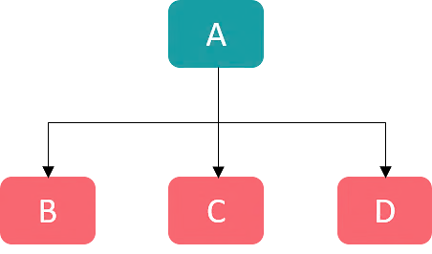
OOPS Principles – Inheritance – Hierarchical Inheritance

Slide 51
OOPS Principles – Inheritance – Hybrid Inheritance
Hybrid inheritance can be a combination of any of the three types of inheritances supported in Java.
Example

Slide 52
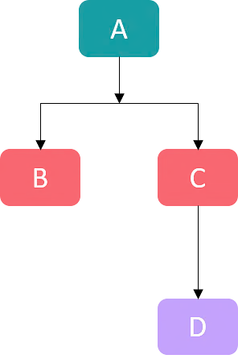
OOPS Principles – Inheritance – Hybrid

Slide 53
OOPS Principles – Inheritance – Multiple
There is also a fifth type of Inheritance, but it is not supported in Java, as multiple class inheritance causes ambiguities. Multiple inheritance is also called a diamond problem. Hence, Java does not support multiple class inheritance.

Slide 54
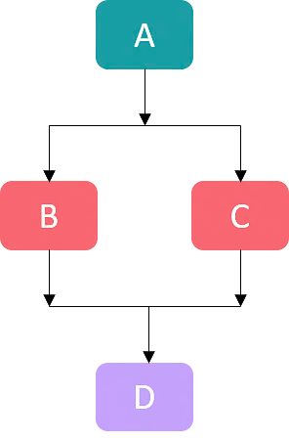
OOPS Principles – Inheritance – Multiple

Slide 55
OOPS Principles – Inheritance – Contd
Is-a Relationship
When a class inherits methods and members from a different class, then the relation is said to be an is-a relationship.
Example: Orange is-a fruit
Has-a Relationship
When a class inherits an instance from a different class or an instance of its class, then the relationship is a has-a type.
Ex: Orange has-a citrus taste.

Slide 56
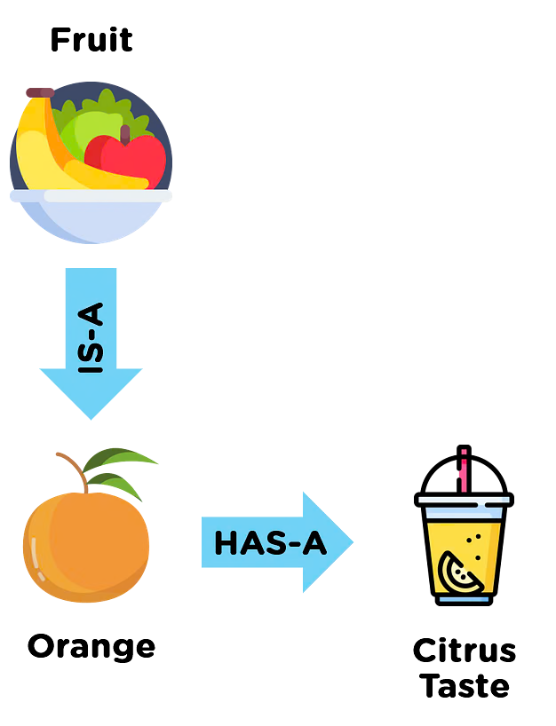
OOPS Principles – Inheritance – Contd

Slide 57
OOPS Principles – Inheritance – Contd
Advantages
Java inheritance enables code reusability and saves time
Inheritance in Java provides the extensibility of inheriting parent class methods to the child class
With Java inheritance, the parent class method overriding the child class is possible
Disadvantages
The inherited methods lag in performance
Some of the data members of the parent class may not be of any use—as a result, they waste memory
Inheritance causes strong coupling between parent and child classes. This means, either of the two (Parent class or Child class) become incapable of being used independent of each other.

Slide 58
OOPS Principles – Polymorphism
Polymorphism is a process of representing “one form in many forms”.
In object oriented programming’s, we have two types of polymorphism.
They are compile time polymorphism and run time polymorphism.
JAVA does not support compile time polymorphism
The functionality of a method behaves differently in different scenarios.
The behaviour of a method depends on the data provided.
It allows the same name for a member or method in a class with different types.
Polymorphism supports implicit type conversion.

Slide 59
OOPS Principles – Polymorphism - Contd
Method Overloading – With Example
Method Overloading is the process in which the class has two or more methods with the same name. Nevertheless, the implementation of a specific method occurs according to the number of parameters in the method call.
Method Overriding - With Example
Method Overriding is a procedure in which the compiler can allow a child class to implement a specific method already provided in the parent class.

Slide 60
OOPS Principles – Data Binding
With Example in Intellij – Copy the points once explained

Slide 61
OOPS Principles – Message Passing
Between Program - In OOPS, message passing is a way for objects to communicate within a program
Between Processes - Similarly, in concurrent programming, we use it to communicate messages between processes or threads.

Slide 62
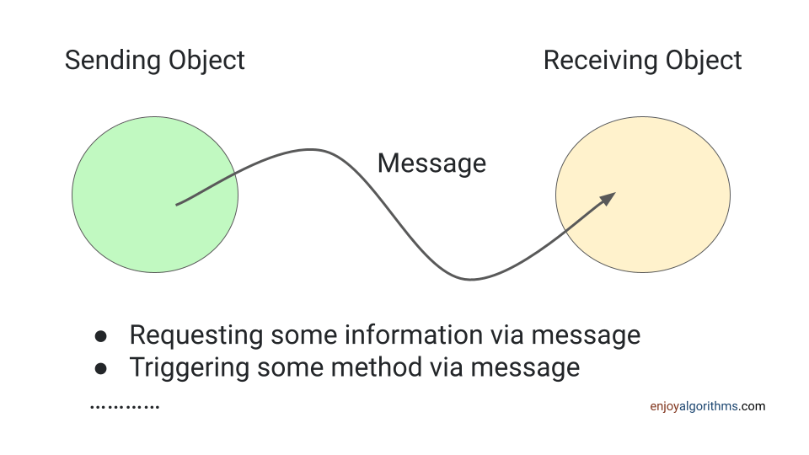
OOPS Principles – Message Passing - Contd

Slide 63
OOPS Principles – Message Passing - Contd
In the Example shown is Objects are tightly coupled ObejctA and ObjectB
To Achieve the similar functionality loosely coupled we use
Interfaces – Example In Learning Project
Dependency Injection

Slide 64
OOPS Principles – Message Passing - Contd
When we use message passing in OOP?
When one object needs to request data from another object
When one object needs to notify another object (or group of objects) of an event
When multiple objects need to collaborate to achieve a common goal
When one object needs to delegate responsibility to another object
When one object needs to control the behavior of another object
When one object needs to communicate with other objects in a concurrent system

Slide 65
In-Depth
Class Contains Five elements:-
Class Test
{
1. variables
2. methods
3. constructors
4. instance blocks
5. static blocks
}

Slide 66
Identifiers
Any name in the java program like variable name,class name,method name, interface name is called identifier.
class Test Test-------→identifier
{
void add() add-------→identifier
{
int a=10; a----------→identifier
int b=20; b----------→identifier
}
}

Slide 67
Rules to declare identifiers
1. The java identifiers should not start with numbers, it may start with alphabet symbol and underscore symbol and dollar symbol.
a. Int abc=10;-----→valid
b. Int 2abc=20;----→not valid
c. Int _abc=30;----→valid
d. Int $abc=40;----→valid
e. Int @abc=50;---→not valid
2. The identifier will not contains symbols like
+ , - , . , @ , # , *………………….

Slide 68
Rules to declare identifiers - Contd
3. The identifier should not duplicated.
class Test
{
void add()
{
int a=10;
int a=20; the identifier should not be duplicated.
}
}

Slide 69
Rules to declare identifiers - Contd
4. In the java applications it is possible to declare all the predefined class names and predefined interfaces names as a
identifier. But it is not recommended to use.
class Test
{
public static void main(String[] args)
{
int String=10; //predefined String class
int Serializable=20; //predefined Serializable class
float Exception=10.2f; //predefined Exception class
System.out.println(String);
System.out.println(Serializable);
System.out.println(Exception);
}
}

Slide 70
Java Naming Conventions
Java is a case sensitive language so the way of writing code is important.
1. All Java classes, Abstract classes and Interface names should start with uppercase letter ,if any class contain more than one word every innerword also start with capital letters.
Ex: String,StringBuffer,FileInputStream
2. All java methods should start with lower case letters and if the method contains more than one word every innerword should start with capital letters.
Ex :- post(),toString(),toUpperCase()
3. All java variables should start with lowercase letter and inner words start with uppercase letter.
Ex:- pageContent, bodyContent
4. All java constant variables should be in uppercase letter.
Ex: MIN_PRIORITY,MAX_PRIORITY,NORM_PRIORITY
5. All java packages should start with lower case letters only.
Ex: java.awt,java.io

Slide 71
Java Comments
Single Line Comment - // Using Double Forward slash
Double Line Comment/Multiline Comment - /* Comment */
Example:

Slide 72
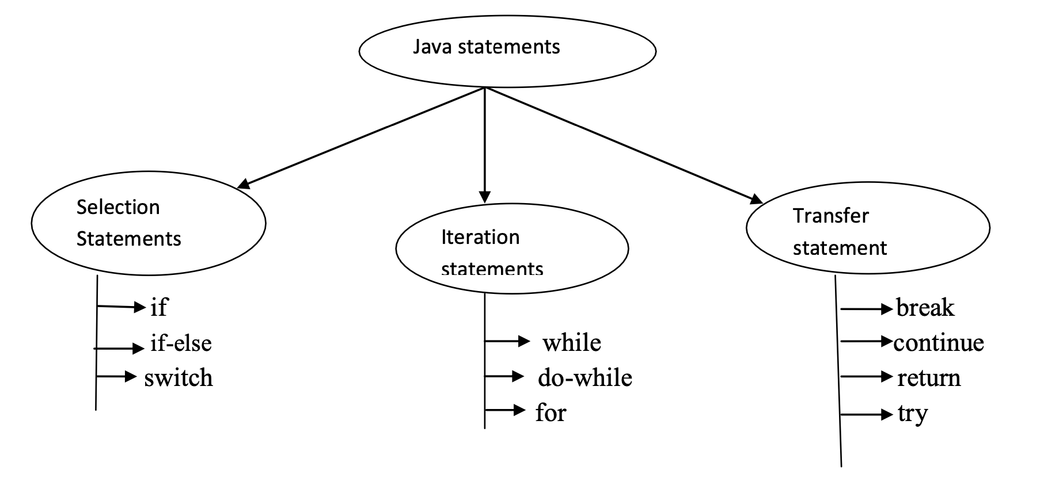
Java Statements

Slide 73
*** Selection Statements ***

Slide 74
If Statement - Syntax
if (condition)
{
if body;
}
The curly brasses are optional whenever we are taking single statements.
The curly brasses are mandatory whenever we are taking multiple statements.

Slide 75
If Statement - Examples
With Integer
With true/false
With 0/1

Slide 76
If-Else Statement
if (condition)
{
if body;(true body)
}
else
{
else body;(false body)
}
The curly brasses are optional whenever we are taking single statements.
The curly brasses are mandatory whenever we are taking multiple statements.

Slide 77
If-Else Statement Examples
If else example with < or >
If else example with Boolean

Slide 78
Switch Statement
1) Switch statement is used to take multiple selections.
2) Curly brasses are mandatory
3) Inside the switch It is possible to declare any number of cases but is possible to declare only one default.
4) Switch is taking the argument the allowed arguments are
a. Byte
b. Short
c. Int
d. Char
e. String(allowed in 1.7 version)
f. https://medium.com/@javatechie/the-evolution-of-switch-statement-from-java-7-to-java-17-4b5eee8d29b7
5) Float and double and long is not allowed for a switch argument because these are having more number of possibilities (float and double is having infinity number of possibilities) hence inside the switch statement it is not possible to provide float and double and long as a argument.
6) If the case is matched particular case will be executed if there is no case is matched default case is executed.

Slide 79
Switch Statement - Syntax
switch(argument)
{
Case label1 : sop(“ “);
break;
Case label2 : sop(“ “);
break;
| |
| |
Default : sop(“ “);
break;
}

Slide 80
Switch Statement – Target to Complete with Example
Case Example with integer
The case label must be unique. Duplicate case labels are not allowed in switch statement.
The case labels must be constant expression if we are providing variables as a case labels the compiler will raise compilation error.
For the case label it is possible to provide constant expressions.
Inside the switch the default is optional part.
Inside the switch case is optional part.
Inside the switch both case and default Is optional.
Inside the switch independent statements are not allowed. If we are declaring the statement that statement must be inside the case or default.
Inside the switch statement beak is optional. If we are not providing break statement at that situation from the matched case onwards up to break statement is executed if no beak is available up to the end of the switch is executed. This situation is called as fall though inside the switch case.
Inside the switch statement we are able make the default anywhere else.(starting ,middle ,ending)
From the 1.8 version onwards the string/char/ENUM also allowed argument for the switch statement.
Switch argument data type and case label values must be same data type otherwise the compiler will raise compilation error.
Inside switch the case label must be within the range of provided argument data type.

Slide 81
New/Latest Features

Slide 82
*** Iteration Statements***

Slide 83
If we want to execute group of statements repeatedly or more number of times then we should go for iteration statements.

Slide 84
For loop Syntax
for (part 1;part 2 ;part 3 )
{
Body;
}
Ex:- for (initialization ;condition ;increment/decrement )
{
Body;
}
1) The for loop contains three parts initialization, condition, increment/decrement part.
2) Each and every part is separated by semicolon and it is mandatory.
The curly brasses are optional whenever we are taking single statement.
The curly brasses are mandatory whenever we are taking more than one statements.

Slide 85
For loop execution
Step1:- Initialization
Step 2:- Condition will be checked.
Step 3:- If the condition is true body will be executed. If the condition is false loop stopped.
Step 4:- After body Execution >> increment/decrement part will be executed.
Step 5:- Condition will be checked Again.
Step 6:- If the condition is true body is executed.
Step 7:- After body Execution > increment/decrement part will be executed.
This repeats Until the condition is false

Slide 86
For Loop Initialization
Inside the for loop initialization part is optional.
Example
Instead of initialization it is possible to take any number of system.out.println(“siva”); also and each and every statement is separated by camas(,).
Example
Possible of Single Initialization not multiple
Example

Slide 87
For Loop Conditional
Inside the for loop conditional part is optional.
Example
If we are not taking any condition then the compiler places the true value.
Example
The condition is always must return Boolean(true, false) values only.
Example

Slide 88
For Loop Increment/Decrement
Inside the for loop increment/decrement session is optional.
Instead of increment/decrement it is possible to take the any number of system.out.pritnln(“siva”); also and each and every statement is separated by comma(,).
for(;;)------------→represent infinite loop because the condition is always true.

Slide 89
For Loop Increment/Decrement
inc/dec part is optional
Example
instead if inc/dec it is possible to take the any number of System.out.println(“Siva”);
Example
each and every part inside the for loop is optional.
for(;;)------------→represent infinite loop because the condition is always true.
Example

Slide 90
While - Syntax
If we want to execute group of statements repeatedly or more number of times then we should go for while loop.
Syntax:-
while (condition)
{
body;
}

Slide 91
While - Example
class Test
{
public static void main(String[] args)
{
int i=0;
while (i<10)
{
System.out.println("Siva");
i++;
}
}
}

Slide 92
While – represent infinite loop
class Test
{
public static void main(String[] args)
{
int i=0;
while (true)
{
System.out.println("Siva");
i++;
}
}
}

Slide 93
While – compilation error unreachable statement
class Test
{
public static void main(String[] args)
{
int i=0;
while (false)
{
System.out.println("Siva");//unreachable statement
i++;
}
}
}

Slide 94
Do-While
1) If we want to execute the loop body at least one time them we should go for do-while statement.
2) In the do-while first body will be executed then only condition will be checked.
3) In the do-while the while must be ends with semicolon otherwise we are getting compilation error.
4) do is taking the body and while is taking the condition and the condition must be Boolean condition.
Syntax:-
Syntax:-do
{
//body of loop
} while(condition);
do
{
//body of loop
} while(condition);

Slide 95
Do-While - Example
class Test
{
public static void main(String[] args)
{
int i=0;
do
{
System.out.println(”Siva");
i++;
}while (i<10);
}
}

Slide 96
Do-While – Example – Unreachable statement
class Test
{
public static void main(String[] args)
{
int i=0;
do
{
System.out.println("Siva");
}
while (true); -- Try with false
System.out.println("M");//unreachable statement
}
}

Slide 97
Transfer/Jump statements
By using transfer statements we are able to transfer the flow of execution from one position to another position
1. break
2. continue
3. return

Slide 98
Transfer statements - Break
Stop the execution , Come out of the loop
Break Uses in Two places
1. Switch
2. Loop
If we are using any other place the compiler will raise compilation error.

Slide 99
Transfer statements – Break - Example
class Test
{
public static void main(String[] args)
{
for (int i=0;i<10;i++)
{
if (i==5)
{
break;
}
System.out.println(i);
}
}
}

Slide 100
Transfer statements - Continue
Skip the current iteration, continue the rest of the iterations normally
Example:
class Test
{
public static void main(String[] args)
{
for (int i=0;i<10;i++){
if (i==5){
continue; }
System.out.println(i);
}}}

Slide 101
Transfer statements - return
The return statement is mainly used in methods in order to terminate a method in between and return back to the caller method. It is an optional statement.
That is, even if a method doesn't include a return statement, control returns back to the caller method after execution of the method. Return statement may or may not return parameters to the caller method.

Slide 102
Transfer statements – return - Example
class Test
{
public static void main(String[] args)
{
Test t = new Test();
int sum = t.addition(10,20); //addition() method return integer value
System.out.println("Sum = "+sum);
t.show("Siva"); //show() method does not return any value
}
int addition(int a,int b)
{
return a+b;
}
void show(String name)
{
System.out.println("Welcome "+name);
return; // not returning anything, it is optional
}
}

Slide 103
Transfer statements – Labelled Statements
In the case of nested loops to break and continue a particular loop we should go for labelled break and continue statements. The Java labelled loops allows transferring to a particular line or statement.

Slide 104
Transfer statements – Labelled Statements - Example
class Test
{
public static void main(String[] args)
{
out:
for(int i=1; i<=100; i++)
{
System.out.println("outer");
for(int j=1; j<=100; j++)
{
System.out.println("nested");
if(j==2)
{
// break; this will exit from inner for loop only
break out; // this will exit from both for loops
}
}
}
}
}

Slide 105
Transfer statements – Practice
Print Even Numbers alone between 0-100
Print odd Numbers Between 0-100
Basic calculator Program – accept Input parameters
Using If-else
Using Switch Statement

Slide 106
Transfer Best Practices
Jump statements can significantly simplify complex control flow structures in Java. However, they should be used judiciously, as excessive use can lead to code that is hard to read and maintain. Here are some best practices and practical applications
Break in Switch-Case: The ‘break’ statement is vital in ‘switch-case’ structures to prevent ‘fall-through’ from one case to another
Control Complex Loops: In nested loops, judicious use of ‘break’ and ‘continue’ can control iterations more precisely and prevent unnecessary processing;
Method Return Values: Using ‘return’ effectively in methods can simplify logic by allowing early exit from a method and reducing nested conditions
Debugging and Error Handling: Jump statements can be used for quick exits or skipping sections of code during debugging and handling errors.

Slide 107
Keywords - ** Need to Remember **
Keywords for Modifiers:
public
private
protected
static
abstract
final
native
volatile
synchronized
transient
strictfp

Slide 108
Keywords - ** Need to Remember **
Keywords for Flow Control
If
else
switch
break
case
default
for
do
while
continue

Slide 109
Keywords - ** Need to Remember **
Keywords for Exception Handling
try
catch
finally
throw
throws

Slide 110
Keywords - ** Need to Remember **
Keywords for Class
import
class
interface
extends
package
implements

Slide 111
Keywords - ** Need to Remember **
Keywords for Object
new
instanceof
super
this

Slide 112
Keywords - ** Need to Remember **
Keywords for primitive data Types
byte
short
int
long
float
double
char
boolean

Slide 113
Keywords - ** Need to Remember **
Method Level
Void
Return

Slide 114
Keywords - ** Need to Remember **
Reserved Literals
true
false
null
Assert and enum are new Keywords →> Introduced from Java 1.5

Slide 115
Data Types in Java
Data types are used to represent the type of the variable and type of the expression.
Data types are used to specify the how much memory is allocated for variables.

Slide 116
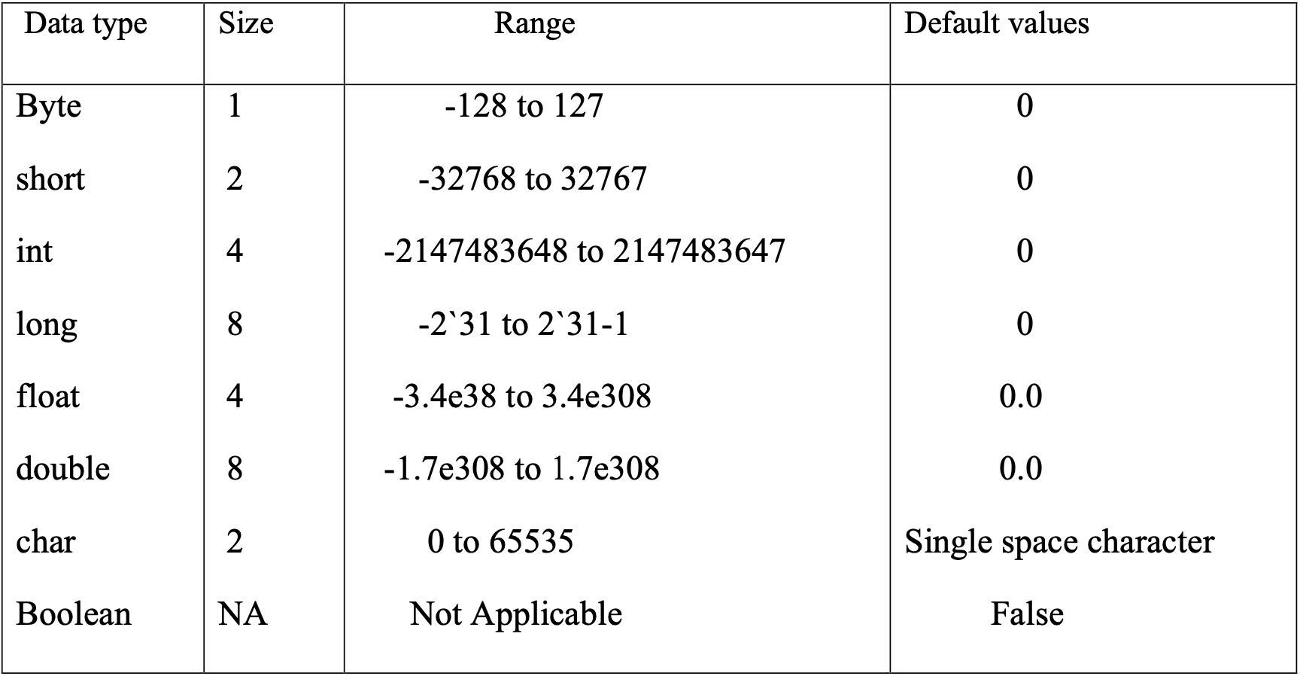
Data Types in Java

Slide 117
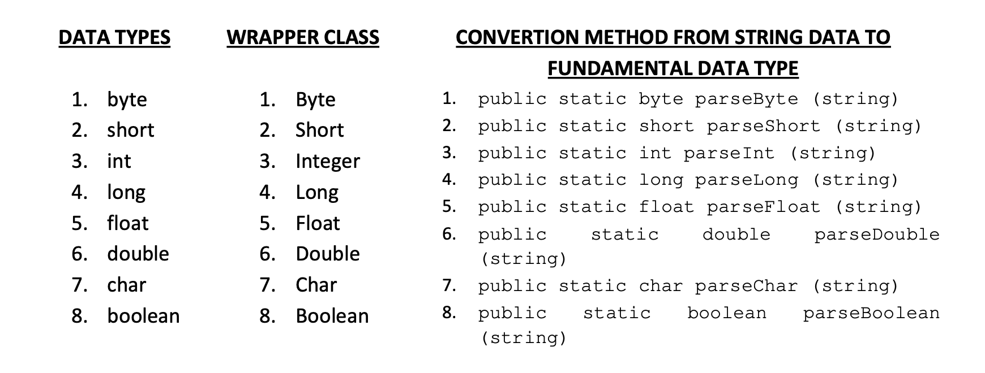
Data Types Contd..

Slide 118
PACKAGE
A package is a collection of classes, interfaces and sub-packages. A sub-package in turns divides into classes, interfaces, sub-sub-packages, etc.
Learning about JAVA is nothing but learning about various packages. By default one predefined package is imported for each and every JAVA program and whose name is java.lang.*.
Whenever we develop any java program, it may contain many number of user defined classes and user defined interfaces. If we are not using any package name to place user defined classes and interfaces, JVM will assume its own package called NONAME package.
In java we have two types of packages they are predefined or built-in or core packages and user or secondary or custom defined packages.
Core packages of java starts with java. (For example: java.lang.*) and Advanced packages of java starts with javax. (For example: java.sql.*)

Slide 119
java.lang.*
This package is used for achieving the language functionalities such as convertion of data from string to fundamental data, displaying the result on to the console, obtaining the garbage collector. This is the package which is by default imported for each and every java program.

Slide 120
Java.io.*
This package is used for developing file handling applications, such as, opening the file in read or write mode, reading or writing the data, etc.

Slide 121
Java.awt.*
This package is used for developing GUI (Graphic Unit Interface) components such as buttons, check boxes, scroll boxes, etc.

Slide 122
Java.net.*
This package is used for developing client server applications.

Slide 123
Java.util.*
This package is used for developing quality or reliable applications in java or J2EE. This package contains various classes and interfaces which improves the performance of J2ME applications. This package is also known as collection framework (collection framework is the standardized mechanism of grouping of similar or different type of objects into single object. This single object is known as collection object).

Slide 124
Java.text.*
This package is used for formatting date and time on day to day business operations.

Slide 125
Java.lang.reflect.*
Reflect is the sub package of lang package. This package is basically used to study runtime information about the class or interface. Runtime information represents data members of the class or interface, Constructors of the class, types of methods of the class or interface.

Slide 126
Java.sql.*
This package is used for retrieving the data from data base and performing various operations on data base.

Slide 127
Exception Handling
Run time errors in JAVA are known as exceptions.
System error messages are those which are unable to understand by end user or client.
User friendly messages are those which are understandable by end user or client.
Exceptional handling is a mechanism of converting system error messages into user friendly messages.
Errors are of two types.
They are compile time errors and run time errors.
Compile time errors are those which are occurring because of poor understanding of the
language.
Run time errors are those which are occurring in a program when the user inputs invalid data.
The run time errors must be always converted by the JAVA programmer into user friendly messages by using the concept of exceptional handling.

Slide 128
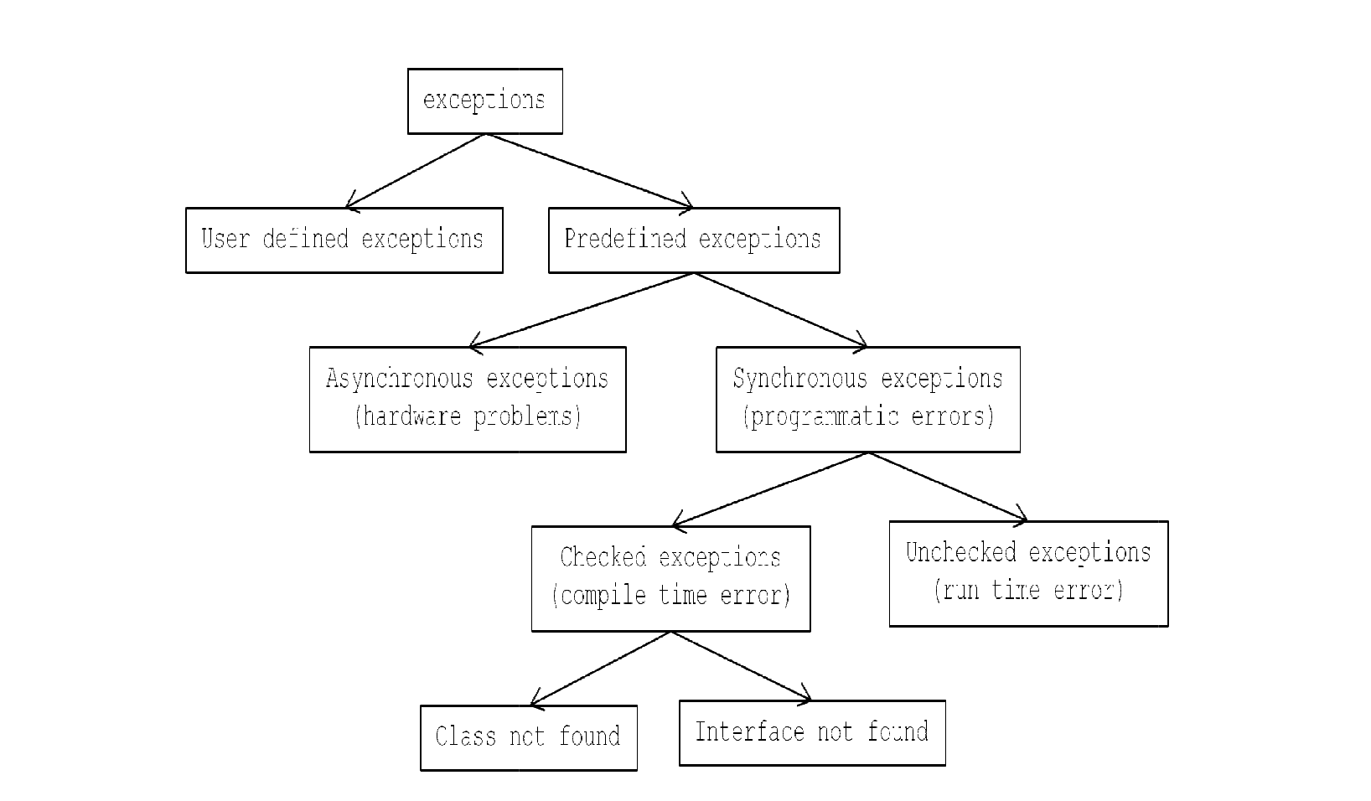

Slide 129
Predefined exceptions are divided into two types. They are asynchronous exceptions and synchronous exceptions.
Asynchronous exceptions are those which are always deals with hardware problems. In order to deal with asynchronous exceptions there is a predefined class called java.lang.Error. java.lang.Error class is the super class for all asynchronous exceptions.
Synchronous exceptions are one which always deals with programmatic errors. In order to deal with synchronous exceptions we must use a predefined class called java.lang.Exception class.
java.lang.Exception is the super class for all synchronous exceptions. Synchronous exceptions are divided into two types. They are checked exceptions and unchecked exceptions.
A checked exception is one which always deals with compile time errors regarding class not found and interface not found.
Unchecked exceptions are those which are always deals with programmatic run time errors such as ArithmeticException, NumberFormatException, ArrayIndexOutOfBoundsException, etc.

Slide 130
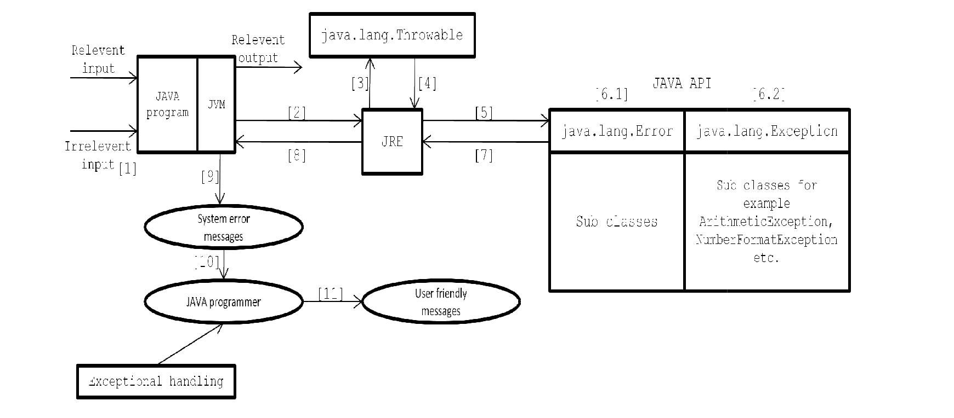

Slide 131
Whenever we pass irrelevant input to a JAVA program, JVM cannot process the irrelevant input.
Since JVM is unable to process by user input, hence it can contact to JRE for getting an appropriate exception class.
JRE contacts to java.lang.Throwable for finding what type of exception it is.
java.lang.Throwable decides what type of exception it is and pass the message to JRE.
JRE pass the type of exception to JAVA API.
[6.1 & 6.2] From the JAVA API either java.lang.Error class or java.lang.Exception class will found an appropriate sub class exception.
Either java.lang.Error class or java.lang.Exception class gives an appropriate exception class to JRE.
JRE will give an appropriate exception class to JVM.
JVM will create an object of appropriate exception class which is obtained from JRE and it generates system error message.
In order to make the program very strong (robust), JAVA programmer must convert the system error messages into user friendly messages by using the concept of exceptional handling.

Slide 132
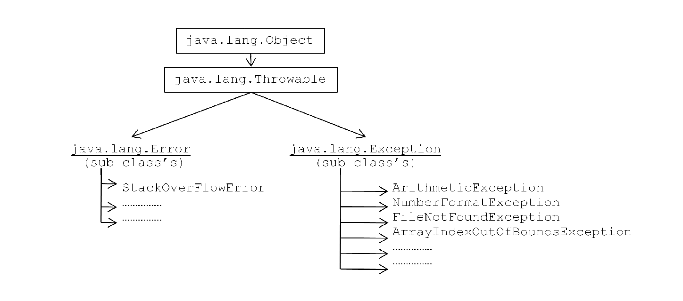

Slide 133
try { Block of statements which are to be monitored by JVM at run time (or problematic errors); }
catch (Type_of_exception1 object1) {
Block of statements which provides user friendly messages;
} catch (Type_of_exception2 object2) {
Block of statements which provides user friendly messages;
} . . . catch (Type_of_exception3 object3) {
Block of statements which provides user friendly messages;
}
finally {
Block of statements which releases the resources;
}

Slide 134
Try Block
This is the block in which we write the block of statements which are to be monitored by JVM at run time i.e., try block must contain those statements which causes problems at run time.
If any exception is taking place the control will be jumped automatically to appropriate catch block.
If any exception is taking place in try block execution will be terminated and the rest of the statements in try block will not be executed at all and the control will go to catch block.
For every try block we must have at least one catch block. It is highly recommended to write ‘n’ number of catch’s for ‘n’ number of problematic statements.

Slide 135
Catch Block
This is used for providing user friendly messages by catching system error messages.
In the catch we must declare an object of the appropriate execution class and it will be internally
referenced JVM whenever the appropriate situation taking place.
If we write ‘n’ number of catch’s as a part of JAVA program then only one catch will be executing at any point.
After executing appropriate catch block even if we use return statement in the catch block the control never goes to try block.

Slide 136
Finally Block
This is the block which is executing compulsory whether the exception is taking place or not.
This block contains same statements which releases the resources which are obtained in try block (resources are opening files, opening databases, etc.).
Writing the finally block is optional.

Slide 137
Throws Block
This is the keyword which gives an indication to the calling function to keep the called function under try and catch blocks.
Syntax: <Return type> method name (number of parameters if any) throws type of exception1,type of exception2,.........type of exception;

Slide 138
Number of ways to find details of the exception
In JAVA there are three ways to find the details of the exception.
They are using an object of
java.lang.Exception class,
using public void printStackTrace method
using public string getMessage method.

Slide 139
User Or Custom Defined Exceptions
User defined exceptions are those which are developed by JAVA programmer as a part of application development for dealing with specific problems such as negative salaries, negative ages, etc.

Slide 140
Choose the appropriate package name.
Choose the appropriate user defined class.
Every user defined class which we have choose in step 2 must extends either java.lang.Exception or java.lang.RunTimeException class.
Every user defined sub-class Exception must contain a parameterized Constructor by taking string as a parameter.
Every user defined sub-class exception parameterized Constructor must called parameterized
Constructor of either java.lang.Exception or java.lang.RunTimeException class by using super (string parameter always).

Slide 141
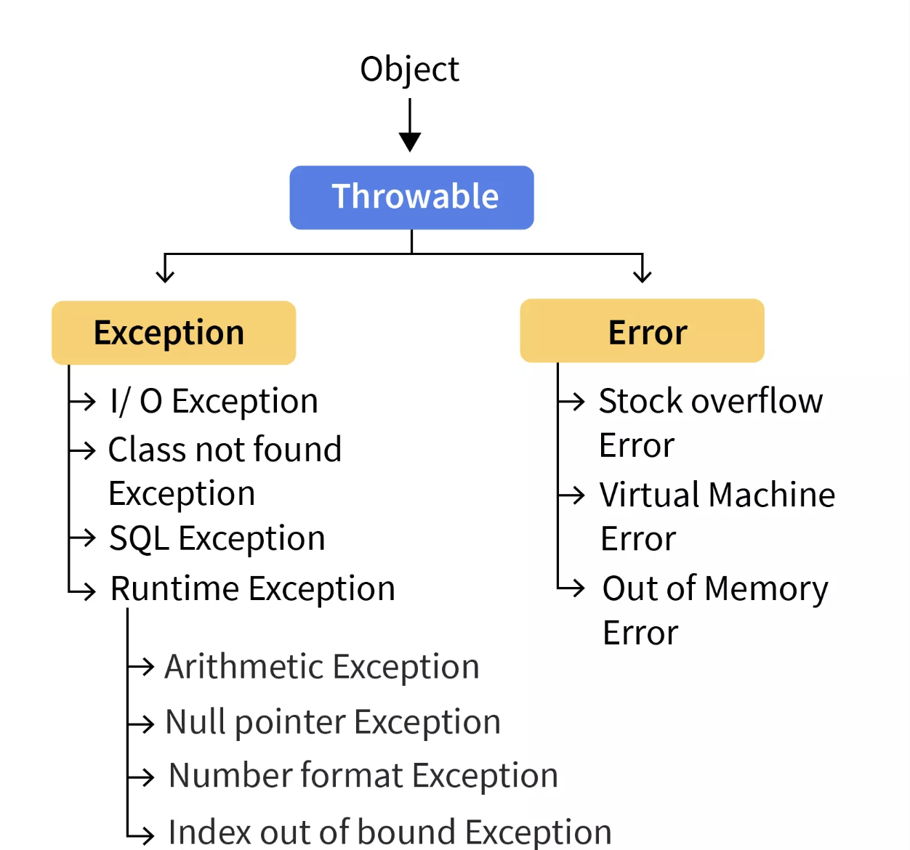

Slide 142
**
Arrays
Two Dimensional Arrays
Stack
Stack Flow
Stack Execution
How methods and Stack occupy jvm memory?
Practice , Practice and Practice

Slide 143
Dynamic Input
The input given to the java application at the time of execution(runtime) is called Dynamic input.
Dynamic input in 5 ways.
1) By using BufferedReader class present in the java.io package(1.2 version)
2) By using Scanner class present in the java.util package(5.0 version)
3) By using Console class present in the java.io package(6.0 version)
4) By using command line arguments
5) By Using DataInputStreamReader

Slide 144
Using BufferedReader
Initialize InputStreamReader object by passing System.in Object
Create BufferedReader Object by passing isr
Read Message
To get String br.readLine()
To get char by char br.read()

Slide 145
Using Scanner
Create Scanner Object by passing System.In
Read message
For String scanner.next()
For Int scanner.nextInt()
So On for each data type

Slide 146
Using Console
Introduced in JDK1.6
Reading password without echoing the entered characters.
Reading methods are synchronized.
Format string syntax can be used.
Does not work in non-interactive environment (such as in an IDE).
System.console().readLine();

Slide 147
Using Command Line Arguments
Passing values via main method
String[] args

Slide 148
Using DataInputStreamReader
DataInputStream reads data in a binary format
Create a DataInputStream object by passing System.in
Read via readLine or subsequent data type methods

Slide 149
Serialization and Deserialization
<<Check for Notes in Github>

Slide 150
Java.io
I/O, short for Input/Output, is a fundamental concept in computing. It refers to the communication between an information processing system (like your computer) and the outside world (which could be a user, a file system, a network, or another system).
Input is the data that is sent to the system, while output is the data that the system produces. For example, when you type on your keyboard, you're providing input to your computer. When your computer displays something on your screen, it's producing output.
In the context of Java, I/O operations often involve working with data sources and destinations like files, network connections, and databases. Java I/O Streams, which we’ll be exploring in this series, provide a powerful and flexible framework for handling these IO operations.

Slide 151
Understanding the Concept of Streams
In the realm of Java I/O, a stream can be visualized as a continuous flow of data. It’s a sequence, a conduit that channels data from a source to a destination. The term "stream" aptly captures the essence of how data is handled in Java: not as large, monolithic blocks, but as a steady, manageable flow. Whether it’s reading from a file, writing to a network socket, or interacting with a database, data streams are the conduits through which data flows in a Java application.

Slide 152
There are two primary directions of this flow:
Input Stream: Channels data from a source into a Java program. This could be reading data from a file, receiving it over a network, or even getting it from user input. It’s important to note that when we say "input stream" here, we’re referring to the general concept of data flowing into a program, not to be confused with the actual `InputStream` class in Java.
Output Stream: Channels data from a Java program to a destination. This could involve writing data to a file, sending it over a network, or displaying it to a user. Similarly, when we say "output stream", we’re referring to the general concept of data flowing out of a program, not to be confused with the `OutputStream` class in Java.

Slide 153
Types of I/O Streams in Java: Byte Streams(5125) & Character Streams(2562)
There are two main types of streams - byte streams and character streams.
Byte streams, represented by the abstract classes InputStream and OutputStream, are for handling raw binary data.
Character streams, represented by abstract classes Reader and Writer, on the other hand, are for handling text data, taking care of the nuances of character encoding.

Slide 154
InputStream & OutputStream classes: These are the base classes for byte stream I/O in Java. They provide methods for reading and writing bytes, respectively. Whether you’re reading from a file, a network socket, or any other source of data, you’ll likely be using a class that extends InputStream. Similarly, if you’re writing data to a file, a network socket, or any other destination, you’ll be using a class that extends OutputStream.
InputStream class: Represents an input stream of bytes. It’s an abstract class that forms the basis for reading data from various sources, be it files, network sockets, or even memory buffers. The idea behind `InputStream` is to provide a consistent interface for reading bytes, regardless of the data source. Methods like `read()` allow you to fetch data byte by byte, abstracting away the complexities of the underlying source.
OutputStream class: Complements the `InputStream` by providing an output stream for writing bytes. Whether you’re saving a file, sending data over a network, or writing to a byte array in memory, `OutputStream` offers a unified approach. Its methods, such as `write()`, ensure that you can push data byte by byte to any destination, without worrying about the specifics of where it’s going.

Slide 155
Reader & Writer classes: These are the base classes for character stream I/O in Java. They provide methods for reading and writing characters, respectively. The Reader class takes care of converting bytes to characters using the appropriate character encoding, while the Writer class handles the conversion of characters to bytes. This makes it easier to work with text data in different character encodings.
Reader class: This abstract class in Java’s I/O system is designed for reading character data. It handles various character encodings, ensuring accurate reading of text irrespective of its encoding format. The Reader class provides methods such as read(), which retrieves data character by character, managing the complexities of character encoding.
Writer class: This class is designed for outputting character data. It ensures that text is written in the correct encoding, offering a uniform interface for writing characters to different destinations. The write()method, for instance, enables text output to a file, a network socket, or any other destination, managing the intricacies of character encodings.

Slide 156
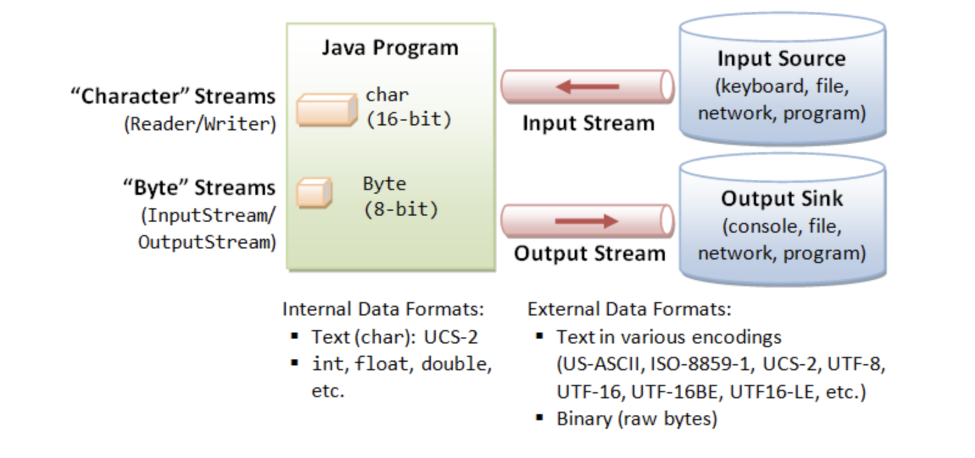

Slide 157
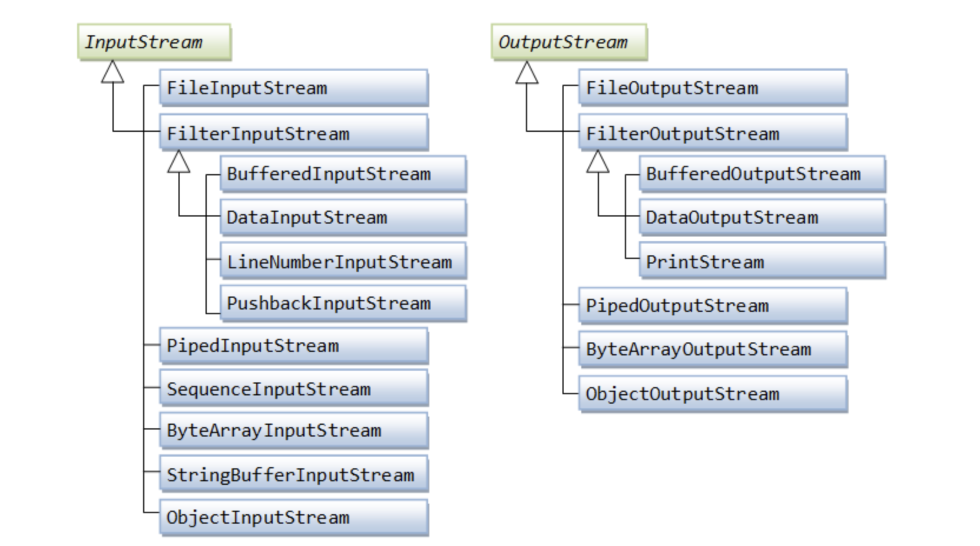

Slide 158
Importance of Buffering in I/O
In the world of I/O operations, efficiency is key. Every read from or write to an external source, such as a file or a network socket, is a relatively expensive operation. It takes time and consumes system resources. This is where buffering comes into play.
Buffering is akin to a temporary holding area or a way-station for data as it journeys from source to destination. When reading data, instead of fetching each byte individually, which can be time-consuming, a buffer allows us to read a larger block of data at once. This block of data is then stored in a buffer - an area of memory - from where your program can access it.
Similarly, when writing data, instead of writing each byte individually, we can write data to a buffer. Once the buffer is full, or when we explicitly decide to, the data in the buffer can be written to the destination in one go.
By reducing the number of actual read and write operations, buffering significantly improves the efficiency of IO operations, especially when dealing with large volumes of data. It's like shopping at a supermarket. Instead of making a trip for each individual item, you fill your cart (buffer) with many items before checking out. This makes the shopping trip (IO operation) much more efficient

Slide 159
Let’s take a look at a few examples:
File Handling: One of the most common uses of Java I/O Streams is reading from and writing to files. Whether it’s a text editor saving your notes, a spreadsheet application loading a CSV file, or a photo editor opening an image, Java I/O Streams are at the heart of these operations.
Network Communication: Java I/O Streams are also crucial for network communication. When you send a request to a web server, or when you receive a response, that data is transmitted as a stream of bytes. Web servers, chat applications, and multiplayer online games all rely on Java IO Streams to send and receive data over the network.
Database Access: When interacting with a database, Java I/O Streams are used to send queries and receive results. Whether it’s a web application fetching data from a database, or a data analysis tool running complex queries, Java I/O Streams ensure that data can be read from and written to databases efficiently.
Inter-Process Communication: Java I/O Streams can also be used for communication between different processes on the same machine. This is particularly useful for applications that need to interact with the operating system or other applications. For instance, a Java application can use I/O Streams to run a shell command and process the output.
Data Compression and Decompression: Java I/O Streams are used in applications that deal with compressed data. Applications like file archivers or software installers use streams to read the compressed data, decompress it, and then write the decompressed data.

Slide 160
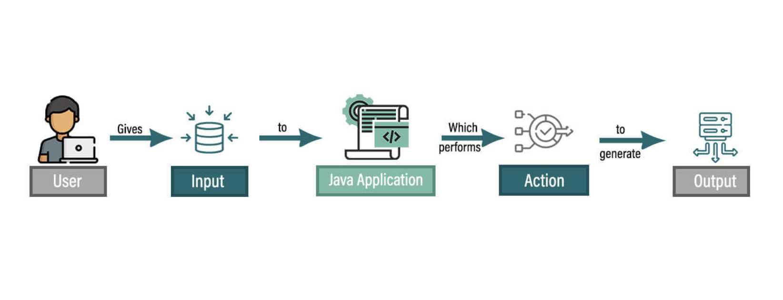

Slide 161
JDK has two sets of I/O packages:
The Standard I/O (in package java.io), introduced since JDK 1.0 for stream-based I/O, and
the New I/O (in packages java.nio), introduced in JDK 1.4, for more efficient buffer-based I/O.
JDK 1.5 introduces the formatted text-I/O via new classes java.util.Scanner and Formatter, and C-like printf() and format() methods for formatted output using format specifiers.
JDK 1.7 enhances supports for file I/O via the so-called NIO.2 (non-blocking I/O) in new package java.nio.file and its auxiliary packages. It also introduces a new try-with-resources syntax to simplify the coding of close() method.

Slide 162
Class java.io.File (Pre-JDK 7)
The class java.io.File can represent either a file or a directory. [JDK 1.7 introduces a more versatile java.nio.file.Path, which overcomes many limitations of java.io.File.]
A path string is used to locate a file or a directory. Unfortunately, path strings are system dependent, e.g., "c:\myproject\java\Hello.java" in Windows or "/myproject/java/Hello.java" in Unix/Mac.
Windows use back-slash '\' as the directory separator; while Unixes/Mac use forward-slash '/'.
Windows use semi-colon ';' as path separator to separate a list of paths; while Unixes/Mac use colon ':'.
Windows use "\r\n" as line delimiter for text file; while Unixes use "\n" and Mac uses "\r".
The "c:\" or "\" is called the root. Windows supports multiple roots, each maps to a drive (e.g., "c:\", "d:\"). Unixes/Mac has a single root ("\").
\ . /

Slide 163
A path could be absolute (beginning from the root) or relative (which is relative to a reference directory). Special notations "." and ".." denote the current directory and the parent directory, respectively.
The java.io.File class maintains these system-dependent properties, for you to write programs that are portable:
Directory Separator: in static fields File.separator (as String) and File.separatorChar. [They failed to follow the Java naming convention for constants adopted since JDK 1.2.] As mentioned, Windows use backslash '\'; while Unixs/Mac use forward slash '/'.
Path Separator: in static fields File.pathSeparator (as String) and File.pathSeparatorChar. As mentioned, Windows use semi-colon ';' to separate a list of paths; while Unixes/Mac use colon ':'.
You can construct a File instance with a path string or URI, as follows. Take note that the physical file/directory may or may not exist. A file URL takes the form of file://..., e.g., file:///d:/docs/programming/java/test.html.

Slide 164
Example
File file = new File("in.txt"); // A file relative to the current working directory
File file = new File("d:\\myproject\\java\\Hello.java"); // A file with absolute path
File dir = new File("c:\\temp"); // A directory

Slide 165
Verifying Properties of a File/Directory
public boolean exists() // Tests if this file/directory exists.
public long length() // Returns the length of this file.
public boolean isDirectory() // Tests if this instance is a directory.
public boolean isFile() // Tests if this instance is a file.
public boolean canRead() // Tests if this file is readable.
public boolean canWrite() // Tests if this file is writable.
public boolean delete() // Deletes this file/directory.
public void deleteOnExit() // Deletes this file/directory when the program terminates.
public boolean renameTo(File dest) // Renames this file.
public boolean mkdir() // Makes (Creates) this directory.

Slide 166
List Directory
public String[] list() // List the contents of this directory in a String-array
public File[] listFiles() // List the contents of this directory in a File-array

Slide 167
(Advanced) List Directory with Filter
You can apply a filter to list() and listFiles(), to list only files that meet a certain criteria.
public String[] list(FilenameFilter filter)
public File[] listFiles(FilenameFilter filter)
Public File[] listFiles(FileFilter filter)
The interface java.io.FilenameFilter declares one abstract method:
public boolean accept(File dirName, String fileName)
The list() and listFiles() methods does a call-back to accept() for each of the file/sub-directory produced. You can program your filtering criteria in accept(). Those files/sub-directories that result in a false return will be excluded.

Slide 168
Reading from an InputStream
The abstract superclass InputStream declares an abstract method read() to read one data-byte from the input source:
public abstract int read() throws IOExceptionThe read() method:
returns the input byte read as an int in the range of 0 to 255, or
returns -1 if "end of stream" condition is detected, or throws an IOException if it encounters an I/O error.
The read() method returns an int instead of a byte, because it uses -1 to indicate end-of-stream.
The read() method blocks until a byte is available, an I/O error occurs, or the "end-of-stream" is detected. The term "block" means that the method (and the program) will be suspended. The program will resume only when the method returns.
Two variations of read() methods are implemented in the InputStream for reading a block of bytes into a byte-array. It returns the number of bytes read, or -1 if "end-of-stream" encounters.
public int read(byte[] bytes, int offset, int length) throws IOException // Read "length" number of bytes, store in bytes array starting from offset of index.
public int read(byte[] bytes) throws IOException // Same as read(bytes, 0, bytes.length)

Slide 169
Writing to an OutputStream
Similar to the input counterpart, the abstract superclass OutputStream declares an abstract method write() to write a data-byte to the output sink. write() takes an int.
The least-significant byte of the int argument is written out; the upper 3 bytes are discarded. It throws an IOException if I/O error occurs (e.g., output stream has been closed).
public void abstract void write(int unsignedByte) throws IOException
Similar to the read(), two variations of the write() method to write a block of bytes from a byte-array are implemented:
public void write(byte[] bytes, int offset, int length) throws IOException // Write "length" number of bytes, from the bytes array starting from offset of index.
public void write(byte[] bytes) throws IOException// Same as write(bytes, 0, bytes.length);

Slide 170
Opening & Closing I/O Streams
You open an I/O stream by constructing an instance of the stream. Both the InputStream and the OutputStream provides a close() method to close the stream, which performs the necessary clean-up operations to free up the system resources.
public void close() throws IOException // close this Stream
FileInputStream in = null; ......
try { in = new FileInputStream(...); // Open stream ...... ...... }
catch (IOException ex) {
ex.printStackTrace(); }
finally {
// always close the I/O streams
try { if (in != null) in.close(); } catch (IOException ex) { ex.printStackTrace(); } }

Slide 171
JDK1.7
JDK 1.7 introduces a new try-with-resources syntax, which automatically closes all the opened resources after try or catch, as follows. This produces much neater codes.
try (FileInputStream in = new FileInputStream(...))
{ ...... ...... }
catch (IOException ex) { ex.printStackTrace(); } // Automatically closes all opened resource in try (...).

Slide 172
Flushing the OutputStream
In addition, the OutputStream provides a flush() method to flush the remaining bytes from the output buffer.
public void flush() throws IOException // Flush the output

Slide 173
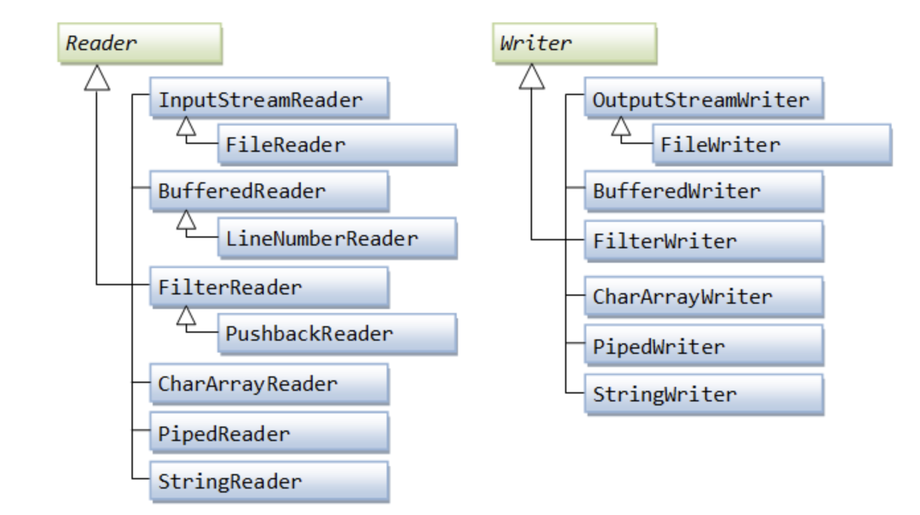
Character-Based I/O & Character Streams

Slide 174
Abstract superclass Reader and Writer
Other than the unit of operation and charset conversion (which is extremely complex), character-based I/O is almost identical to byte-based I/O. Instead of InputStream and OutputStream, we use Reader and Writer for character-based I/O.
The abstract superclass Reader operates on char. It declares an abstract method read() to read one character from the input source. read() returns the character as an int between 0 to 65535 (a char in Java can be treated as an unsigned 16-bit integer); or -1 if end-of-stream is detected; or throws an IOException if I/O error occurs.
There are also two variations of read() to read a block of characters into char-array.
public abstract int read() throws IOException
public int read(char[] chars, int offset, int length) throws IOException
public int read(char[] chars) throws IOException

Slide 175
The abstract superclass Writer declares an abstract method write(), which writes a character to the output sink. The lower 2 bytes of the int argument is written out; while the upper 2 bytes are discarded.
public void abstract void write(int aChar) throws IOException
public void write(char[] chars, int offset, int length) throws IOException
public void write(char[] chars) throws IOException

Slide 176
File I/O Character-Streams - FileReader & FileWriter
FileReader and FileWriter are concrete implementations to the abstract superclasses Reader and Writer, to support I/O from disk files. FileReader/FileWriter assumes that the default character encoding (charset) is used for the disk file. The default charset is kept in the JVM's system property "file.encoding".
You can get the default charset via static method java.nio.charset.Charset.defaultCharset() or System.getProperty("file.encoding"). It is probable safe to use FileReader/FileWriter for ASCII texts, provided that the default charset is compatible to ASCII (such as US-ASCII, ISO-8859-x, UTF-8, and many others, but NOT UTF-16, UTF-16BE, UTF-16LE and many others). Use of FileReader/FileWriter is NOT recommended as you have no control of the file encoding charset.

Slide 177
Buffered I/O Character-Streams - BufferedReader & BufferedWriter
BufferedReader and BufferedWriter can be stacked on top of FileReader/FileWriter or other character streams to perform buffered I/O, instead of character-by-character. BufferedReader provides a new method readLine(), which reads a line and returns a String (without the line delimiter). Lines could be delimited by "\n" (Unix), "\r\n" (Windows), or "\r" (Mac).

Slide 178
Conclusion
Byte-stream Classes:
InputStream
OutputStream
FileInputStream
FileOutputStream
ByteArrayInputStream
ByteArrayOutputStream
Character-stream Classes:
Reader
Writer
FileReader
FileWriter
BufferedReader
BufferedWriter

Slide 179
Non-stream Classes:
File
RandomAccessFile
FileInputStream
- FileOutputStream

Slide 180
RandomAccessFile
The RandomAccessFile class is an indispensible tool when it comes to accessing files in a more flexible manner. This class, as the name suggests, allows both reading and writing operations at a random position in the file.
RandomAccessFile raf = new RandomAccessFile("randomfile.txt", "rw");
raf.seek(raf.length()); // point to the end of the file
raf.writeUTF("Hello, World!");
raf.seek(0); // point to the beginning
raf.skipBytes(5); // skip 5 bytes
String subStr = raf.readUTF(); // read the remaining part

Slide 181
Java IO Package - Key takeaways
The Java IO Package is a collection of classes designed for operations involving Input/Output (IO), categorized into stream classes (input/output of primitive datatypes) and non-stream classes (support stream classes and provide additional functionality).
Java IO Package's stream classes are further divided into byte-stream classes (InputStream, OutputStream) and character-stream classes (Reader, Writer).
Java IO Package offers different classes like FileInputStream, FileOutputStream, FileReader, FileWriter, BufferedReader, BufferedWriter for various file operations in code.
Understanding how to use Java IO Package in techniques for reading and writing data, two main types being Byte Streams (for reading/writing raw binary data) and Character Streams (for reading/writing Unicode characters).
To use Java IO Package effectively includes proper handling of IO exceptions, use of decorators to add special behaviours to an object dynamically, reading data in chunks for better performance.

Slide 182
What is Thread ?
Thread is the smallest unit of processes which executes independently within the program, JVM allows an application multiple threads of execution concurrently.

Slide 183
Thread Lifecycle in Java
Understanding the thread lifecycle is crucial for proper thread management. A thread in Java goes through several states:
New: When a thread instance is created, it’s in the new state.
Runnable: Once the start() method is invoked, the thread enters the runnable state, where it's ready to run and waiting for CPU allocation.
Running: The thread is currently executing.
Blocked/Waiting: The thread might be waiting for resources or for another thread to perform a task.
Terminated: The thread’s run method completes, and the thread is terminated.

Slide 184
How can we create thread in java ?
There are 2 ways we can create threads in Java.
By extending Thread class
By implementing runnable Interface.

Slide 185
Methods of Thread
activeCount()
Returns an active thread count of the current threads thread group and its subgroup.
currentThread()-
Refers to the currently running thread object.
getId()
Returns the identifier of the thread.
getName() -
Returns the current thread’s name.
setName(String name)-
Assigns a new name to the thread.
setPriority(int newPriority)
Sets new priority to the thread.
getPriority()
Returns the thread’s priority.
run() -
When the run method is called it simply executes the code in the run method same as the normal method.
The run method simply executes the code specified in the run method, it does not create a new thread

Slide 186
start()
Creates a new thread and starts the execution of code in the run method.
getThreadGroup()
Returns the current thread group this thread belongs to.
interrupt()
Interrupts this thread.
interrupted()
Tests whether this thread is interrupted.
isAlive()
Tests whether this thread is alive.
isDaemon()-
Tests whether this thread is a daemon thread or not.
setDaemon(boolean on)-
Set if thread is daemon or not

Slide 187
join() -
Waits for the current thread to die before starting execution of the thread on which the join method is called.
yield()
A hint to the scheduler that the current thread is willing to yield its current use of the processor.
Yield tells the processor that it is ready to give up its resources voluntarily, this method is platform-dependent and its behaviour is not predictable.

Slide 188
There are few methods in the Thread which are depreciated like Thread.stop(), Thread.suspend(),Thread.resume().
Why Thread.stop(), Thread.suspend(),Thread.resume() are depricated ?
Thread.stop() -
The stop method is used to terminate the thread execution, Stopping threads causes unlock all the monitors that it has locked.
It’s unsafe to call the stop method because it abruptly stops the execution of the thread.
If the thread is holding a lock on shared resources after stopping it, another thread will be able to use the resources which might be in an inconsistent state which can cause subtle behaviour of the code which will be difficult to detect.

Slide 189
Thread.suspend() & Thread.resume()
This will put the thread execution on pause and the Thread will go into a waiting state until it resumes its execution. The thread. resume() method is used to resume the suspended thread.
Suspend and resume methods are also depreciated because these methods are deadlock-prone and can result in unexpected behaviour.
In the below program, we suspended threadOne and resumed it after notify was called, which caused notify method to call first and then the wait method, which resulted in infinite waiting of thread one and deadlock

Slide 190
Why Use Threads?
Improved Application Performance: By allowing multiple operations to run concurrently, threads can significantly improve the performance of high-load applications.
Better Resource Utilization: Threads utilize the CPU more efficiently by performing background operations while the main thread continues its primary tasks.
Asynchronous Behaviour: Threads enable asynchronous processing, where a task can run in the background and notify the main thread upon completion.

Slide 191
Challenges with Threads
While powerful, threads come with challenges:
Thread Safety: When threads share resources, ensuring that they don’t interfere with each other is crucial.
Deadlocks: A deadlock can occur when two or more threads are waiting indefinitely for each other’s resources.
Resource Management: Creating too many threads can lead to excessive consumption of memory and processing power, slowing down the entire system.

Slide 192
Synchronization and Thread Safety
Synchronization in Java is a important concept for ensuring that multiple threads can work together without interfering with each other’s operations, especially when they access shared resources. The primary purpose of synchronization is to avoid thread interference and memory consistency errors.

Slide 193
Thread Interference and Memory Consistency Errors
Thread Interference: Occurs when multiple threads try to access and modify the same resource simultaneously, leading to inconsistent or erroneous results.
Memory Consistency Errors: These errors happen when different threads have inconsistent views of what should be the same data, leading to unpredictable results.

Slide 194
Synchronized Methods
To avoid these issues, Java provides synchronized methods:
Method-Level Synchronization: By using the synchronized keyword with a method, you ensure that only one thread can access this method at a time. It's a simple way to prevent thread interference.
public synchronized void increment() { count++; }
Object Locks: When a thread enters a synchronized method, it acquires an intrinsic lock (or monitor lock) for that method’s object. Other threads attempting to enter any of the object’s synchronized methods are blocked until the first thread exits the synchronized method.

Slide 195
Synchronized Blocks
Block-Level Synchronization: Instead of locking the entire method, Java allows you to synchronize a block of statements within a method. This approach provides better performance as it reduces the duration for which the lock is held.
synchronized(this) { // critical section code }
Specific Object Locks: Synchronized blocks can lock on any object, not just this. This flexibility allows finer control over which resources are locked.

Slide 196
Understanding Locks and Synchronization
Intrinsic Locks: In Java, every object comes with an intrinsic lock. When a thread acquires an intrinsic lock, no other thread can acquire the same lock until it’s released.
Reentrant Synchronization: Java’s intrinsic locks are reentrant. If a thread already holds a certain lock, it can enter another block of code synchronized on the same lock without any issues.

Slide 197
The Volatile Keyword
Memory Visibility: To ensure that changes made by one thread to a shared variable are visible to other threads, Java introduces the volatile keyword. A volatile variable's value is always read from and written to the main memory, ensuring that every thread sees the latest value.

Slide 198
Executors and Thread Pools
Managing threads manually (creating, starting, and coordinating their lifecycle) can be complex and error-prone. The Executor framework abstracts the creation and management of threads, providing a powerful toolbox for asynchronous processing.
ExecutorService: It provides methods to manage termination and methods that can produce a Future for tracking progress of one or more asynchronous tasks.
ExecutorService executor = Executors.newFixedThreadPool(4); executor.submit(() -> { // Task code });
ScheduledExecutorService: This is used to schedule tasks with a delay or to execute repeatedly with a fixed interval.
ScheduledExecutorService scheduledExecutor = Executors.newScheduledThreadPool(1); scheduledExecutor.scheduleAtFixedRate(() -> { // Task code }, 0, 1, TimeUnit.SECONDS);

Slide 199
What is Thread Pool?
Thread Pools are useful when you need to limit the number of threads running in your application at the same time. There is a performance overhead associated with starting a new thread, and each thread is also allocated some memory for its stack etc.
Instead of starting a new thread for every task to execute concurrently, the task can be passed to a thread pool. As soon as the pool has any idle threads the task is assigned to one of them and executed. Internally the tasks are inserted into a Blocking Queue which the threads in the pool are dequeuing from. When a new task is inserted into the queue one of the idle threads will dequeue it successfully and execute it. The rest of the idle threads in the pool will be blocked waiting to dequeue tasks.

Slide 200
Java 5 comes with built in thread pools in the java.util.concurrent package, so you don’t have to implement your own thread pool. Below are the important interfaces and classes for using thread pool.
Interface Executor
Interface ExecutorService
Class Executors
Class ThreadPoolExecutor

Slide 201
Types of Thread Pool
Class Executors supports to create five types of thread pool with corresponding factory methods. You can choose any of them based to your requirement.

Slide 202
Method | Description
newCachedThreadPool | New threads are created as needed; idle threads are kept for 60 seconds.
newFixedThreadPool | The pool contains a fixed set of threads; idle threads are kept indefinitely.
newSingleThreadExecutor | A “pool” with a single thread that executes the submitted tasks sequentially (similar to the Swing event dispatch thread).
newScheduledThreadPool | A fixed-thread pool for scheduled execution; a replacement for java.util.Timer.
newSingleThreadScheduledExecutor | A single-thread “pool” for scheduled execution.

Slide 203
Future and Callable
While Runnable tasks can be executed by executors, they don't return a result. Callable and Future come into play when you need to get results from your threads.
Callable Interface: Unlike Runnable, a Callable can return a value and throw checked exceptions. It represents a task that returns a result.
Callable<Integer> callableTask = () -> { // Task code return 42; };
Future Interface: A Future represents the result of an asynchronous computation. Methods are provided to check if the computation is complete, to wait for its completion, and to retrieve the result.
Future<Integer> future = executor.submit(callableTask); Integer result = future.get(); // This blocks until the result is available

Slide 204
The Fork/Join Framework
Introduced in Java 7, the Fork/Join framework is designed to recursively divide parallelizable tasks into smaller tasks and then combine the results of these subtasks.
Work-Stealing: This framework follows the work-stealing algorithm where idle threads can ‘steal’ work from those that are busy.
RecursiveTask: A subclass of ForkJoinTask, RecursiveTask can return a result and is useful for tasks that can be broken down into smaller, independent subtasks.

Slide 205
Deadlock
Deadlock describes a situation where two or more threads are blocked forever, waiting for each other.
Deadlock occurs when multiple threads need the same locks but obtain them in different order.
A Java multithreaded program may suffer from the deadlock condition because the synchronized keyword causes the executing thread to block while waiting for the lock, or monitor, associated with the specified object.

Slide 206
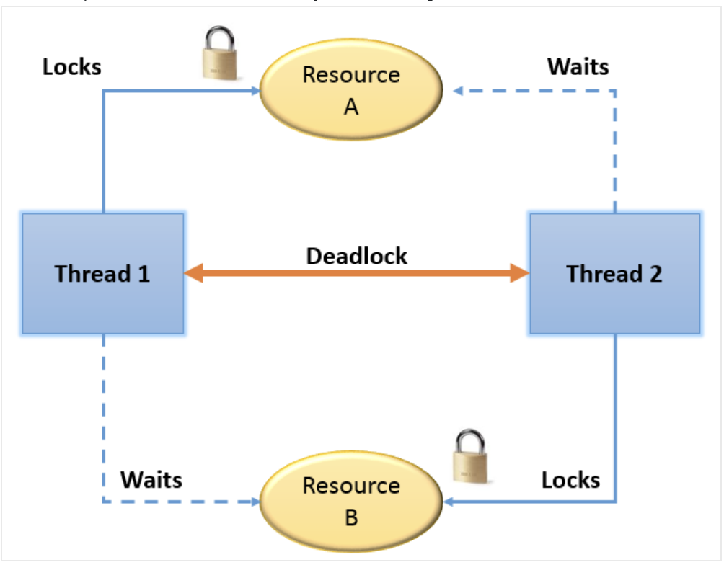

Slide 207
DeadLock Detection
Deadlock can be very hard to detect during development, and you may have to restart the application in order to recover. It also happens in production environment, which causes severe consequences. Such issue is very hard to spot during testing, and is very difficult to reproduce it locally.

Slide 208
Detect Deadlock Programmatically
Java 5 introduced ThreadMXBean - an interface that provides various monitoring methods for threads.
There are many useful methods for monitoring the application performance.
The method of our interest is findMonitorDeadlockedThreads, or, if you are using Java 6,findDeadlockedThreads.
The difference is that findDeadlockedThreads can also detect deadlocks caused by owner locks (java.util.concurrent), while findMonitorDeadlockedThreads can only detect monitor locks (i.e. synchronized blocks).

Slide 209
ThreadLocal
The ThreadLocal class in Java enables you to create variables that can only be read and written by the same thread. Thus, even if two threads are executing the same code, and the code has a reference to a ThreadLocal variable, then the two threads cannot see each other’s ThreadLocal variables.

