Slide 1





GLOWGUIDE – LEGAL INFORMATION CHATBOT
GE19612 - PROFESSIONAL READINESS FOR INNOVATION, EMPLOYABILITY AND ENTREPRENEURSHIP
MADHAN B (2116210701138)
PRASADH C (2116210701191) KARTHICK RAJA K (2116210701505)
PROJECT COORDINATOR:
Dr . K.Ananthajothi M.E.,Ph.D.,
Assistant Professor(SG)
DEPARTMENT OF COMPUTER SCIENCE AND ENGINEERING

Slide 2
Abstract
This project aims to develop a user-friendly digital assistant tailored to provide
legal information in multiple languages, focusing on enhancing accessibility and
improving legal awareness among marginalized communities in India. Through a
comprehensive needs assessment, we will identify the specific legal information
requirements and accessibility challenges faced by these communities. Leveraging
advanced natural language processing (NLP) technologies, our digital assistant will
support interactions in various languages, including regional dialects spoken by the
target users. We will curate a robust legal database updated regularly by legal experts,
ensuring the accuracy and relevance of the information provided. The user interface
will be intuitively designed, catering to diverse technological literacy levels and
accessibility needs. Community engagement will be central to our approach, involving
local leaders, legal experts, and grassroots organizations in the development and
promotion process. Through partnerships and collaborations with relevant
stakeholders, we aim to ensure the sustainability and scalability of the project,
ultimately empowering marginalized communities with essential legal knowledge and
resources.

Slide 3
Problem Statement
The problem at hand lies in the prevalent lack of access to comprehensive legal
information among marginalized communities in India, compounded by language
barriers and limited resources. Despite the existence of legal frameworks, many
individuals within these communities struggle to navigate them effectively due to
linguistic constraints. By designing a user-friendly digital assistant capable of
delivering legal information in multiple languages, we aim to enhance accessibility and
improve legal awareness within marginalized communities across India.

Slide 4
Aim and Objectives
Aim:
The aim of our project is to bridge the gap in legal accessibility and awareness
among marginalized communities in India through the development and
implementation of a cutting-edge legal chatbot solution. By harnessing advanced
chatbot technology and a rich database of legal resources, our objective is to empower
individuals belonging to underserved populations to navigate complex legal procedures
with confidence and clarity
Objectives:
The objective of our project is to develop and deploy a state-of-the-art legal
chatbot, tailored for marginalized communities in India. By offering seamless user
experience, multilingual support, and a rich database of legal resources, we aim to
enhance accessibility, awareness, and empowerment in navigating complex legal
procedures.

Slide 5
Existing System
Several legal chatbot systems and pilot projects have been developed to enhance access to justice for marginalized communities. The United Nations Development Programme implemented a chatbot to provide legal aid to refugees and asylum seekers, while the Legal Aid Society of New York deployed a chatbot to assist low-income tenants with housing-related legal issues. Researchers at the University of Michigan proposed a human-centered design approach for legal chatbots, emphasizing stakeholder engagement and iterative prototyping. Other projects, like LAW-U and CREA2, focus on specific domains such as sexual violence support and general legal assistance, respectively. These existing systems demonstrate the potential of legal chatbots to bridge justice gaps but also highlight the need for continuous improvement, cultural sensitivity, and ethical considerations in their development and deployment.

Slide 6
Proposed System
The proposed system is a conversational legal chatbot designed specifically to serve marginalized communities facing barriers in accessing legal information and services. It will employ natural language processing techniques to engage users in natural dialogue, comprehend legal queries, and provide relevant information in plain language. The chatbot will be trained on a diverse corpus of legal resources tailored to the unique challenges faced by marginalized groups, such as housing rights, immigration law, workers' rights, and domestic violence support. Through an intuitive chat interface accessible via web or mobile apps, users can pose questions and receive personalized guidance on their legal matters. The system will incorporate multilingual support to cater to diverse language needs and integrate accessibility features for users with disabilities. Regular knowledge base updates and human oversight will ensure the accuracy and relevance of the legal information provided.

Slide 7
Hardware & Software Requirements
Desktop/Laptop Computers:
Processor: Intel Core i3 or equivalent
RAM: 4GB or higher
Storage: 128GB SSD or higher
Display: 15-inch monitor or larger
Operating Systems:
Database Server: MongoDB 4.4 or later
Client Devices: Windows 10, macOS 10.15, iOS 12.0, Android 7.0, or later
Development Tools:
Integrated Development Environment (IDE): Visual Studio Code, PyCharm
Version Control: Git, GitHub
Package Manager: pip (Python)
Backend Technologies:
Programming Language: Python 3.8 or later
Web Framework: Flask 1.1.2 or later
Database Connectivity: pymongo 3.11.3 or later
Natural Language Processing: NLTK 3.5 or later, BeautifulSoup 4.9.3 or later
Machine Learning: OpenAI API
Frontend Technologies:
HTML5, CSS3, JavaScript
Frontend Framework: Bootstrap 4.5.2 or later

Slide 8
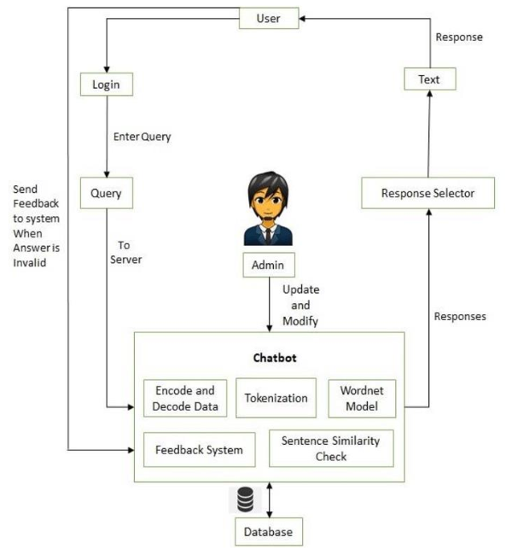
Architecture Diagram

Slide 9
Functional Description
MODULES
1. User Interface Module: This module is crafted to provide users with an
intuitive interface for seamless interaction with the Legal Chatbot. It encompasses
features like text input/output, interactive elements, and options for language selection
and accessibility settings, ensuring a user-friendly experience.
2. Natural Language Processing (NLP) Module: Tasked with analyzing user
queries, extracting pertinent information, and generating suitable responses, the NLP
module utilizes advanced techniques such as tokenization and named entity
recognition. Its goal is to comprehend user intent and context effectively to deliver
accurate and contextually relevant responses.
3. Multilingual Support Module: Empowering the chatbot to communicate with
users in multiple languages, this module includes features such as language detection,
translation services, and language-specific resources. Its aim is to ensure accessibility
for users worldwide, particularly those from diverse linguistic backgrounds.

Slide 10
Sample coding
chatbot.py
from flask import Flask, render_template, request
from flask_socketio import SocketIO, emit
from deep_translator import GoogleTranslator
app = Flask(__name__)
socketio = SocketIO(app)
# Supported languages and their codes
languages_supported = {
'en': 'English',
'hi': 'Hindi',
'ta': 'Tamil',
'bn': 'Bengali',
# Add more languages as needed
}

Slide 11
Sample coding
chatbot.py
# Sample legal information to be provided in multiple languages
legal_info = {
'en': "I'm not sure I understand. Can you provide more information or clarify your question?",
# Add more legal information as needed
}
@app.route('/')
def index():
return render_template('index1.html', languages=languages_supported)

Slide 12
Sample coding
chatbot.py
@socketio.on('send_message')
def handle_send_message(json):
message = json['message']
language = json['language']
# Identify query type and generate response
response = generate_response(message, language)
emit('receive_message', {'message': response, 'language': language})
def generate_response(message, language):
message_lower = message.lower()
if 'student' in message_lower:
response = """In India, there are several government schemes and else:
return translate_text(response, language)

Slide 13
Sample coding
chatbot.py
def translate_text(text, target_language):
translator = GoogleTranslator(source='auto', target=target_language)
translation = translator.translate(text)
return translation
if __name__ == '__main__':
socketio.run(app, debug=True)

Slide 14
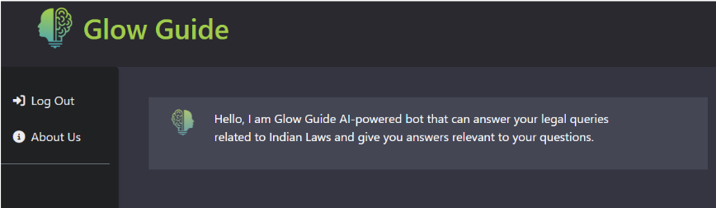
Outputs and Final Results
Glow Guide : WEB UI

Slide 15
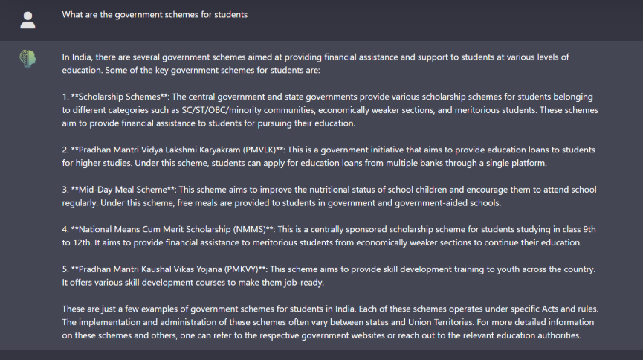
Outputs and Final Results
DEMONSTRATION

Slide 16
Conclusion and Future Enhancements
1. Advanced Natural Language Processing (NLP): Invest in more sophisticated NLP
algorithms to enhance the chatbot's ability to understand and respond to user queries with greater accuracy and nuance. This includes incorporating sentiment analysis and context awareness to tailor responses based on the emotional state and specific circumstances of the user.
2. Data Analytics and Predictive Insights: Leverage data analytics tools to analyze user interactions and generate insights into trends, patterns, and emerging legal issues within marginalized communities.
3. Partnerships and Collaborations: Strengthen partnerships with legal aid
organizations, community groups, and technology companies to expand the reach and impact of the chatbot. Collaborative efforts can facilitate resource sharing, knowledge exchange, and joint advocacy initiatives aimed at addressing systemic barriers to legal empowerment and access to justice for marginalized populations.

Slide 17
References
[1] Rabee Al-Qasem, Banan Tantour, Mohammed Maree, "Towards the Exploitation of
LLM- based Chatbot for Providing Legal Support to Palestinian Cooperatives" 2023,
ResearchGet.
[2] Jay Morgan, Adeline Paiement, Monika Seisenberger, Jane Williams, Adam Wyner,
"A Chatbot Framework for the Children's Legal Centre" 2018, ResearchGet.
[3] Mohammad Amin Kuhail, Justin Thomas, Salwa Alramlawi, Syed Jawad Hussain
Shah, Erik Thornquist, "Interacting with a Chatbot-Based Advising System:
Understanding the Effect of Chatbot Personality and User Gender on Behavior" 2022,
MDPI.
[4] Riya Sil, Shamin Shahriar Labib Chy, Sumita Bose, Humayun Kabir Mollick, "A
Study on Interactive Automated Agent based Response System over Legal Domain"
2020, ICICNIS.

Slide 18
Thank You

