Slide 1
Physics-Informed Neural Networks
for Additive Manufacturing
1D Stefan Problem — Phase Change & Solidification
• Goutam Kumar Biswas • Maddox Gonzalez
EML 5360 Project presentation
Based on:
Zhu, Liu & Yan (2021),
Computational Mechanics
67(2):619–635

Slide 2

Background
Applications include
Aerospace
Medical Implants
Automotive Industry
Why this matters
Enables complex shapes & geometries
Supports rapid prototyping
Reduces material waste compared to subtractive manufacturing, and other manufacturing processes

Slide 3
Research Gap and Questions
Research gap
▪ Most PINN literature handles smooth PDEs — phase change introduces a discontinuous source term that is poorly conditioned.
▪ Published PINN-AM studies rarely report implementation details or failure modes; reproducibility is limited.
▪ The trade-off between hard- and soft-BC enforcement is not systematically compared on the same problem.
Research Questions
▪ Q1. Can a PINN reproduce a 1D Stefan AM solidification problem to FEM-level accuracy?
▪ Q2. Does hard-BC enforcement outperform soft-BC penalties in convergence and final loss?

Slide 4
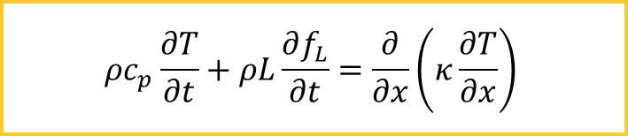
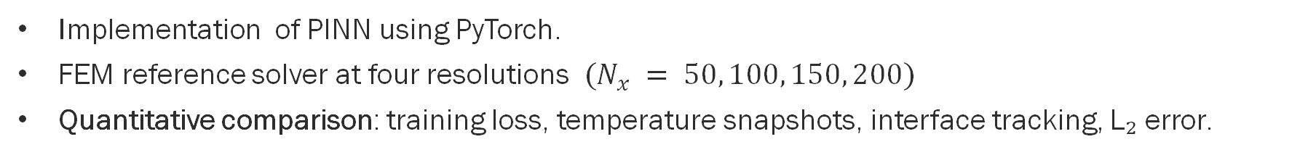
Project Objective
Reproduced the Zhu–Liu–Yan (2021) PINN framework on a 1D Stefan solidification problem, compare hard- vs soft-boundary enforcement, and benchmark the trained PINN against FEM across four mesh resolutions
$$ρc_{p}\frac{∂T}{∂t}+ρL\frac{∂f_{L}}{∂t}=\frac{∂}{∂x}\left(κ\frac{∂T}{∂x}\right)$$
Implementation of PINN using PyTorch.
FEM reference solver at four resolutions $(N_{x} = 50, 100, 150, 200)$
Quantitative comparison: training loss, temperature snapshots, interface tracking, L₂ error.

Slide 5
Related Work — PINNs and AM Thermal Modelling
Study
Contribution
Domain / PDE
Reported limitation
Raissi et al. (2019)
Introduced PINNs
Burgers, Schrödinger
Smooth PDEs only
Zhu, Liu, Yan (2021)
PINN for AM melt pool
1D Stefan, 2D steady
No BC-type comparison
Wang et al. (2022)
NTK analysis of PINNs
Convection-diffusion
Loss-weight sensitivity
Liao et al. (2023)
Adaptive sampling
Transient heat
Case-specific tuning
McClenny
&
Braga-
Self-adaptive weights
Benchmark PDEs
No phase-change test
Neto
Gap addressed by this project: none of the above directly compare hard- vs. soft-boundary enforcement on
the same phase-change problem with a matched FEM reference across multiple resolutions. This study fills
that gap and documents the practical training failure modes other papers omit.

Slide 6
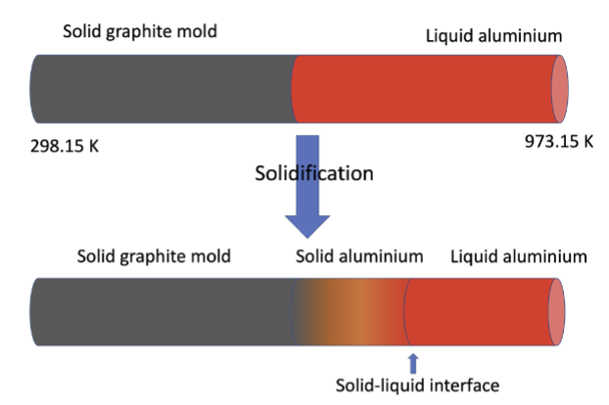




Problem Setup (1D Stefan)
Domain
A bi-material rod representing an AM deposit:
Property
Al (liq)
Al (sol)
Graphite
change)
ρ [kg/m3]
2555
2555
2200
κ [W/m K]
91
211
100
liquid phase change)
cp [J/kg K]
1190
1190
1700
L [kJ/kg]
398
398
—
Boundary conditions
(Dirichlet)
Objective: Predict T(x,t) and interface s(t) betterthan FEM, without labelled interior data.

Slide 7


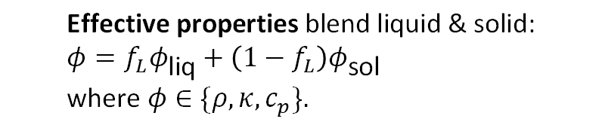
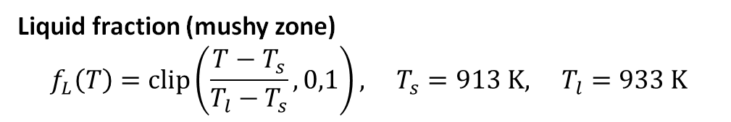
Governing Equation
Enthalpy-based heat equation form Zhu et al.
$$ρc_{p}\frac{∂T}{∂t}+ρL\frac{∂f_{L}}{∂t}=\frac{∂}{∂x}\left(κ\frac{∂T}{∂x}\right)$$
Term-by-term:
$$ρc_{p}∂_{t}T \text{— }\text{thermal} \text{inertia}$$
$$ρL∂_{t}f_{L} \text{— }\text{latent} \text{heat} \text{release}$$
$$∂_{x}\left(κ∂_{x}T\right) \text{— }\text{heat} \text{conduction}$$
PDE residual (PINN physics loss):
$$r=ρc_{p}∂_{t}T+ρL∂_{t}f_{L}−∂_{x}\left(κ∂_{x}T\right)$$
Liquid fraction (mushy zone)
$$f_{L}\left(T\right)=\text{clip}\left(\frac{T−T_{s}}{T_{l}−T_{s}},0,1\right), T_{s}=913 \text{K}, T_{l}=933 \text{K}$$
$$\text{Effective} \text{properties} \text{blend} \text{liquid} \text{\&} \text{solid}\text{:} \\ φ=f_{L}φ_{\text{liq}}+\left(1−f_{L}\right)φ_{\text{sol}} \\ \text{where} φ∈\{ρ,κ,c_{p}\}.$$

Slide 8
FEM Reference — Mesh Refinement Study
Setup
1D FEM solver on Ω= [−0.4, 0.4] m,
t ∈ [5, 10]s
Nx
∆x [m]
Nt
∆t [s]
50
1.6×10−2
50
0.20
Enthalpy form with apparent heat-capacity for
latent heat
100
8.0×10−3
100
0.10
150
5.3×10−3
150
0.067
200
4.0×10−3
200
0.050
Dirichlet BCs: Tlb =298.15 K, Tub =973.15 K
401*
2.0×10−3
201
0.050
Matched coarsening: Nt = Nx
Four resolutions
Used for: L2-error benchmark vs. PINN and
interface tracking s(t)
Nx ∈ { 50, 100, 150, 200}
Reference (“truth”): fine FEM on 401×201 grid

Slide 9













Methodology $\text{—}$PINN Architecture
Hidden Layer 1 (200)
Activation (Paper) : $\text{swish}\text{/}\text{SiLU} \text{= }x⋅σ\left(x\right)$
Activation (Our) : $tanh$
... (4 layers total)
Init: Xavier uniform: used to initialize the
weights of neural network
Hidden Layer 4 (200)
:
Input normalization

Slide 10





PINN Hard BC vs. Soft BC Enforcement
Loss
:
IC + BC penalties + PDE (4 objectives)
Loss
:
IC + PDE only (2 objectives)
Challenge:
balance
4
objectives,
risk
of
saddle-
point collapse
Advantage:
exact BC, fewer competing terms
Shared hyperparameters:

Slide 11



PINN Training Procedure
Stage 1 — Pre-training
(IC fit only)
$${Objective: ℒ}_{\text{𝓅𝓇}\text{ℯ}}=\frac{1}{N_{f}}\sum_{k}{{\left|T_{θ}\left(x_{k},t_{0}\right)−T_{k}^{\text{FEM}}\right|}^{2}/}T_{\text{NRM}}$$
Set
Symbol
Count
Initial condition
N0
300
Boundary (Soft only)
Nb
100
Initializes weights in a physically meaningful
Collocation (LHS)
Nf
40,000
state
LHS = Latin Hypercube Sampling; ensures uniform
Stage 2 — Main training
(IC + PDE + BC)
coverage without regular-grid repetition.
Analogy
:
Adam = hiker finding the valley;
L-BFGS = GPS robot locating the exact minimum.

Slide 12
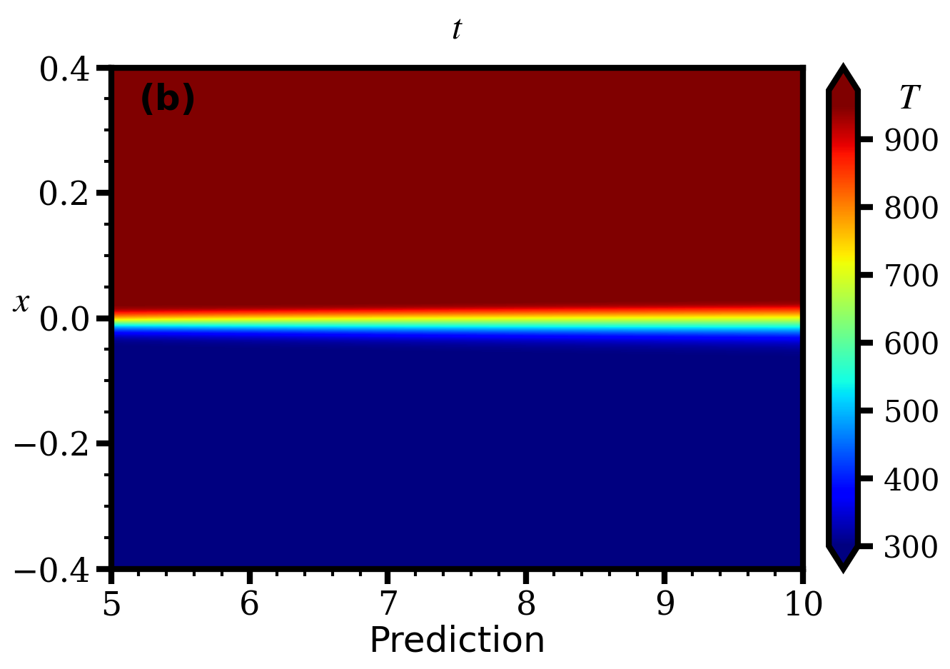
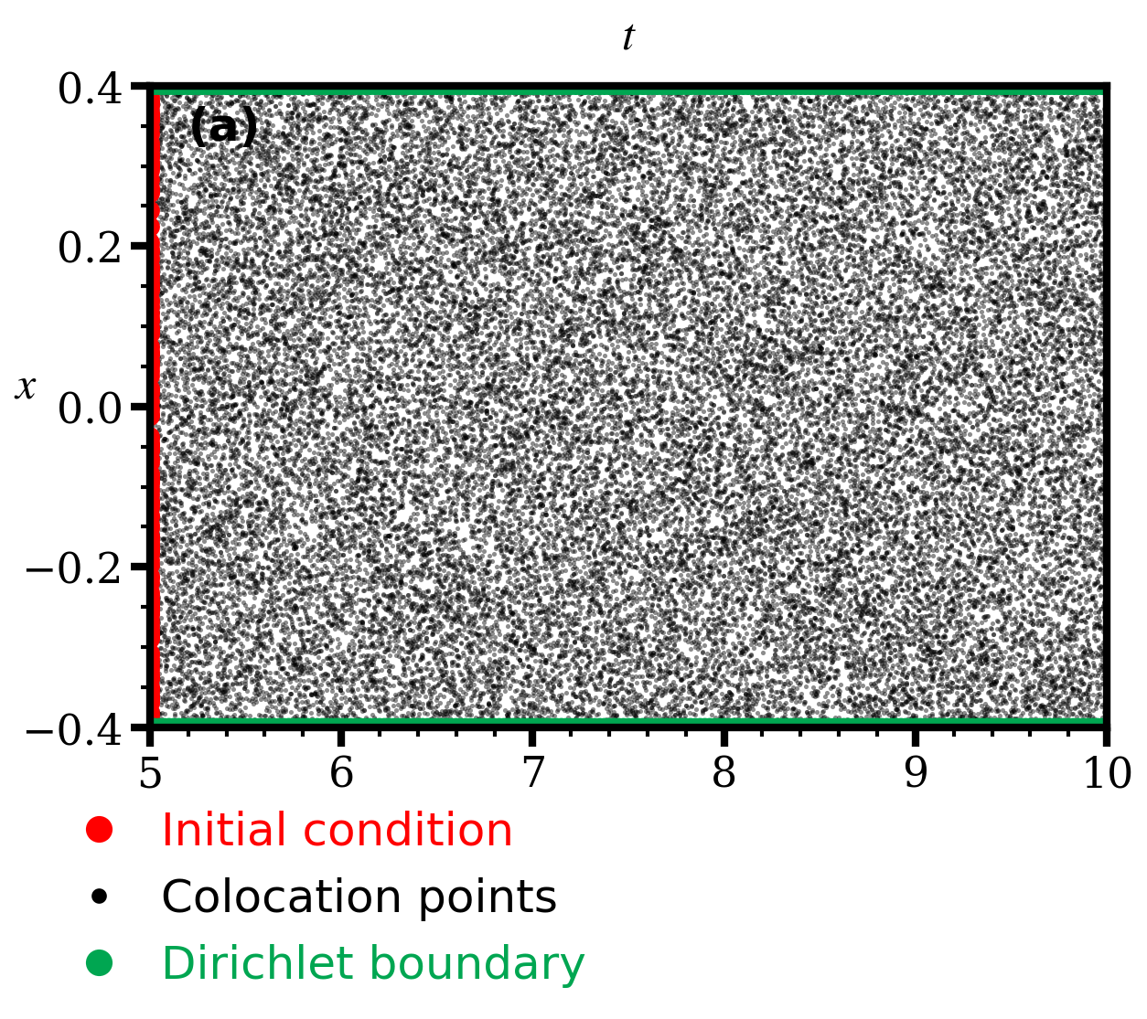
Training Data & PINN Prediction Field
(a) Training data layout in (t, x): collocation (black), IC (red), BC
(b) Predicted temperature field T(x, t) from the Hard-BC PINN
(green)
The PINN is mesh-free: once trained, T(x, t) is evaluated at any (x, t) in microseconds.

Slide 13

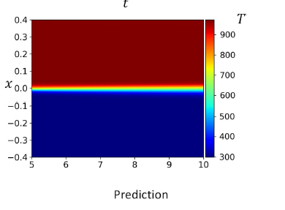
Geometry and Prediction
a)
b)
Our PINN model prediction
Zhu et al PINN model prediction
c)
d)
Fig: Predicted temperature field T(x, t) from the Hard-BC PINN

Slide 14
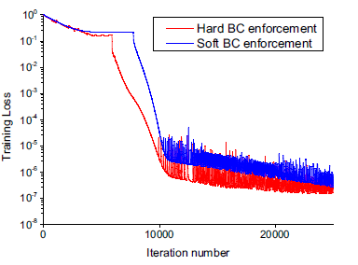
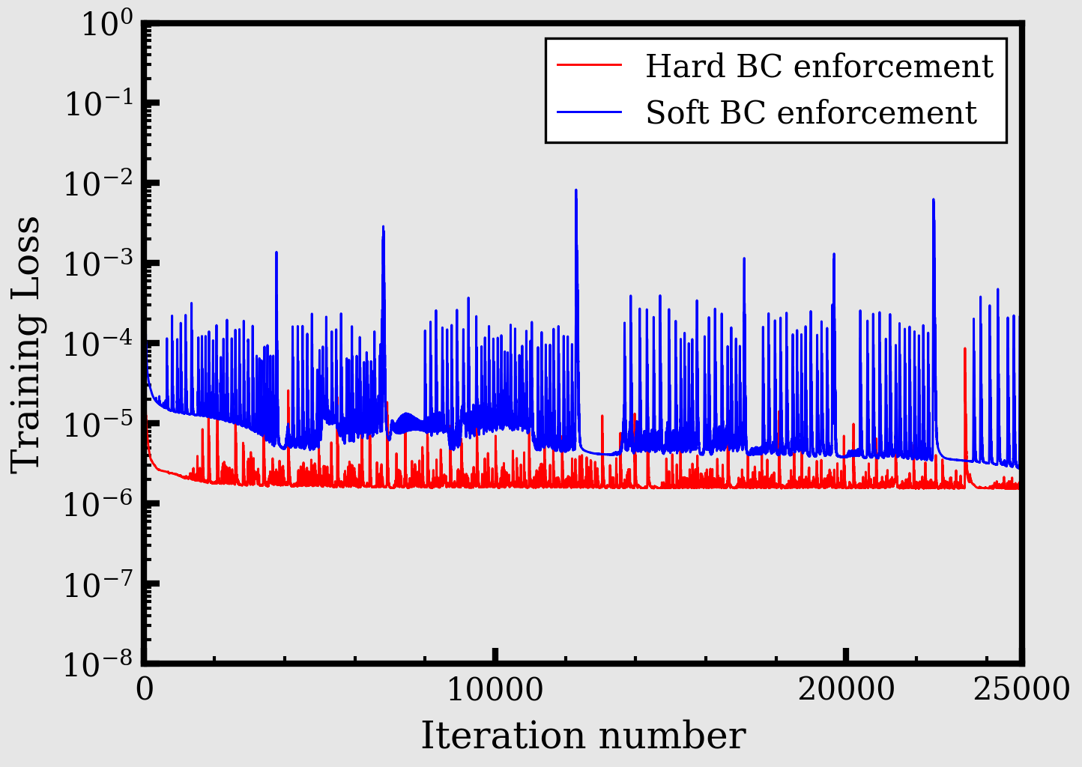
Training Loss comparison
a)
b)
Our PINN model Training loss
Zhu et al PINN Training loss
c)
d)

Slide 15
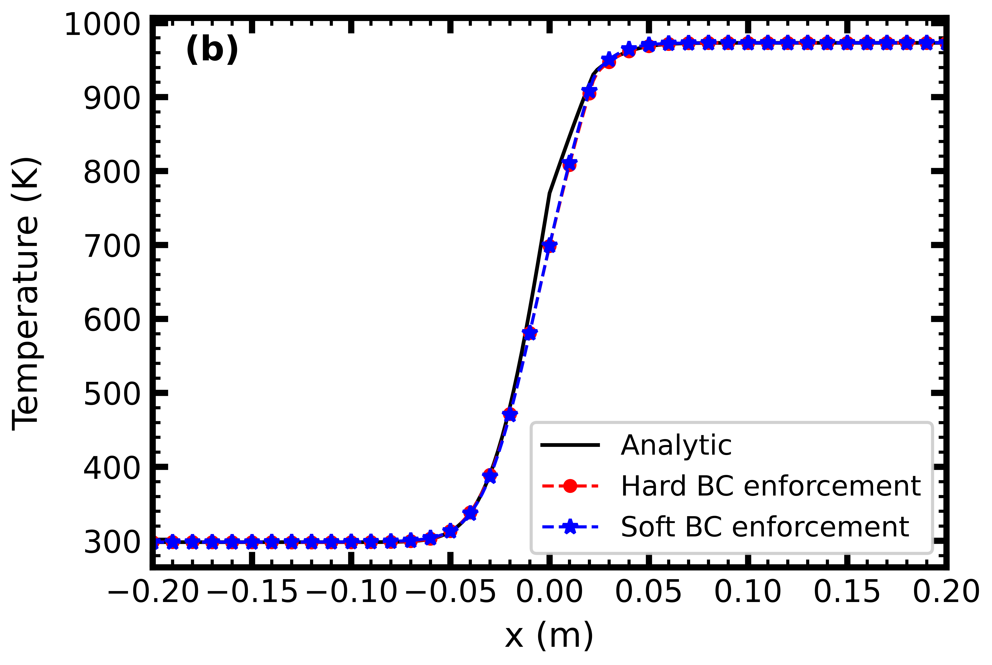
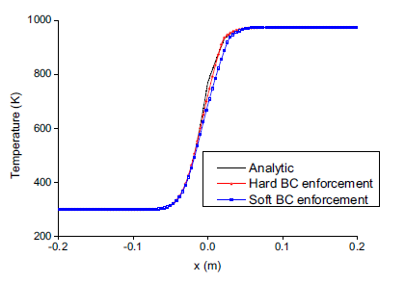
Temperature prediction comparison
Our PINN model temperature prediction
a)
b)
Zhu et al PINN model temperature prediction
c)
d)
Both Hard- and Soft-BC PINN predictions track the FEM reference across the domain, including the mushy zone near
x ≈ 0–0.1 m.

Slide 16
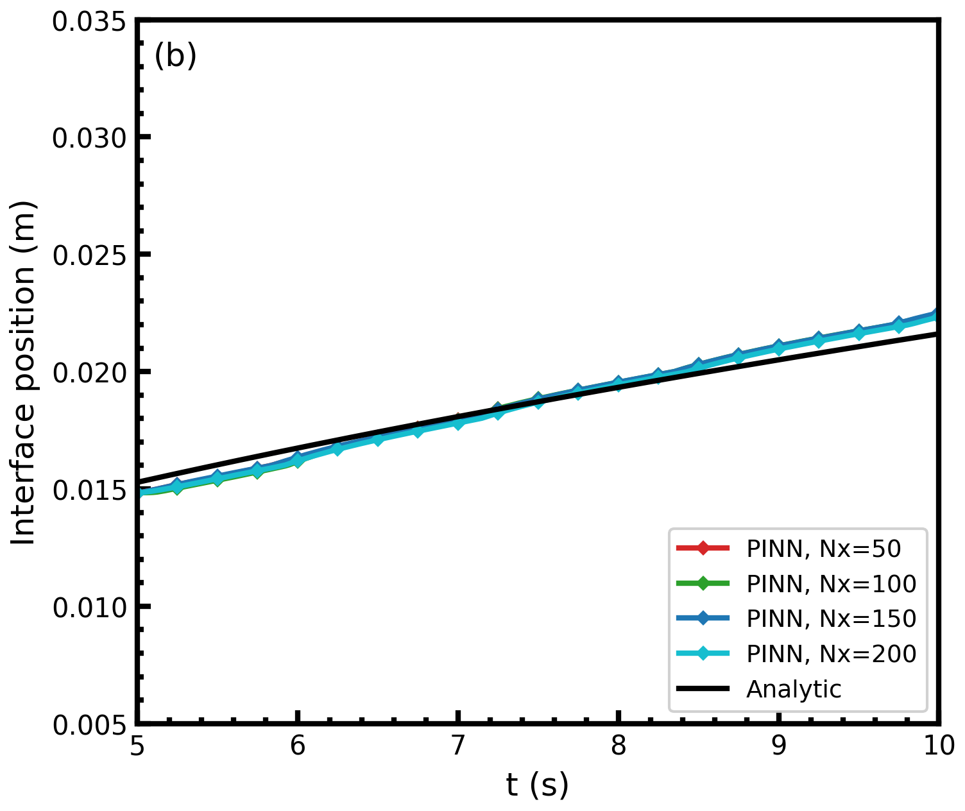
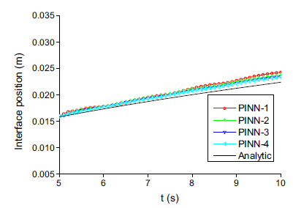
Solid--Liquid Interface Tracking- PINN comparison
Our PINN model interface prediction
Zhu et al PINN model interface prediction
Fig: PINN interface at N = 50, 100, 150, 200 collocation points

Slide 17
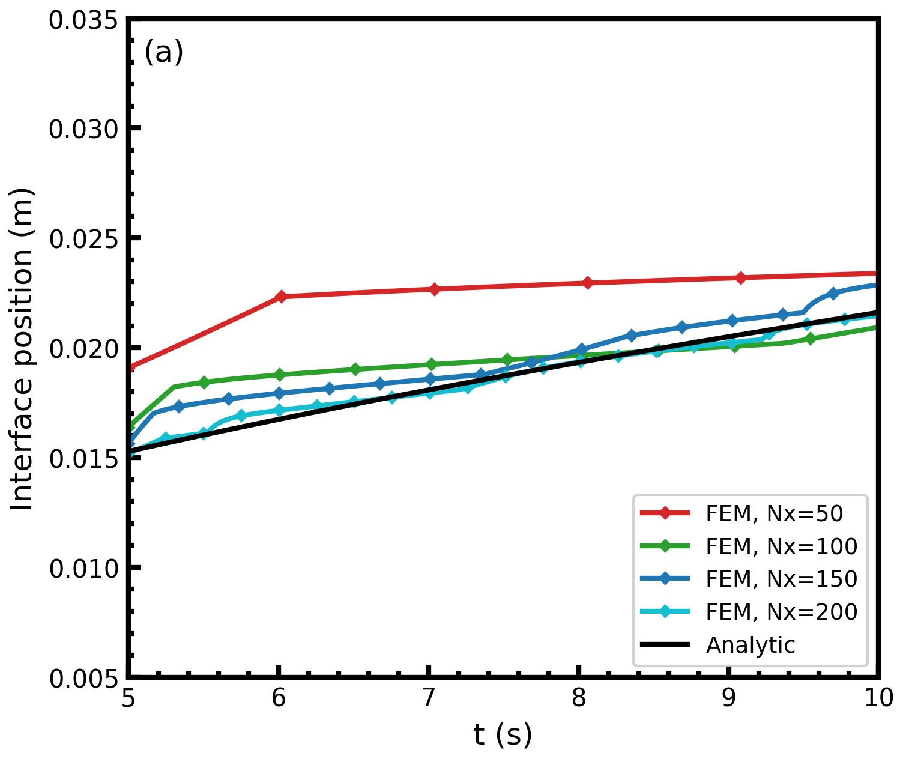
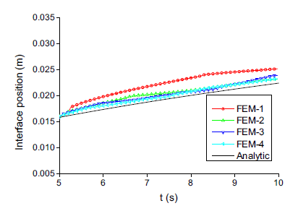
FEM mesh study comparison
Our FEM temperature prediction
Zhu et al FEM temperature prediction
Fig: FEM interface s(t) at Nx = 50, 100, 150, 200 (Nt = Nx)

Slide 18
Results — L2 Resolution Study
Resolution Nx
FEM L2 (Our)
FEM L2 (paper)
PINN L2 (Hard)
PINN L2 (Soft)
∆ FEM vs. PINN
50
3.6×10−2
3.7×10−2
1.1×10−3
2.4×10−3
FEM ≫ PINN
100
9.1×10−3
9.3×10−3
1.0×10−3
2.2×10−3
FEM > PINN
150
4.1×10−3
4.2×10−3
1.0×10−3
2.1×10−3
FEM > PINN
200
2.3×10−3
2.4×10−3
0.9×10−3
2.0×10−3
FEM ≈ PINN
Key observations
FEM error scales as Nx— requires Nx ≥ 200 to match the PINN accuracy.
PINN error is set at training time — resolution-independent, no post-hoc tuning.
At Nx ≤ 150: single trained PINN outperforms FEM with zero re-computation cost.

Slide 19
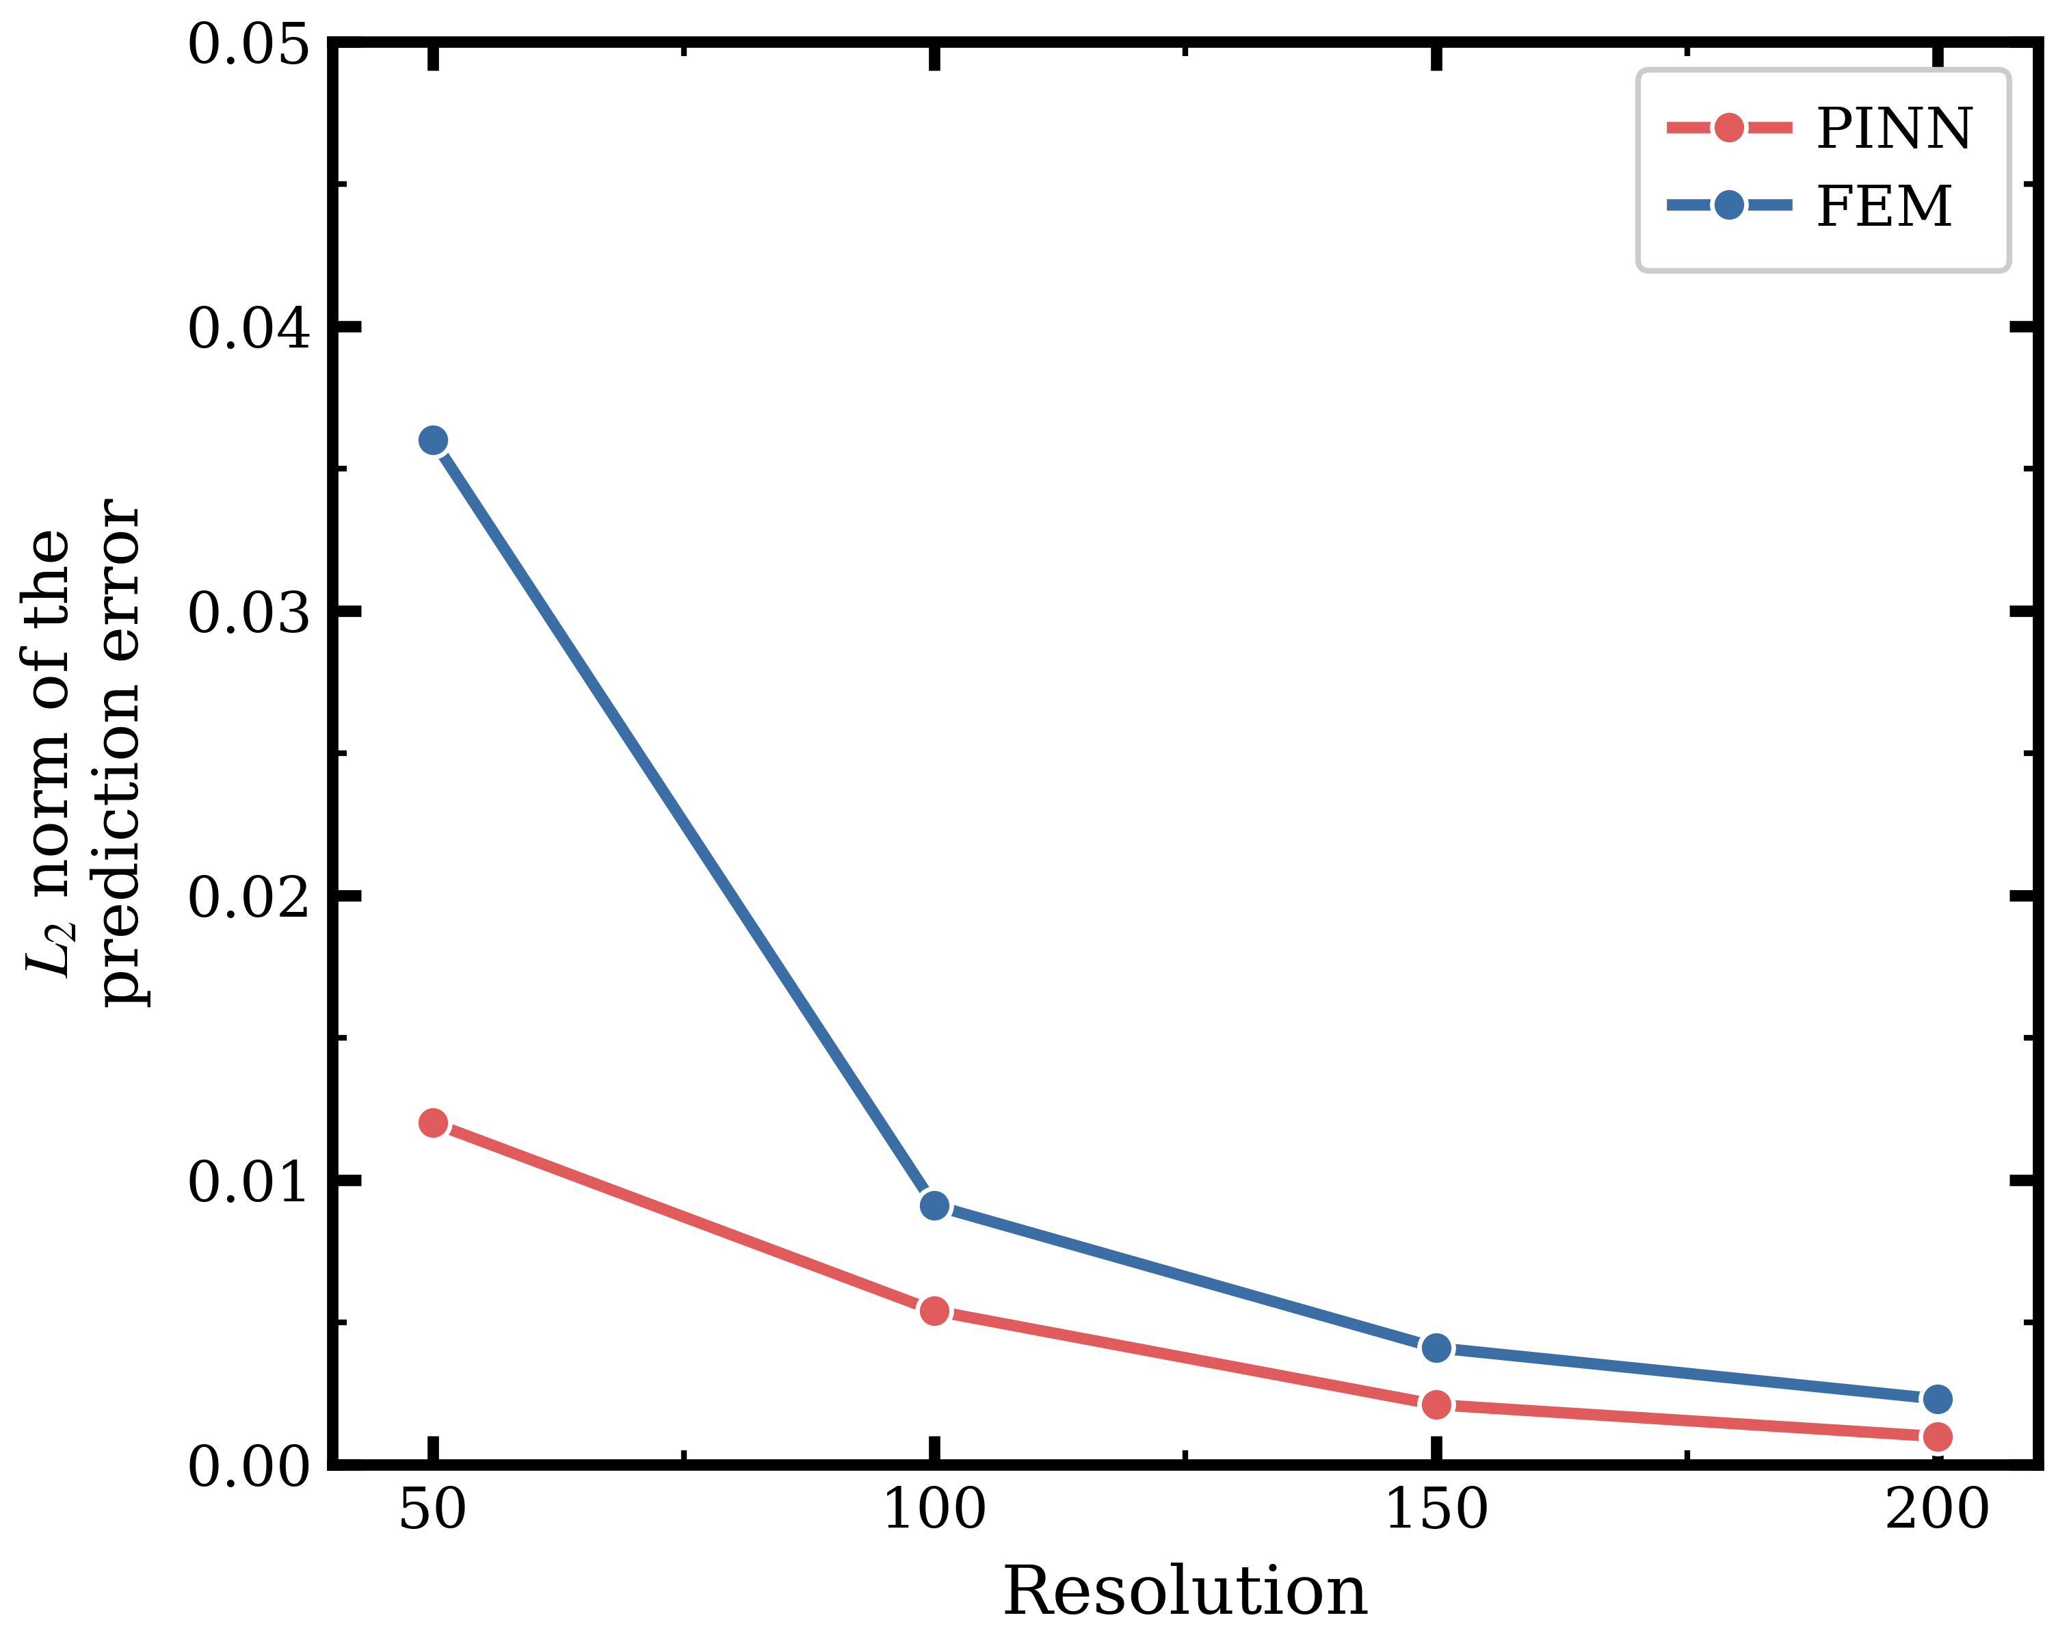
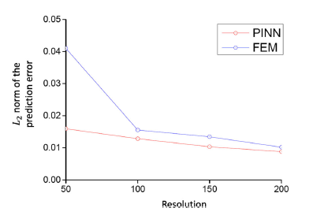
L2 norm prediction error
Our L2 error
Zhu et al L2 error
Relative L2 error vs. spatial resolution Nx | Reference: fine FEM on 401×201 grid

Slide 20
Conclusion
Temperature profiles: PINN ≈ FEM
Mesh-free: evaluate at any (x, t)
reference
Resolution-independent: one net ≡all Nx
Interface tracking: matches analytic
s∗(t)
Physics-constrained: PDE embedded
L2 study: FEM > PINN at Nx ≤ 150
Matches paper Fig. 6
Data-efficient: IC from FEM at t0 only
Summary: PINN trained on the 1D Stefan problem achieves accuracy comparable to a fine FEM solution, However
while remaining mesh-free

Slide 21
Weaknesses & Future Work
Potential weaknesses
Future work
. IC relies on a FEM reference at t_0 — not fully data-free
2D extension — PINN advantage grows as
FEM cost scales ∼ N2.
Uncertainty quantification — Bayesian
PINN or ensembles.
. Only 1 dimension is taken into account
Real AM integration — laser boundary
source, 3D multi-layer deposits.

Slide 22
References
[1] Q. Zhu, Z. Liu, J. Yan, "Machine learning for metal additive manufacturing: predicting temperature and melt pool fluid dynamics using physics-informed neural networks," Computational Mechanics 67(2): 619-635, 2021. DOI: https://doi.org/10.1007/s00466-020-01952-9
[2] M. Raissi, P. Perdikaris, G. E. Karniadakis, "Physics-informed neural networks: a deep learning framework for solving forward and inverse problems involving nonlinear partial differential equations," Journal of Computational Physics 378: 686-707, 2019. DOI: https://doi.org/10.1016/j.jcp.2018.10.045
[3] S. Wang, Y. Teng, P. Perdikaris, "Understanding and mitigating gradient flow pathologies in physics-informed neural networks," SIAM Journal on Scientific Computing 43(5): A3055-A3081, 2021. DOI: https://doi.org/10.1137/20M1318043
[4] S. Liao, T. Xue, J. Jeong, S. Webster, K. Ehmann, J. Cao, "Hybrid thermal modeling of additive manufacturing processes using physics-informed neural networks for temperature prediction and parameter identification," Computational Mechanics 72(3): 499-512, 2023. DOI: https://doi.org/10.1007/s00466-022-02257-9
[5] L. D. McClenny, U. M. Braga-Neto, "Self-Adaptive Physics-Informed Neural Networks using a Soft Attention Mechanism," arXiv, 2020. DOI: https://doi.org/10.48550/arXiv.2009.04544
Thank you — Questions?

