Slide 1
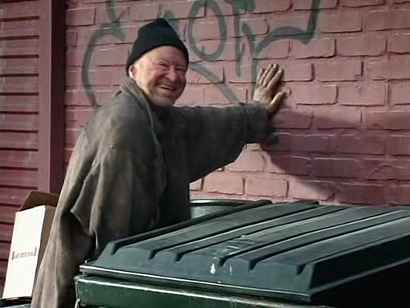
Title Layout
MEET ME IN THE ALLEY
AN ONLINE MARKET PLACE
Subtitle
Created by:
Daniel Olivas, Bon Silva, Andrew Nowlin,
Daniel Shook & Matthew Babcock
*Not responsible for anything that happens to you if you do meet someone in the alley.

Slide 2
Title Layout
Concept & Reason
The why?
Poor functionality of Letgo, Offerup, etc.
To create a better and more intuitive app for searching and posting items.
Subtitle

Slide 3
Title Layout
Design Process
Responsibilities
Bon – HTML Routes, Controller and Sequelize
Daniel O – Handlebars, CSS HTML, front-end, GitIgnore
Andrew – Sequelize, API Routes, ServerJS, MySQL, Config
Matt – SASS
Daniel S -
Subtitle

Slide 4
Title Layout
Design Process
Integrating all the moving pieces required project management
To succeed, means having to work to incorporate everyone’s code.
Subtitle

Slide 5
Title Layout
TECHNOLOGIES
SequelizeJS
HandlebarsJS
ExpressJS
PathJS
MySQL
APIs
Routes
TOAD Data Modeler
Subtitle

Slide 6
Title Layout
DEMONSTRATION
Subtitle

Slide 7
Title Layout
FUTURE STATE
Authentication
Add more categories
Create more functionality with the searches
Add a company backend for reporting on statistics of buyers, sellers, products, etc.
To provide a statistical interface for sellers to monitor their accounts
APIs
Routes
TOAD Data Modeler
Allow sellers to update data about their products
Keep track of sales
Testing
Questions?
Subtitle

