Slide 1
Breaking the Dilemma of
Medical Image-2-Image Translation
By :
Ashish Tara Shivakumar Ireddy
J41325c
Advanced Natural Language Processing April 2022

Slide 2
Brief Info on the Paper
Paper Name - “Breaking the Dilemma of Medical Image-to-image Translation”
Date of Publication – October 2021
Journal - Advances in Neural Information Processing Systems 34 pre- proceedings (NeurIPS 2021) (NIPS Journal)
Doi - https://doi.org/10.48550/arXiv.2110.06465
Citations so far: 3
The Application: https://github.com/Kid-Liet/Reg-GAN

Slide 3
What is the Paper about...??
Medical Imaging & its Analysis
Existing Issues when dealing with Imaging
A new approach to tackle existing imaging issues
Comparison of the new Approach with existing methods
Effectiveness of using the new Approach
* I will be discussing the pros, cons. Applications, experiments, finding out more about it. Its practcial relevamce. Detailed explantaion of this technology. In the end i haave also analysed the applicability of this tech in the actual medical field.

Slide 4
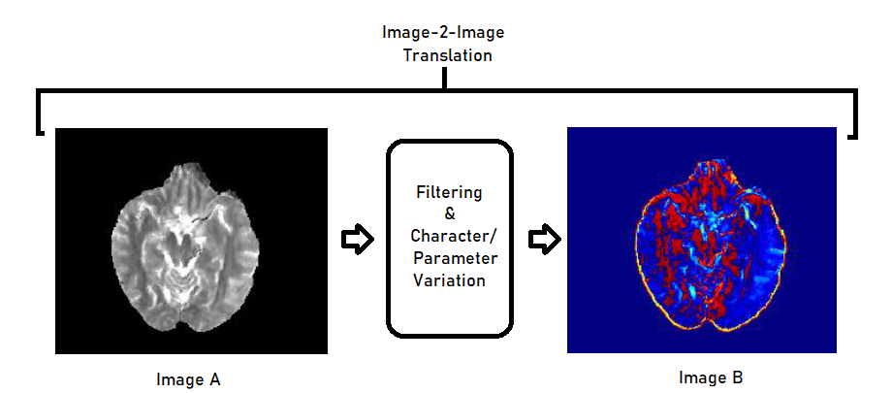
Introduction
Medical Image-2-Image Translation is a methodology in which an Image ‘A’ is applied with a specific set of Characteristics so as to produce Image ‘B’ which consists of additional highlightable features from Image ‘A’ via changes to its Characteristics. (something like Filters and Characteristics)
This Method of Imaging is widely used in the Medical sphere to Diagnose and Treat patients. (instances such as Tumors, Abnormatilies etc)
E.g. MRI, CAT scans etc.
Image Translations provide
Advanced Analysis of Images
To visualize Details that cannot be highlighted otherwise

Slide 5
Introduction - Contd
In Today’s market, Pix2Pix and Cycle Consistency are the most extensively used methods to perform image2image translations.
The paper proposes a new method to perform and enhance Image2Image Translations. It is called as RegGAN.
RegGAN works similar to Cycle Consistency & Pix2Pix only using their weakness & deficients as power points to improve its own performance.
The Functionality of RegGAN is greater than that of Cycle Consistency & Pix2Pix according to the tests performed by the Authors.
RegGAN can provide a stronger and enhanced approach to dealing with Medical Imaging & analysis.

Slide 6
Background - 1
What is Medical Imaging..??
Medical imaging refers to several different technologies that are used to view the human body in order to diagnose, monitor, or treat medical conditions.
Why Filtering..??
Medical image translation has the potential to reduce the imaging workload, by removing the need to capture some sequences, and to reduce the annotation burden for developing machine learning methods.
(GANs) Generative Adversarial networks have been used successfully to translate images from one domain to another.

Slide 7
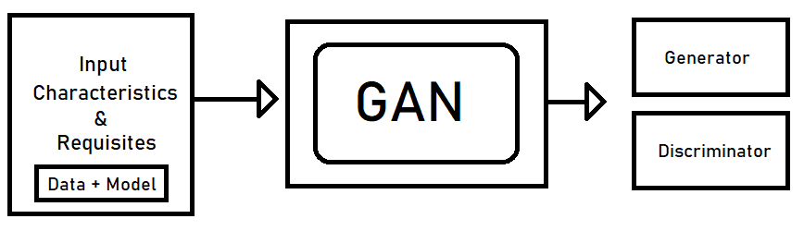
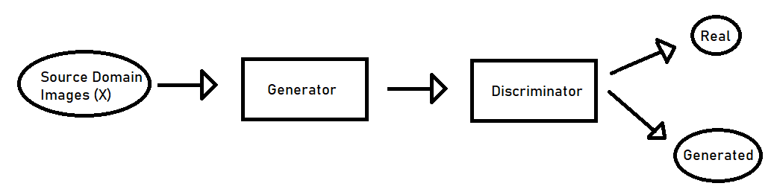
Background - 2
What is a (GAN) Generative Adversarial Networks...??
Generator & Discriminator

Slide 8
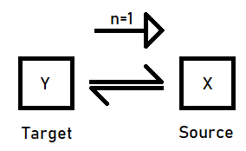
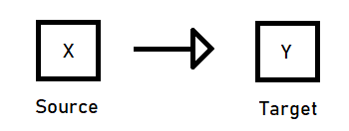

Background - 3
Supervised Pix2Pix and unsupervised Cycle-consistency are two modes that dominate the field of medical image-to-image translation.
The Pix2Pix mode has excellent performance. But it requires paired and well pixel-wise aligned images. (Pixel Level details are Crucial)
The Cycle-consistency mode is less stringent with training data and works well on unpaired or misaligned images. But its performance may not be optimal.
Pix2Pix
Cycle Consistency

Slide 9
Limitations & rise of issues
Why propose a new technique..??
-> To deal with misaligned and unpaired images
-> Enhance current gen techniques
-> Improve Quality & accuracy of detection
Whats the issue with existing techniques..??
1. Pix2Pix:
  Heavily dependent on Aligned & paired images
  High variation & error if images are not aligned properly
2. Cycle Consistency
  Better than Pix2Pix but is affected by Multiple solutions issue
  Misalignment & Non paired does not have major effect, yet accuracy takes a toll

Slide 10
Methodology / Solution
A new unsupervised model called RegGAN for medical image-to-image translation.
The REGGAN Model is based on the theory of "loss-correction". It is based off Pix2Pix & Cycle Consistency
In RegGAN, the misaligned target images are considered as noisy labels and the generator is trained with an additional registration network to fit the misaligned noise distribution adaptively.
The goal is to search for the common optimal solution to both image-to-image translation and registration tasks.

Slide 11
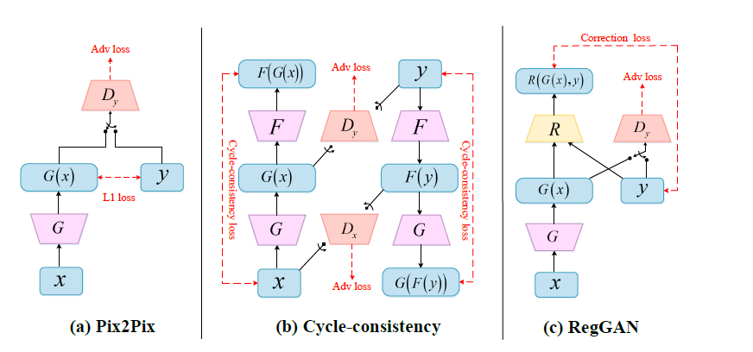
Elaboration of the Methodology
RegGAN produces a noise transition matrix.
This matrix is used to create a Noise Distribution which is there in used to resolve the uncertainty

Slide 12
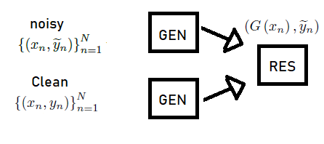

Analysis of Methodology
The Theoretical approach is to try and attain the Same result from a noisy Dataset applied through a generator as a Clean Dataset.
The Influence on noise cannot be theoretically removed using Equational modifications instead the Noise is addressed using a “Loss Correction” methodology.

Slide 13
Experimental Analysis
The model was tested against the Pix2Pix & Cycle Consistency methods for performance.
The Test Experiment was conducted on training Dataset of T1 & T2 MR images.
It was determined that the RegGAN model had better feasibility and superiority of the RegGAN mode in various methods.
The Method has better sensitivity to Noise than the Latter.
The Availability of RegGAN on unpaired data makes it much more reliable to produce a single solution when compared to the rest.

Slide 14
Experimental Analysis
The Dataset was modified and created such that there were
1. misaligned images by randomly adding different levels of rotation, translation and rescaling to the original images.
2. Mix and Match images from T1 and T2
3. Random Image pairing
Types of Comparisons Carried out
1. Based on Training Mode
2. Based on Metrics

Slide 15
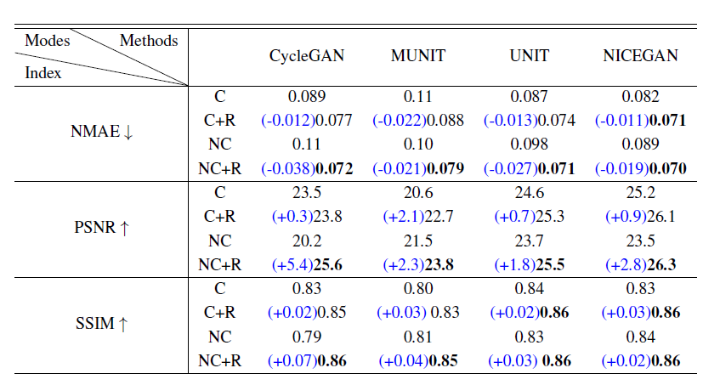
Experimental Analysis
Comparison based on Training
1. C(Cycle-consistency)
2. C+R (Cycle-consistency + Registration):
3. NC(Non Cycle-consistency):
4. NC+R(Non Cycle-consistency
+ Registration):

Slide 16
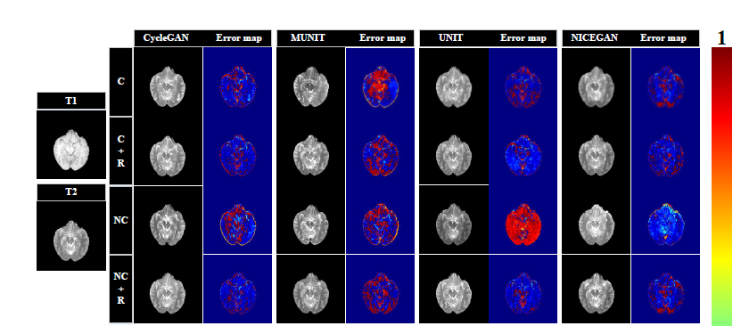
Experimental Analysis
Error View by model of each method

Slide 17
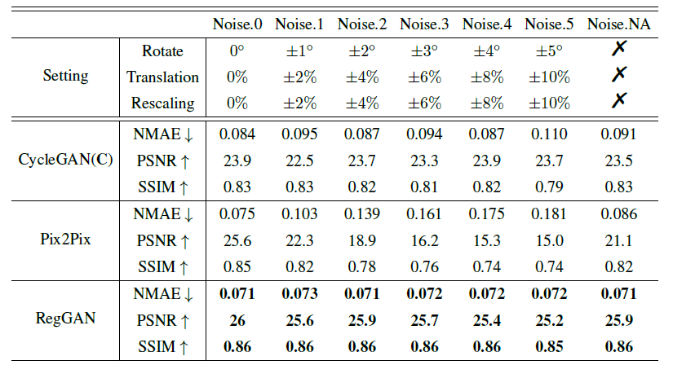
Experimental Analysis
Comparison based on Metrics
The Normalized Mean Absolute Error (NMAE)
Peak Signal to Noise Ratio (PSNR)
Structural Similarity (SSIM)

Slide 18
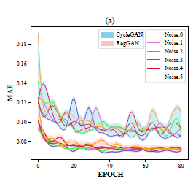
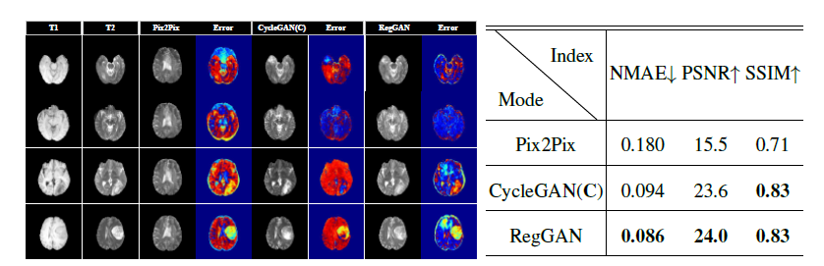
Applications & examples - 2

Slide 19
Advantages
1. RegGAN eliminates the requirement for well aligned paired images
2. Searches unique solution in training process.
3. Outperformed both Pix2Pix on aligned data and Cycle-consistency˘aon misaligned or unpaired data (according to authors test result)
4. RegGAN can be integrated into other methods without changing the original network architecture
5. Compared to Cycle-consistency with two generators and discriminators, RegGAN can provide better performance using less network parameters.

Slide 20
Future Work & Conclusion
Image compression is a technique of reducing the redundancies in image and represents it in shorter manner, which can allow more cost-effective utilization of network bandwidth and storage capacity. Therefore, the medical image compression plays an important role in many applications.
RegGAN is insensitive to noises which makes it a better choice for a wide range of scenarios, especially for medical image-to-image translation tasks in which well pixel-wise aligned data are not available.
RegGAN has the potential to overtake present gen methodologied such as pix2pix & cycle Consistency over their adaptability to noise and variations. There is more scope ahead for this method to be commercially implemented.

Slide 21
My View on this Paper....

