Slide 1
Python
Title Slide
Heading
• Font: Calibri, 32 pt, Bold
• Color: White
Secondary Heading
• Font: Calibri, 18 pt
• Color: White
Date
• Font: Calibri, 16 pt
• Color: White
NO SLIDE NUMBER
Click on the corner of this text box to delete
Presenter: Venkatesh Reddy Madduri

Slide 2
Python - Introduction
Python is a high-level, easy, interpreted, general-purpose, and dynamic programming language. It supports object-oriented programming approach. It is straight forward to learn, and its elegant syntax allows programmers to express concepts in fewer lines of code as compared to other languages such as C, C++, or Java.
It has excellent data-structure, which makes it a unique language for scripting and application development on most platforms.
Python is a platform-independent language, which means a Python program can run on any operating system like Windows, Macintosh, Linux, etc.
Python runs on an interpreted system, which means that code can be executed line by line.
Python is a dynamically typed, so we don’t need to declare the data type of variable such as x=20 assigns an integer value to an integer variable.
In Python, development and debugging is fast because there are no compilation steps included in Python development, and edit-test-debug cycle is also very fast.

Slide 3
Python - History
A Brief History of Python
The implementation of Python was started in the late 1980s by Guido van Rossum as a member of the National Research Institute of Mathematics and Computer Science in Netherland. Its first version was released on February 20, 1991.
The Python concepts have taken from the ABC programming language. ABC is a general-purpose programming language, and the greatest achievement of ABC was to influence the design of Python.
ABC programming language is known as predecessor of the Python language. ABC was capable of Exception Handling and interfacing with Amoeba Operating System.
Fact about choosing a name: The inspiration for the title came from BBC’s popular TV Show – ‘Monty Python’s Flying Circus,’ as Guido van Rossum was a big fan of the TV show. He wanted a short, unique and little bit mysterious name for his invention and hence he named it Python.
In 1994, Python version 1.0 was released with new features like map, filter, and reduce.
Python 2.0 was released on Oct 2000 with new features like list comprehension and garbage collection system.
Python 3.0, also known as “Py3k” was released on December 3, 2018, with new features. For example, in Python 2.x, “print” is a statement. In 3.x “print()” is function.

Slide 4
Python - Usages
Usage of Python
Python is used by many programmers and used in various fields. Most of the time, it is used to perform any complicated task in a much easier way than other programming languages.
When Python is installed, it comes up with the many powerful libraries which made up of many functions.
There are many libraries available on the internet that makes it possible to do complicated tasks more straightforwardly.
These standard libraries make it a powerful programming language. Python is widely used in the following fields:
Web development,
Software development,
Machine Learning,
GUIs based applications,
Network programming,
Game development,
Mathematics
Artificial Intelligence
Data Science

Slide 5
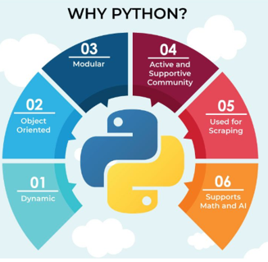
Python – Why?
Python provides rich libraries:
Python provides vast standard libraries that include areas like machine learning, mathematics, web service tools, operating system interfaces, and protocols.
Python is Open Source language:
Python is freely available at its official site (www.python.org). Anyone can download Python from its official website
Easy to use:
Python is very easy to learn and easy to use. It is a user-friendly language. It uses a few lines to express the code as compared to other languages.
For example- Suppose you want to print “Hello world” in java, code will be

Slide 6
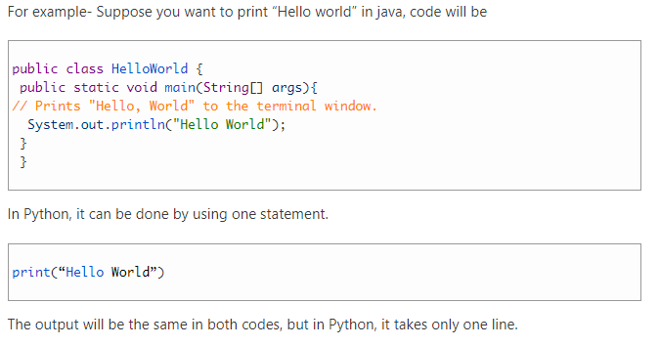
Python – Why contin..

Slide 7
Python - Why contin..
Frameworks and Libraries
Python provides various frameworks for different development fields. There are some popular frameworks given below:
Web development (Server-side): Django is the most popular web development framework of Python. Flask, Pyramid, CherryPy, and others are also used for development.
GUIs based applications: Tk, PyGTK, PyQt, PyJs, etc
Machine Learning: TensorFlow, PyTorch, Scikit-learn, Matplotlib, etc
Mathematics: Numpy, Pandas, etc.
Object-Oriented Approach
Python supports object-oriented programming approach. In object-oriented programming, OOPs concepts are based on creating reusable code and solve programming problems by creating objects. These concepts are also known as DRY (Don’t Repeat Yourself).
In Python, OOPs concepts are given below
Classes
Objects
Inheritance
Polymorphism
Encapsulation

Slide 8
Python - Why contin..
Extensible
Python is extensible, which allows invoking C and C++ library, and you can combine JAVA as well as .NET components.
Portability
Python is a portable language. For example, we have Python program for windows, and we want to run this code on other platforms such as Mac, Unix, Linux, then we do not need to change the code, we can run it on any platform. In this tutorial, we have covered a brief introduction to Python. Python is a very popular language and nothing wrong to say that it is the next generation language

Slide 9
Python – Features….
Python is a powerful, easy to learn, popular programming language. It has effective data structures and its elegant syntax makes it user-friendly language.
Below are the key features of Python:
a) Easy to code
Coding in Python is effortless as compared to other programming languages like Java and C++.
It does not take too much time to learn Python syntax; anyone can learn it in just a few hours or days; thus, it is a programmer-friendly language.
A user with the non-coding background can also quickly learn this language if they have good logical skill.
b) Easy to read
Being a high-level programming language, Python code is quite similar like English. There is no use of curly braces, it is used indentation to define the block of code, and its code is easy to read.

Slide 10
Python – Features….
2. High-level Language
Python is a high-level language. It focuses more on the programming logic rather than the essential hardware components such as memory addressing and registers utilization.
Its code runs freely and does not require knowledge about the system architecture. We also do not need to manage the memory.
3. Interpreted
Programming languages like C or C++, there are two steps for execution of code that we must first compile it, and then run it, whereas, in Python, there is no need to compile it. Internally, its source code is converted into an immediate form called byte code.
Python is an interpreted language; its means that Python code is executed line by line and all code at once. That’s why; it is easier to debug your code. The interpreter makes it a little bit slower than JAVA, but that does not matter because it provides benefit as compared to other languages.
Python is tending to be more flexible than the compiled languages. It provides automatic memory management.

Slide 11
Python – Features….
4. Object-Oriented
Python supports object-oriented programming approach and concepts of objects, classes, encapsulation, inheritance, etc. It focuses on objects and combines data and functions. In OOPs, real-world entities are represented through an object, and classes are the blueprint of the object.
It also supports procedural-oriented language. Procedural language programming revolves around functions and makes code reusable.
Object-oriented programming is the most natural and useful approach. OOPs concepts allow break down your software into a smaller problem that you can solve – one object at a time.
The OOPs allow reusing of code using inheritance where child class can inherit all the properties of base (Parent) class. We will learn about these concepts later.

Slide 12
Python – Features….
5. Dynamically Typed
Python is the dynamically typed language; it means data type does not assign while declaring variables. The kind of value is decided at run time, not in advance.
When we declare a variable with some value, that value will get stored at memory location and binds that variable to memory container. For example, we can write x=”Hello world” assign to string value to a string variable.
The benefit of using dynamic memory allocation is avoiding the wastage of memory. When we use static memory allocation, a lot of memory is wasted because all memory allocation cannot be utilized.
6. Large standard Library
When you install Python, It downloaded with a vast library that you can use, so you don’t have to write to everything in your code.
There is a library for regular expressions, threading, databases, image-manipulation, unit-testing web browsers, CGI, and a lot of functionality.
Python library is a collection of methods and function. It allows you to perform many tasks without writing code.

Slide 13
Python – Features….
7. Extensible
Python is extensible, its means you can write your Python code in other languages such as Java, C, C++. This makes a Python an extensible language.
It’s not extending the language itself (syntax, constructs, etc.), but it does let you interface Python with libraries written in other languages. (mainly C or C++, but using C as a bridge you can call other languages as well that provide C interfaces.)
8. Portable
Python is portable, or we can say, platform-independent. Python code can execute in various platform like Mac, Linux, Windows, etc. Suppose you wrote your code in Windows machine. Now, if you want to run it on a Linux, you don’t need to changes to it. There is no need to write different code for different platform.
9. Free and Open Source
Python is freely available on its official website (www.python.org). Anyone can download and install it. You can also download an IDE (Integrated Development Environment) for Python such as Pycharm, Jupiter, Visual studio, etc.
Python is also an open-source language; its means that the source code of Python is freely available without any restriction. Anyone can download it, use it, and create to new module or functions and distribute to Python community.

Slide 14
Python – Features….
10. GUI Programming
GUI is an acronyms of “Graphical User Interface.” We can develop a basic desktop-based application by using Python Tkinter or PyQt.
11. Expressive
Python is an expressive language. Its means that single line of Python code can be more expressive than other programming languages.
The key feature of a more expressive language is that-the fewer line of code you write, faster you can complete the project. It is easier to debug and maintains the code.

Slide 15
Python – Installation.

Slide 16

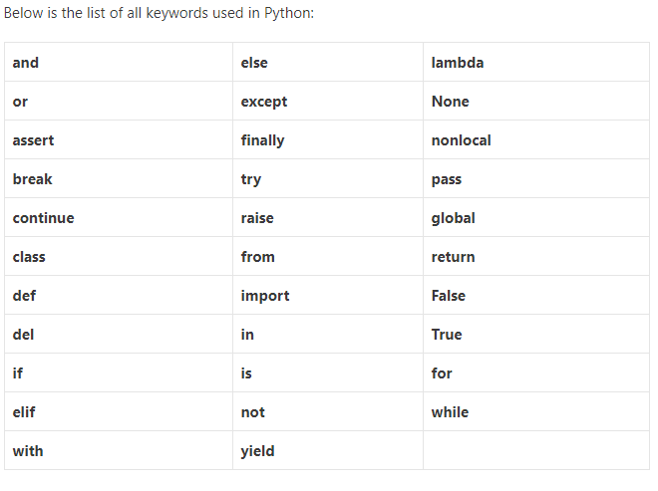
Python – Keywords
Keywords are the reserved words that have special meanings to the compiler. They cannot be used as a variable. Keywords are the part of the syntax, for example:

Slide 17
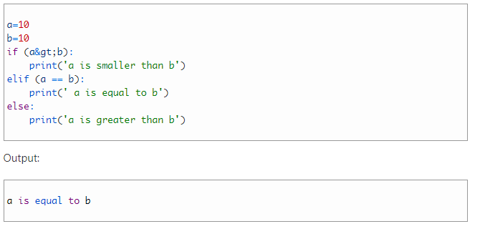
Python – Keywords
If, elif and else
print(1==1) // True
print(1&gt;1) // False

Slide 18
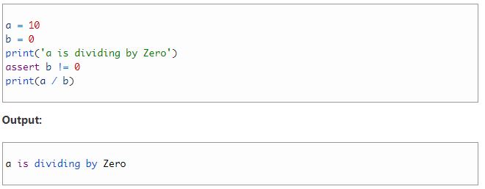
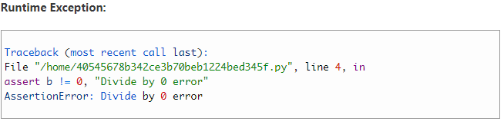
Python – Keywords
assert
The assert is a keyword which is used as a debugging tool. It helps in a smooth flow of code. It helps us to find bugs more conveniently
Assertions are mainly assumptions that a programmer knows and always wants it to be true. Hence puts them in code so that failure of that statement doesn’t allow the code to execute further.

Slide 19


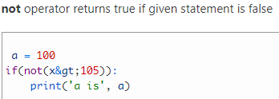
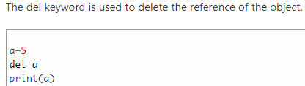

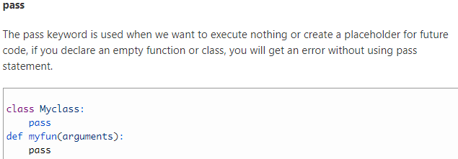
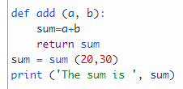
Python – Keywords Examples

Slide 20
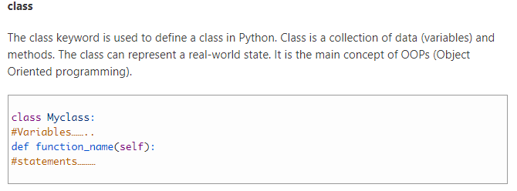
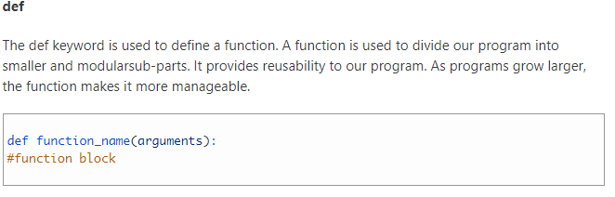
Python – Keywords

Slide 21
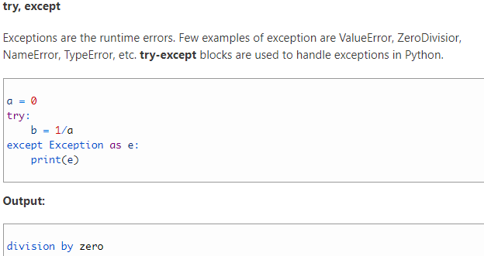
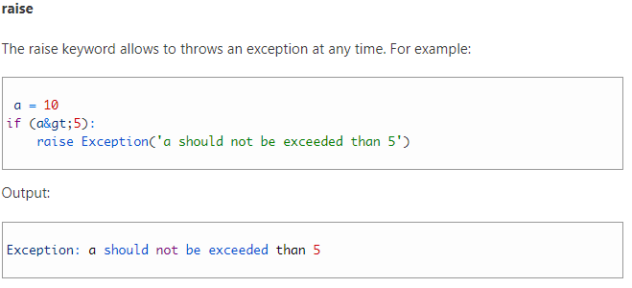
Python – Keywords

Slide 22
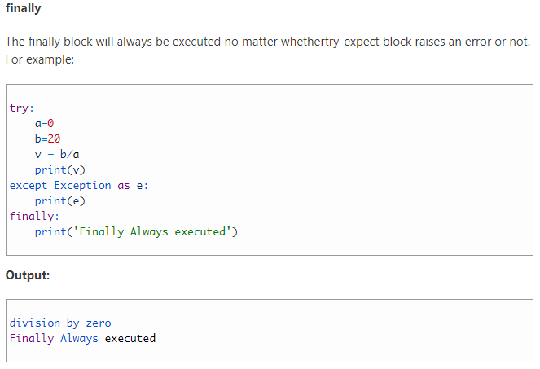
Python – Keywords

Slide 23
Python – Keywords

Slide 24
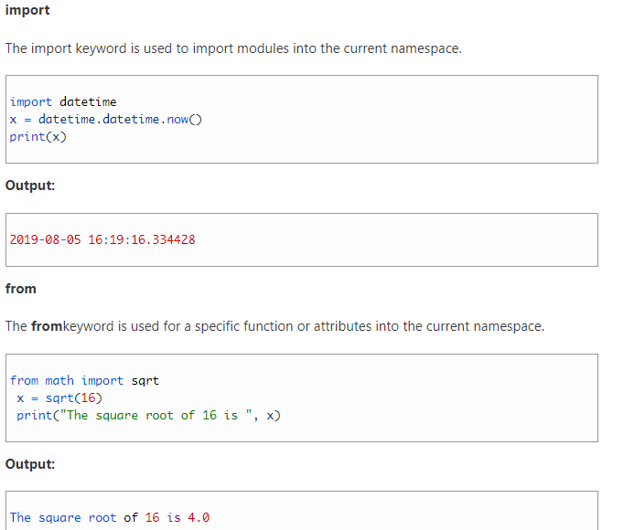
Python – Keywords

Slide 25
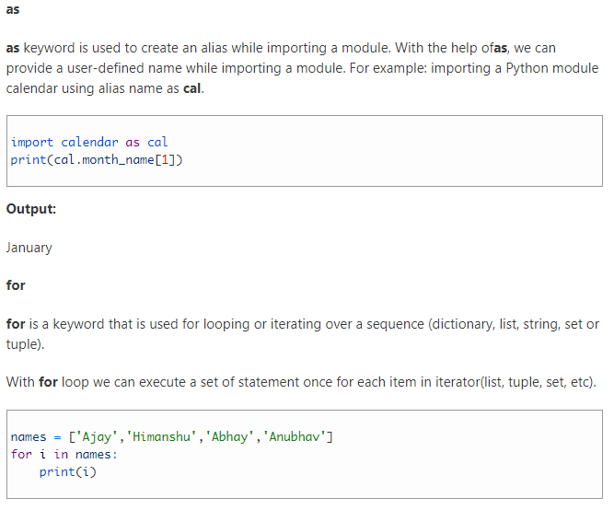
Python – Keywords

Slide 26
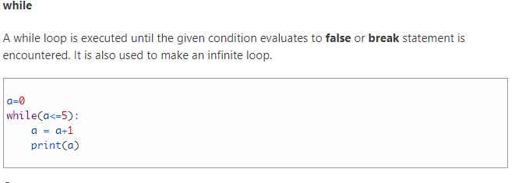
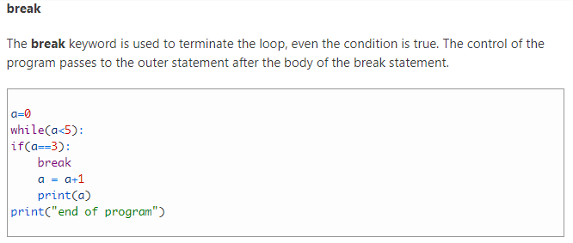
Python – Keywords

Slide 27
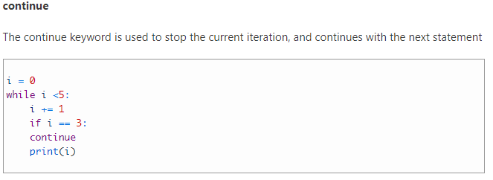
Python – Keywords

Slide 28
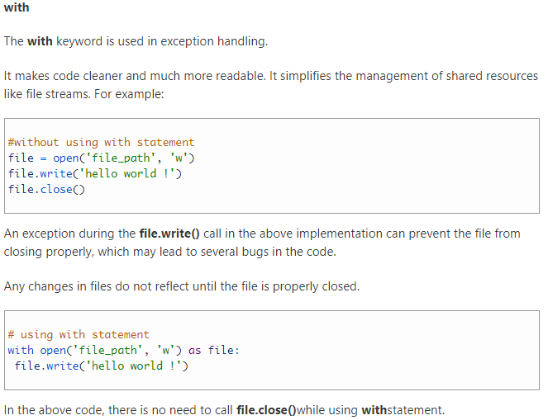
Python – Keywords

Slide 29
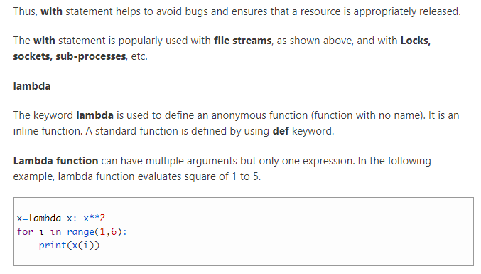
Python – Keywords

Slide 30
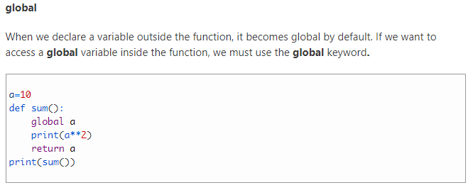
Python – Keywords

Slide 31
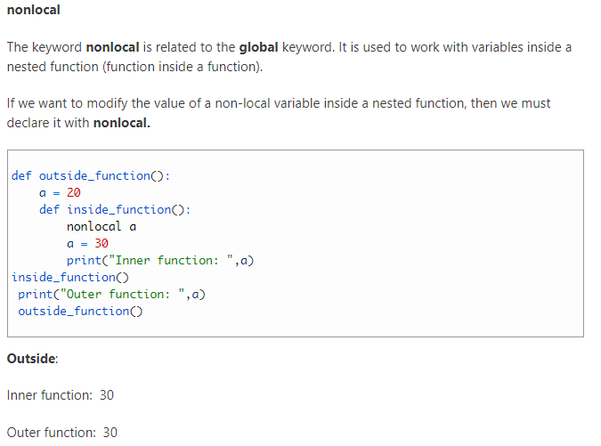
Python – Keywords

Slide 32
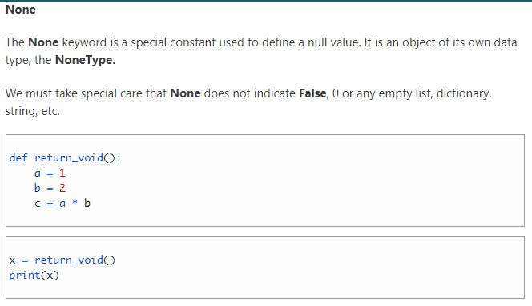
Python – Keywords

Slide 33
Python – Keywords

Slide 34
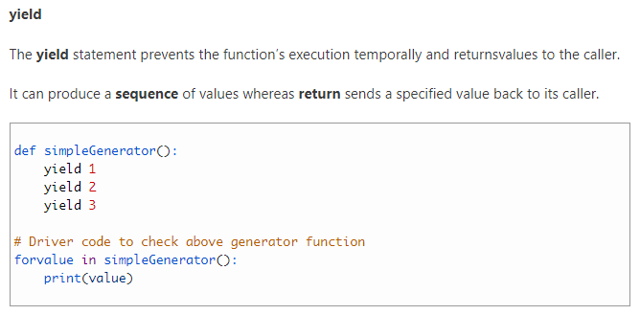
Python – Keywords

Slide 35
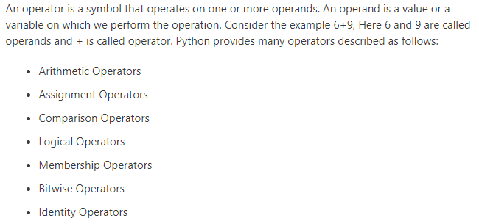
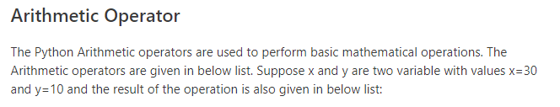
Python – Operators

Slide 36
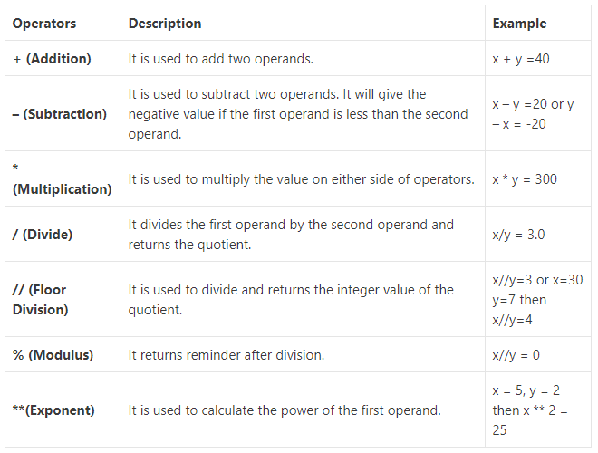
Python – Operators

Slide 37
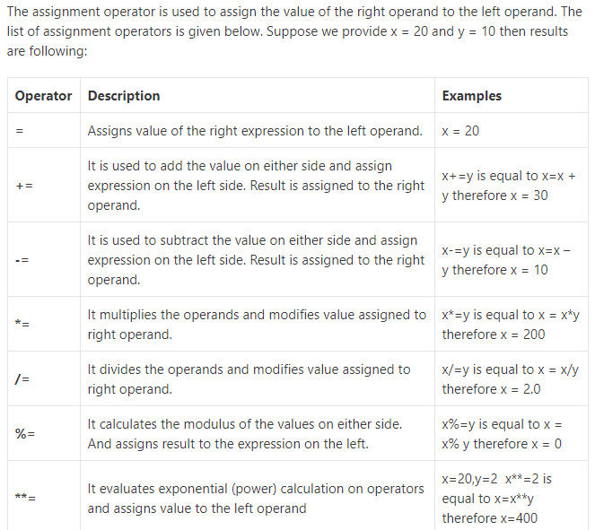
Python – Operators
Assignment Operators

Slide 38
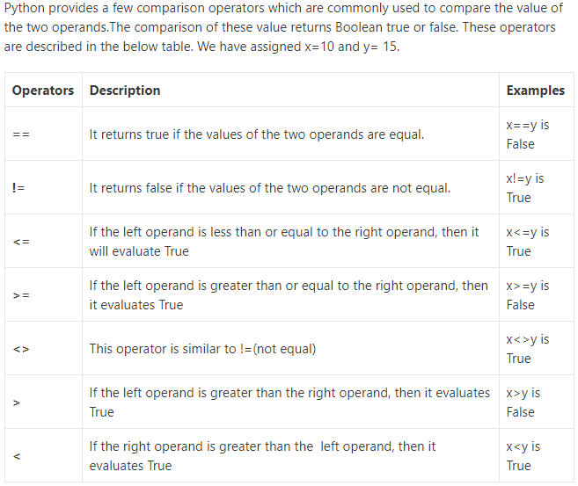
Python – Operators
Comparison Operators

Slide 39
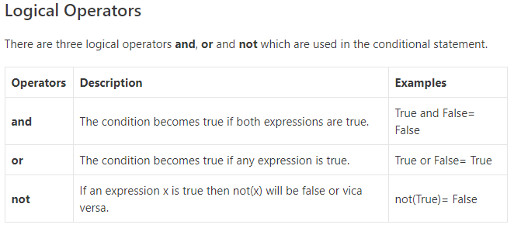
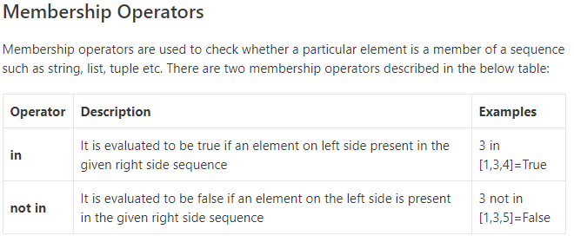
Python – Operators

Slide 40
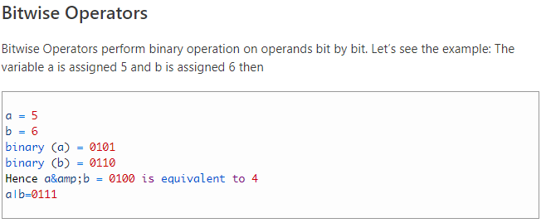
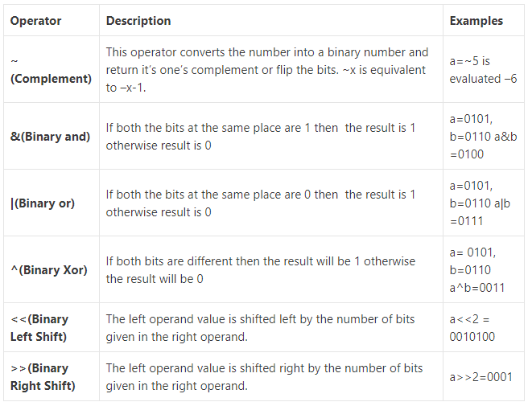
Python – Operators

Slide 41
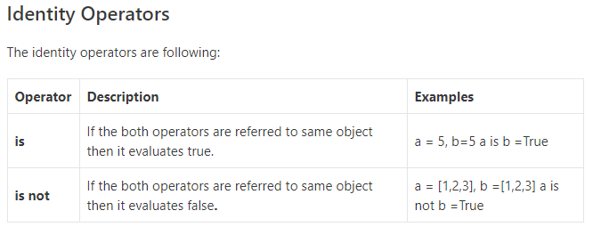
Python – Operators

Slide 42
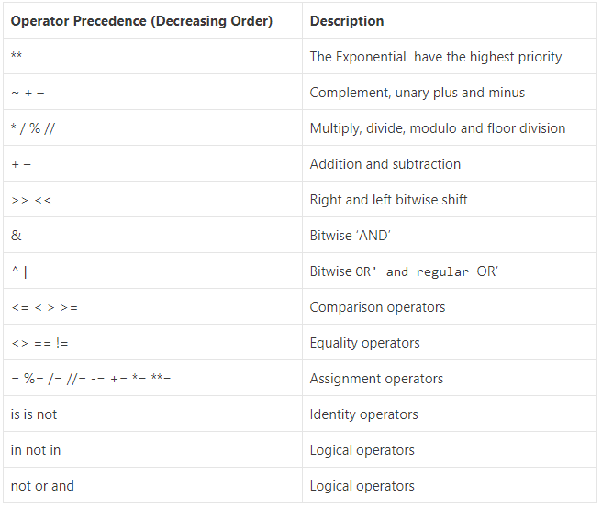
Python – Operators

Slide 43
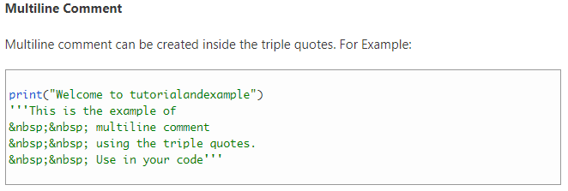
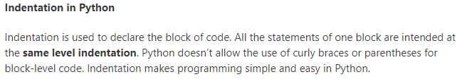
Python – Comments

Slide 44
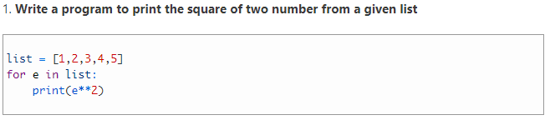
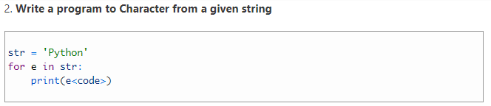
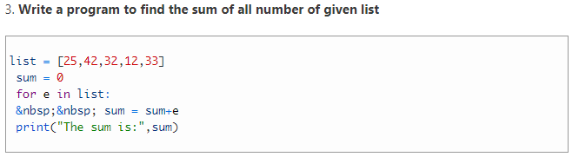
Python – programs…

Slide 45
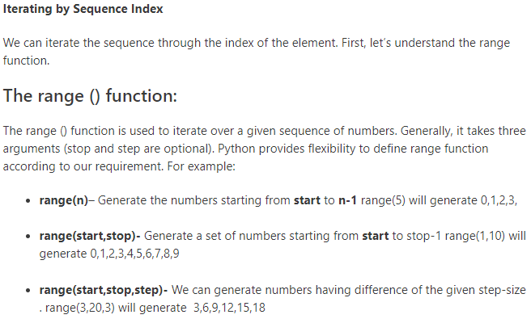
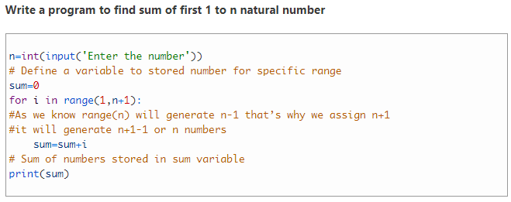
Python – programs…

Slide 46
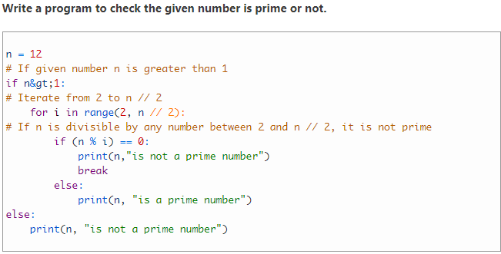
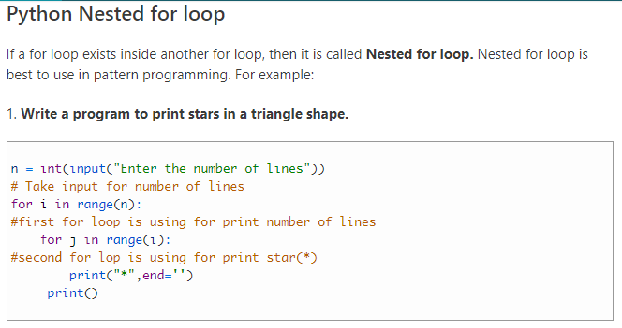
Python – programs…

Slide 47
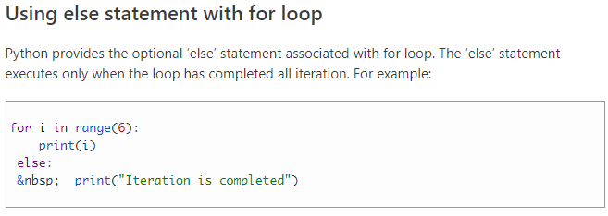
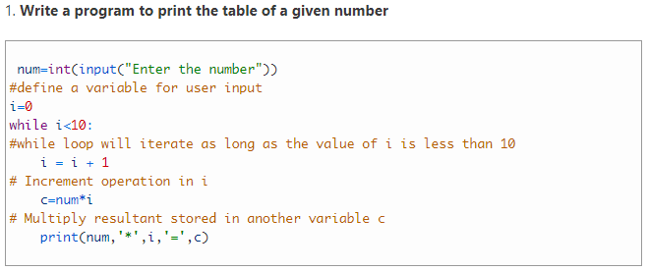
Python – programs…
While loop

Slide 48
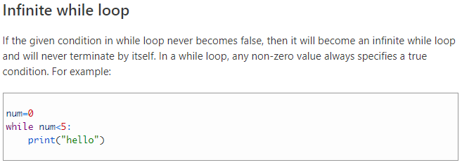
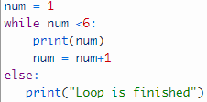

Python – programs…
Python List

Slide 49


Python – List

Slide 50

Python – List

Slide 51

Python – List

Slide 52




Python – List

Slide 53


Python – List

Slide 54


Python – List

Slide 55


Python – List

Slide 56


Python – List

Slide 57



Python – Tuple

Slide 58



Python – Dictionary

Slide 59


Python – Dictionary

Slide 60



Python – Dictionary

Slide 61

Python – Dictionary

Slide 62


Python – Functions

Slide 63


Python – Functions

Slide 64

Python – Functions

Slide 65

Python – Functions

Slide 66

Python – Functions

Slide 67

Python – Functions

Slide 68

Python – Functions

Slide 69

Python – Functions

Slide 70

Python – Functions

Slide 71

Python – Functions

Slide 72


Python – File Handling

Slide 73


Python – File Handling

Slide 74


Python – File Handling

Slide 75



Python – File Handling
Reading a file

Slide 76

Python – File Handling

Slide 77

Python – File Handling

Slide 78

Python – File Handling

Slide 79

Python – File Handling

Slide 80

Python – File Handling

Slide 81

Python – File Handling

Slide 82

Python – File Handling

Slide 83

Python – Assertion

Slide 84

Python – Assertion

Slide 85

Python – read csv ..

Slide 86

Python – read CSV

Slide 87
Python – read CSV
import csv #importing csv library
with open('myfile.txt') <strong>as </strong>csv_file: #open text file named myfile
csv_reader = csv.reader(csv_file, delimiter=<strong>','</strong>)
line_count = 0
for row in csv_reader:
if line_count == 0:
print(f'Column names are {", ".join(row)<strong>}'</strong>)
line_count += 1
else:
print(f'\t{row[0]} works in the {row[1]} department, and was born in {row[2]<strong>}.'</strong>)
line_count += 1
print(f'Processed {line_count} lines.')

Slide 88

Python – read CSV
import csv # importing csv library
with open('myfile.txt', mode=<strong>'r'</strong>) as csv_file:
csv_reader = csv.DictReader(csv_file)
line_count = 0
for row in csv_reader:
if line_count == 0:
print(f'The Column names are {", ".join(row)<strong>}'</strong>)
line_count += 1
print(f'\t{row["name"]} belongs to the {row["department"]} department, and was born in {row["birthday month"]<strong>}.'</strong>)
line_count += 1
print(f'Processed {line_count} lines.')

Slide 89

Python – read CSV

Slide 90
Questions
Questions?
Thank you
Venkatesh Reddy Madduri

