Slide 1
Angular 8
Title Slide
Heading
• Font: Calibri, 32 pt, Bold
• Color: White
Secondary Heading
• Font: Calibri, 18 pt
• Color: White
Date
• Font: Calibri, 16 pt
• Color: White
NO SLIDE NUMBER
Click on the corner of this text box to delete
Presenter: Venkatesh Reddy Madduri
Date: 7th Nov, 19

Slide 2
Angular - Introduction
Angular is a Framework of JavaScript used to build web and mobile applications. Angular 8 is a client-side TypeScript based structure which is used to create dynamic web applications. Its first version was released by Google in 2012 and named as Angular JS. Angular 8 is the updated version of Angular2.
Before starting Angular, we must have a good understanding of JavaScript, HTML, CSS, AJAX, and TypeScript.
Angular 8 is a great UI (User Interface) library for the developers. Angular is a reusable UI component helps us constructing attractive, consistent, and functional web pages and web application. Angular 8 is a JavaScript framework which makes us able to create an attractive Single Page Applications (SPAs). “A single page application is a web application or a website which provides a fluid, reactive, and fast application same as a desktop application. It contains menu, buttons, and blocks on a single page and when a user clicks on them, it dynamically rewrites the current page without loading new pages from the server so that its speed is fast.”

Slide 3
Angular – Introduction – Continu..
Angular 8 has entirely based on component and consist of some tree structures with parent and child component. Angular 8 classes are created in such a way that the web page can fit in any screen size so that they are fully compatible with mobiles, tablets, laptops, and large systems.
Angular Version History
Version | Released
Angular JS | October 2010
Angular2.0 | September 2016
Angular4.0 | March 2017
Angular5.0 | November 2017
Angular6.0 | May 2018
Angular 8.0 | October 2018

Slide 4
Angular Key Terms
What is Angular CDK?
The Component Dev Kit (CDK) is a set of tools that implement common interaction patterns while being preserve about their presentation. It represents an abstraction of the core functionalities found in the Angular Material library, without any styling specifically to Material Design.
What is Angular CLI?
Angular CLI is known as Angular Command Line Interface. It is a command-line tool for creating angular apps. It is mentioned to use angular CLI for creating angular apps as if we do not need to spend time to install and configure all the required dependencies and wiring everything together. Angular CLI is a helpful tool to create and work with Angular Applications efficiently.
What is Ng in Angular?
The prefix ng stands for “Angular;” all of the built-in directives that craft with Angular use that prefix. Similarly, it is suggested that you do not use the ng prefix on your instructions to avoid possible name impacts in future versions of Angular.

Slide 5
Architecture
Angular 8 is a platform and framework which is used to create clients applications in HTML and Typescript. Angular 8 is written in Typescript. Typescript is a superset of JavaScript.
Angular 8 implements core and optional functionality as a set of Typescript libraries which we can import in our application.
NgModules are the basic building blocks of Angular 8 application. They provide a compilation context for components.
Various units are combined to build an angular application, which is as follows.

Slide 6
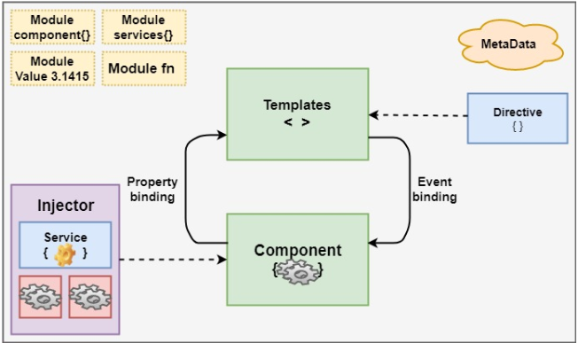
Architecture
Angular 8 always has at least a root module which enables bootstrapping.
Components define views, which are set of screen element that is modified according to your program logic and data in Angular 8.

Slide 7
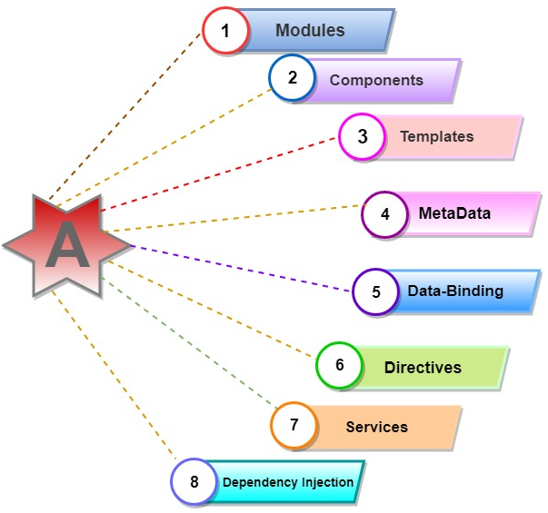
Architecture essentials

Slide 8
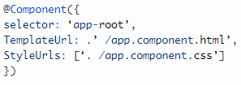
Architecture essentials – Contin…
1. Modules:
Every Angular 8 app has provided the bootstrap mechanism that launches the application.
Generally, every angular 8 modules contain many functional modules.
Some interactive features of Angular 8 modules:
NgModules import the functionality from another NgModules just like other JavaScript modules.
NgModules allow their functionality to be imported and used by other modules, e.g., if we want to use route service in our app, we can import the Routing Ng module.
2. Components:
Every angular project has at least 1 component, the root component, and the root components connect the component with a page Document Object Module (DOM). Each component defines a class which contains data, application, logic, and it is binding with the HTML template.
Click here for the answer

Slide 9

Architecture essentials – Contin…
3. Templates :
The angular template integrates the HTML with Angular mark-up that can modify HTML elements before they are displayed. It provides program logic, and binding mark-up connects to your application data and the DOM.
Click here for the answer

Slide 10
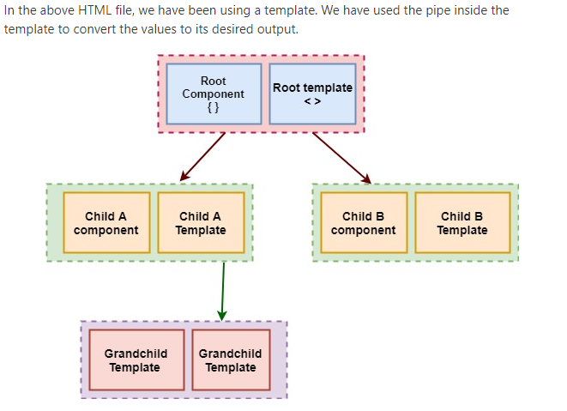
Architecture essentials – Contin…

Slide 11
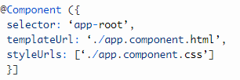
Architecture essentials – Contin…
4. Metadata :
Decorators are the metadata in Angular. It is used to enhance the class so it can configure the expected behavior of a class. Decorators are the core concept of when developing with Angular. User can use metadata in a class to tell Angular app that app component is a component. Metadata can attach to the Typescript through the decorator.
@pipe, @directive
Click here for the answer

Slide 12

Architecture essentials – Contin…
5. Data binding :
Angular allows communication between a component and a DOM. Making it very easy to define interactive application without pulling and pushing the data.
There are two types of data binding.
Event Binding: Our app responds to user input in the target environment by updating our application data.
Property Binding: Interpolates values that are computed from application data into the HTML.
Interpolation: {{value}} Interpolation adds the value of the property to the component.
Property binding: [property]=”value”
A value has been passed from a component to a special property, with property binding which can be a simple html attribute.
Click here for the answer

Slide 13
Architecture essentials – Contin…
5. Data binding :
Angular allows communication between a component and a DOM. Making it very easy to define interactive application without pulling and pushing the data.
There are two types of data binding.
Event Binding: Our app responds to user input in the target environment by updating our application data.
Property Binding: Interpolates values that are computed from application data into the HTML.
Interpolation: {{value}} Interpolation adds the value of the property to the component.
Property binding: [property]=”value”
A value has been passed from a component to a special property, with property binding which can be a simple html attribute.
Click here for the answer

Slide 14
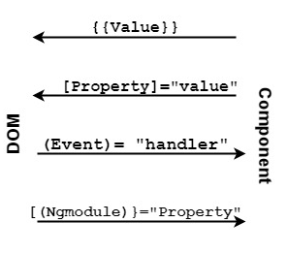
Architecture essentials – Contin…
5. Data binding :
Click here for the answer

Slide 15
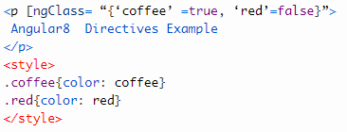
Architecture essentials – Contin…
6. Directives:
Directives used for expanding the functionality of HTML elements. There are three types of directives in Angular are Component , Structural Directive and Attribute directive.
Components—directives with a template.
Structural directives—change the DOM layout by adding and removing DOM elements.
Attribute directives—change the appearance or behavior of an element, component, or another directive.
Components are the most common of the three directives.
Structural Directives change the structure of the view. Two examples are NgFor and NgIf.
Attribute directives are used as attributes of elements. Angular directives like: ngClass which is a better example of excising angular attribute directive.

Slide 16
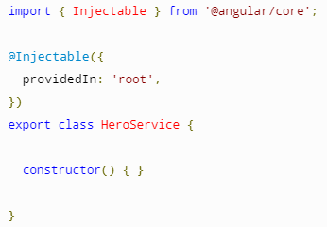

Architecture essentials – Contin…
7. Services:
Services used to reuse the code. The services can be used in more than one component. The decorator provides the meta-data that allows our services to be injected into the client component as a dependency.
Why Services:
Components shouldn't fetch or save data directly and they certainly shouldn't knowingly present fake data. They should focus on presenting data and delegate data access to a service.

Slide 17

Architecture essentials – Contin…
8. Dependency Injection:
It is a design pattern for efficiency and modularity. DI is wired into Angular into an Angular framework and used everywhere to provide new component with new services.
Pipes
A class with the @Pipe decorator defines a function which transforms an input value to output value for display in an amount.
Angular defines various pipes like data pipe and currency pipe; for a complete list and we can also define new pipes. To specify a value transformation in a HTML template, use the pipe operator (|).

Slide 18
Installation –
To install Angular 8, we require the following things
OS (Windows 10/Linux)
Node.js (12.6.0)
NPM
Angular CLI(Command Line Interface)
An IDE for writing our code(VS code)
Git
After installing these in our system, we have to know what these things are:
Node.js: Node.js is open-source, cross-platform JavaScript runtime environment that executes JavaScript code outside a browser. And it is developed by Ryan Dahl wrote in C, C++, and JavaScript. It is free to use and run on various platforms (Windows, Linux, UNIX, Mac, etc. It can generate dynamic page content and can add, delete, and modify data in the database. Node.js file have extension “.js”.
NPM: NPM is a package manager in node.js packages. www.npmjs.com hosts millions of free packages to download and use. The NPM program is installed in our computer when we install node.js. A package in node.js contains the entire package we need for a module. Downloading a package is very compatible. Open the command-line interface and say NPM to download the packages which we want. If we want to download a package called “upper-case”:

Slide 19
Installation –
To install Angular 8, we require the following things
Angular CLI: Angular CLI is known as Angular Command-line interface. An Angular CLI is used for creating a project. It can be used to create content, services, pipes, directives, and many more; also, it helps in building, serving, testing, etc. It makes Angular Development workflow much easier and faster.
IDE (Visual Studio): Microsoft Visual Studio is an integrated development environment developed by Microsoft and it is written in C++ and C#. It is used to create computer programs, as well as websites, web apps, and mobile applications. The visual studio uses Microsoft Software Development platforms such as Windows API, Windows Forms, Windows Presentation Foundation, Windows Store, and Microsoft Silver light. It has produced both native codes and managed code.
VS code is light and easy to set up. It is free to use and provide a massive number of extensions that increase your productivity.
We can download the VS Code from here: https://code.visualstudio.com.
Git: Git is a distributed version control system used for tracking changes in source code during software development. It is designed for spreading work among programmers. But it is used to track any set of change in files. Linus Torvalds created it in 2005 for developing the Linux kernel. Git is free and open-source software distribution system under the term of the GNU(General Public License) version 2.

Slide 20
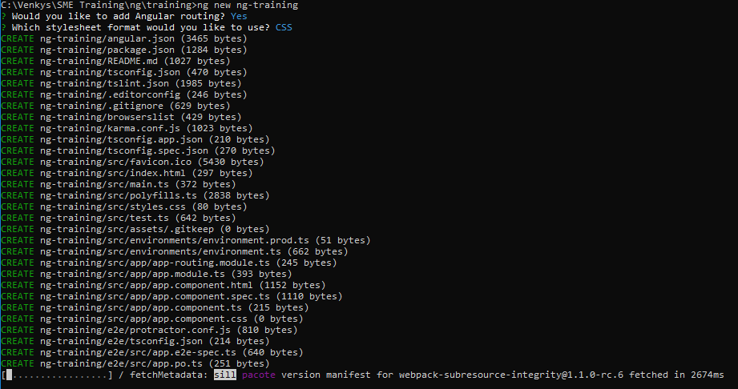
Angular Project Creation –
ng new ng-training

Slide 21
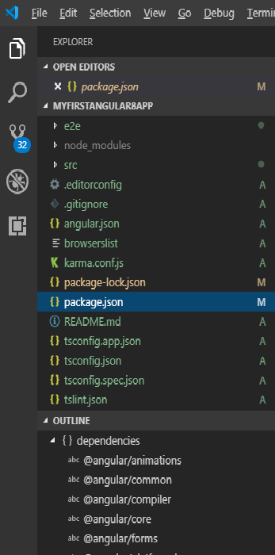
Angular Project File Structure –
A file structure contains the files for one or more projects. A project is the set of files that comprise an application on a shareable library. An angular module is used to group related angular components, services, directives, etc.
Let see the structure of the Angular 8 app on VS code IDE for Angular development, and we can use either Web Storm IDE or Visual Studio IDE. Both are better. Here, we are using the VScode IDE.

Slide 22
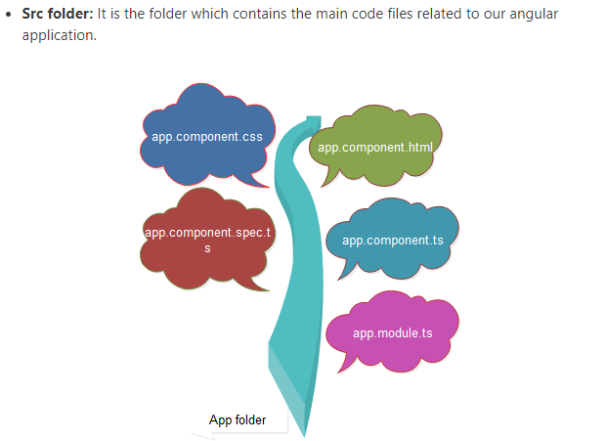
Angular Project File Structure –
Src folder

Slide 23
Angular Project File Structure –
Src folder
app folder: It contains the files which we have created for app components.
app.component.css: The file contains the CSS(cascading style sheets) code in our app component.
app.component.html: The file contains the HTML file related to its app component. Itis the template file which is specially used by angular to the data binding.
app.component.spec.ts: This file is a unit testing file is related to the app component. This file is used across with more other unit tests. It is run from angular CLI by command ng test.
app.component.ts: It is the essential typescript file which includes the view logic beyond the component.
app.module.ts: It is also a typescript file which consists of all dependencies for the website. The data is used to define the needed modules has been imported, the components to be declared, and the main element to be bootstrapped.

Slide 24
Angular Project File Structure –
Other Important Files
package.json: It is the npm configuration file. It includes details of our website’s and package dependencies with more information about our site being a package itself.
package-lock.json: This is an auto-generated and transforms file that gets updated when npm does an operation related to the node_modules or package.json file.
angular.json:It is a necessary configuration file related to our angular application. It defines the structure of our app and includes any setting to accomplish with the application.
.gitignore: The record is related to the source code git.
.editorconfig: This is a standard file which is used to maintain consistency in code editors to organizing some basics. such as indentation and whitespaces.
Assets folder: This folder is a placeholder for the resource files which are used in the application such as images, locales, translations, etc.
Environment folder: The environment folder is used to grasp the environment configuration constants that help when we are building the angular application.
Browser list: This file specifies a small icon that appears next to the browser tab of a website.
favicon.ico:It defines a small image that appears next to the browser tab of any website.

Slide 25
Angular Project File Structure –
Other Important Files
Index.html: It is the entry file which holds the high-level container for the angular application.
karma.config.js: It specifies the config file in the karma Test runner, Karma has been developed by the AngularJS team and can run tests for AngularJS and Angular 2+.
main.ts: This is the main ts file that will run; first, It is mainly used to define the global configurations.
polyfills.ts: The record is a set of code that can be used to provide compatibility support for older browsers. Angular 8 code is written in ES6+ specifications.
test.ts:It is the primary test file that the Angular CLI command ng test will apply to traverse all the unit tests within the application.
styles.css: It is the angular application uses a global CSS.
tsconfig.json:This is a typescript compiler of the configuration file.
tsconfig.app.json: It is used to override the ts.config.json file with app-specific configurations.
tsconfig.spec.json: It overrides the tsconfig.json file with the app-specific unit test cases.

Slide 26
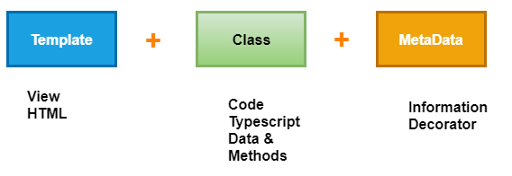
Angular Components
Angular is used for building mobile and desktop web applications. The component is the basic building block of Angular. It has a selector, template, style, and other properties, and it specifies the metadata required to process the component.
Components are defined using a @component decorator and a tree of the angular component. It makes our complex application in reusable parts which we can reuse easily.
The component is the most critical concept in Angular and a tree of components with a root component. The root component is one contained in the bootstrap array in the main ngModule module defined in the app.module.ts file.
One crucial aspect of components is re-usability. A component can be reused throughout the application and even in other applications. Standard and repeatable code that performs a specific task can be encapsulated into a reusable component.

Slide 27
Angular Components Contin…
What is Component-Based Architecture?
An Angular application is build of some components which form a tree structure with parent and child components.
A component is an independent block of an extensive system that communicates with the other building blocks of the systems using inputs and outputs. It has an associated view, data, and behavior and has parent and child components.
The component allows maximum re-usability, secure testing, maintenance, and separation of concerns. Go to our Angular project folder and open the src/app folder, which we will see the following files.
App folder: The app folder contains the data we have created for app components.

Slide 28
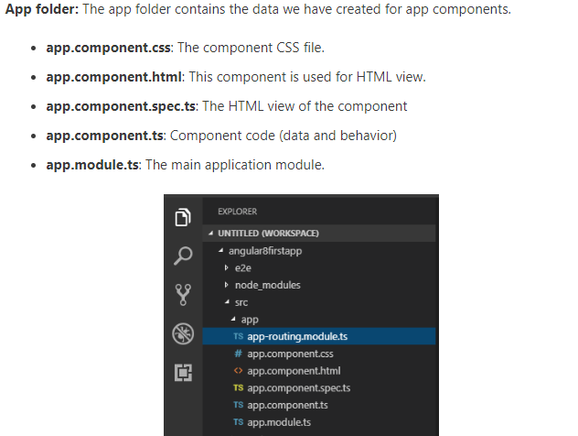
Angular Components Contin…

Slide 29
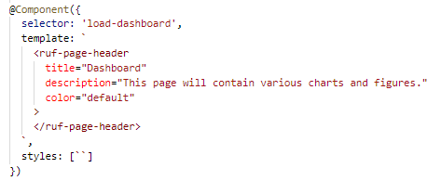
Angular Components Contin…
Firstly, we import the Component decorator from @angular/core and then we use it to preserve the Typescript AppComponent class. The Component decorator takes an object with multiple parameters, however:
selector: It specifies the tag that can be used to call this component in HTML templates just like the standard HTML tags
templateUrl: It indicates the path of the HTML template that will be used to display this component.
styleUrls: It specifies an array of URLs for CSS style-sheet in the component.
The export keyboard is used to export the component, and it has imported from other components and modules in the application file.
The title variable is a member variable which holds the string’ app,’ and it is not the part of the legal definition of any Angular component.

Slide 30
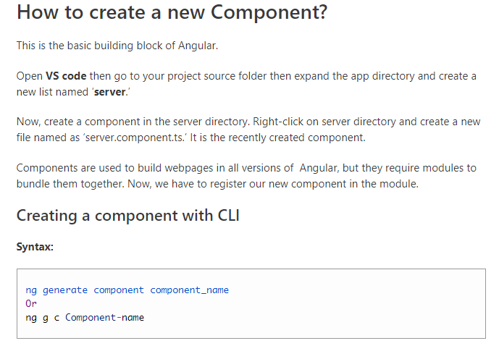
Angular Components Contin…

Slide 31
Angular Components Contin…

Slide 32
Angular Components Contin…
Life cycle hooks
A component has a lifecycle managed by Angular.
Angular creates and renders components along with their children, checks when their data-bound properties change, and destroys them before removing them from the DOM.
Angular offers lifecycle hooks that provide visibility into these key life moments and the ability to act when they occur.
A directive has the same set of lifecycle hooks.

Slide 33
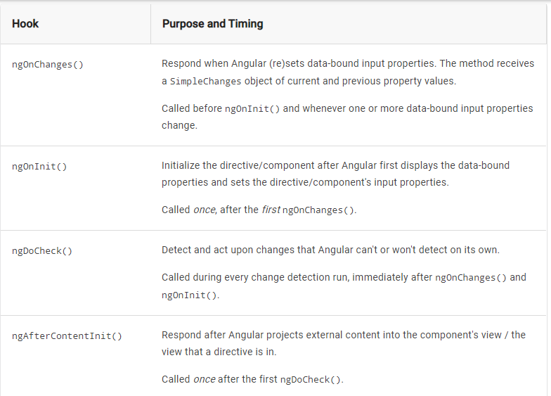
Angular Components Contin…
Life cycle hooks

Slide 34
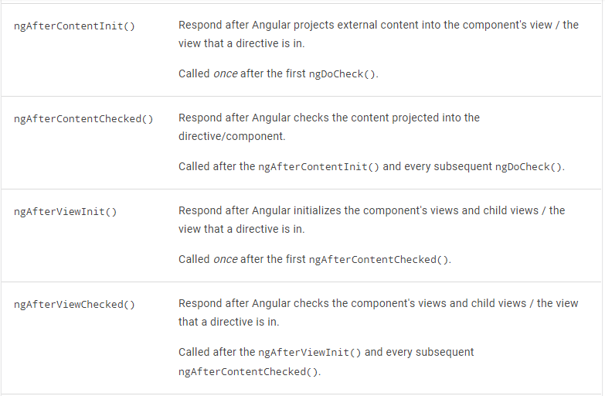
Angular Components Contin…
Life cycle hooks

Slide 35
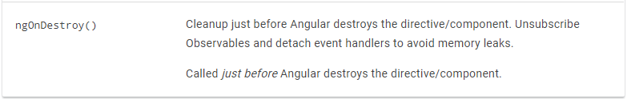
Angular Components Contin…
Life cycle hooks

Slide 36
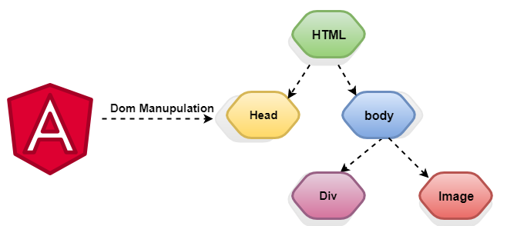
Angular Directives
Directives are instructions in the DOM (Document Object Model). It specifies how to place our business logic in Angular. The directive is markers on a DOM element that tell Angular to attach a specified behavior to that DOM element or even transform the DOM element and its children. Mostly directives in Angular starts with ng- where ng stands for Angular, and it extends the HTML.

Slide 37
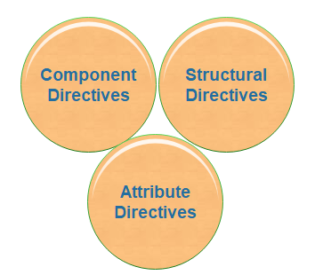
Angular Directives
There are three kinds of directives:
1. Component Directives
2. Structural Directives
3. Attribute Directives

Slide 38
Angular Directives
Component Directives
Components are the most common of the directives. It contains the details of how the component should be processed, instantiated, and used at runtime. The component comprises meta-data.
Structural Directives
Structural Directivesaredone in the elements section. These directives are used to manipulate and change the structure of the DOM elements. Structural directives have a star (*) sign before the directive. Like as,* ngIf, *ngFor, and *ngSwitch directive.
*ngIf Directive: The *ngIf allows us to Add/Remove DOM Element.
*ngSwitch Directive: The *ngSwitch will enable us to Add/Remove DOM element. It is same as the switch statement of C#.
*ngFor Directive: The *ngFor directive is used to repeat a part of HTML template once per each item from an iterable list (Collection).

Slide 39
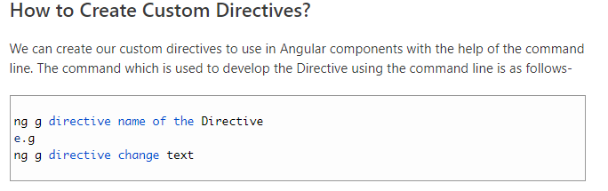
Angular Directives
Attributes Directives
Itdeals with changing the look and behavior of the DOM element. For example: ngClass, ngStyle etc.
NgClass Directive: The ngClass Directive is used to add or remove CSS classes to an element.
NgStyle Directive: The ngStyle Directive facilitates you to modify the style of an HTML element using the expression. We can also use the ngStyle Directive to change the style of our HTML element dynamically.

Slide 40
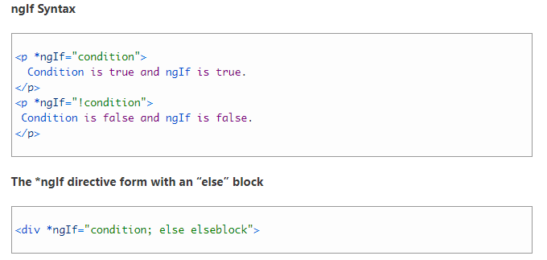
Angular Directives
ngIf Directive is the part of structural directives.The NgIf is the most straightforward structural Directive and comfortable to understand. The ngIf Directives is used to add and remove HTML elements according to the expression. The expression returns a Boolean value. If the appearance is false, then the removed, otherwise portion is inserted.
It is same as the ng-if Directive of AngularJS. The ngIf directive doesn’t hide elements. It adds and removes them physically from the DOM. We can confirm it by using browser developer tools to inspect the DOM. When the condition is false, NgIf removes the host element from the DOM, which detection, and destroys it.
ngIf Syntax

Slide 41
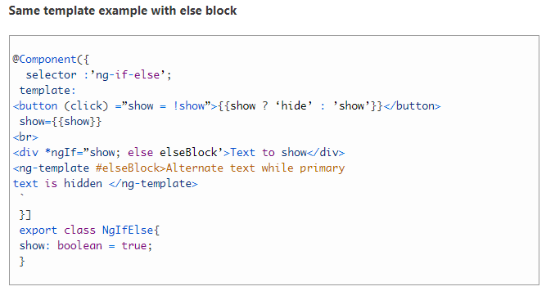
Angular Directives

Slide 42
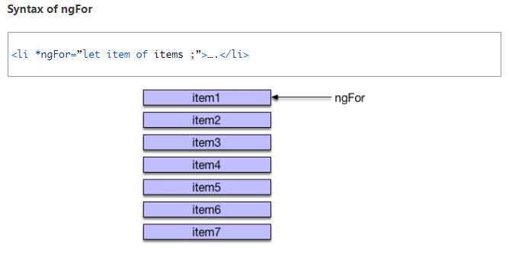
Angular Directives
Angular 8 ngFor Directive
The *ngFor directive is used to repeat to repeat a portion of HTML template once per each item from an iterable list (collection). The ngFor is an Angular structural directive and is similar to ngRepeat in AngularJS. Some local variables like Index, First, Last, odd and even are exported by *ngFor directive.
Syntax of ngFor

Slide 43
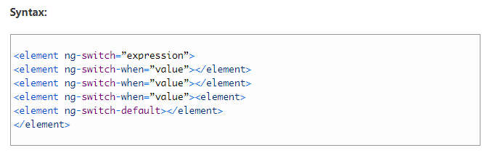
Angular Directives
Angular 8 ng-Switch Directive
The ng-Switch Directive hides and shows the HTML elements depending on an expression.
Child elements with the ng-switch-when directive will be displayed if it gets a match; otherwise, the component and its children will be removed.
We could also define a default section, by using the ng-switch default directive, to show a section if no any other part gets a match.

Slide 44
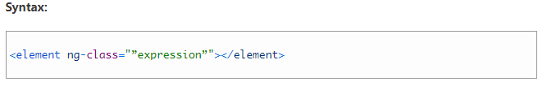
Angular Directives
Angular 8 ngClass Directive
ngClass Directive is a type of attribute directive. Angular provided built-in directive, and it helps in adding or removing CSS classes on an HTML element. The ngClass directive allows us to apply CSS classes dynamically based on expression evaluation.
[ngClass] selector uses the NgClass directive, and ngClass offers three simple ways through which we can update CSS classes in the DOM.

Slide 45
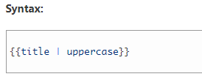
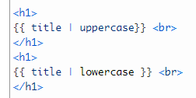
Angular Pipes
Pipes are a useful feature in Angular. These are the simple way to transform values in an Angular template. It takes the integers, strings, array, and dates as input separated with | to be converted in the format as required and display same as an in the browser.
Inside the interpolation expression, we define the pipe and use it based on the situation because there are many types of pipes. We can use in our angular applications.
A pipe holds in data as input and transforming it into the desired output. Some values benefit for a bit of editing. We may notice that we want many of the same transformations repeatedly, both within and across many applications.
We can almost think of them as styles, and In fact, we might like to apply them in our HTML templates.

Slide 46
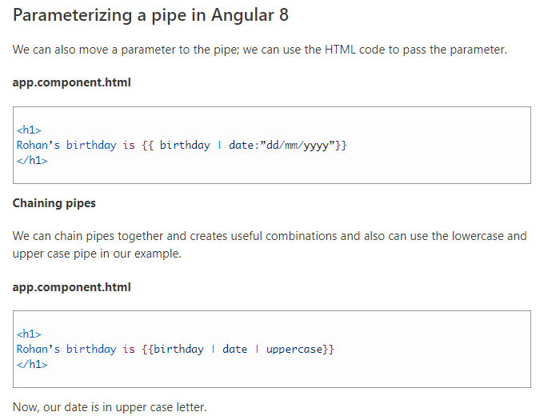
Angular Pipes

Slide 47
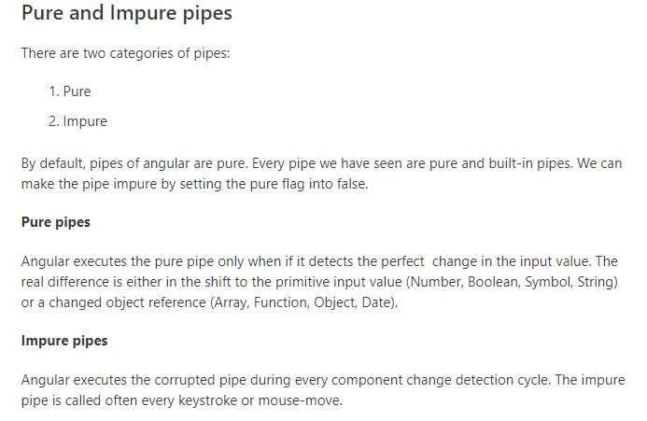
Angular Pipes

Slide 48
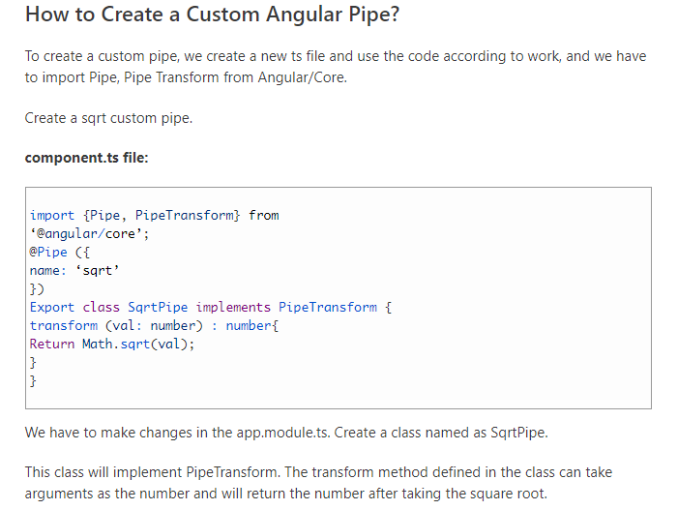
Angular Pipes

Slide 49
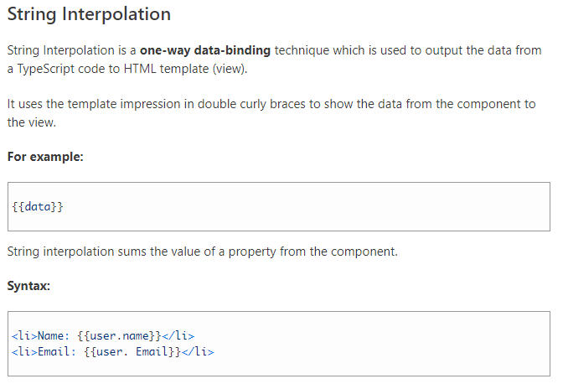
Angular Data Binding

Slide 50
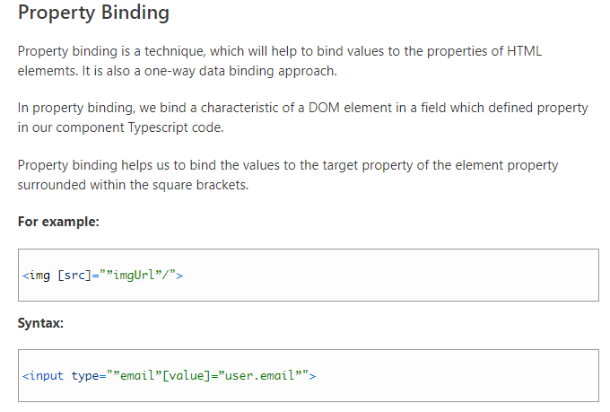
Angular Data Binding

Slide 51
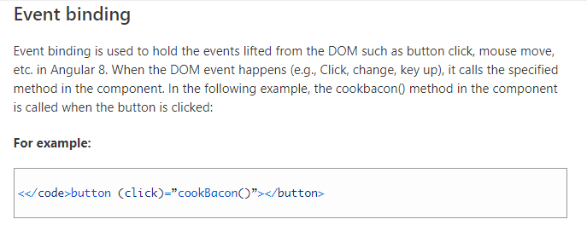
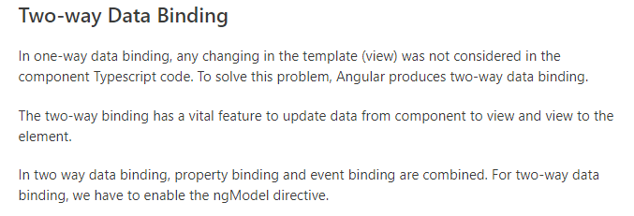
Angular Data Binding

Slide 52
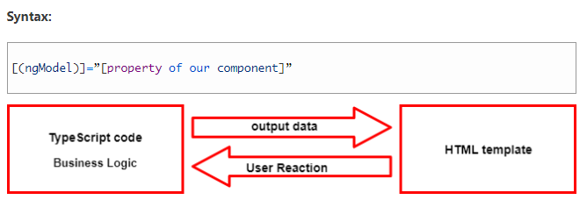
Angular Data Binding
Two-way data Binding

Slide 53
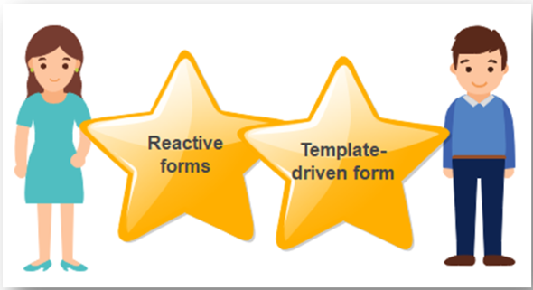
Angular Forms
Reactive forms
Angular forms are used to handle the user’s input. We use Angular form in our application to authorize users to log in, to update profile, to enter information, and to perform many other data-entry tasks.
In Angular 8, there are two approaches to handle the user’s input through forms:
Both methods are used to collect user input event from the view, validate the user input, create a form model to update, and provide a way to track changes.
Reactive and template-driven forms process and manage form data differently. Each offers different advantages.
Reactive forms
Reactive forms are more robust, and they are more scalable, reusable, and testable. If forms are a vital part of our application or are already using reactive patterns for building our app, handle responsive forms.

Slide 54
Angular Forms
Template-driven forms
It is useful for adding a simple form to an app, such as an email list signup form to an app, or login form. It is easy to add to an app, but they don’t scale as well as reactive forms. If we have fundamental form requirements and logic that can be managed in the template and use template-driven forms.
Practice examples
https://stackblitz.com/angular/rlqdvkmerpde?file=src%2Fapp%2Fprofile-editor%2Fprofile-editor.component.ts
https://stackblitz.com/angular/ymagmgbovvq?file=src%2Fapp%2Fhero-form%2Fhero-form.component.html

Slide 55
Angular Routing
Angular Router is a powerful JavaScript router is built and maintained by the Angular core team that can install from the package @angular/router. Routing provides a complete routing library with the possibility of multiple router outlets, different path strategies.
The angular Router is the main part of Angular platform. It allows developers to build single-page applications with multiple views and allow navigation between views.
Angular supports SPA using routing module ngRoute. The routing module acts based on the URL. It works as a browser navigation’s bar, and it was navigating between the pages.
Enter URL in the address bar, and then the browser will navigate to the corresponding page.
Click on the link to the page and the browser will navigate to the new page.
Click on the browser on the back or forward, and the browser will navigate backward or forward according to the history pages.

Slide 56
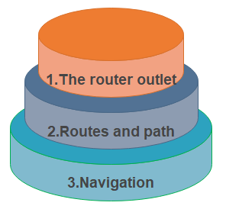
Angular Routing
Angular brings many improved modules to the Angular ecosystem, including a new router called the component router. The component router is highly configurable and features packed Router. Features included are standard view routing, nested child routes, named routes, and route parameters. The concept related to the Router are:

Slide 57
Angular Routing
The Router-outlet
The Router-outlet is a directive accessible from the router library where the Router inserts the component and gets matched based on the current browser’s URL. We can add multiple outlets in our angular application, which enables us to implement advanced routing scenarios.
Routes And Paths
Routes are definitions comprised of a path and component attributes. The path mention to the part of the URL that determines a unique view that can be displayed, and refer to the Angular component that needs to be associated with a path.
In a component, each route maps a URL path.
The path could take a wildcard string (**). The Router selects this route if the called URL doesn’t match the explained routes. It can be used for displaying a “Not Found” view or redirecting to a specific view if there is no match.
Example:
If the route definition is provided to the router configuration, the router will render ContactListComponent
when the browser URL for the web application /contacts.

Slide 58

Angular Routing
Route Params
To creating the routes with parameters is a common feature in web apps. The angular Router allows us to access parameters in different ways.
We can create a router parameter using the colon syntax.
Route Guard
A route guard is the feature of the Angular Router which allows the developer to run logic if a router is requested, and it is based on the logic. It allows and denies the user access to the route. We can add a route guard by implementing the CanActivate interface available from @angular/router package. It can activate() method which holds the logic to allow and deny access to the route.

Slide 59
Angular Routing
Route Params
To creating the routes with parameters is a common feature in web apps. The angular Router allows us to access parameters in different ways.
We can create a router parameter using the colon syntax.
Route Guard
A route guard is the feature of the Angular Router which allows the developer to run logic if a router is requested, and it is based on the logic. It allows and denies the user access to the route. We can add a route guard by implementing the CanActivate interface available from @angular/router package. It can activate() method which holds the logic to allow and deny access to the route.

Slide 60
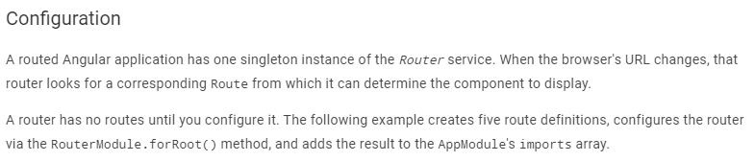
Angular Routing
<base href>
Most routing applications should add a <base> element to the index.html as the first child in the <head> tag to tell the router how to compose navigation URLs
<base href="/">
import { RouterModule, Routes } from '@angular/router’;

Slide 61
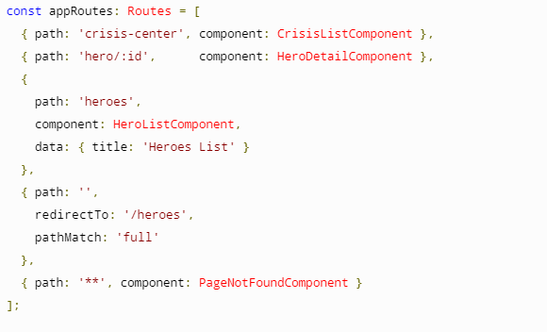
Angular Routing

Slide 62
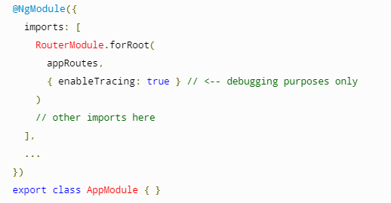
Angular Routing

Slide 63
Angular Routing
The appRoutes array of routes describes how to navigate. Pass it to the RouterModule.forRoot() method in the module imports to configure the router.
The :id in the second route is a token for a route parameter. In a URL such as /hero/42, "42" is the value of the id parameter.
The data property in the third route is a place to store arbitrary data associated with this specific route. The data property is accessible within each activated route. Use it to store items such as page titles, breadcrumb text, and other read-only, static data.
The empty path in the fourth route represents the default path for the application, the place to go when the path in the URL is empty, as it typically is at the start.
The ** path in the last route is a wildcard. The router will select this route if the requested URL doesn't match any paths for routes defined earlier in the configuration.
The order of the routes in the configuration matters and this is by design. The router uses a first-match wins strategy when matching routes.
If you need to see what events are happening during the navigation lifecycle, there is the enableTracing option as part of the router's default configuration.

Slide 64
Angular Routing
Navigation Directive
The Angular Router provides the router link directive to create the navigation links. This directive generates the path associated with the component to navigate.
https://stackblitz.com/angular/jyydopxboqn?file=src%2Fapp%2Fapp-routing.module.ts
For more information of example explanation
https://angular.io/guide/router#the-basics

Slide 65
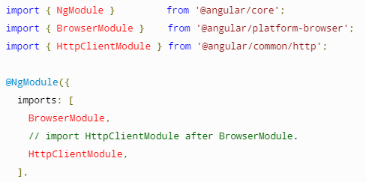
Angular HTTP Client
The HttpClient in @angular/common/http offers a simplified client HTTP API for
Angular applications that rests on the XMLHttpRequest interface exposed by browsers.
Additional benefits of HttpClient include testability features, typed request and response objects,request and response interception, Observable apis, and streamlined error handling.
Setup

Slide 66
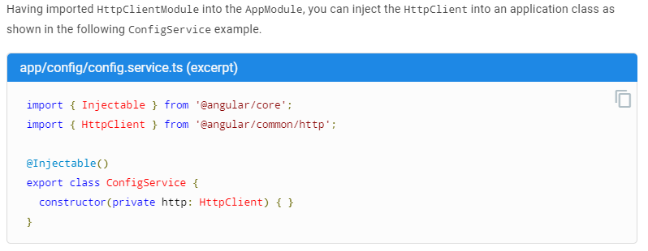
Angular HTTP Client

Slide 67
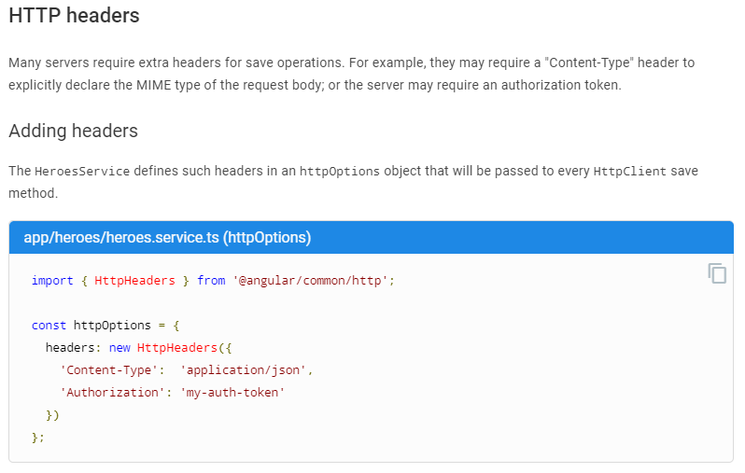
Angular HTTP Client

Slide 68
Angular HTTP Client
https://angular.io/generated/live-examples/http/stackblitz

Slide 69
Observables & RxJS
RxJS (Reactive Extensions for JavaScript) is a library for reactive programming using observables that makes it easier to compose asynchronous or callback-based code
RxJS provides an implementation of the Observable type. The library also provides utility functions for creating and working with observables. These utility functions can be used for:
Converting existing code for async operations into observables
Iterating through the values in a stream
Mapping values to different types
Filtering streams
Composing multiple streams

Slide 70
Observables & RxJS
RxJS Operators
Combination ( concat, endWith, merge etc)
Conditional (defaultIfEmpty, sequenceequal, iif, every)
Creation (ajax, create, defer, from , of, range etc)
Error Handling (catch/catchError, retry etc)
Filtering ( filter, find , first, last, skip, take etc)
Multicasting ( multicast, publish, share etc)
Transformation (buffer, expand, map, scan etc)
Utility (delay, tap/do , toPromise , repeat etc)

Slide 71
Observables & RxJS
RxJS Subjects
A Subject is a special type of Observable which shares a single execution path among observers.
We can think of this as a single speaker talking at a microphone in a room full of people. Their message (the subject) is being delivered to many (multicast) people (the observers) at once. This is the basis of multicasting. Typical observables would be comparable to a 1 on 1 conversation.
There are 4 variants of subjects:
Subject - No initial value or replay behavior.
AsyncSubject - Emits latest value to observers upon completion.
BehaviorSubject - Requires an initial value and emits its current value (last emitted item) to new subscribers.
ReplaySubject - Emits specified number of last emitted values (a replay) to new subscribers.

Slide 72
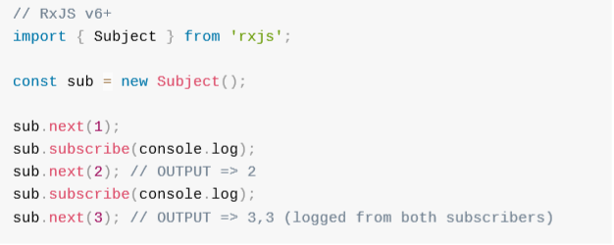
Observables & RxJS
Subject:
A special type of Observable which shares a single execution path among observers

Slide 73
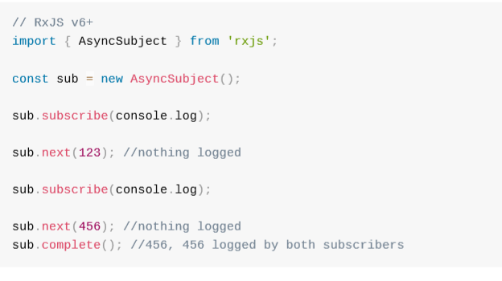
Observables & RxJS
AsyncSubject:
Emits its last value on completion

Slide 74
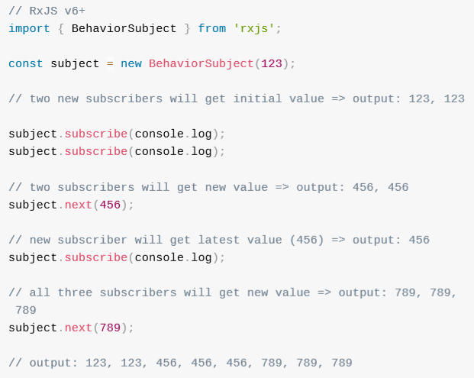
Observables & RxJS
BehaviourSubject:
Requires an initial value and emits the current value to new subscribers

Slide 75
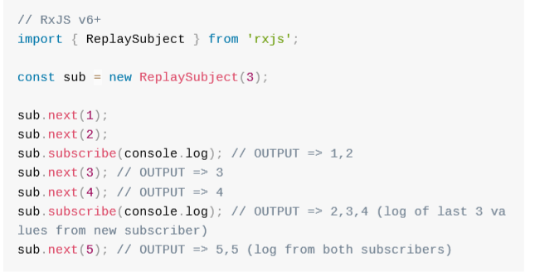
Observables & RxJS
ReplaySubject:
"Replays" or emits old values to new subscribers
For additional reference: https://www.learnrxjs.io/

Slide 76
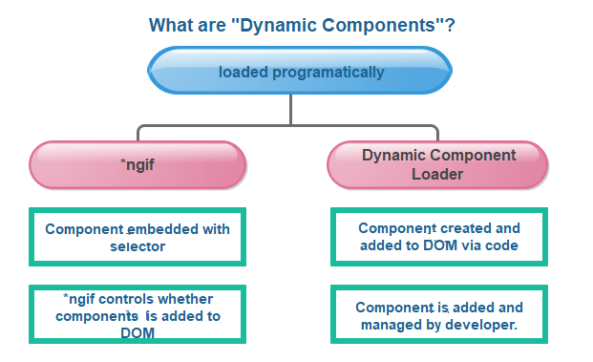
Angular Dynamic Components
The dynamic component is one of the versatile and core concept introduced in Angular, Component template is not fixed. An application needs to load new elements at runtime in various scenarios.
The dynamic component is the component which is created dynamically at the runtime. Angular has its API for loading components dynamically.

Slide 77
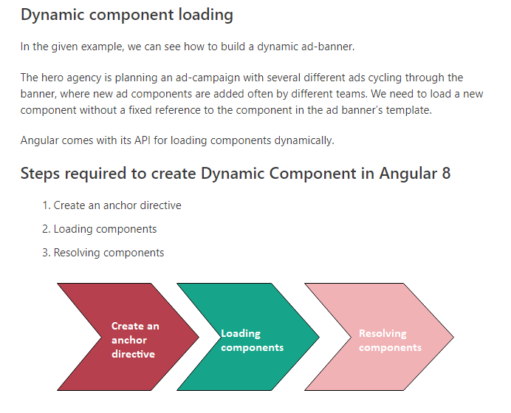
Angular Dynamic Components

Slide 78

Angular Dynamic Components

Slide 79

Angular Dynamic Components

Slide 80

Angular Dynamic Components
For example: https://stackblitz.com/edit/angular-rtzd4w?file=src%2Fapp%2Fad-banner.component.ts

Slide 81
Angular Animations
The animation is a process of drawing, designing , making layouts, and preparation of photographic sequences which are integrated into the multimedia and gaming products.
A reflection of movement created for displaying a series of frames, or pictures. Cartoons on television are on of the examples of animation.
Angular Animation
Animation provides the illusion of motion. HTML elements change styling over time. A well designed animation can make our application more fun and easier to use.

Slide 82
Angular Animations
Set-up of Animation in Angular 8
Previously, we have to import new animation package through the command “npm install –save@angular/animations.”
Then, add the BrowserAnimationsModule to our imports[] array in AppModule.
The module needs to be imported from @angular/platform-browser/animations’ => import { BrowserAnimationsModule } from ‘@angular/platform-browser/animations’( in AppModule).
After that, we import trigger, state, style, etc. from @angular/animations instead of @angular/core.

Slide 83

Angular Animations

Slide 84

Angular Animations

Slide 85

Angular Animations

Slide 86

Angular Animations

Slide 87

Angular Animations

Slide 88


Angular Animations

Slide 89

Angular Animations

Slide 90

Angular Animations

Slide 91

Angular Animations

Slide 92
Angular Animations
Example: https://stackblitz.com/angular/mkqrxnyekjx?file=src%2Fapp%2Fapp.component.ts

Slide 93

Angular CLI Commands
Angular CLI is a command-line interface which is used to initialize, develop, and maintain Angular applications. We can use these Command on command prompt or consequentially by an associated UI. i.e., Angular Console.

Slide 94

Angular CLI Commands
shows

Slide 95

Angular CLI Commands

Slide 96

Angular CLI Commands

Slide 97

Angular CLI Commands

Slide 98

Angular CLI Commands

Slide 99

Angular CLI Commands

Slide 100

Angular CLI Commands

Slide 101


Angular CLI Commands

Slide 102

Angular CLI Commands

Slide 103

Angular CLI Commands

Slide 104

Angular CLI Commands

Slide 105

Angular CLI Commands

Slide 106

Angular CLI Commands

Slide 107

Angular CLI Commands

Slide 108

Angular CLI Commands

Slide 109

Angular CLI Commands

Slide 110

Angular CLI Commands

Slide 111

Angular CLI Commands

Slide 112

Angular CLI Commands

Slide 113

Angular CLI Commands

Slide 114

Angular CLI Commands

Slide 115
Angular additional references
Angular State management: https://redux.js.org/
https://blog.angular-university.io/angular-ngrx-store-and-effects-crash-course/
Angular Storage : https://www.npmjs.com/package/angular-web-storage
Debugging : https://augury.rangle.io/
Architecture of angular application : https://nx.dev/angular/getting-started/what-is-nx
Style Guide: https://angular.io/guide/styleguide
Reuse components in your application
https://material.agnular.io
https://primefaces.org/primeng/#/

Slide 116
Questions
Questions?
Thank you
Venkatesh Reddy Madduri

