Slide 1
Flow 1: Application Users / App Owners using Dispatch Product UI
Spring Boot Backend (REST APIs) • Authentication • Notification Orchestration • Business Services • Audit & Logging
Database 1 (R/W)
Users / App Owners Perform actions using Application UI
React Frontend • Dashboard • Templates • Notification Config
Database 2 (Read Replica)
Thymeleaf Template Engine Process & Render Templates
Notification Channels Email | Teams BigPanda | Jira xMatters

Slide 2
Flow 2: Application Teams using Apigee Gateway APIs
Apigee API Gateway • Routing • Authentication • Throttling • Rate Limiter
Dispatch Product APIs (Spring Boot) • Notification APIs • Template APIs • Event APIs
Dispatch Processing Layer • Template Rendering • Workflow Logic • Retry Handling
Application Teams Consumers / Developers Automation Workflows
Shared Data Layer DB1 + DB2
Notification Channels

Slide 3
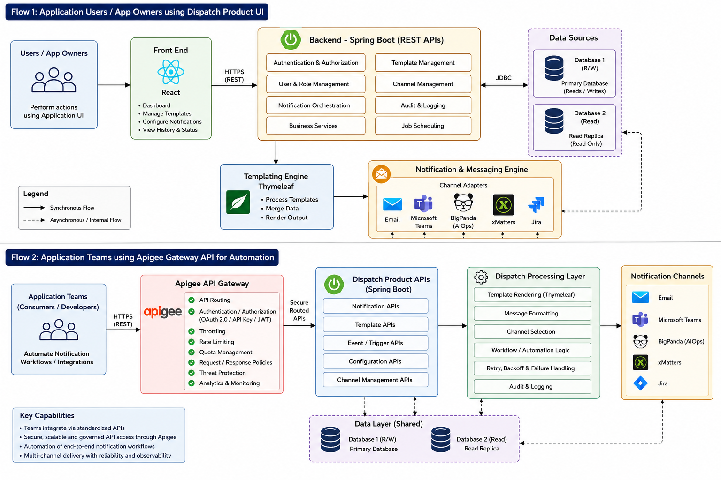
Reference Architecture Diagram (Original Design Image)

