Slide 1
Adaptive Routing Based on Real-Time Network Conditions
A simulation study of reactive and ML-assisted routing
Your Name | Roll No. 00 | III Year
Computer Networks + Machine Learning
Guide: Prof. Guide Name
1
Notes:
One-line hook: classical routing asks 'what is shortest?' - this project asks 'what is fastest right now?'

Slide 2
The problem
Static metrics ignore the state of the network
▪ OSPF and RIP choose a path from a static metric - normally hop count
▪ The path is recomputed only when a link goes up or down
▪ Networks rarely fail - they degrade: buffers fill, delay rises, packets drop
▪ Result: all traffic stays pinned to “the shortest path” while that path saturates
Cost and congestion are simply not the same quantity.
2
Notes:
This is the standard congestion-collapse story: the metric and the objective have drifted apart. 803 ms vs 86 ms in experiment 2.

Slide 3
Goal and objectives
▪ Build a routing decision that reacts to live link conditions
▪ Measure it against a load-oblivious baseline with a real packet simulation
▪ Add an ML congestion predictor and test whether it adds value
▪ Report the results honestly - including where the ML module does NOT help
3
Notes:
The last bullet matters: the ML module only changes the outcome in one of six scenarios, and we say so.

Slide 4
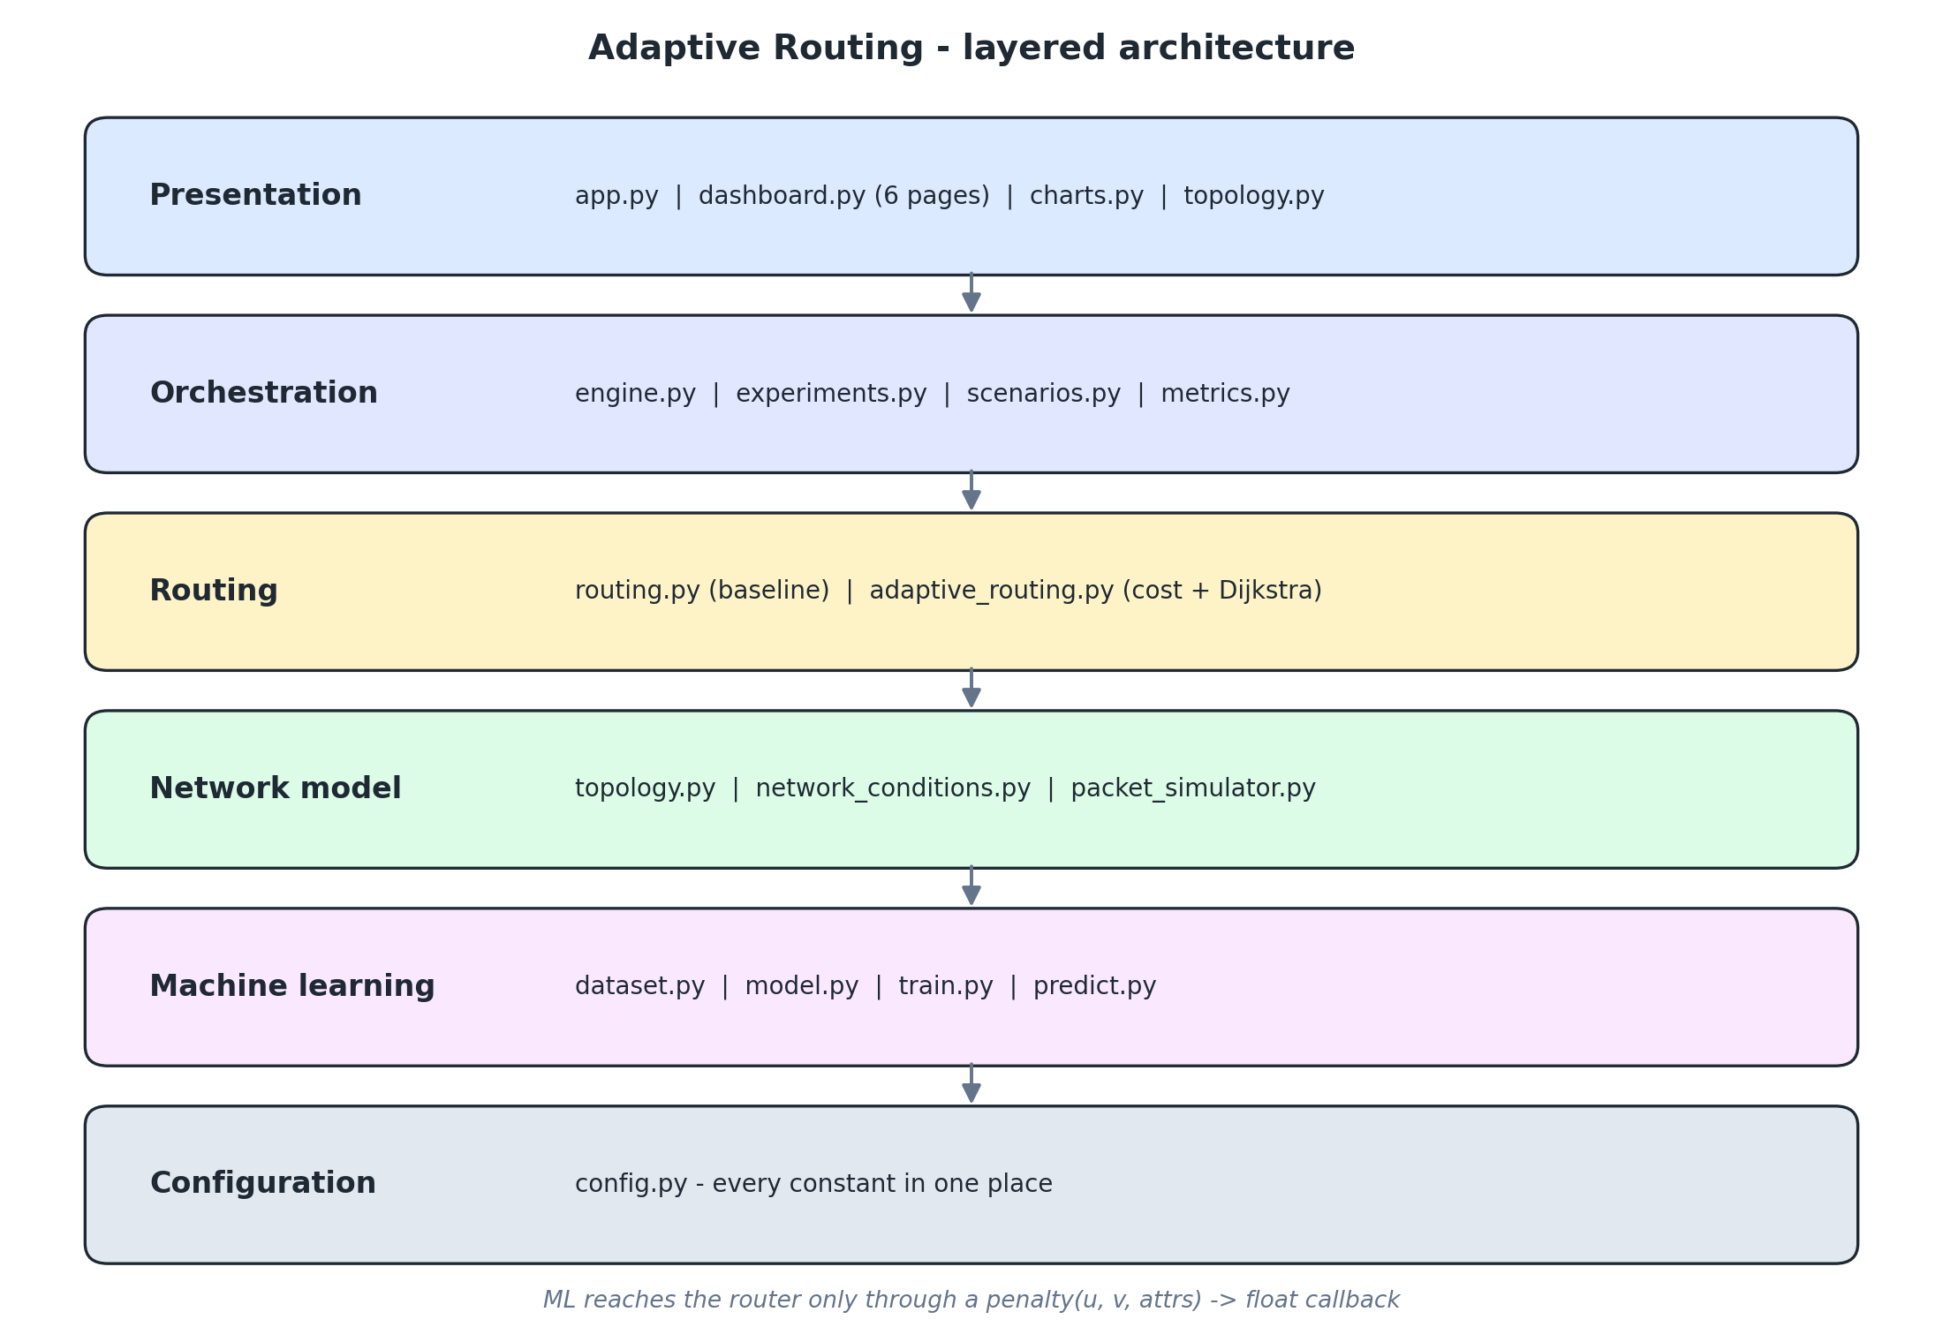
System architecture
Five layers, one callback boundary
ML reaches the router only through penalty(u, v, attrs) -> float - so core never imports ml
4
Notes:
The callback boundary is the key design decision: it is why the system still runs if models/congestion_model.joblib is deleted.

Slide 5
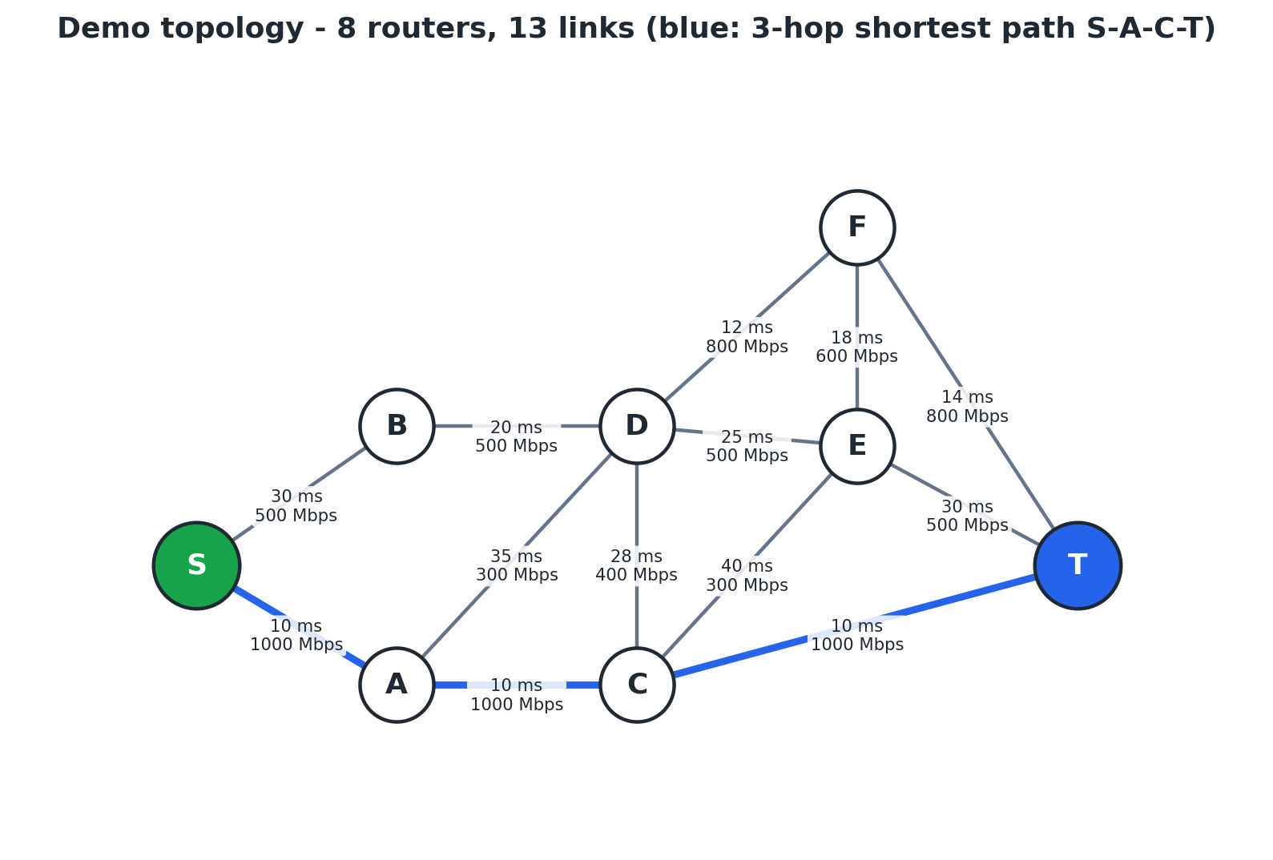
The network
8 routers, 13 links
▪ Routers S, A, B, C, D, E, F, T
▪ Hop-count shortest path: S → A → C → T (3 hops)
▪ Main alternate: S → B → D → F → T (4 hops)
▪ Each link carries bandwidth, latency, loss, congestion, traffic, reliability
▪ Live values plus base_* copies - so any fault can be undone exactly
▪ Invariant: congestion = traffic / bandwidth
5
Notes:
Point out that the backbone is faster on paper but is exactly the route every naive protocol keeps using.

Slide 6
Simulating real-time conditions
Six degradations plus a way back to health
Condition | Effect on the affected links
CONGESTION | queue fills; congestion, traffic and latency rise
TRAFFIC_SPIKE | utilisation jumps on a single link
HIGH_LATENCY | delay × 6, loss untouched
HIGH_PACKET_LOSS | loss driven to 5 - 20 %
LOW_BANDWIDTH | capacity cut by up to 70 %
NORMAL | restore every link to its baseline
▪ A severity parameter in (0, 1] scales every effect
▪ Congestion is clamped at 0.97 so the queueing curve stays finite
▪ Default target: the current shortest path - “congest the route a naive protocol would keep using”
6
Notes:
Severity is what lets one scenario be milder than another; exp5 uses a gentle spike while exp2 saturates the whole backbone.

Slide 7
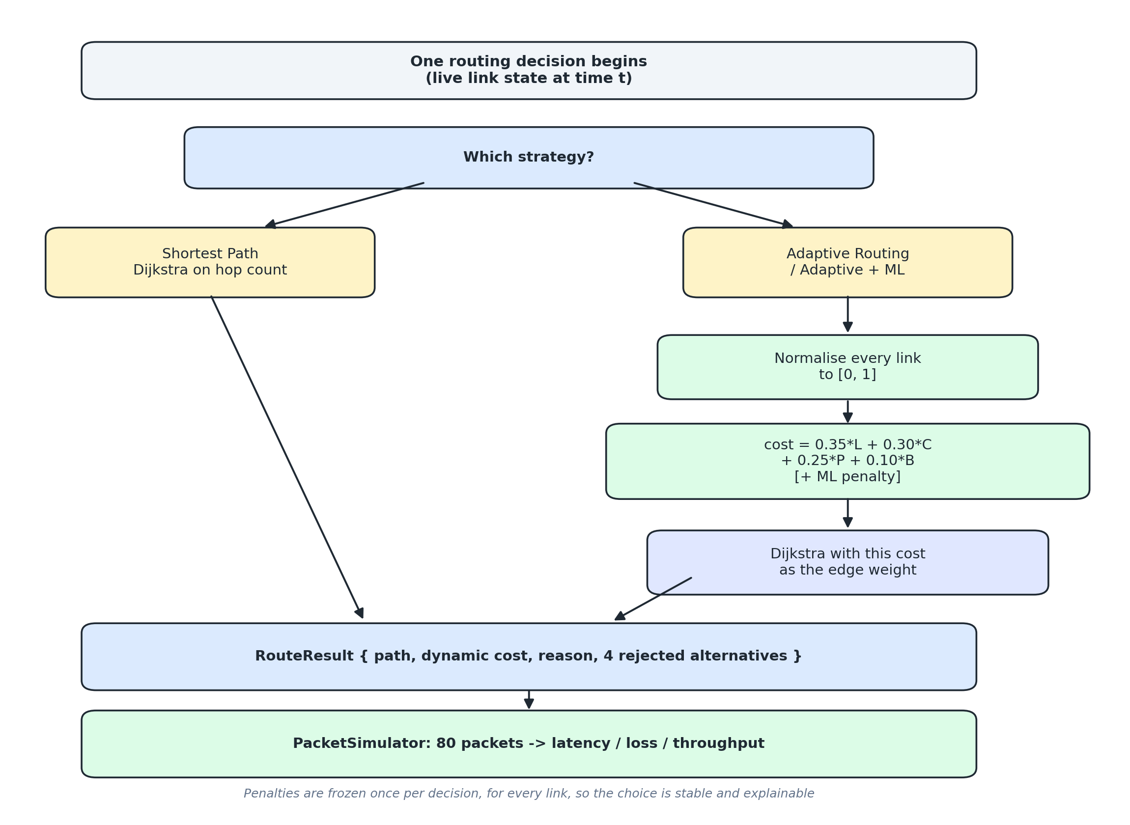
Strategy 1 - baseline
Exactly what OSPF / RIP do
▪ Dijkstra on hop count
▪ Never looks at latency, loss or congestion
▪ The control group every other strategy is measured against
7
Notes:
Walk the flowchart once here, then reuse it on the next two slides.

Slide 8
Strategy 2 - adaptive cost
Every term normalised to [0, 1]
cost = 0.35·min(lat/100,1) + 0.30·congestion
+ 0.25·min(loss/0.20,1) + 0.10·(1 − min(bw/1000,1))
▪ Normalisation makes the four metrics comparable - ms, % and Mbps cannot be added raw
▪ Weights are validated to sum to 1.0 and live in config.py
▪ Dijkstra with this cost as the edge weight → minimum cost under current conditions
▪ The four cheapest rejected alternatives are listed too - the decision is explainable
8
Notes:
Weights are a priori engineering judgement. A sensitivity sweep is the first item of future work.

Slide 9
Strategy 3 - ML-assisted
A proactive signal added to the same cost
▪ 6 features: latency, loss, utilisation, traffic, queue length, previous_level
▪ Random Forest - 5 000 samples, 75/25 split, seed 42
▪ Labels come from an explicit rule:
  – severity = 0.40·util + 0.30·min(lat/100,1) + 0.30·min(loss/0.15,1)
  – severity ≥ 0.65 → Congested, ≥ 0.40 → Warning, else Normal
▪ Predicted class → additive penalty of 0.00 / 0.35 / 0.90
▪ Penalties are computed once per decision, for every link
9
Notes:
previous_level is the previous prediction for the same link - a router always knows it, so it is not leakage. It is what makes the prediction temporal rather than per-sample.

Slide 10
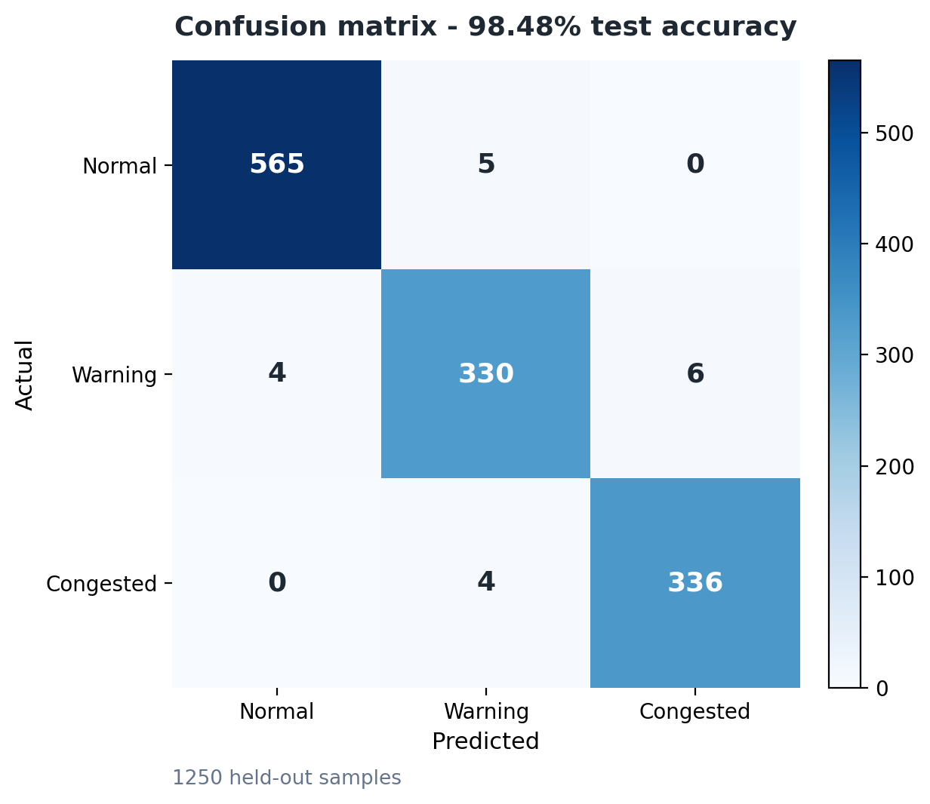
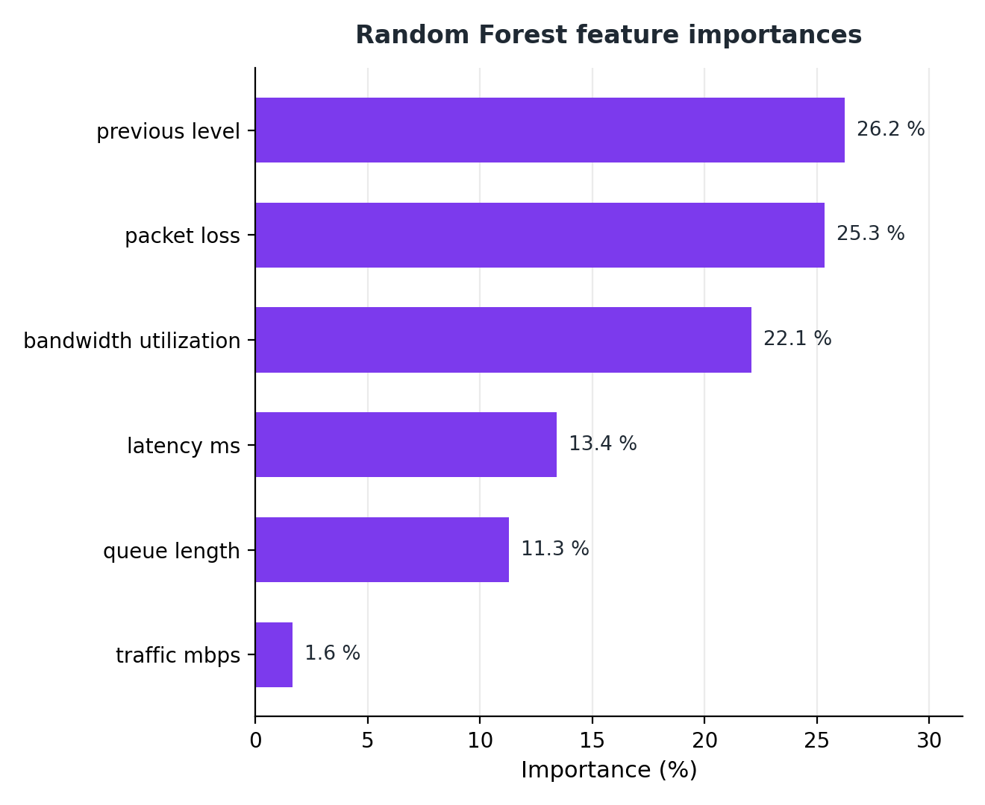
Classifier evaluation
98.48 % on 1 250 held-out samples
Accuracy measures consistency with our own labelling rule - the end-to-end proof is slide 13
10
Notes:
Macro F1 0.983. Importances: previous_level 26 %, packet_loss 25 %, utilisation 22 % - congestion persists, and the two direct symptoms follow. Say the caveat out loud before anyone asks.

Slide 11
Experimental design
6 scenarios × 3 strategies = 18 runs
Dimension | Value
Runs | 18 (6 scenarios × 3 strategies)
Time steps per run | 5
Packets per step | 80 → 400 per run, 7 200 in total
Seed | 42 (conditions, packets, ML split)
Topology | predefined 8-router / 13-link graph
Source → destination | S → T
▪ Every strategy sees the identical timeline on an identical fresh topology
▪ exp1 is a control: with no faults all three must agree
▪ exp5 targets only link S-A - the scenario built to isolate the ML contribution
11
Notes:
A fresh topology per run means runs cannot contaminate each other. The condition targets the hop-count shortest path, so the experiment is not rigged in favour of the adaptive router.

Slide 12
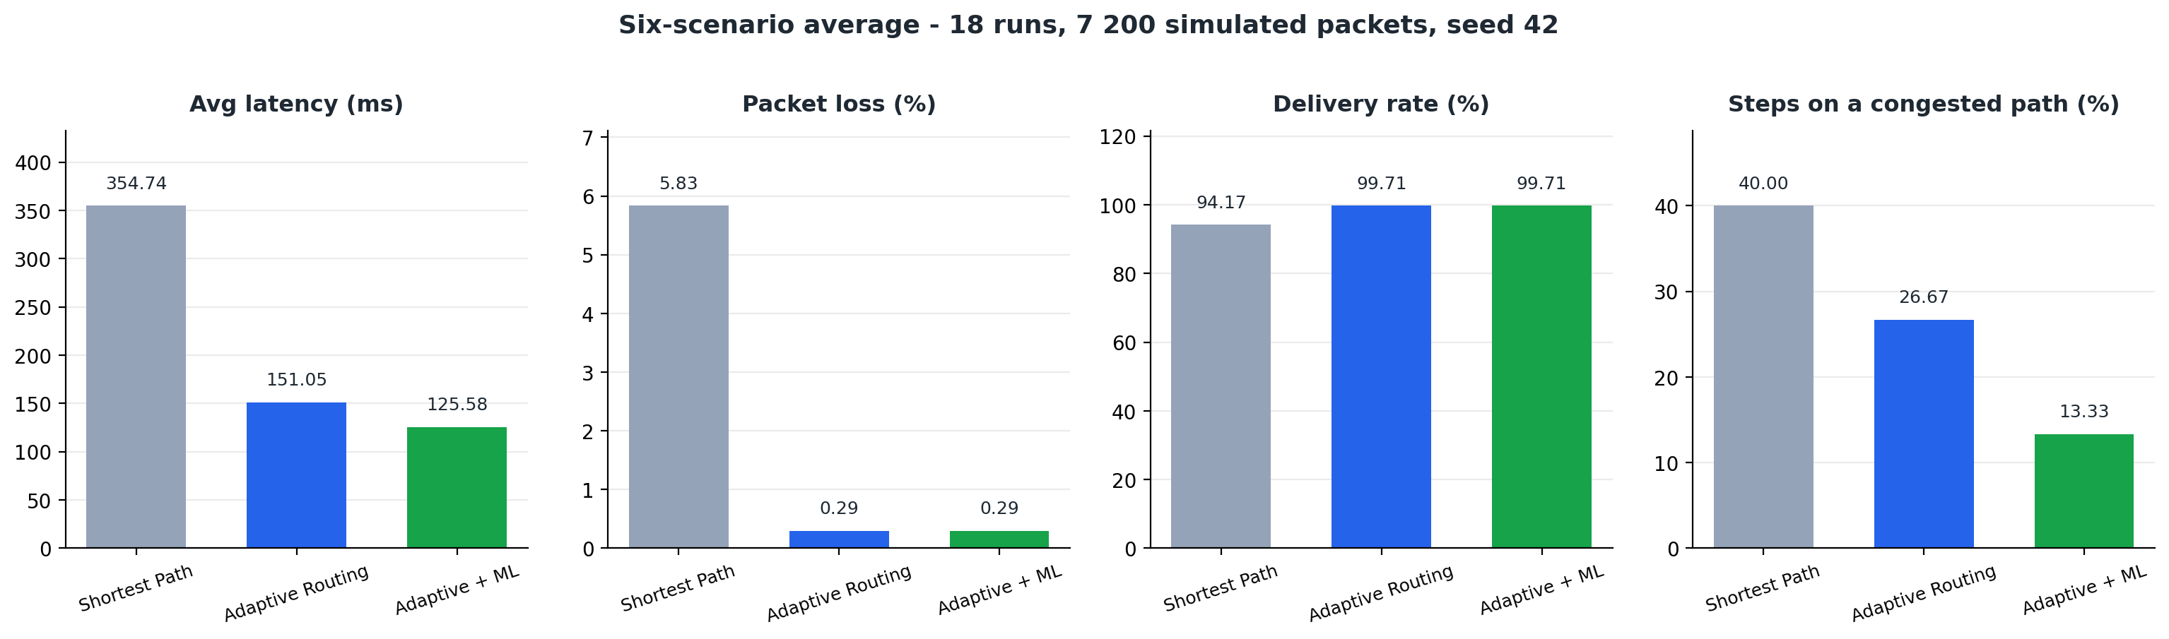
Headline results
Averaged over the six scenarios
Strategy | Latency (ms) | Loss (%) | Delivery (%) | Congested steps (%)
Shortest Path | 354.74 | 5.83 | 94.17 | 40.00
Adaptive Routing | 151.05 | 0.29 | 99.71 | 26.67
Adaptive + ML | 125.58 | 0.29 | 99.71 | 13.33
vs hop count: −57 % latency, −95 % packet loss, +43 % throughput
12
Notes:
Network utilisation is identical (31.32 %) for all three - the same traffic is offered every run, only the route differs. Route utilisation 43.3 % → 23.2 % is the meaningful figure.

Slide 13
Where the win comes from
Two experiments carry the result
exp2 - congestion on the shortest path | Route | Latency
Shortest Path | S → A → C → T (stuck) | 803 ms
Adaptive (+ ML) | S → B → D → F → T | 86 ms
exp5 - traffic spike on a single link | Route | Latency
Shortest Path | S → A → C → T | 238 ms
Adaptive Routing | S → A → C → T (does not move) | 238 ms
Adaptive + ML | S → B → D → F → T | 86 ms
In exp5 the ML route's current cost is higher (0.608 vs 0.512) - the model is buying a future improvement, not a present one
13
Notes:
This is the defining difference between a reactive and a proactive signal, and it is the honest answer to 'why would you pay more now?'

Slide 14
When it does not help
Reported, not hidden
▪ Healthy network (exp1): all three strategies pick the identical route - adaptation costs nothing, but gains nothing either
▪ Whole neighbourhood degraded (exp6): every strategy falls to ~369 ms - adaptive routing finds the least-bad path but cannot create capacity
▪ The ML module changes the outcome in 1 of 6 scenarios, not all of them
▪ Results are deterministic (one seed, one topology): reproducible, but not a statistical sample
14
Notes:
Volunteering the limitations is the strongest thing you can do here. Exp6 shows the technique's boundary: finding the least-bad path is not the same as having capacity.

Slide 15
Limitations
▪ Simulation, not a testbed - no NS-3, Mininet or real routers
▪ Synthetic dataset, so accuracy reflects our own labelling rule
▪ Small fixed topology (8 routers); the random-topology builder is not yet swept
▪ Only three strategies - no ECMP, QoS or SDN baseline
▪ Hand-chosen weights, no sensitivity analysis yet
15
Notes:
Each of these is a concrete next step, not a dead end.

Slide 16
Conclusion and future work
▪ Reacting to real-time conditions halves latency and removes 95 % of packet loss
▪ A small explainable classifier adds a proactive step that reactive routing cannot take
  – learned or swept cost weights
  – real public traffic traces instead of generated data
  – 20 - 100 router topologies, repeated over many seeds
  – ECMP and QoS baselines; closed-loop feedback
  – deploy the cost function as an OSPF metric or an SDN controller app
Thank you - questions?
16
Notes:
Close on the one-line framing: hop count is cheap to compute and wrong exactly when it matters. Thank the panel and invite questions.

