Slide 1

Thank You For Using ABCD Project!

Slide 2
Namasthe is a customary, non-contact form of Hindu greeting. Namaste is usually spoken with a slight bow and hands pressed together, palms touching and fingers pointing upwards. Namaste is used as a form of greeting, acknowledging, and welcoming a relative, guest, or stranger. In some contexts, it can be used to express gratitude for assistance offered or given and to thank people for their generosity. Did you know?: The gesture of joining both hands has more than a symbolic meaning. It is said to provide a connection between the right and left hemispheres of the brain thus representing unification.

Slide 3
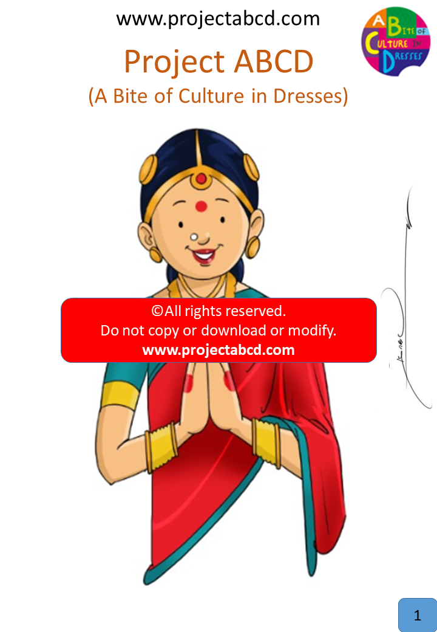
Namasthe

Slide 4
The salwar kameez is a sleek design originating from the Indian state of Punjab. The 'kameez' is a knee length tunic with lots of intricate adornments. The 'salwar' are loose pajama-like trousers. Did you know?: In some regions of Asia, this dress is worn by both men and women.

Slide 5
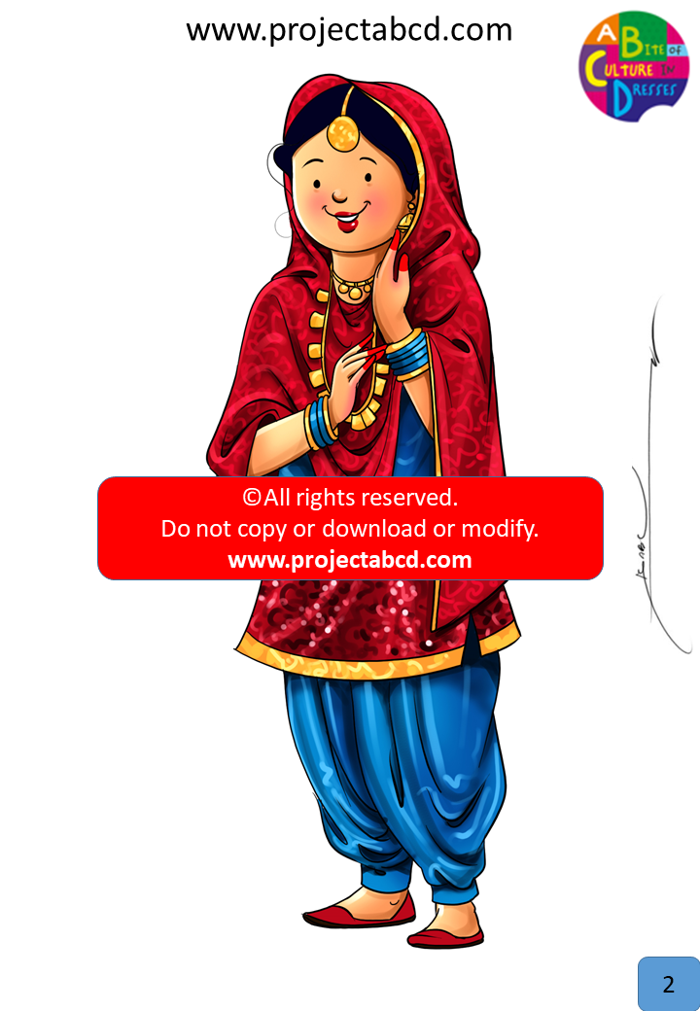
Salwar Kameez

Slide 6
Gujarathi saree, also known as Surat saree, is a very interesting variation of the traditional saree. In this dress, the pallu (or drape) is worn hanging forward as opposed to hanging back over one shoulder. These sarees are usually found in the bandhej print, which is uniquely found in Gujarat. These sarees are generally only worn on special occassions, such as weddings and festivals, but also can be found in plain colors for every day life. Did you know?: Gujarat is the home to tallest statue in the world.

Slide 7
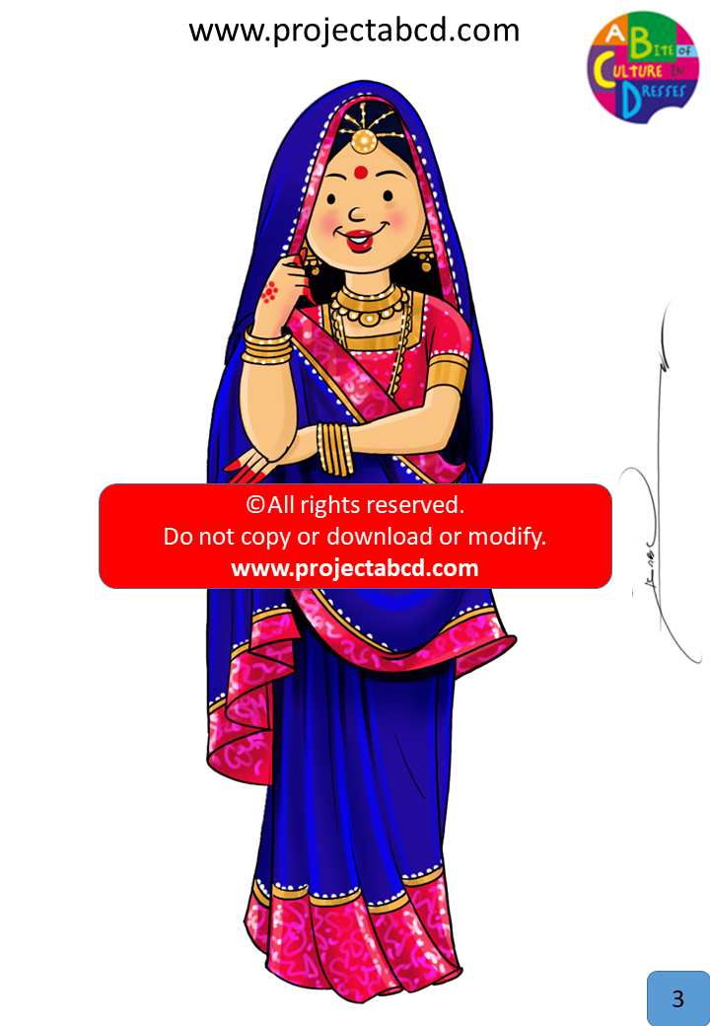
Gujarathi Saree*

Slide 8
Saree is a cultural icon worn by women in India. It is a continuous weave of fabric, 4-12 meters or 15-30 feet long draped around a woman in different ways. This fabric is traditionally made from natural fibers like Cotton & silk. Man made fibers like polyester, chiffon are also used. It is worn with an upper garment called 'choli or saree blouse'. And a lower underlayer called petticoat which gives the Saree some form. Did you know?: There are more than 100 ways of wearing a saree!

Slide 9
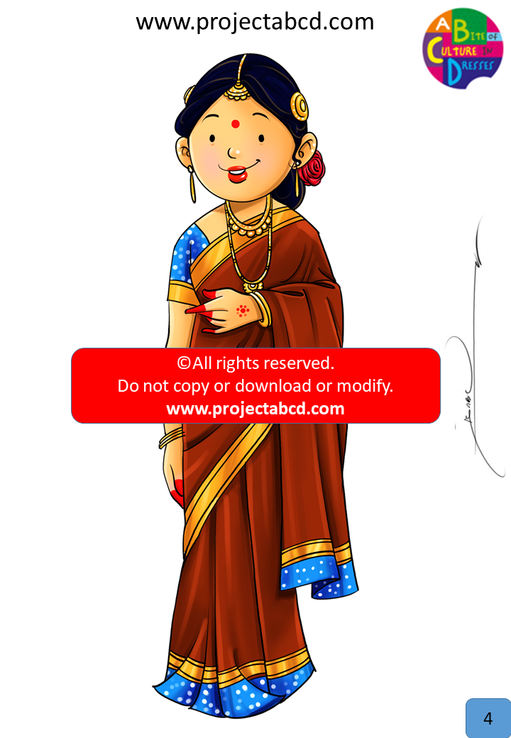
Saree

Slide 10
The Kasavu style saree is a traditional dress for the people of Kerala. Back in the day, patterned dresses were seen as a "crime", so the minimalistic approach was used. These sarees are always white cotton with a colored border. If the border is gold, it is a much more expensive dress and is generally used for weddings. If it is any other color, then it is worn every day. Did you know?: The wider the colored border is the more luxurious it is!

Slide 11
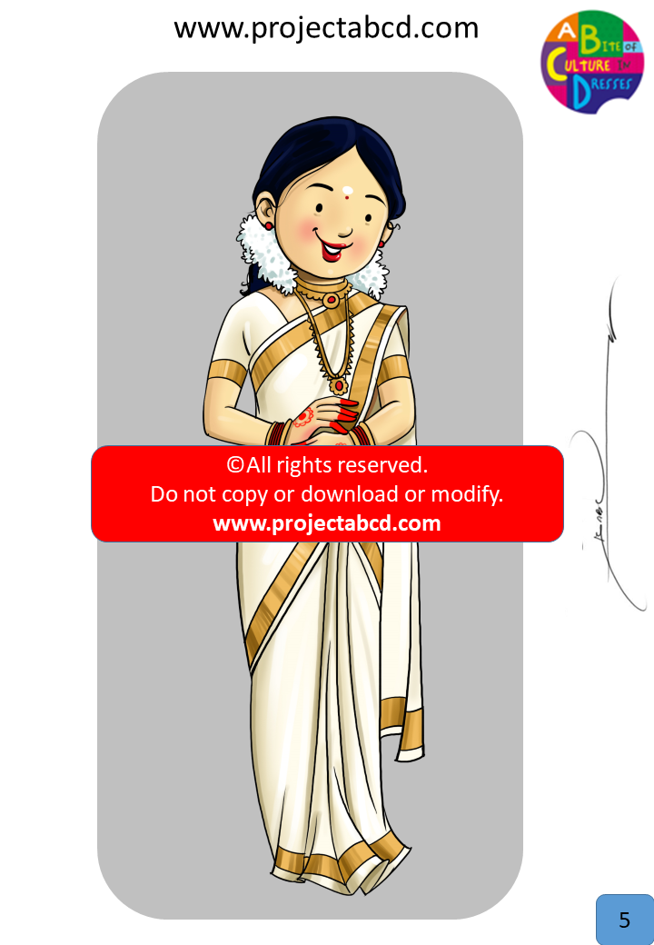
Kerala Kasavu

