Slide 1

Clothing Assistant Chatbot with Retrieval-Augmented Generation
GROUP 5
Madhav (21f1004828@ds.study.iitm.ac.in)
Manish (21f1005330@ds.study.iitm.ac.in)
Neeraj (21f3002261@ds.study.iitm.ac.in)
Harsha (23f2005056@ds.study.iitm.ac.in)
Adarsh (21f2000283@ds.study.iitm.ac.in)

Slide 2
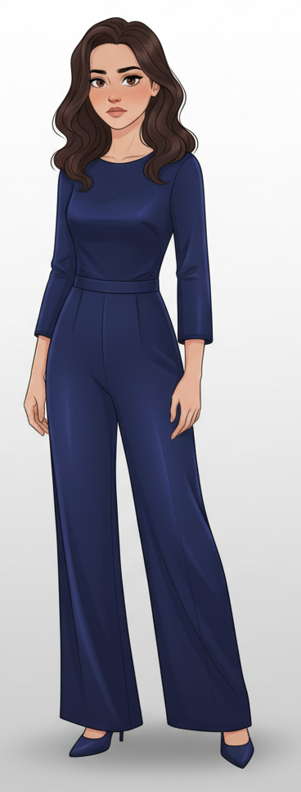



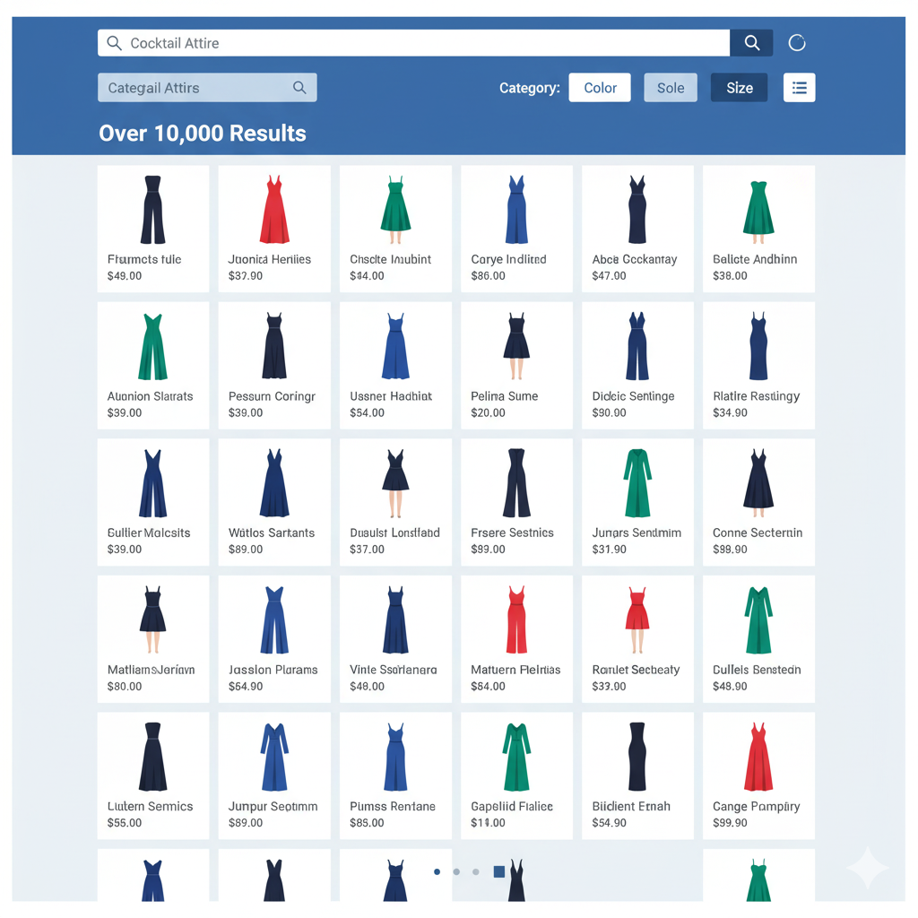
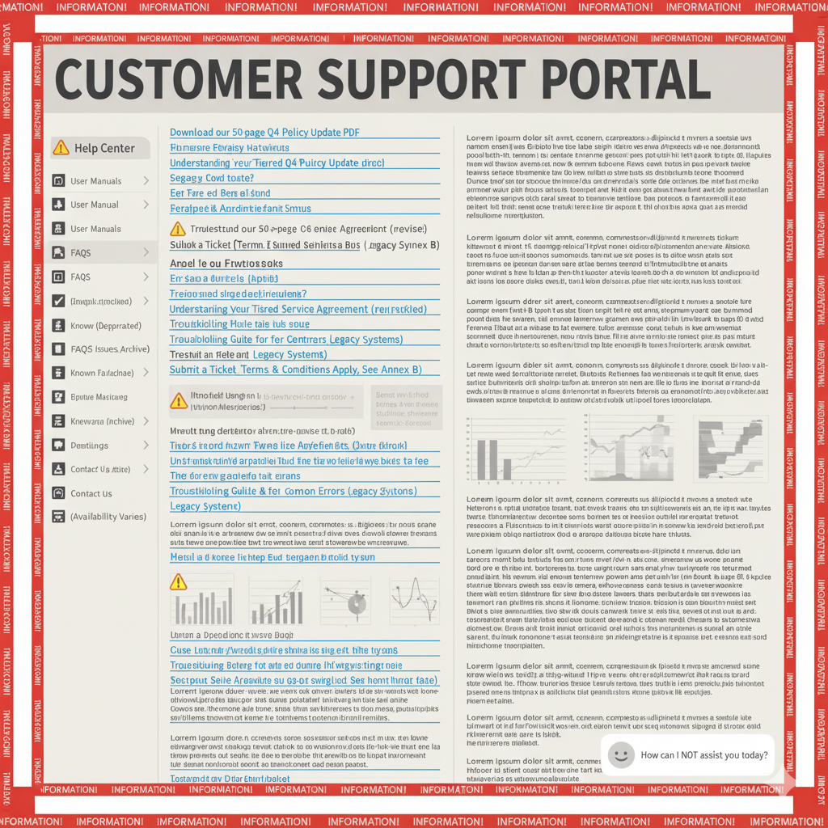




She needs something elegant fast
She opens a silk-blend
jumpsuit but starts worrying about shine, fit, and shipping cutoff.
Maya tries browsing a major retailer for a navy blue jumpsuit.
Maya realizes she has only one day left before the engagement party
300+ results even after filters.
She wishes buying one outfit wasn’t such a chore.
Every question leads her away from the product page.
After 90 minutes, she’s exhausted and still undecided.
She switches to the Help Center searching for shipping cutoff.
She want to know about the
Return policy on this product

Slide 3
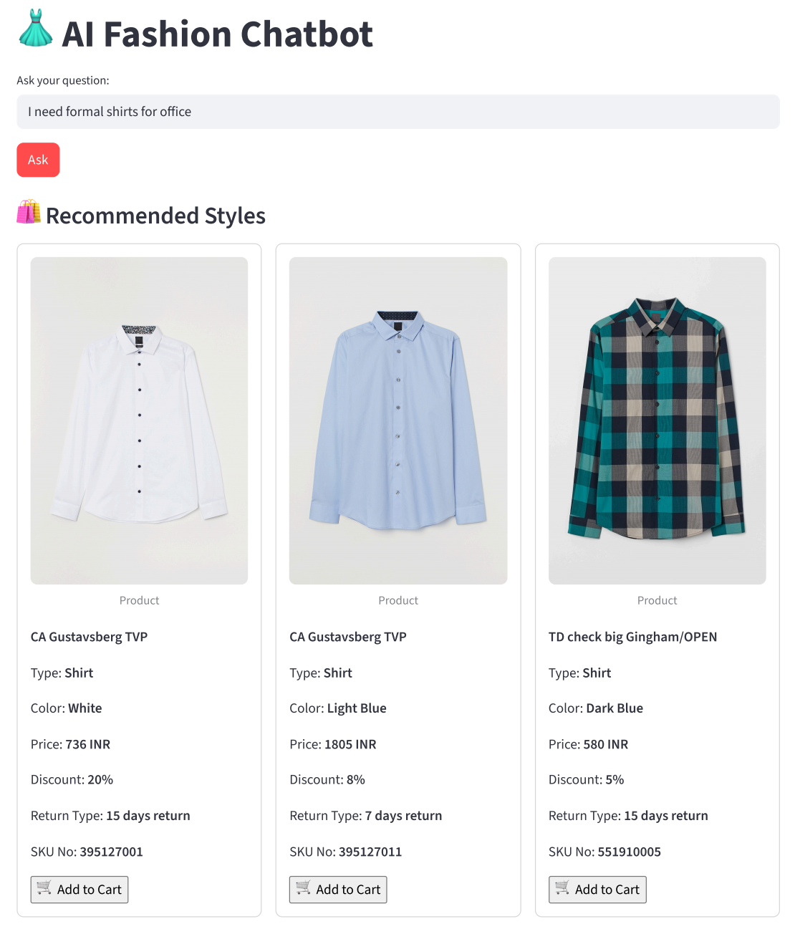
Maya couldn’t help thinking—why isn’t shopping simple? Say goodbye to endless filters and guessing the perfect keywords. There should be a way to describe what you want just like you’d tell a friend and get a clear, reliable answer with accurate shopping data. Imagine asking a question and instantly getting an organized response with rich visuals and the details that matter—price, reviews, inventory—so you can decide what to buy quickly and confidently.

Slide 4


Why a Fashion Chatbot?
An unified internal product catalog ensures all recommendations are in stock and on-brand.
Query-based filtering keeps the AI strictly aligned with the customer’s exact request.
Context-aware fashion rules provide relevant outfit suggestions.
Vector-based Product catalog search.
External Links
Forgot my context
Irrelevant matches
Internal Catalog
Contextual Memory
Smart Pairing

Slide 5
Problem Statement
To build a Clothing Assistant. A chatbot designed to answer questions from store policy, previous purchases of customers, and suggest outfits based on query given and customer’s previous purchases.

Slide 6
Fashion Chatbot
Store policy + Customer help desk
AI stylist
What is the return policy?
Can I get discount voucher if i return old clothes?
What are the payment policies available?
What is the refund conditions?
How is the shipping done?
What about a red one?
Help me find a blue shirt for my office
Shirt that goes with cream pant
Trendy tops in pastel colors for brunch
Dress for winter

Slide 7
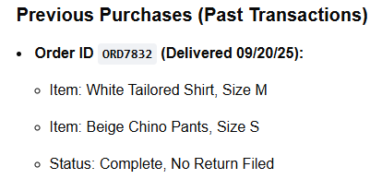

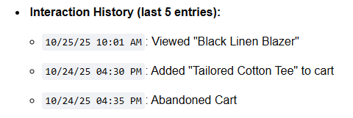
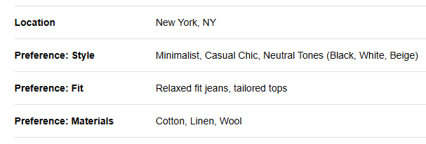
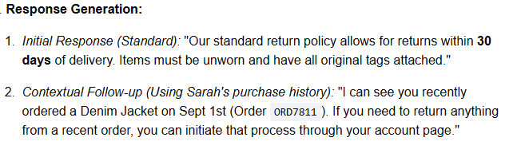
Chat History
Context
User Query
Previous Purchases
Chat Response

Slide 8
Problems faced and solutions built
Existing problems
Multi-dimensional similarity — fashion items may match in one aspect (like color) yet differ in style, or pattern, making compatibility difficult for simple models to judge correctly
Agents lack personalization
Agents do not stick to customer requests
Ex- when a customer asks for a pant for formal event, some ai models recommend shorts
No conversational memory — agents forget previous context (e.g., occasion, colors, previous choices).
Solutions
Personalization — we take user history into account while recommending products
Stick to customer requests —created another layer for this purpose, which gives very high weight to current user query to ensure that they are taken into consideration
Conversational History maintained.
Ensures that all aspects are considered – ensure that all the aspects of the products are considered, instead of focusing on only 1 aspect.

Slide 9
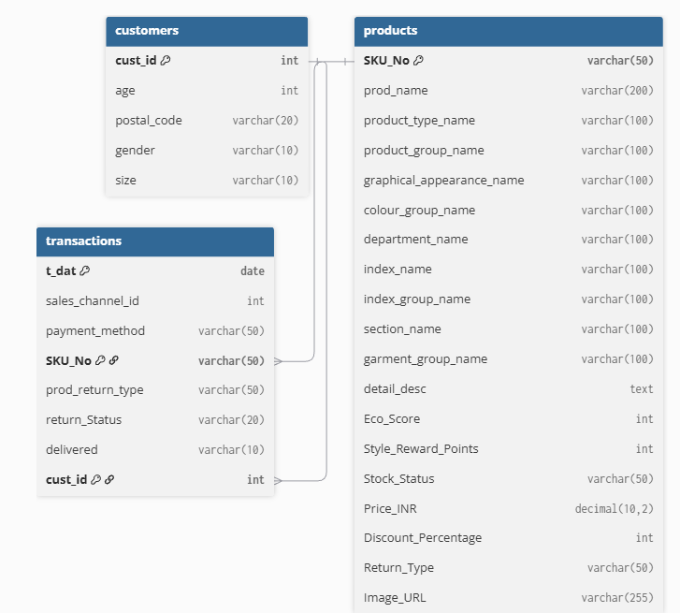
Database scheme
The data is stored in a connected way so we can easily link every customer, product, and transaction.
This structure makes it easy to get complete details about any purchase, customer behaviour, or product performance.

Slide 10
Policy Dataset
A comprehensive policy framework was developed using ChatGPT, drawing references from established policy documents of leading clothing retailers such as H&M, Marks & Spencer (M&S), and Levi’s.
The formulated document encompasses key operational and customer-centric policies, including exchange, refund, and return procedures, garment recycling initiatives, loyalty and reward programs, as well as gifting policies.
Link to the policy Document: Policy
Summary Stats on Policy Document:
Minimum policy word count - 43
Max policy word count - 760
Median policy word count - 433
Mean/average policy word count - 396
Most common range for each policy- 350-500

Slide 11
EDA on Product Dataset
Dataset Overview:
Total Records: 105,542
Total Features: 25
Data Cleaning
Filtered out non-clothing categories (Shoes, Bags, Underwear, Accessories, etc.)
Final dataset after filtering: 78,017 clothing items
Feature Types
Numeric Columns: 11
Categorical Columns: 15
Missing Values
Only detail_desc column contains missing values (≈0.3%)
Key Insights
Most Common Product Type: Trousers (11,169 entries)
Most Frequent Color: Black (22,670 entries)
Most Common Appearance: Solid pattern (49,747 entries)
Most Frequent Item Name: Dragonfly Dress (98 entries)

Slide 12
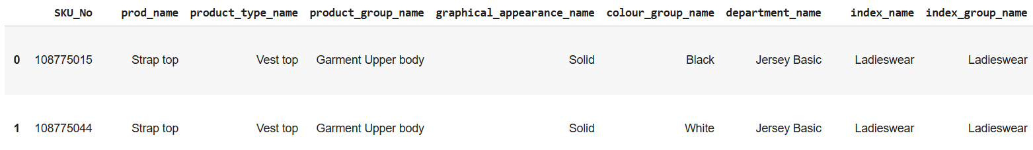
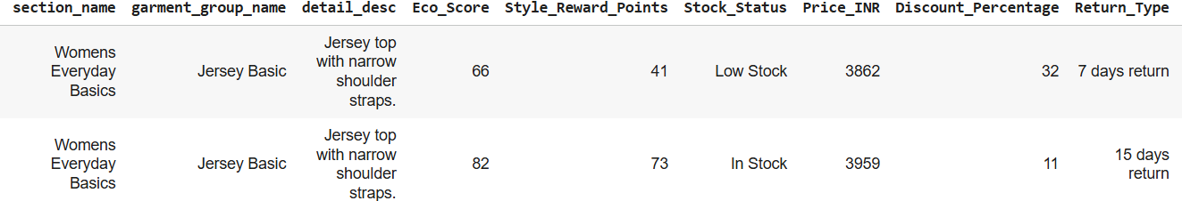
Sample Product Dataset

Slide 13
Embedders Used
BGE Sentence Transformer
Specifically tuned for dense retrieval in RAG, where matching query and context meaning matters more than syntax.
Delivers strong performance in multilingual and domain-agnostic document search, making it versatile for global or diverse datasets.
Smaller models (like bge-small-en or bge-base-en) give excellent performance-to-size ratio, ideal for local or edge RAG setups.
Strong alignment with LLM-based question answering pipelines — integrates well with vector databases (like FAISS, Milvus, Chroma).
Product RAG: BAAI/bge-small-en-v1.5
Policy RAG: BAAI/bge-base-en-v1.5

Slide 14
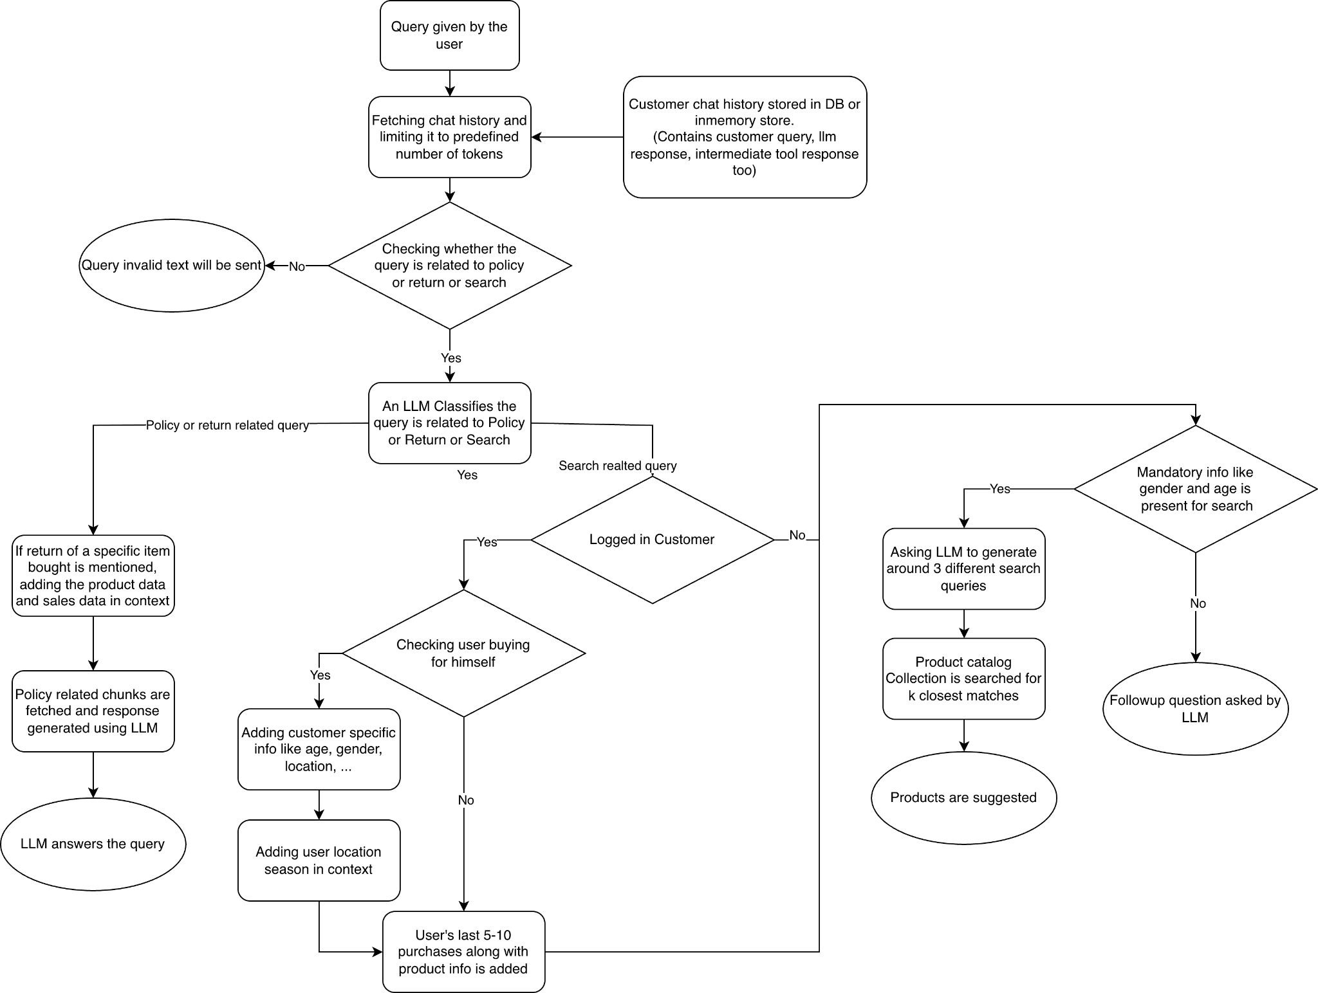
Chatbot Flow

Slide 15
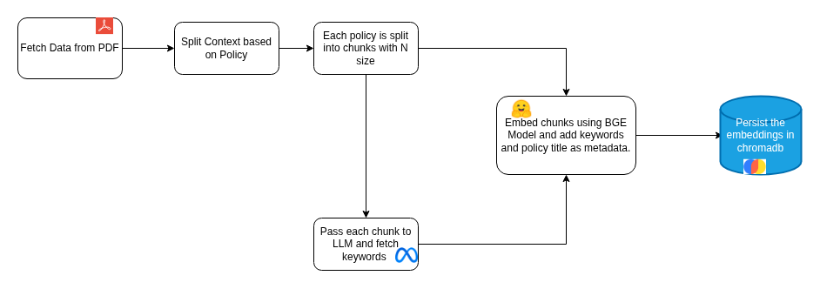
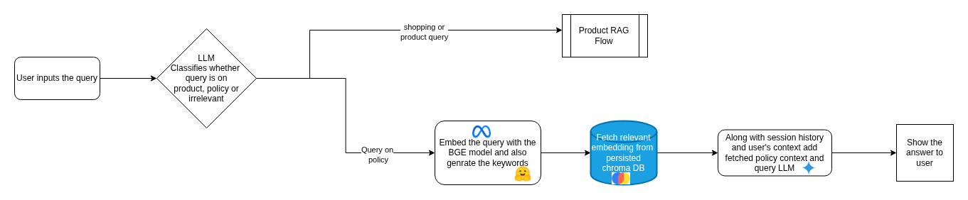
Policy RAG

Slide 16
Evaluation on Policy RAG
RAGAS : Retrieval-Augmented Generation Assessment
Based on the policy document, we formulated questions directly linked to the facts it outlined. Several questions drew from multiple policies, addressing areas such as the accrual and validity of loyalty points, as well as refund eligibility, including considerations related to GST and shipping charges.
Following Setup was used to perform Ragas evaluation:
Question: The user query provided as input to the RAG pipeline.
LLM Answer: The response generated by the RAG pipeline.
Contexts: The retrieved passages or documents from the external knowledge source that support the answer.
Ground Truths: The correct or reference answer used to assess the pipeline’s performance.
Link to Policy Evaluation RAGAS: Evaluation

Slide 17
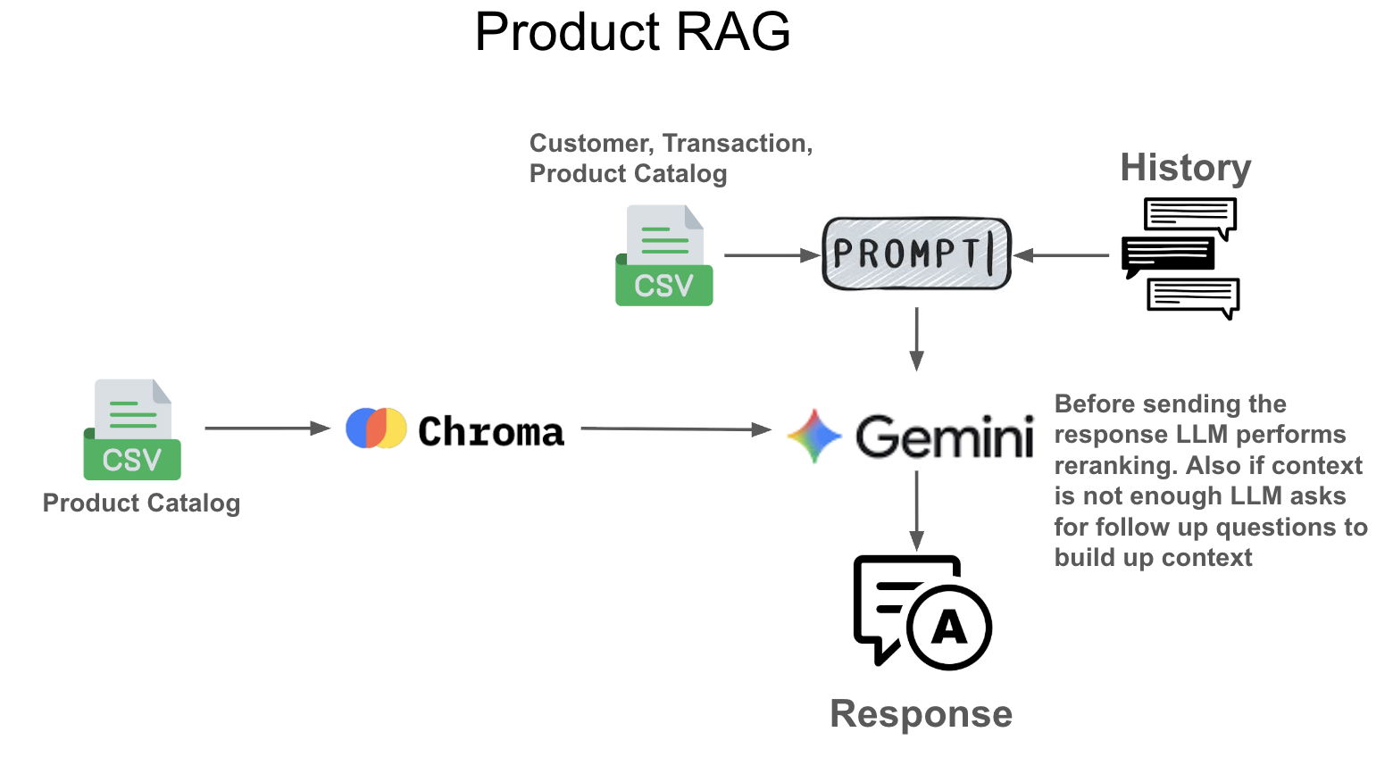
Product RAG - Working
Products stored in VDB
Customer info, transactions stored in csv (can also be stored in RDB)
User query along with customer context and chat history is used to create a prompt to search for relevant products in VDB
The fetched products are reranked using LLM

Slide 18
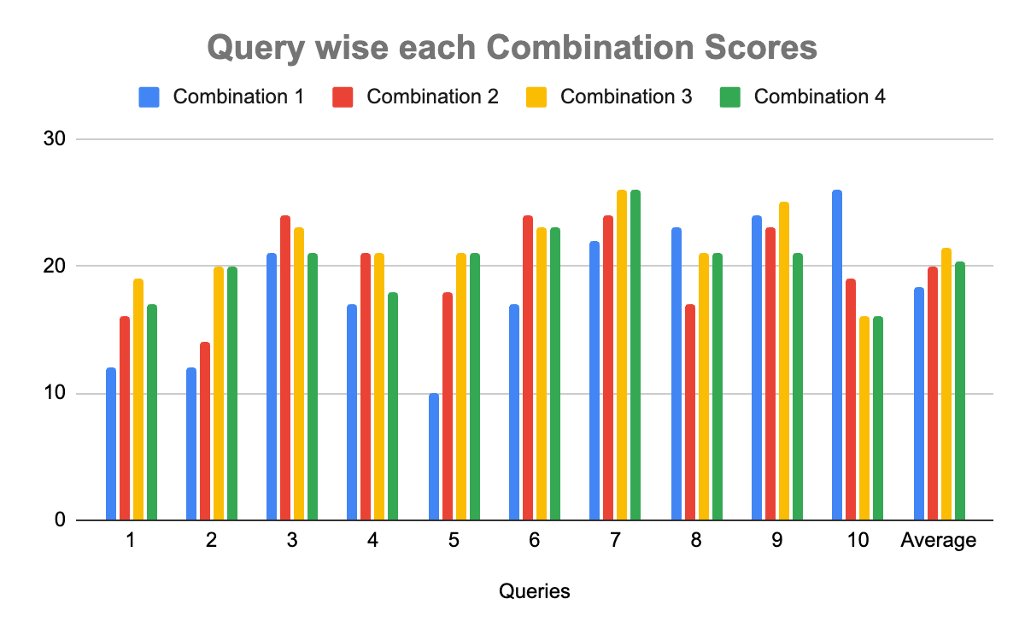
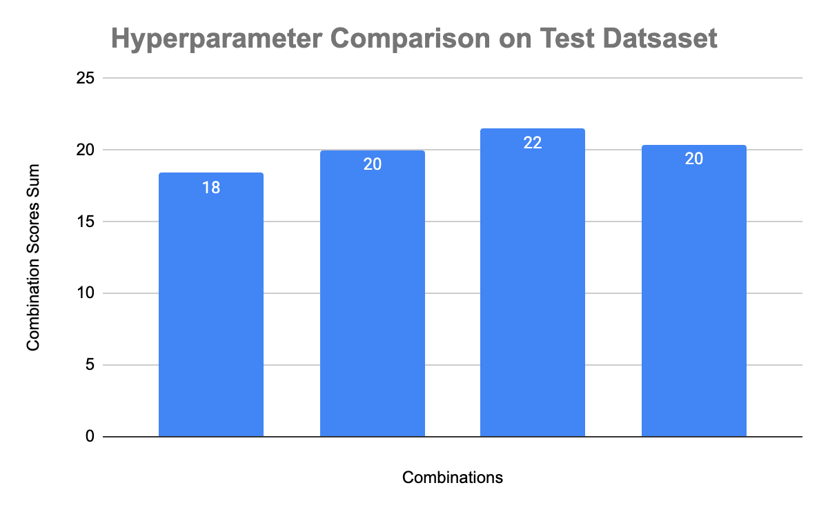
Product RAG - Scoring
The scoring and hyperparameter tuning of product RAG is explained.
Setup: Came up with 10 queries, along with chat history, customer context (age, gender, transaction history). The queries were run through the chat bot and the results were scored manually.
Scoring sheet link: product_rag_scoring_sheet

Slide 19
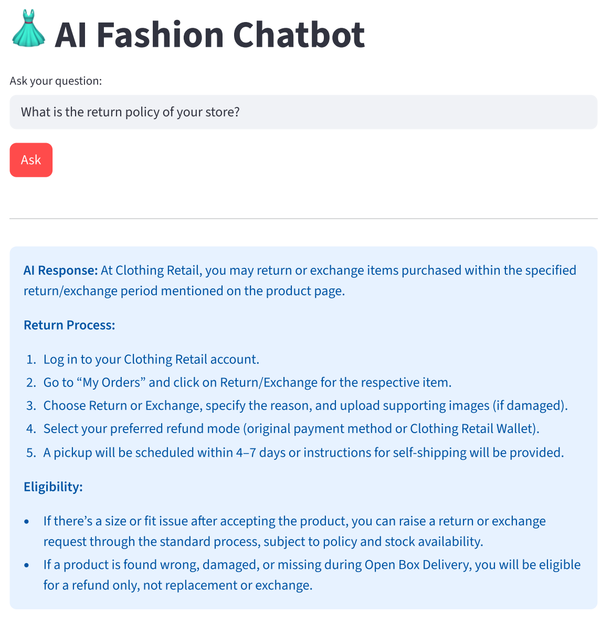
Chatbot Demo

Slide 20
Individual Contribution
Defining problem statement - All members
Literature review - All members
Policy dataset and EDA - Madhav, Harsha
Product dataset and EDA - Manish, Neeraj, Adarsh
Policy Embedding - Madhav, Harsha
Product Embedding - Adarsh, Neeraj
Chat flow - Manish, Madhav
Policy RAG hyperparameter tuning - Madhav, Manish
Product RAG hyperparameter tuning - Manish, Harsha, Neeraj, Adharsh
Coding - All members
Policy and Product RAG testing - All members
Documentation and PPT - All members
Coordinators - Manish, Harsha

Slide 21
Thank You

