Slide 1
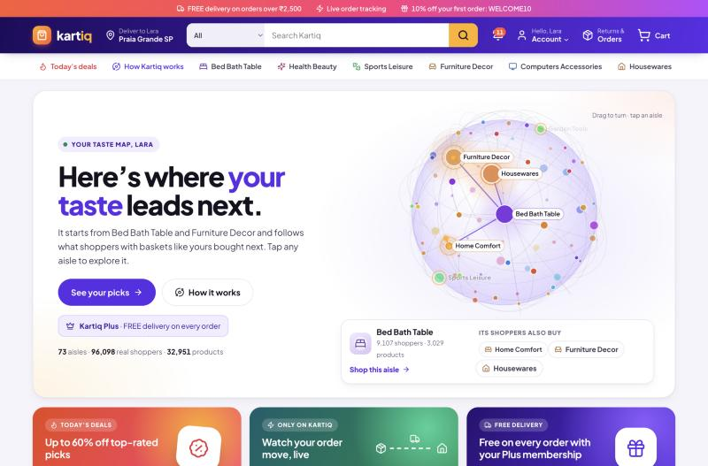
Kartiq
21CSE562T · SQL & NoSQL for Data Science · CLA-2
Real-time retail intelligence, built on MongoDB
Smart shopping, live.
MongoDB 9 · FastAPI · React · scikit-learn
Presented by: Your Name · Register No.
Notes:
Introduce yourself. Kartiq = cart + IQ. It's a full online store where MongoDB is the centre: shoppers sign up, search, buy and track orders live, while aggregation pipelines feed three ML models that act on the shopper in real time.

Slide 2



Stores act on their data too late
Online stores collect huge amounts of order and click data.
Usually it is analysed in weekly reports, long after the customer has left.
Kartiq answers three questions while the customer is still shopping.
What kind of customer is this?
K-Means segment sets their offer
What will they want next?
Collaborative filtering shapes the home page
Is this behaviour unusual?
Isolation Forest can hold the order
Notes:
The problem: data sits unused until a weekly report. Kartiq answers three questions live: what kind of customer, what next, and is this unusual. Each answer is produced by a MongoDB aggregation feeding a small model.

Slide 3




Kartiq at a glance
99,441
96,096
32,951
102,230
real orders
real customers
products
reviews
Real Olist Brazilian e-commerce dataset (2016–2018), plus clearly labelled synthetic shopping events
Shop
Analyse
Learn
React live
Sign up, search, cart, checkout, track and review: full CRUD
3 aggregation pipelines turn raw data into features
K-Means, collaborative filtering, Isolation Forest
Change Streams push every change to the browser
Notes:
Real data, not toy data: 99k orders from the public Olist dataset. Four pillars: shopping (the CRUD), analytics (aggregation pipelines), models, and the live layer with Change Streams.

Slide 4





How the pieces fit together
React 18 (Vite)
REST
FastAPI (Python)
pymongo
MongoDB 9 · rs0
Shopper pages + admin work queues
REST /api · JWT auth · workers
Single-node replica set
Change Stream → WebSocket /ws → browser updates
Transactions
Background workers
Analytics run (~35 s)
Sign-up, checkout, cancel and review are multi-document ACID transactions
Change Stream listener, order fulfilment every 20 s, live simulated traffic
Pipelines A, B, C → Modules 1, 2, 3 → results written back to MongoDB
Notes:
Three tiers. The browser talks REST to FastAPI, which talks to MongoDB through pymongo. The return path is the interesting part: MongoDB's Change Stream tells FastAPI about every change, and FastAPI pushes it over a WebSocket, so pages update without polling. MongoDB runs as a replica set because both transactions and Change Streams need one.

Slide 5
Schema: what lives where
users
customers
orders
products
reviews
login
96,096
99,441
32,951
102,230
_id
email (unique)
password_hash (scrypt)
role
customer_id →
_id
customer_unique_id (unique)
city, state
order_count
_id, customer_id →
order_status
purchase_timestamp
_id, product_id (unique)
name, category
price, price_range
rating_avg, sales_count
delivery_days ($median)
_id
product_id →
customer_id →
rating, message
created_at
line_items[ ] product_id →
segment { label, cluster }
payment { type, total }
anomaly { risk, score }
seller { city, state }
status_history[ ]
notifications
events
alerts
carts
derived ($merge)
TTL 30 d
write-heavy
live
1 per customer
user_id →
title, body, read
created_at (TTL index)
customer_id →, session_id
event_type, timestamp
customer_id →
risk_label, score
reason, status
_id = customer id
updated_at
rfm_features
category_affinity
rolling_behavioral_metrics
category_similarity
ml_runs
metadata { varies by type }
items[ ] product_id →
Read-heavy core
Write-heavy
App collections
Pipeline output
Embedded sub-document
Reference
Notes:
Nine main collections. Purple = read-heavy core data from Olist. Coral = events, which is write-heavy, so it has only two indexes. Blue = collections the app creates. Green = outputs that the pipelines write back with $merge. Amber boxes are embedded sub-documents: order line items and payment live inside the order; the K-Means segment and the risk score live inside the customer. Arrows are references by id.

Slide 6




Embed or reference, and why
EMBED
EMBED
EMBED
Order → line items, payment
Customer → segment, risk
Cart → items (_id = customer)
Bounded, never change after checkout, read together. Lets Pipeline B $unwind instead of $lookup.
Small, one writer each, read on every offer and checkout. No join on the hottest path.
One cart per customer, small, always read and written whole. Found by primary key.
REFERENCE
REFERENCE
REFERENCE
Customer ← events
Product ← reviews
User → customer
Unbounded and write-heavy: embedding would grow a document forever. Only 2 indexes.
Hundreds per product, shown a page at a time. Embedding would hit the 16 MB limit.
Keeps password hashes out of the analytics document that pipelines read.
Notes:
The examiner will ask why something is embedded. The rule: embed what is small, bounded and read together; reference what is unbounded, write-heavy, or should be kept separate. Pre-aggregated product fields (price, rating, sales count) are a deliberate read optimisation, kept correct with $inc inside the checkout transaction.

Slide 7
CRUD across the core collections
Collection | Create | Read | Update | Delete
users + customers | Sign-up (one transaction) | Login, /me, Customer 360 | Segment & risk written by models | n/a
carts | POST /cart/items | GET /cart | PATCH quantity (max 20) | DELETE /cart/items/{id}
orders | POST /checkout (transaction) | My orders, live order page | processing → shipped → delivered; approve | Cancel (status kept in history)
reviews | POST review | Paged on product page | Product rating via update pipeline | n/a
notifications | On every order change | Bell menu | Mark as read | TTL index: auto after 30 days
alerts | Raised by Change Stream | Admin alert list | Resolve | n/a
Every endpoint is listed and testable at http://localhost:8100/docs
Notes:
This is the CRUD map. Cart has the cleanest full CRUD: add, view, change quantity, remove. Orders are never hard-deleted: cancel is a status change so history is kept. Notifications are deleted automatically by a TTL index after 30 days, so no clean-up job is needed.

Slide 8
Three pipelines feed three models
A
RFM per customer
$match
$group
$addFields
$lookup
$merge
Module 1 · K-Means
→ rfm_features · 94,399 rows
B
Category affinity
$match
$unwind line_items
$group
$size
$merge
Module 2 · Recommender
→ category_affinity · 96,853 rows
C
Rolling behaviour
$sort
$setWindowFields
$addFields
$setWindowFields
$merge
Module 3 · Isolation Forest
→ rolling_behavioral_metrics · 25,714 rows
Also inside the app: $text + $facet + $bucket search (results and all filter counts in one round trip) · $median delivery promise · "also bought" with $unwind + $group + $lookup
Notes:
Pipeline A groups completed orders per customer into Recency, Frequency, Monetary. Pipeline B unwinds the embedded line items and groups by customer and category. Pipeline C uses $setWindowFields: partition by customer, sort by time, with a 7-day RANGE window, a $shift for the gap since the previous event, and DOCUMENTS windows over the last 10 events. That's the MongoDB version of SQL OVER (PARTITION BY ... ORDER BY ...). Every pipeline writes a real collection with $merge, and the models read only those outputs.

Slide 9


Checkout is one ACID transaction
session.with_transaction( … )
All or nothing
1
Re-read the cart (refuse if it changed)
A declined card never opens the transaction: no order, cart untouched, one payment_failed event recorded.
2
Insert the order
3
Empty the cart
4
$inc each product's sales count
Also transactions
5
Insert purchase events
6
Update the customer's counters
Sign-up: customer + login together
Cancel / reject: status + restore counters
Review: insert + update product average
7
Insert the "order placed" notification
Notes:
Checkout touches five collections, so it must be all-or-nothing. If any step fails, MongoDB rolls everything back. Demo point: pay with the declined test card first and show that no order exists and the cart is still full. Single-document updates, like changing cart quantity, are already atomic and don't need a transaction.

Slide 10



Change Streams make it live
One background listener watches events, orders, notifications and alerts (fullDocument: updateLookup, with a resume token). Nothing is polled.
Order status updated
Pushed to the shopper's open tab: the tracker moves by itself. On "shipped", the customer is re-segmented live.
Event inserted
3 abandoned carts in 30 min or 2 failed payments in 10 min → re-run Pipeline C for that customer → Isolation Forest score.
Alert inserted
A HIGH risk score raises an alert on the admin screen instantly, and holds that customer's next order.
Notification inserted
Appears in the user's bell icon instantly.
Notes:
Change Streams read MongoDB's oplog, so the app reacts within a second of any change and does nothing when nothing changes. The relational alternative would be polling a table every few seconds or triggers plus a message queue.

Slide 11
Module 1: K-Means segments
How
Features: Recency, Frequency, Monetary
log1p + standardise
k = 4 chosen by silhouette (0.37)
Each segment gets its own offer
High-Value Loyal
PLUS10 + free delivery
Big Spender
PREMIUM10
At-Risk
COMEBACK15
Bargain Browser
DEALS10
Notes:
K-Means on the RFM features from Pipeline A. Frequency and spend are heavily skewed, so they're log-transformed first. k=4 had the best silhouette score. The model is saved, so a single customer can be placed in a segment live, the moment their order ships. Each segment has its own coupon; demo by logging in as Lara, Bruno and Alice.

Slide 12
Modules 2 & 3: recommend and protect
Module 2 · Collaborative filtering
Module 3 · Isolation Forest
Cosine similarity between 74 categories, blended with popularity
Unusual behaviour from Pipeline C's rolling windows
1,464
customers scored
147
rated HIGH
94%
of 'intense' test personas caught
HIGH risk → next order held for admin review
Notes:
Module 2: about 97% of Olist customers buy only once, so pure collaborative filtering is weak. Blending it with popularity beats both on held-out customers. Module 3 has no labels, so Isolation Forest is a good fit. The simulator includes a hidden 'intense' persona used only for evaluation; the model caught 15 of 16 of them as HIGH on our run.

Slide 13
Let's go shopping
1
Browse
Taste map, search with facets
LIVE DEMO · ~6 MIN
2
Cart CRUD
Add, change qty, remove
3
Checkout
Declined card, then 4242 card
4
Live tracking
Shipped → Delivered, no refresh
localhost:8100 · Compass · /docs
5
Risk flow
3 abandons → alert → held → approve
6
Proof
Compass, /docs, 27 tests
Notes:
Switch to the browser now. Logins: loyal@retail-intel.test / Shopper#2026demo, admin@retail-intel.test / Admin#2026demo. Cards: 4000 0000 0000 0002 declines, 4242 4242 4242 4242 approves. For the risk flow: with items in the cart, go to Checkout and press Back to cart three times, then open admin Operations. Full script with timings is in docs/TEST_PLAN.md.

Slide 14
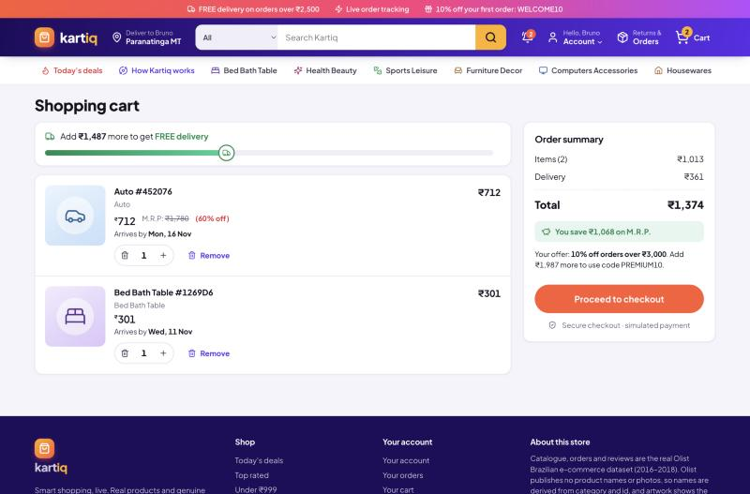
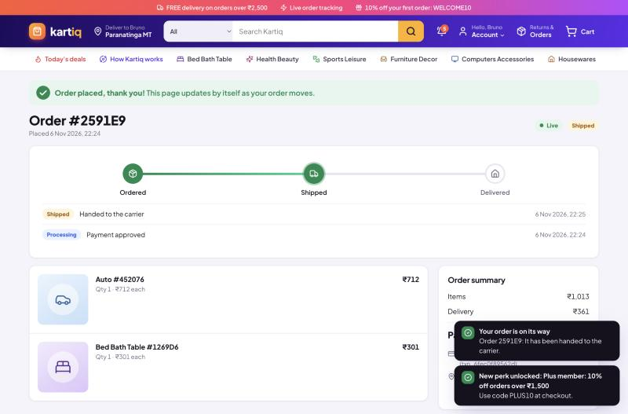
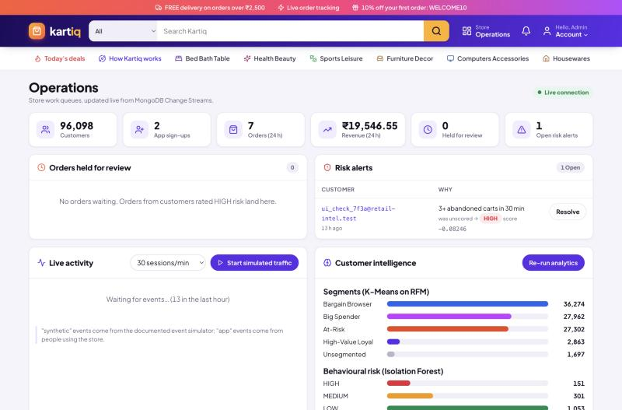
What the demo shows
Cart: free-delivery bar, savings vs M.R.P.
Order page updating live over a WebSocket
Admin: held orders, risk alerts, segments
Demo logins Shopper loyal@retail-intel.test · Admin admin@retail-intel.test
Test cards 4242 4242 4242 4242 approved · 4000 0000 0000 0002 declined (payments are simulated)
Notes:
Backup slide: if anything misbehaves during the live demo, talk through these screenshots.

Slide 15


Tested end to end
27/27
Pipelines
Models
A: frequency = order count · B: spend = line-item sum · C: every window value matches a hand calculation
Saved and reloaded · recommendations skip bought categories · live score matches batch
automated tests pass (pytest, ~9 s)
Run on a separate retail_intel_test database on the real replica set, so transactions and $setWindowFields really execute.
Transactions
Security & live
Checkout commits everything · declined card creates nothing · cancel restores counters
Roles (403 for shoppers) · hashed passwords · Change Stream handlers · WebSocket auth
Verified on Windows: MongoDB 9.0.8 · Python 3.11 · setup in 2.6 min · health ok · rs0 · Change Stream on
Notes:
Run the tests live if there's time: .\venv\Scripts\python -m pytest -p no:warnings. The manual test cases and the full demo script are in docs/TEST_PLAN.md.

Slide 16



Why MongoDB for this workload
Events change shape
Two workloads, one DB
A search carries a query, a declined payment a reason. New event type = new document, no ALTER TABLE.
Write-heavy events keep 2 indexes; read-heavy products and orders get the indexes their pages need.
Reads match the screen
Reactive by design
An order page is one document. A search page is one $facet call. SQL needs several joins.
Change Streams tail the oplog. SQL would need polling, or triggers plus a queue.
Where an RDBMS still wins: ledger-style data with many cross-table constraints. MongoDB has ACID transactions, but foreign keys are enforced by our application code, not declared in the database.
Notes:
This is the trade-off question the examiner usually asks. Be fair: say where SQL would still be the better choice.

Slide 17

Thank you
QUESTIONS?
Source code
github.com/maddy0001/retail-intelligence-platform
Built with
Kartiq: smart shopping, live
MongoDB 9
FastAPI
React 18
scikit-learn
pandas
Olist data
Data: Olist Brazilian E-Commerce Public Dataset (Kaggle), CC BY-NC-SA 4.0
Notes:
Thank the panel and invite questions. Likely questions: why embed line items; how $setWindowFields works; why a replica set; what happens if checkout fails halfway; why Isolation Forest.

