Slide 1
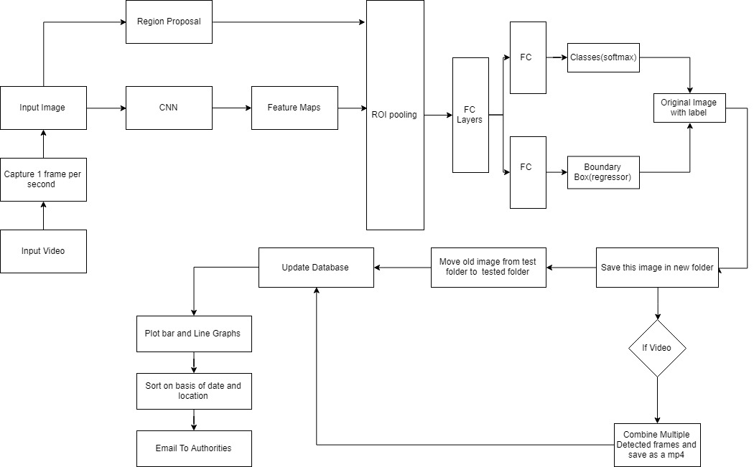
Solution Architecture
*
1
www.mastek.com

Slide 2
Technologies Used
Faster-Rcnn Resnet101
Tensorflow
Tkinter
LableImg
Cuda, CuDnn
Python
Key Features
Brand Identification from image
Brand identification from video
Data analysis using bar and line graph
E-mail database after sorting according to date, time and location
Accuracy
Test : 80%-90%
Benefits
Easy to use
Provides a complete end to end solution
Added feature to detect brands from video
Automatically creates brand profiles
Send email to authorities easily
Good accuracy and speed
Practically viable technique

