Slide 2


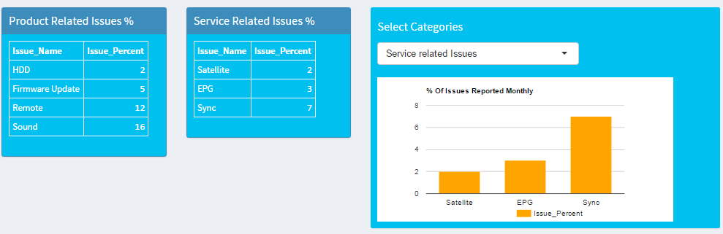
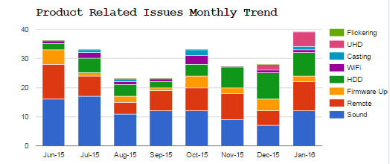
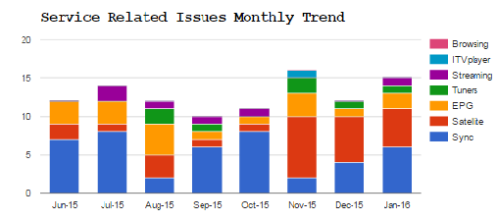
Social Media Analysis for Product Intelligence
Business Case
A Fortune 500 Consumer Electronics company based out of Japan wants to
improve Customer Experience
They want to gauge Product and Service Quality discussions on Social Media Platform
4.1K crawled records from Product Community Site
8 variables
Data from Product
Community Site
Algorithms used for Analysis
Data Pre-processing & n-gram Tokenization for Text Mining
Identification of issues through Machine Learning ARM methodology
Classifying Review into specific named issues using SVM model
Textual mining leading to key observations:
Product Related issues
Service Related issues
The insights are provided to the product/delivery/support/relevant teams
This information is used for enhancing the product quality & facilitating better delivery of service
Turn-Around-Time for Service is reduced
Some of the Monthly reports generated resulting into Insights:

Slide 3


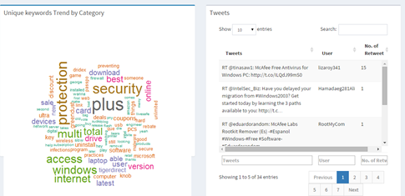
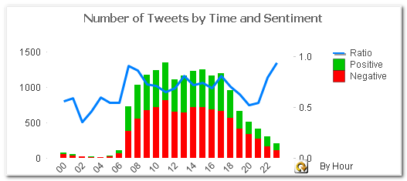
Topic Modeling of Social-Media Trending Topics
Business Case
Identify Social media buzz/trend on customer products
Evaluate customer feedback on campaigns
Analysis Highlights
Data Pre-processing & n-gram Tokenization for Text Mining
Top trending Topics / Categories of tweets by relevance using Topic Modelling
User sentiment calculation of each trending topic
Textual mining leading to key observations:
Trending Topics Identification
Topic wise User/Customer Sentiment
Impact of Promotional/ Campaigns on product
Data from Twitter
N-Gram Tokenization
Crawling of Social-Media Data
Topic Modelling
Sentiment Analysis (Lexica based)
A Fortune 500, Global Computer Security Software company
Some of the Topics identified , visualization with Sentiment scores :

