Slide 2
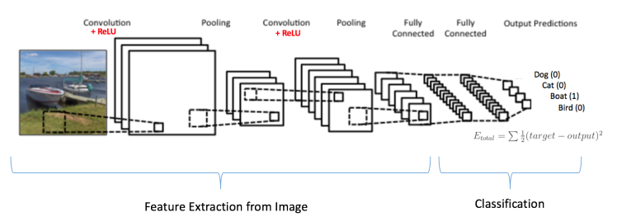
Identification of Multiple Digits From Real-World Images
An internal initiative to :
Utilize SVHN is obtained from house numbers in Google Street View images
Predict a series of numbers given an image of House Numbers.
Correctly detect each digit and
Sequence of digits
Data Details : Training data shape: (230070, 32, 32, 1)
Validation data shape: ( 5684, 32, 32, 1)
Test data shape: ( 13068, 32, 32, 1)
Analytical Approach :
Data Processing
Reading Original Image
Bounding Boxes & padding to identify digits
Processed Image Used for Training
Training CNN
Input Layer: Images with 32 x 32 dimensions with 1 channel (grey scale)
Convolution Layers: 3; Filters: 16/32/64; Receptive fields: 3 x 3;Stride: 2; Padding: Valid
ReLu Activation
Max Pooling; Softmax Activation
Dropout: 0.5/0.7; Learning Rate0.5/0.005;
Optimizer: Gradient DecentOptimizer / AdagradOptimizer
Original Image
Bounding Boxes and padding
Processed Image Used for Training

Slide 3
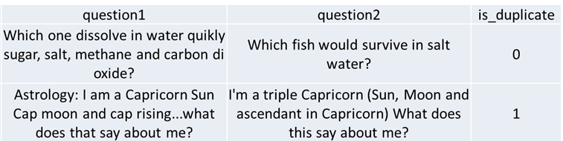
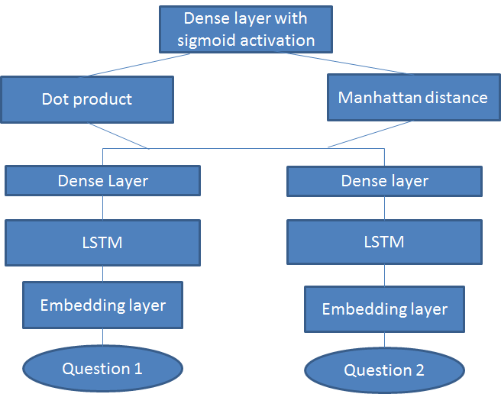
Identification of Duplicate Question in Quora
An internal initiative to :
Quora is a community/social web-site for sharing views in a question-answer format
Classification of two questions as duplicate or not.
Business Application:
In customer/product support – Automatically send a response to an incoming question if it is identified as a duplicate.
Product support-Identification of a recurrent issue with a product.
Data Details : 404,290 question pairs;
255,027 negative samples (non-duplicates);
149,263 positive samples (duplicates).
No of unique questions = 53,7933
Analytical Approach :
6 different Models are used
The words in each question are converted into 300 dimensional vectors. A 300 node LSTM is applied to output a 300 dimensional vector for each question.
The output from the previous 6 models are input to a sequential series of Dense layers with Parameterized ReLu activations. The final dense layer (a single node) gives the probability of two questions being duplicate.
Hyper-Parameters
Optimizers - Stochastic gradient descent(sgd) / Adaptive Moment Estimation(Adam)
Learning rates - Time based / Drop-Based Learning Rate
Dropout
Size of filters
Application of Ensemble techniques.
Training Data (Questions) is passed to the Neural Network
The Final Output gives
Probability of the Question
Closer to 0 => Not Duplicate
Closer to 1 => Duplicate
Outcome : 80.26% Accuracy achieved on Test Data; 85.55% on Training.

Slide 4
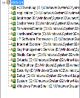

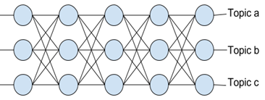
Tagging of Articles
An internal initiative to :
Financial magazine publishes articles on finance, equities & other investment related news.
Some articles may be related to multiple topics
Application of Deep Learning Algorithm RNN-LSTM to build classification model
Tagging of New articles using the DL model
Data Details : 21,578 labelled articles
Classifier learns from Topic & Document Vector
Analytical Approach :
Training the Doc2vec model
Doc2vec algorithm to extract features from text documents
Doc2vec (aka sentence embedding's) modifies the word2vec algorithm to unsupervised learning of continuous representations for larger blocks of text
In the doc2vec architecture, the corresponding algorithms are “distributed memory” (dm) and “distributed bag of words” (dbow)
Dimensionality reduction using advanced techniques like Principal Component Analysis (PCA) and T-Distributed Stochastic Neighbour Embedding (TSNE)
Training the classifier: Output Neuron returning a value between 0 and 1 for the probability that the news article is about the topic
Prediction phase
a
Topic
Articles
Inputs
Document Vector
Text of the Article processed by Doc2Vec
Trained Classifier Model
Trained Doc2Vec Model
New Articles
Text of the New Article processed
Classification of the New Article
Label

Slide 5
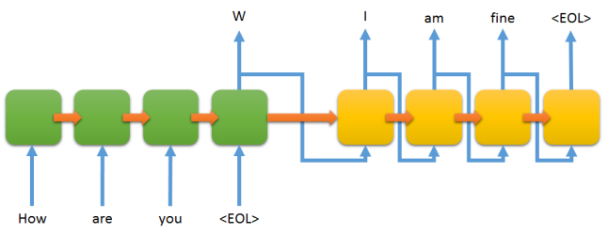
Conversational Chatbot
An internal initiative to :
Build a general-purpose conversational Chatbot based on a seq2seq approach implemented in tensor flow.
Applications of this chatbot can be used in various industries such as, e-commerce, telecom, Banking, Healthcare as a virtual conversational agent
Data Details : 10,292 pairs of fictional conversations from fictional movies
10,292 pairs of Question & Answers
Input
Analytical Approach :
Training the seq2seq model
The Sequence to Sequence model (seq2seq) consists of two RNNs - an encoder and a decoder. The encoder reads the input sequence, word by word and emits a context, which would ideally capture the essence (semantic summary) of the input sequence.
Based on this context, the decoder generates the output sequence, one word at a time while looking at the context and the previous word during each timestep.
2. Build the network using question & answer pairs.
3. Hyper-Parameters
Optimizers - Stochastic gradient descent(sgd) / Adaptive Moment Estimation(Adam)
Learning rates - Time based / Drop-Based Learning Rate
Dropout
Network input
Creation of the RNN cell (GRU Cell, LSTM Cell)
Build Network
Use an embedding model, it takes integer as input and convert them into word vector for better word representation
Define the network
Define the loss function
Output
Use of optimizer
Answer as a sentence to users query

Slide 6
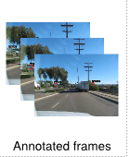
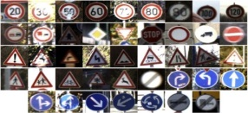
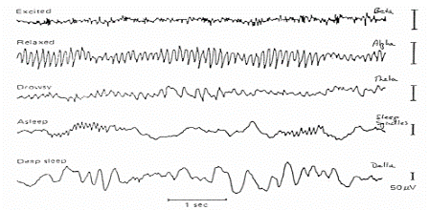
Advanced Driver Assistance System using Traffic signs & Driver EEG data
An internal initiative to :
Develop a Hybrid Deep Learning model to improve ADAS (Advanced Driver Assistance System)
BCI (Brain Computer interface) with the help of
Analyzed EEG signal to detect drowsiness of driver
Actionable traffic signs from vehicle cameras
Implemented with Multilayer FC network with Leaky ReLU with tensor board graph view and SVM classifier.
Data Details :
EEG brain wave for confusion data: 12000+ records Each data point consists of 120+ rows, sampled every 0.5 seconds corresponding to a one minute video.
Traffic sign data:
4591 images for training
2534 images for testing
DL Model for Signboard classification
Analytical Approach :
This approach implemented with Multilayer FC network with LeakyReLU & tensor board graph view for initial prototype .
The other model is to classify the driver EEG data set ,for this we developed a SVM based classifier to analyse the input components of EEG data like Alpha, Beta, Theta values.
This algorithm parallely checks for the responses of two sub models (EEG model, Sign board model) and give the necessary alerts based on its program flow.
In this model we used Adam Optimizer & Leaky ReLU activation function for better accuracy.
This prototype implemented in Cloud instances with python 3.5, tensor flow 1.0with tensor board graph view. The response time observed for the both sub models .
Traffic Signs
Input images
Python API for Alerting & controlling
Driver’s EEG signal input
Classifier Model to Detect Divers Drowsiness
Actionable Traffic sign detection
No Action
No
Initiated dependent /packages &scripts
Yes
Take the action to Alert driver
Alert the vehicle controlling system to take respective action
Driver drowsiness detection
Yes
No
No Action

Slide 7


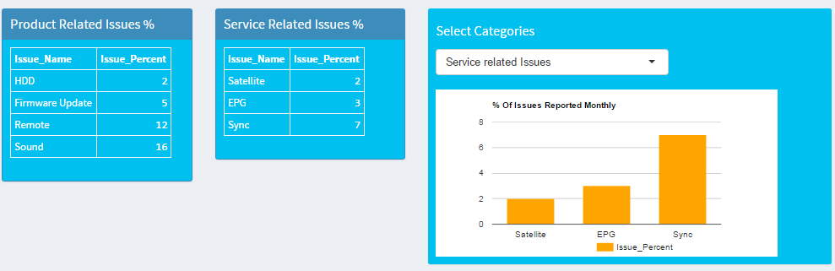
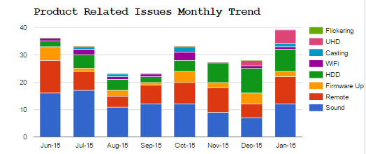
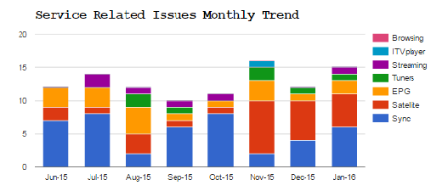
Social Media Analysis for Product Intelligence
Business Case
A Fortune 500 Consumer Electronics company based out of Japan wants to
improve Customer Experience
They want to gauge Product and Service Quality discussions on Social Media Platform
4.1K crawled records from Product Community Site
8 variables
Data from Product
Community Site
Algorithms used for Analysis
Data Pre-processing & n-gram Tokenization for Text Mining
Identification of issues through Machine Learning ARM methodology
Classifying Review into specific named issues using SVM model
Textual mining leading to key observations:
Product Related issues
Service Related issues
The insights are provided to the product/delivery/support/relevant teams
This information is used for enhancing the product quality & facilitating better delivery of service
Turn-Around-Time for Service is reduced
Some of the Monthly reports generated resulting into Insights:

Slide 8


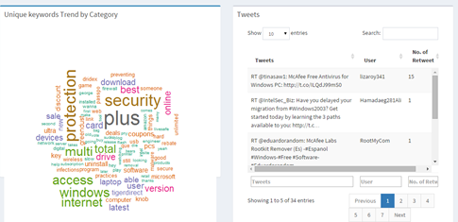
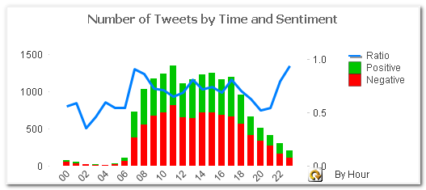
Topic Modeling of Social-Media Trending Topics
Business Case
Identify Social media buzz/trend on customer products
Evaluate customer feedback on campaigns
Analysis Highlights
Data Pre-processing & n-gram Tokenization for Text Mining
Top trending Topics / Categories of tweets by relevance using Topic Modelling
User sentiment calculation of each trending topic
Textual mining leading to key observations:
Trending Topics Identification
Topic wise User/Customer Sentiment
Impact of Promotional/ Campaigns on product
Data from Twitter
N-Gram Tokenization
Crawling of Social-Media Data
Topic Modelling
Sentiment Analysis (Lexica based)
A Fortune 500, Global Computer Security Software company
Some of the Topics identified , visualization with Sentiment scores :

