Slide 1
Voice Based AI Applications and Industry Trend
Some of the popular voice based applications which are being used already
Siri is one of the most popular personal assistant with a voice-controlled natural language interface offered by Apple.
Google Now is one of the most intelligent evolutions of Google. It can predict what you will want or need to know before you know it.
Amazon Echo can help you to search the web for information, schedule appointments, shop, control lights, switches, thermostats, answers questions, reads audiobooks, reports traffic and weather. So basically it works like your personal assistant.

Slide 2
Deep Learning for Siri’s Voice: On-device Deep Mixture Density Networks for Hybrid Unit Selection Synthesis
Siri is a personal assistant that communicates using speech synthesis.
Speech synthesis—the artificial production of human speech—is widely used for various applications from assistive technology to gaming and entertainment. Recently, combined with speech recognition, speech synthesis has become an integral part of virtual personal assistants, such as Siri.
There are essentially two speech synthesis techniques used in the industry:
1. Unit selection
2. Parametric synthesis
Unit selection
Unit selection synthesis provides the highest quality given a sufficient amount of high-quality speech recordings
It is the most widely used speech synthesis technique in commercial products.
Parametric selection
Parametric synthesis provides highly intelligible and fluent speech, but suffers from lower overall quality
Parametric synthesis is often used when the corpus is small or a low footprint is required

Slide 3
Modern unit selection systems combine some of the benefits of the two approaches, and so are referred to as hybrid systems.
Hybrid unit selection methods are similar to classical unit selection techniques, but they use the parametric approach to predict which units should be selected.
Recently, deep learning has gained momentum in the field of speech technology, largely surpassing conventional techniques, such as hidden Markov models (HMMs).
Deep learning has also enabled a completely new approach for speech synthesis called direct waveform modeling (for example using WaveNet), which has the potential to provide both the high quality of unit selection synthesis and flexibility of parametric synthesis.
However, given its extremely high computational cost, it is not yet feasible for a production system.
In order to provide the best possible quality for Siri’s voices across all platforms, Apple is now taking a step forward to utilize deep learning in an on-device hybrid unit selection system.

Slide 4
Google Now
Cloud speech API - Speech to text conversion powered by machine learning
SPEECH API FEATURES
Automatic Speech Recognition
Automatic Speech Recognition (ASR) powered by deep learning neural networking to power your applications like voice search or speech transcription.
Global Vocabulary
Recognizes over 110 languages and variants with an extensive vocabulary.
Streaming Recognition
Returns recognition results while the user is still speaking.
Word Hints
Speech recognition can be customized to a specific context by providing a set of words and phrases that are likely to be spoken. Especially useful for adding custom words and names to the vocabulary and in voice-control use cases.
Real-time or Pre-recorded Audio Support
Audio input can be captured by an application’s microphone or sent from a pre-recorded audio file. Multiple audio encodings are supported, including FLAC, AMR, PCMU and Linear-16

Slide 5
Noise Robustness
Handles noisy audio from many environments without requiring additional noise cancellation.
Inappropriate Content Filtering
Filter inappropriate content in text results for some languages.
Integrated API
Audio files can be uploaded in the request or integrated with Google

Slide 6
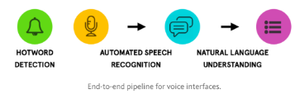
Snips Voice Platform
The Snips Voice Platform allows anyone to integrate AI powered voice interaction in their devices with ease.
The end-to-end pipeline –
Hotword detection
Automatic Speech Recognition (ASR)
Natural Language Understanding (NLU)
runs fully on device, powered by state of the art deep learning. By using Snips, you can avoid cloud provider costs, cloud latency, and protect user's privacy.
Voice assistant available in English, French, German, Spanish or Korean (more to come) can be configured easily via a web console.
Select pre-built assistants, or create completely custom ones. Today, the assistant can be deployed to a Raspberry Pi 3

Slide 7
1. Hotword detection
Your voice assistant is listening to a hotword to know when it should start interacting with you. Hotwords are generally small phrases like Google’s “Ok Google”, Apple’s “Hey Siri”, or Amazon Echo’s “Alexa”.
2. Automatic speech recognition
Once the assistant has identified the hotword, it will capture the user’s speech, until the end of his/her query.
This audio stream is converted to text through automatic speech recognition. You can choose between Snips deep-learning ASR (English now, French and more coming soon), which runs on-device and thus does not imply variable costs or data transfers, or you can choose to run Google’s server side version.
3. Natural language understanding
The Snips NLU engine is aimed at parsing a query in text format. The parsing process is twofold:
Intent classification: the engine has to guess which intent the input query corresponds to.
Slot filling: when an intent is detected, the engine must then extract the attributes (slots) of the query.
Intent: An intent is the classification of natural language queries into given, pre-specified use cases. You want your assistant to handle one or several intents.
Slot: A slot is an attribute of a specific intent. A slot is specified by two attributes, its type and its name

Slide 8
Let’s consider an assistant that covers the intent WeatherForecast, and that is asked the following query:
"Give me the weather in Paris today please“
In this case:
the intent classifier will identify that this query is related to a weather forecast request
the slot filler will look for different attributes of a weather forecast request: location, date...
Given a text input, the NLU engine outputs an object with the three following properties:
input: the actual text input.
intent: the result of the intent classification process. It contains the detected intent, plus a probability.
slots: a list of detected slots, each slot being specified with its name, value, and span within the original query. For dates, and other built-in slot types, the value of the slot can be resolved into a directly usable object. For example, “Christmas” will be resolved into 2017-12-25 00:00:00 +00:00.

Slide 9
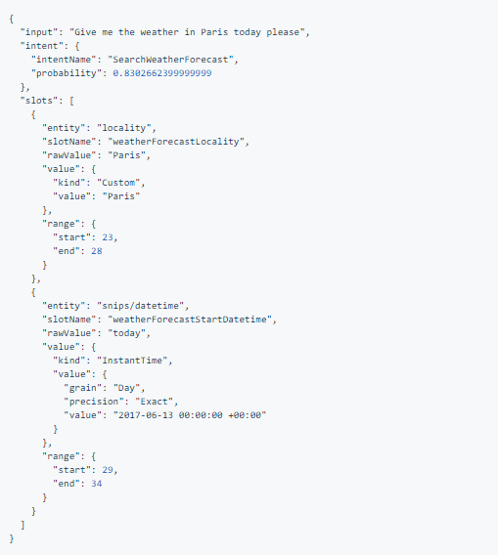
Back on the weather forecast example, an assistant including the intent WeatherForecast should return the following parsed output for the query:
"Give me the weather in Paris today please"
4. The handler code
The parsed intent is made available to your code to perform actions on behalf of the user. This is where you connect the Snips AI to your own logic.
The handler code can include anything that you can code, from triggering a voice response, switching the colour of the kitchen lights, to making HTTP requests and triggering the robot dance moves.

Slide 10
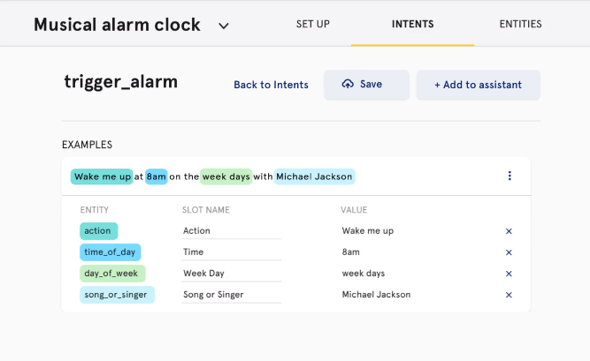
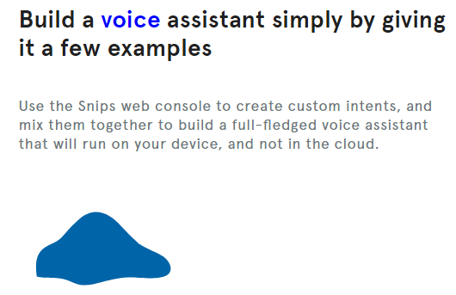
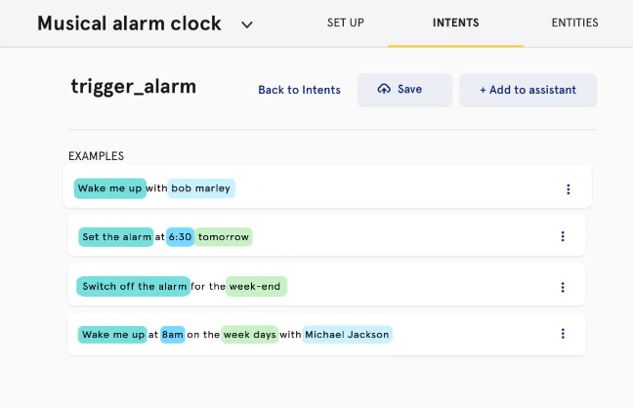
Demo UI

Slide 11
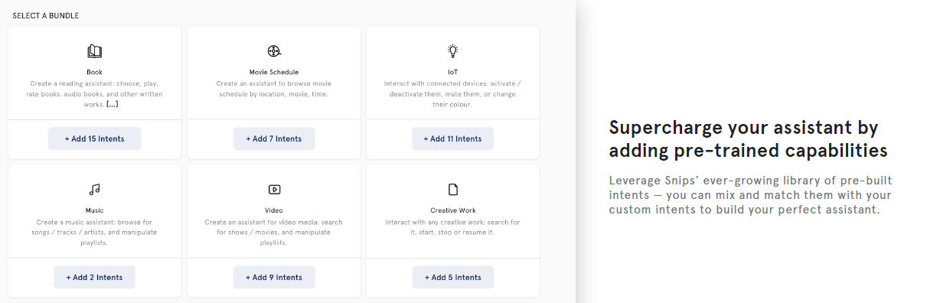
Pre-Trained Capabilities Models

Slide 12
Hardware requirements
These are the current minimal requirements to install and run the Snips Voice Platform:
Raspberry Pi 3 Model B and power supply (see starter kit)
an SD card (at least 4Gb, 8Gb recommended) with Raspbian Jessie Lite installed.
a USB microphone
optional: a speaker (USB or 3.5mm-jack) or headphone if you want to use the dialog features, where you need to hear questions from the assistant
USB keyboard, USB mouse, and a monitor with an HDMI cable, to easily setup your Raspberry.

Slide 13
Amazon Polly
Amazon Polly is a service that turns text into lifelike speech. Polly is an Amazon AI service that uses advanced deep learning technologies.
Amazon Polly is an Amazon AI service that uses advanced deep learning technologies to synthesize speech that sounds like a human voice.
Amazon Polly includes dozens of lifelike voices across a variety of languages, so you can select the ideal voice and build speech-enabled applications that work in many different countries.
With Amazon Polly, you only pay for the number of characters you convert to speech, and you can save and replay Amazon Polly’s generated speech.
Amazon Polly’s low cost per character converted, and lack of restrictions on storage and reuse of voice output, make it a cost-effective way to enable Text-to-Speech everywhere.

Slide 14
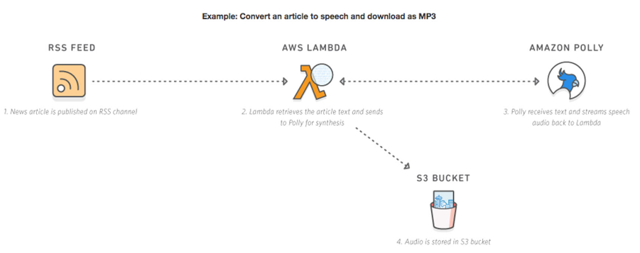
47 voices and 24 languages can be used and Indian English option is provided.
Tones whispering, anger, etc can be added to particular part of the speech using “amazon effects”.

Slide 15
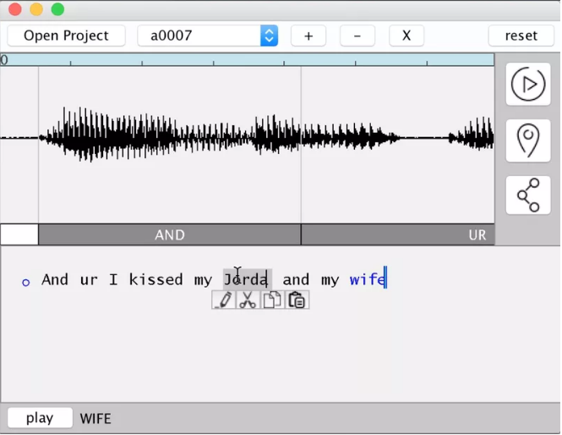
Project VoCo by Adobe
Adobe is working on an audio app that lets you add words someone never said.
Adobe is working on a new piece of software that would act like a Photoshop for audio
Project VoCo is designed to be a state-of-the-art audio editing application.
Beyond standard speech editing and noise-cancellation features, Project VoCo can also apparently generate new words using a speaker’s recorded voice.
Essentially, the software can understand the makeup of a person’s voice and replicate it, so long as there’s about 20 minutes of recorded speech.

Slide 16
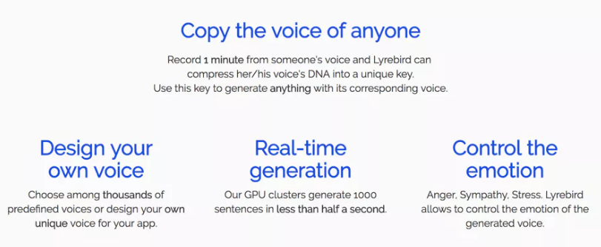
Lyrebird : a startup specializing in AI speech synthesis
Create a digital copy of your voice with one minute of audio

Slide 17
Private beta for Lyrebird API
This technology will create a wide range of new applications.
Some Use cases:
Video game makers who want to machine generate dialogs on the fly. In particular virtual reality developers seem very excited.
Audiobooks that can be read with the voice of your choice.
Personal assistants that can read loud any text message with the voice of the sender.
Movie makers that want to freeze actors' voices so that they can be available forever, even if the actor ages or dies.

Slide 18
Interesting Application:
An AI can replace what a world leader said in his video-taped speech.
Video Researchers have crafted algorithms that can blend an audio recording of someone talking with a video of them saying something else entirely – and create a new convincing lip-synched video with the replacement sound.
The video below demonstrates this machine-learning system's current capabilities: sound taken from an interview with Barack Obama is threaded through a different clip of him speaking, so it looks as though he's giving the same speech in a completely different setting.
https://youtu.be/MVBe6_o4cMI
Crafting a fake talking head is a tricky process.
First, an audio sample is taken and fed into a recurrent neural network that spits out an outlining of the mouth. Next, texture is applied and blended into a target video.
To make it as natural as possible, the jaw line is warped to match the movements of the chin and mouth, reproducing the natural wrinkles and dimples in a person's face seen during speech.

Slide 19
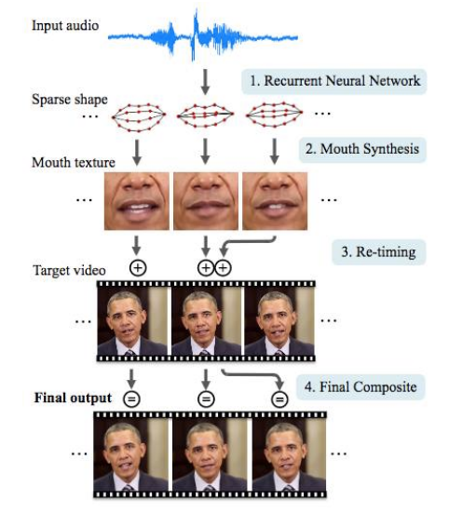
It takes hours of high quality footage – 17 hours for Obama and nearly two million frames – to train a system to translate different audio sounds into basic mouth shapes.

Slide 20
Reference
https://www.theverge.com/2016/11/3/13514088/adobe-photoshop-audio-project-voco
https://www.theverge.com/2017/4/24/15406882/ai-voice-synthesis-copy-human-speech-lyrebird
https://github.com/snipsco/snips-platform-documentation/wiki/5.-Learn-more:-Key-Concepts#intent
https://github.com/awslabs/amazon-polly-sample
https://www.theregister.co.uk/2017/07/12/ai_transforms_audio_into_lipsynched_videos/
https://www.producthunt.com/posts/lyrebird
https://www.fastcompany.com/3059719/handicapping-the-ai-assistants-from-siri-to-ozlo
http://media.speech.zone/images/Simon_King_Crete2016_4_hybrid_speech_synthesis_for_publication.pdf
https://machinelearning.apple.com/2017/08/06/siri-voices.html

Slide 21
Thank You

