Slide 1
Systems Engineering and the World of Modern Systems
Chapter 1

Slide 2
1.1 What is Systems Engineering?
The function of systems engineering is to guide the engineering of complex systems.
to guide – the process of selecting the path for others to follow from among many possible courses
engineering – the application of scientific principles to practical ends
  Efficient
  Economical

Slide 3
system – a set of interrelated components working toward some common objective
complex – systems in which the elements are diverse and have intricate relationships
Engineered systems EXCLUDE complex systems such as living organisms, etc.
Be aware: the definition of “systems engineering” is not unique or universally agreed upon, but nevertheless is used throughout the book.

Slide 4
Systems Engineering vs. Traditional Engineering Disciplines
Systems engineering is focused on the system as a whole.
2. Design decisions can not be based entirely on quantitative knowledge, also rely on qualitative judgments.
Do you agree with this?
Are some factors unquantifiable?
3. Systems engineering bridges the traditional engineering disciplines.

Slide 5
Systems Engineering and Project Management
Systems engineering is an inherent part of project management – the part that is concerned with guiding the engineering effort itself.

Slide 6
1.2 Origins of Systems Engineering
The recognition of systems engineering is associated with the effects of WWII (1950s and 60s).
SE was a necessary corollary to the rapid growth of technology.
Computer control is qualitatively increasing the complexity of systems.

Slide 7
The relation of modern systems engineering to its origins is summarized in three factors:
Advancing technology
Competition
Specialization
Now, let’s look at these in more detail.

Slide 8
1. Advancing Technology: Risks
Technology is the single largest factor in the emergence of systems engineering.
Innovation produces new materials, devices, and processes – whose characteristics are not yet measured or understood.
Failure to apply new technology carries risks.
“Risk Management”
  System engineers must determine how to balance new technology with potential risks.
  (Is this an example of a qualitative decision?)

Slide 9
Example: The Growth of Automation
Human-machine interfaces and other people-system interactions are particular concerns of systems engineering.
More systems engineering has had to be directed to the control of software design.

Slide 10
2. Competition: Trade-offs
military capabilities
competitive contracting – new system capabilities
Commercial products always have competition.
“phased approach” - used in new system development.
essential characteristics: performance, cost and schedule.
“trade-off” analysis

Slide 11
3. Specialization: Interfaces
high quality; low cost
engineering specialization – a basic condition in the system development process
Physical fit is accomplished at inter-component boundaries, called interfaces.
Functional relationships are called interactions.

Slide 12
An essential goal of systems engineering is to achieve modularity – for efficient manufacture, system integration, test, operational maintenance, reliability, and ease of in-service upgrading.
The process of subdividing a system into modular building blocks is called “functional allocation.”

Slide 13
1.3 Examples of Systems Requiring Systems Engineering
Characteristics of systems that require system engineering:
  an engineered product that satisfies a specified need
  has diverse components with intricate relationships; multi-disciplinary and complex
  uses advanced technology

Slide 14
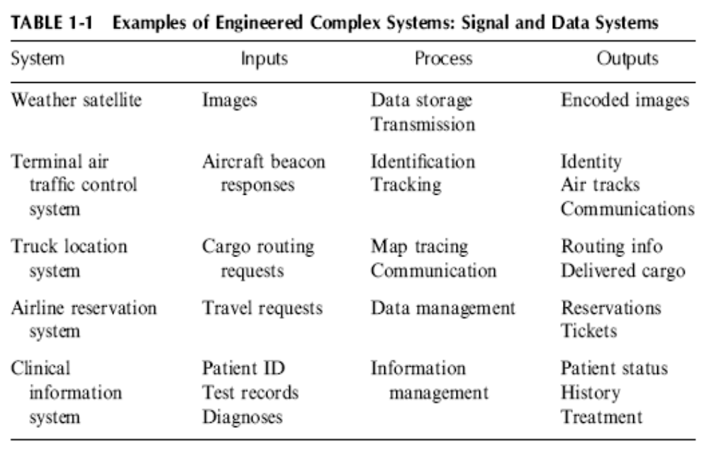
Examples of Complex Engineered Systems

Slide 15
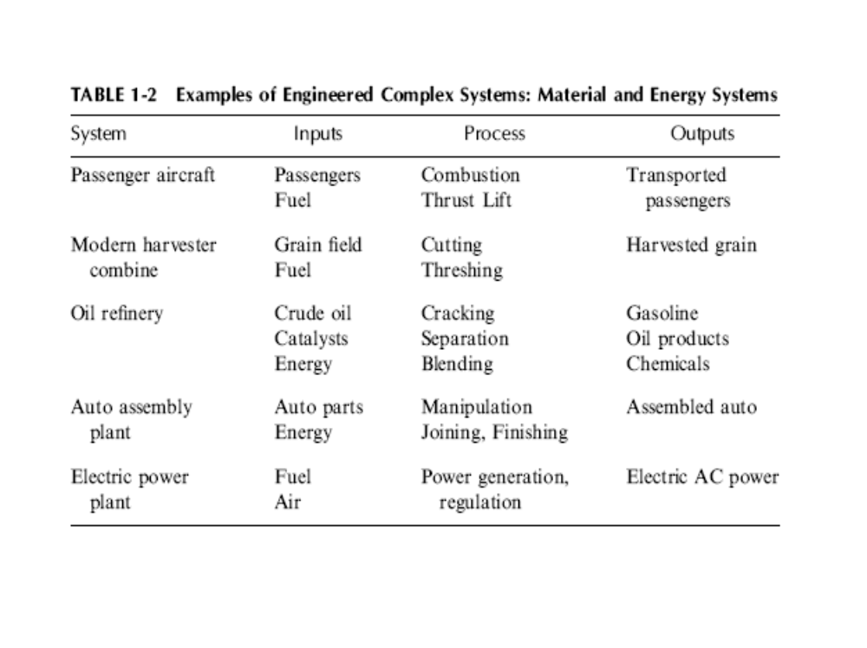
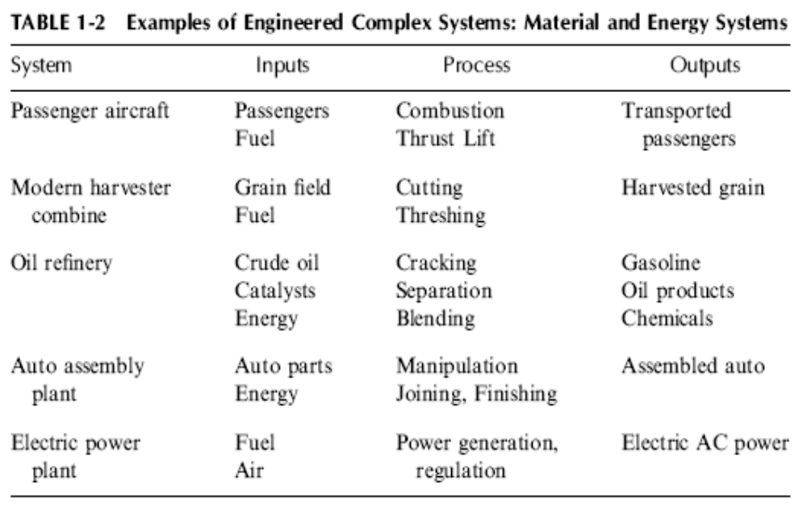

Slide 16
Example: A Modern Automobile
Can be considered a lower limit to more complex vehicular systems.
Example of a system that requires active interaction (control) by a human operator.

Slide 17
1.4 Systems Engineering Viewpoint
Typically acquired through experience
Ability to lead complex system development programs is acquired through experience
“systems engineering viewpoint” – making the central objective the system as a whole

Slide 18
A Successful System
Success of a system:
  meets requirements and development objectives
  successful operation in the field
  has a long, useful operating life
Innovation
Select the most promising technological approaches.
Combine risk-taking and risk-mitigation.

Slide 19
The “Best” System
“Systems engineering is the art of the good enough.” Not settling for second best.
Definition of “best” – multi-objective optimization (not just performance)
Also important:
  affordability
  availability
  ease of maintenance
  adherence to development completion schedule

Slide 20
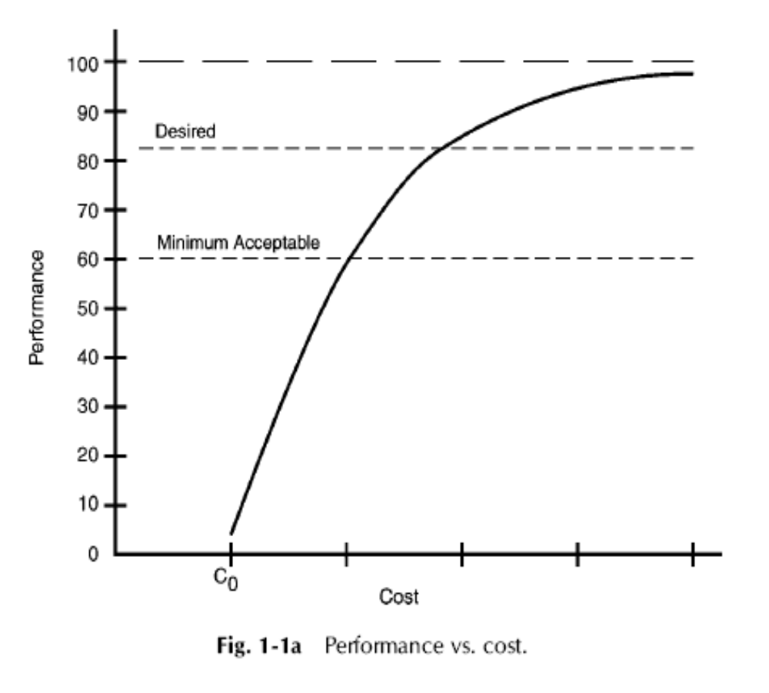
Law of Diminishing Returns
Performance of a System as a Function of the Cost of the Expended Development Effort
Really one-dimension?
Slope: a measure of price vs. performance

Slide 21
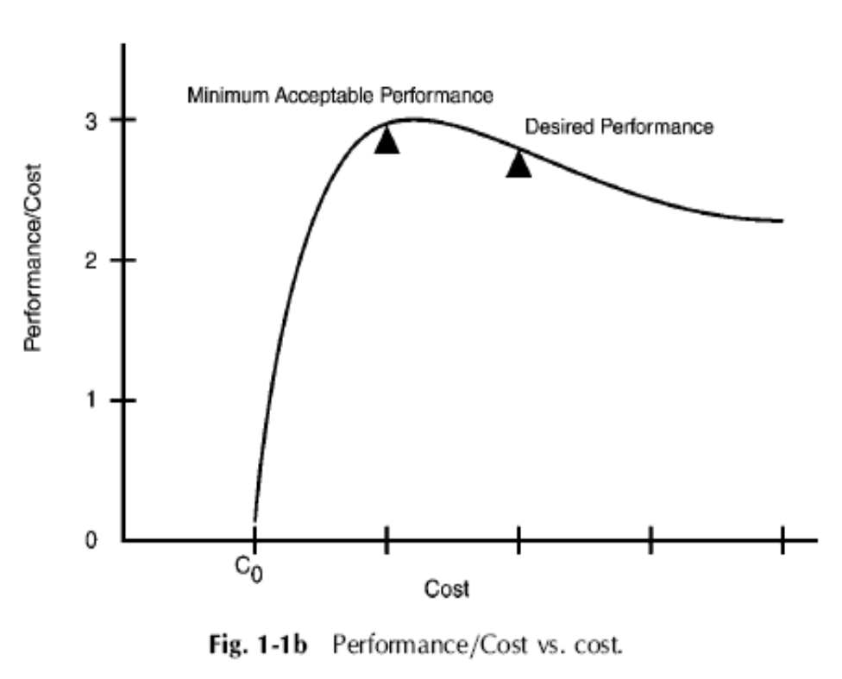
The performance-to-cost ratio is equivalent to the concept of cost effectiveness.
Performance/Cost is the same as the slope from Fig. 1-1a
Minimum Acceptable Performance – Best?

Slide 22
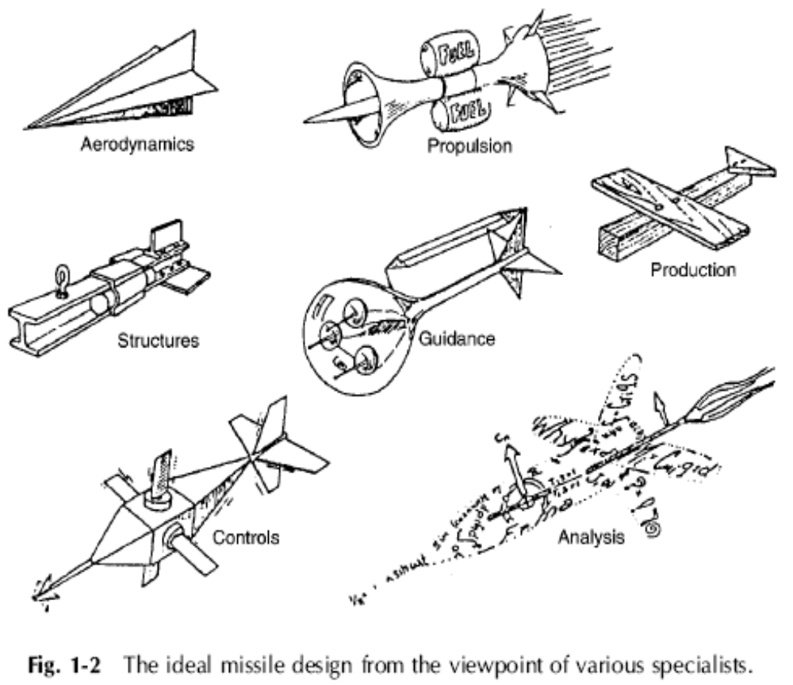
A Balanced System
Design specialists seek to optimize the particular aspect of a system that they best understand.
Attention is focused on assigned responsibilities.
It’s the responsibility of the system engineer to guide the development so that each of the components receives the proper balance of attention and resources,
for the best overall system behavior.

Slide 23
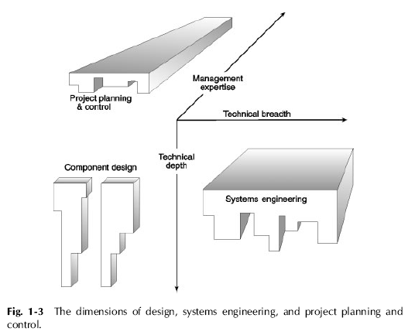
A Balanced Viewpoint
Virtually all critical attributes are interdependent.
Characteristics are typically incommensurable.
Systems engineers have different skills than design specialists or managers.

Slide 24
1.5 Systems Engineering as a Profession
Engineering disciplines are built on quantitative relationships, physical laws, and measured properties.
Systems engineering, deals with incomplete knowledge, variables that don’t obey known equations, and must balance conflicting objectives.
Professional society: International Counsel on Systems Engineering (INCOSE).

Slide 25
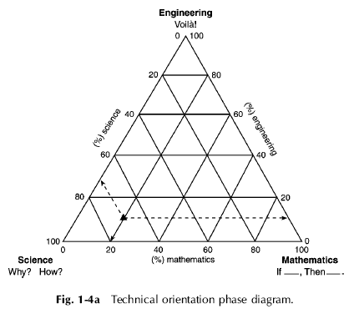
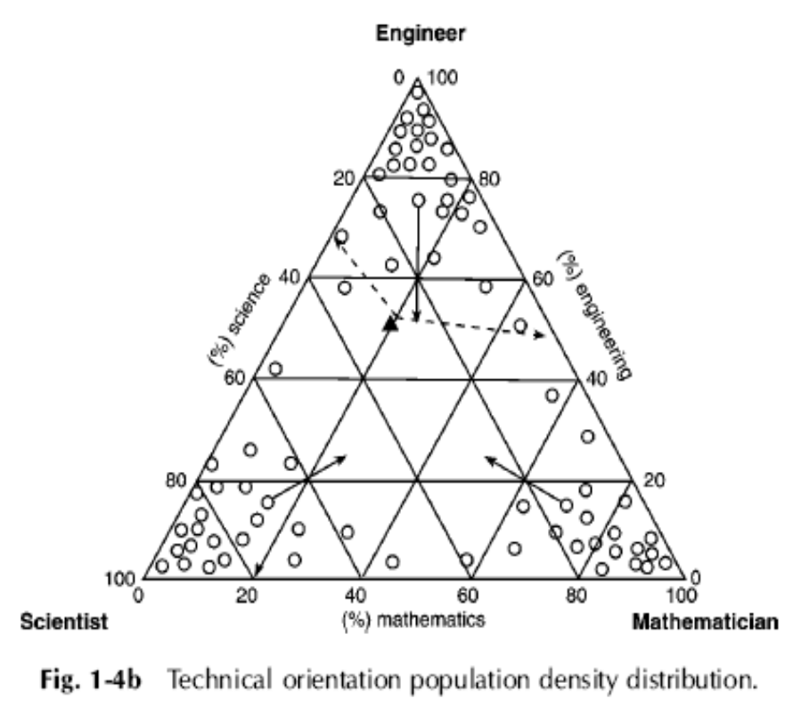
= system engineers
n
Another axis for soft skills?

Slide 26
The Challenge of Systems Engineering
Requires an extensive broadening of the engineering base, as well as excellent communication and management skills
There are few tools and few quantitative relationship to help make decisions.
Success is measured by the apparent absence of program difficulties

Slide 27
Attributes of Successful Systems Engineers
Enjoy learning new things and solving problems
Like a challenge
Are skeptical of unproven assertions
Are open minded to new ideas
Have a solid background in science and engineering
Have demonstrated technical achievement in a specialty area
Are knowledgeable in several engineering areas
Pick up new ideas and information quickly
Have good interpersonal and communication skills

Slide 28
1.6 The Power of Systems Engineering
Multidisciplinary Knowledge
SEs are literate in different disciplines:
  Understand the languages of specialists
  Appreciate their problems
  Interpret the necessary communications
Enables them to solve problems no one else is capable of solving.
Know which principles, relationships, acronyms, and the like are important at the system level and which are details.

Slide 29
Approximate Calculation
Are often required to carry out “back of the envelope” calculations to obtain a “sanity check.”
Skeptical Positive Thinking
Ask the right questions.
Temper despair of unexpected failures.
Mitigate risks.

Slide 30
Homework Problems (page 29)
1.2) Discuss the difference between engineered complex systems and complex systems that are not engineered. Give three examples of the latter. Can you think of systems engineering principles that can also be applied to non-engineered complex systems?
1.5) List four pros and cons (two of each) of incorporating some of the latest technology into the development of a new complex system. Give a specific example of each.
1.6) What is meant by the term “modularity?” What characteristics does a modular system possess? Give a specific example of a modular system and identify the modules.
1.7) Figure 1-1 illustrates the law of diminishing returns in seeking the optimum system (or component) performance against the cost. Give examples of two pairs of characteristics other than performance vs. cost where optimizing one frequently competes with the other, and briefly explain why they do.

