Slide 1
A guide to NaMaster

Slide 2
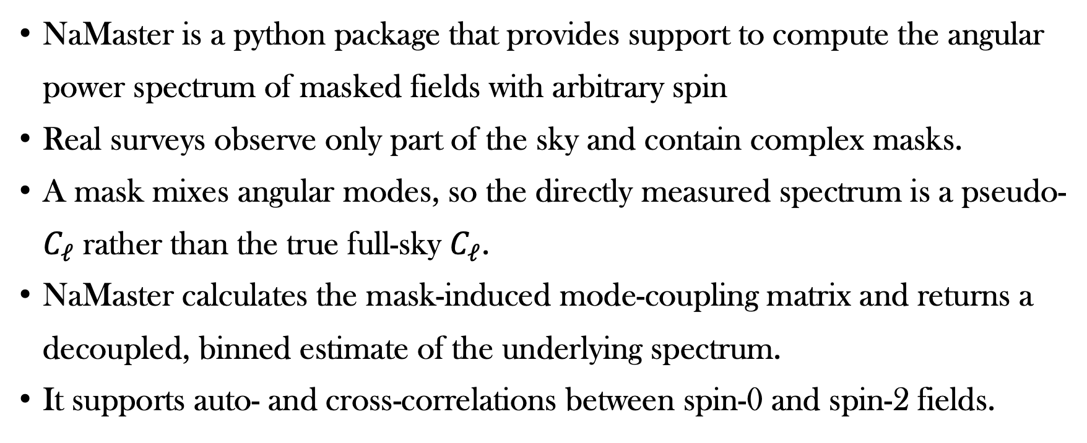
What is NaMaster
NaMaster is a python package that provides support to compute the angular power spectrum of masked fields with arbitrary spin
Real surveys observe only part of the sky and contain complex masks.
A mask mixes angular modes, so the directly measured spectrum is a pseudo-$C_{ℓ}$ rather than the true full-sky $C_{ℓ}$.
NaMaster calculates the mask-induced mode-coupling matrix and returns a decoupled, binned estimate of the underlying spectrum.
It supports auto- and cross-correlations between spin-0 and spin-2 fields.

Slide 3
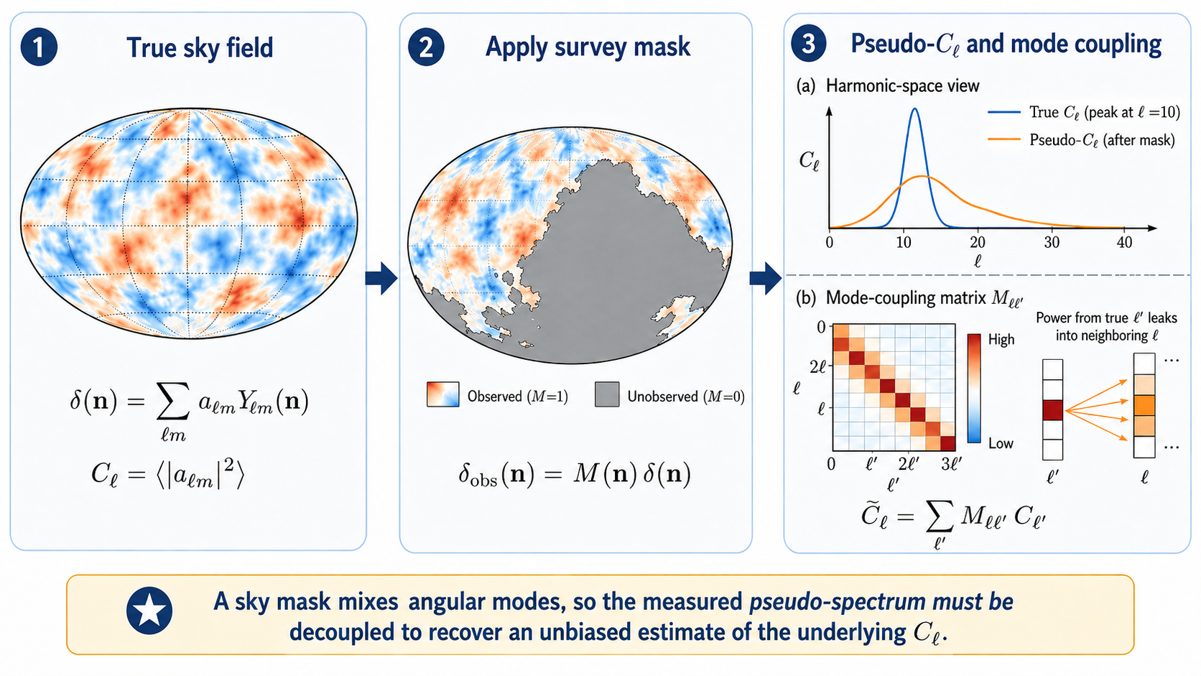
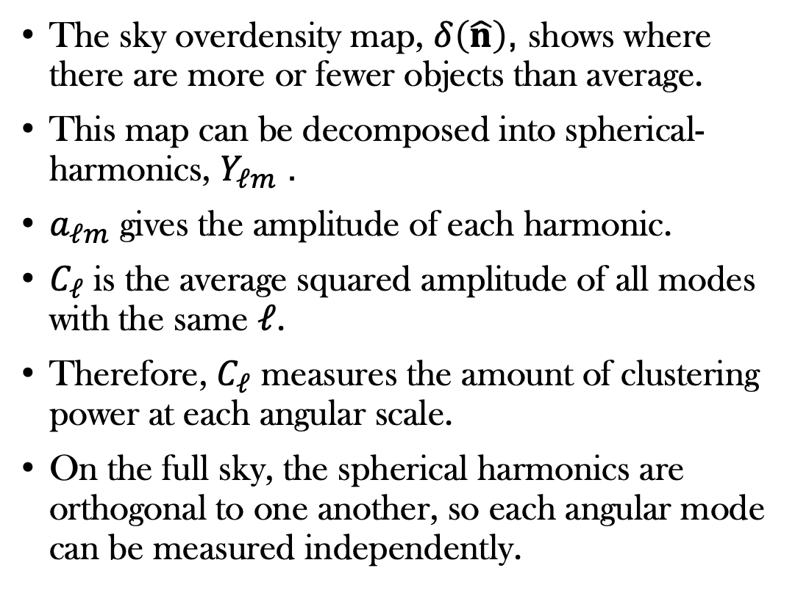
Angular power without a sky mask
The sky overdensity map, $δ\left(\hat{n}\right)$, shows where there are more or fewer objects than average.
This map can be decomposed into spherical-harmonics, $Y_{ℓm}$.
$a_{ℓm}$ gives the amplitude of each harmonic.
$C_{ℓ}$ is the average squared amplitude of all modes with the same $ℓ$.
Therefore, $C_{ℓ}$ measures the amount of clustering power at each angular scale.
On the full sky, the spherical harmonics are orthogonal to one another, so each angular mode can be measured independently.

Slide 4
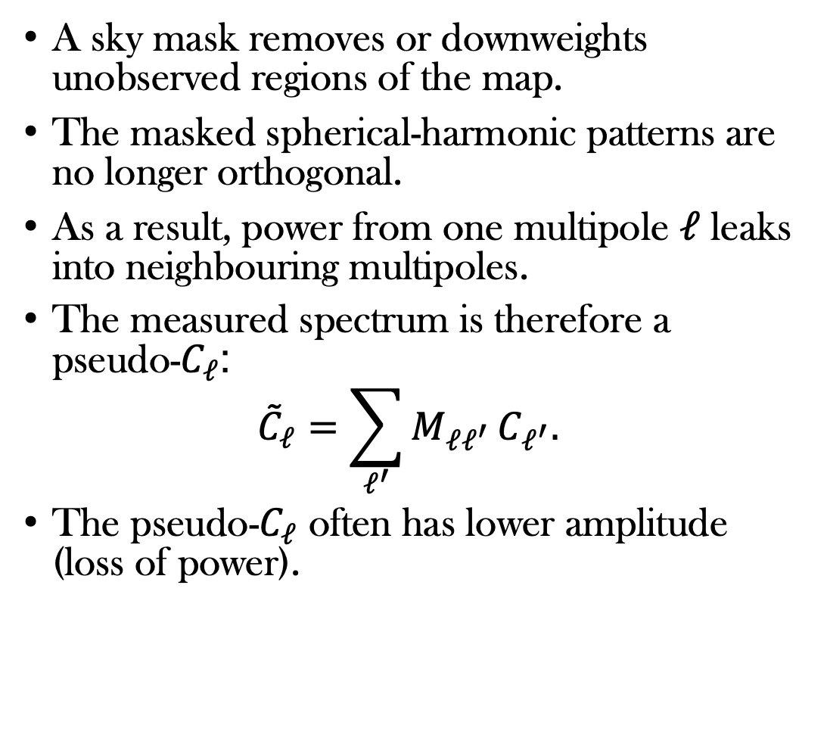
Angular power with a sky mask
A sky mask removes or downweights unobserved regions of the map.
The masked spherical-harmonic patterns are no longer orthogonal.
As a result, power from one multipole $ℓ$ leaks into neighbouring multipoles.
The measured spectrum is therefore a pseudo-$C_{ℓ}$:
$${\tilde{C}}_{ℓ}=\sum_{ℓ^{′}}{M_{ℓℓ^{′}}}C_{ℓ^{′}}.$$
The pseudo-$C_{ℓ}$ often has lower amplitude (loss of power).

Slide 5
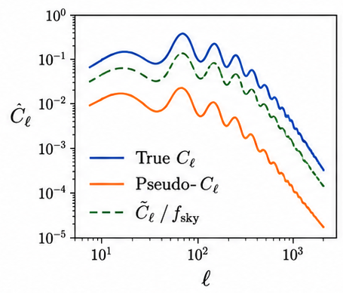
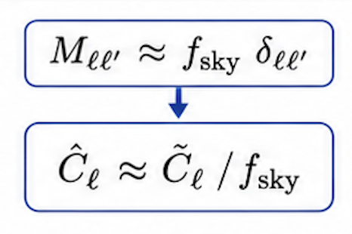
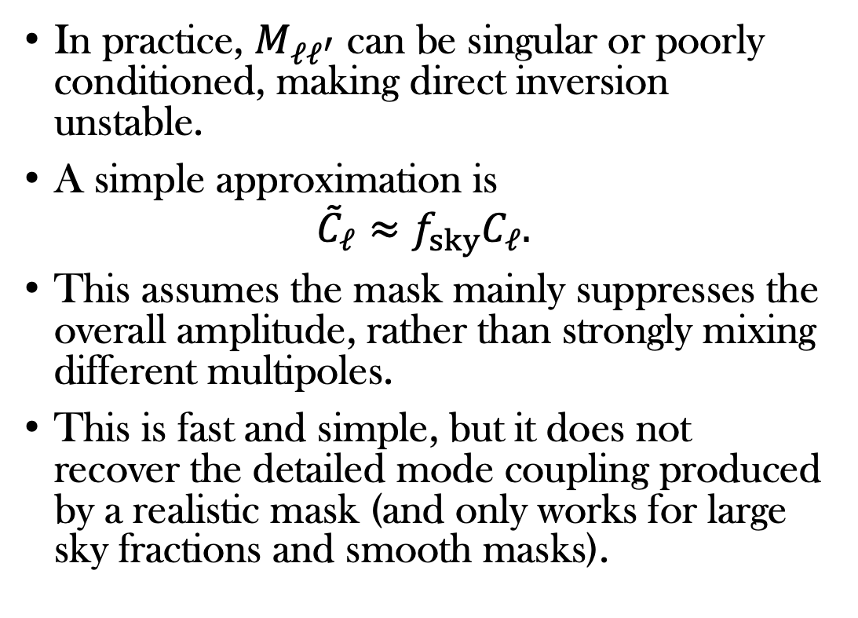
An approximate correction
In practice, $M_{ℓℓ^{′}}$ can be singular or poorly conditioned, making direct inversion unstable.
A simple approximation is
$${\tilde{C}}_{ℓ}≈f_{sky}C_{ℓ}.$$
This assumes the mask mainly suppresses the overall amplitude, rather than strongly mixing different multipoles.
This is fast and simple, but it does not recover the detailed mode coupling produced by a realistic mask (and only works for large sky fractions and smooth masks).

Slide 6
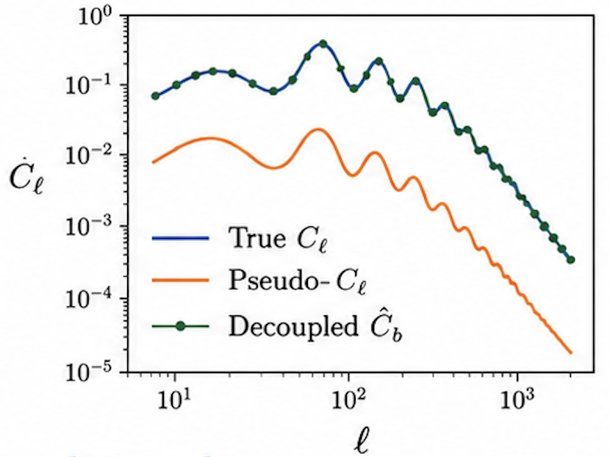
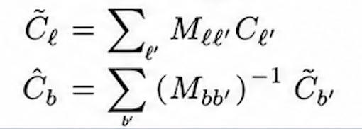
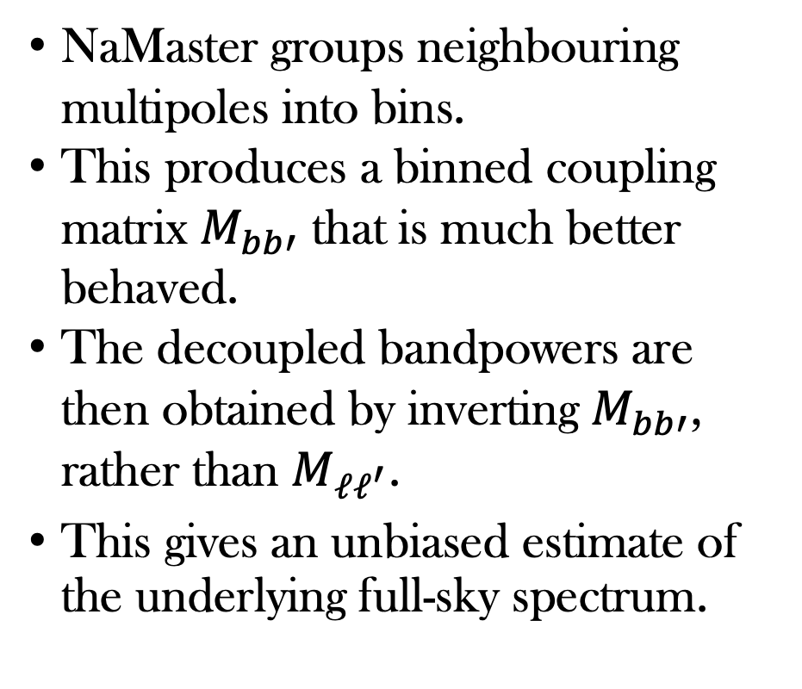
The NaMaster way
NaMaster groups neighbouring multipoles into bins.
This produces a binned coupling matrix $M_{bb′}$ that is much better behaved.
The decoupled bandpowers are then obtained by inverting $M_{bb′}$, rather than $M_{ℓℓ^{′}}$.
This gives an unbiased estimate of the underlying full-sky spectrum.

Slide 7
Spin fields
Spin describes how a field changes when the local coordinate axes are rotated.
Spin 0: the measured value is unchanged by the rotation (e.g. galaxy overdensity, GW number counts and CMB temperature).
Spin 2: the field has an orientation, so its numerical components change when the axes rotate (e.g. weak-lensing shear and CMB polarisation).
For galaxy and GW overdensity maps, we therefore use spin-0 NaMaster fields.

Slide 8
When to use NaMaster
Want to compute the auto- or cross-angular power spectrum of observed or simulated sky fields.
Have a sky mask describing which regions of the sky were observed.
Need to correct for mode coupling caused by incomplete sky coverage.
Want to analyse scalar or spin fields, including number counts, temperature, shear or polarisation.

Slide 9
Resources
https://namaster.readthedocs.io/en/latest/source/sample_simple.html
https://github.com/maddycp/NaMaster_Tutorial

