Slide 1
MAKE SKILLED
MACHINE LEARNING

Slide 2
WHY IS MACHINE LEARNING IMPORTANT
MAKE SKILLED
MS
▸ It is all around us in this modern world.
▸ From Facebook Feeds to Google Maps for navigation, Machine Learning finds its application almost in every aspect of our lives.
▸ It is quite frightening and interesting to think of how our lives would have been without the use of Machine Learning.
▸ That is why it becomes quite important to understand what is Machine Learning, its applications and its importance.

Slide 3
ML IS THE FUTURE
MAKE SKILLED
MS
SINCE THE DAWN OF TIME …
UP UNTIL 2005 … HUMANS HAD CREATED … 130 EXABYTES OF DATA

Slide 4







1 byte
1k byte
1M Byte
1G Byte
1T Byte
1 Petabyte
1 Exabyte

Slide 5
ML IS THE FUTURE
MAKE SKILLED
MS
2005 - 130 EXABYTES
2010 - 1,200 EXABYTES
2015 - 7,900 EXABYTES
2020 - 40,900 EXABYTES

Slide 6
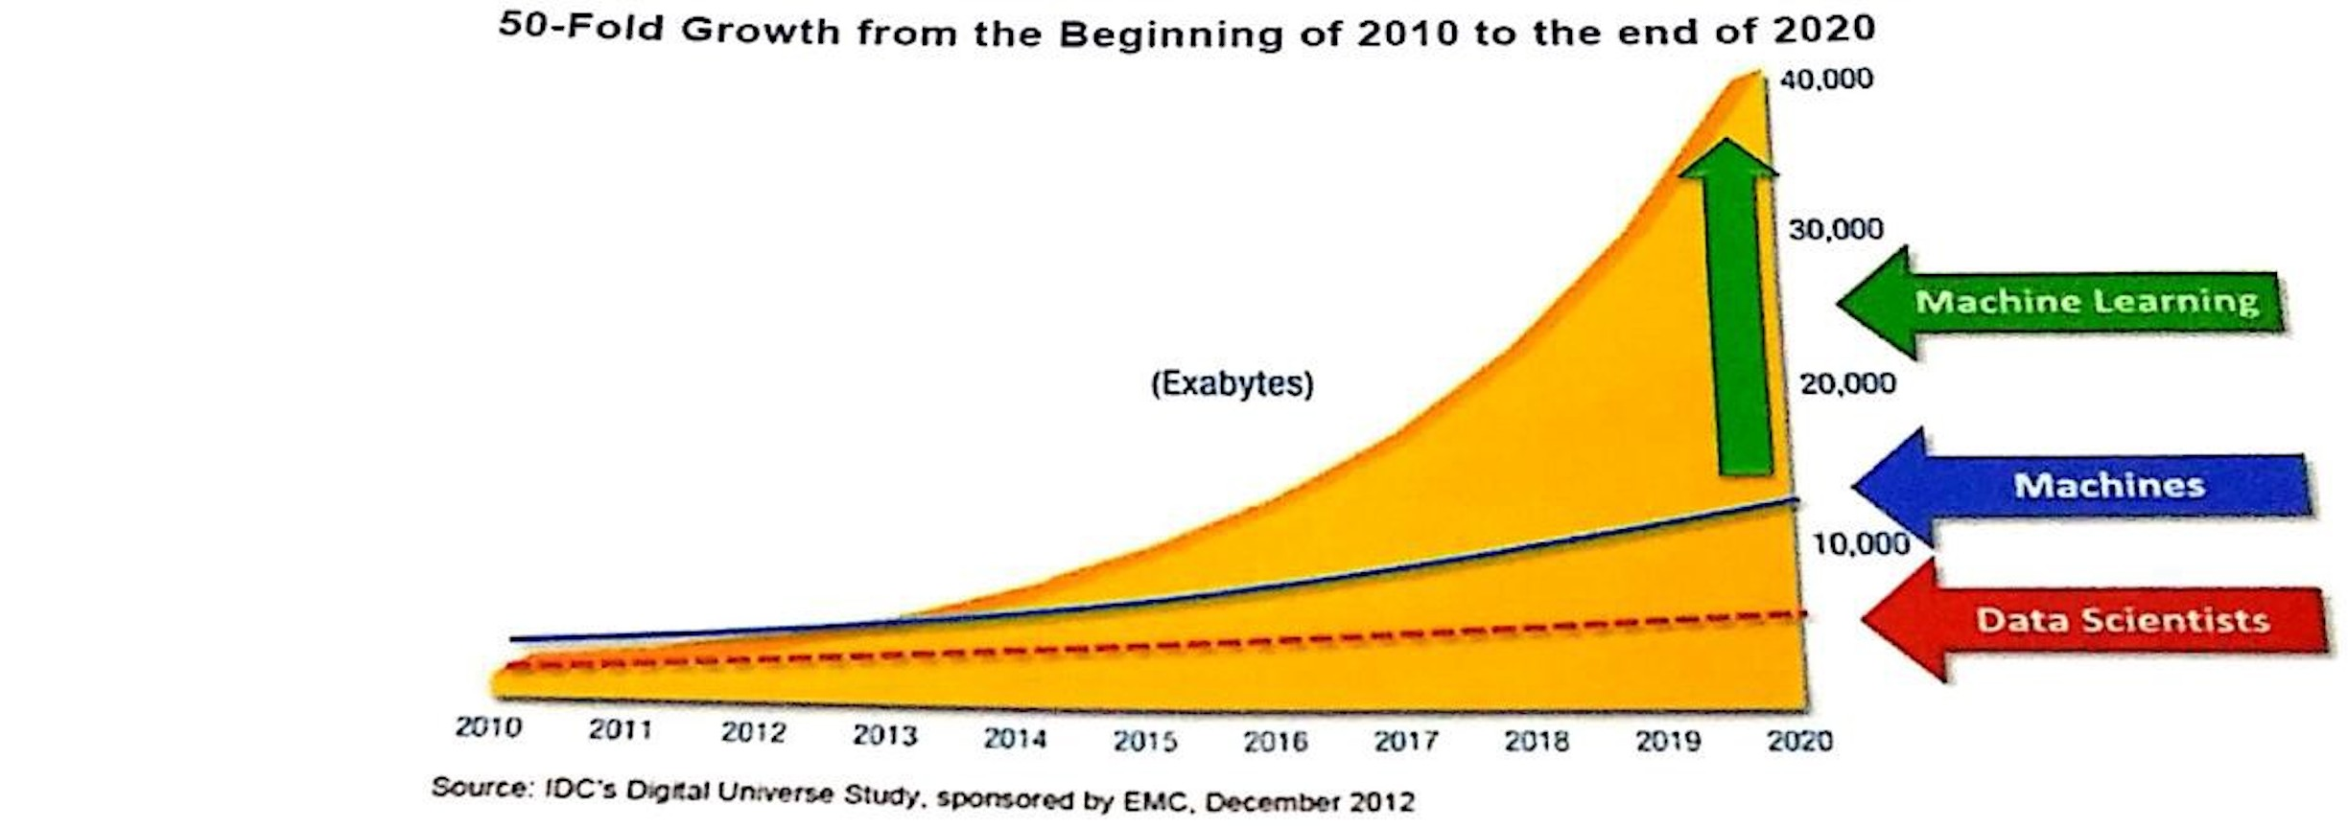
MAKE SKILLED
MS
ML IS THE FUTURE

Slide 7
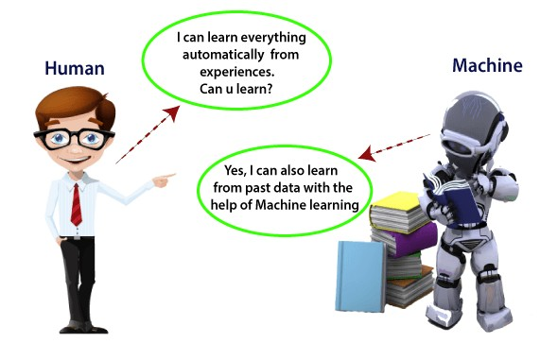
WHAT IS MACHINE LEARNING
MAKE SKILLED
MS
▸ Machine Learning enables a machine to automatically learn from data, improve performance from experiences and predict things without being explicitly programmed.
▸ A machine has the ability to learn if it can improve its performance by gaining more data.

Slide 8
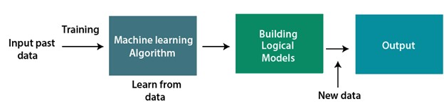
HOW DOES MACHINE LEARNING WORK
MAKE SKILLED
MS
▸ A Machine Learning system learns from historical data, builds the prediction models, and whenever it receives new data, predicts the output for it.
▸ The accuracy of the predicted output depends upon the amount of data, as the huge of amount of data helps to build a better model which predicts the output more accurately.

Slide 9
FEATURES OF MACHINE LEARNING
MAKE SKILLED
MS
▸ Machine Learning uses data to detect various patters in a given dataset.
▸ It can learn from past data and improve automatically.
▸ It is a data-driven technology.
▸ Machine Learning is much similar to data mining as it also deals with the huge amount of the data.

Slide 10
IMPORTANCE OF MACHINE LEARNING
MAKE SKILLED
MS
▸ Rapid increment in the production of data
▸ Solving complex problems, which are difficult for a human
▸ Decision making in various sector including finance
▸ Finding hidden patterns and extracting useful information from data

Slide 11
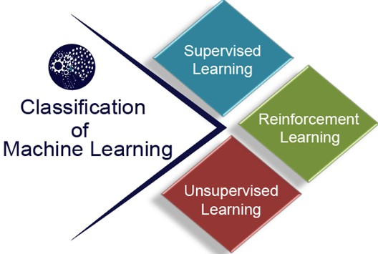
CLASSIFICATION OF MACHINE LEARNING
MAKE SKILLED
MS
▸ Supervised Learning
▸ Unsupervised Learning
▸ Reinforcement Learning

Slide 12
SUPERVISED LEARNING
MAKE SKILLED
MS
▸ It is a type of machine learning method in which we provide labeled data to the ML system in order to train it, and on that basis, it predicts the output.
▸ Classification
▸ Regression

Slide 13
UNSUPERVISED LEARNING
MAKE SKILLED
MS
▸ Unsupervised learning is a learning method in which a machine learns without any supervision.
▸ In unsupervised learning, we don’t have a predetermined result.
The machine tries to find useful insights from the huge amount of data
▸ Clustering
▸ Association

Slide 14
REINFORCEMENT LEARNING
MAKE SKILLED
MS
▸ It is a feedback-based learning method, in which a learning agent gets a reward for each right action and gets a penalty for each wrong action.
▸ The agent learns automatically with these feedbacks and improves its performance.

Slide 15
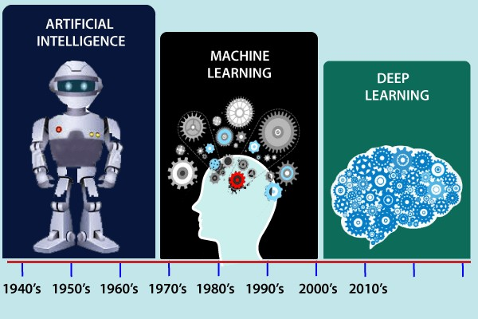
MAKE SKILLED
MS
HISTORY OF ML

Slide 16
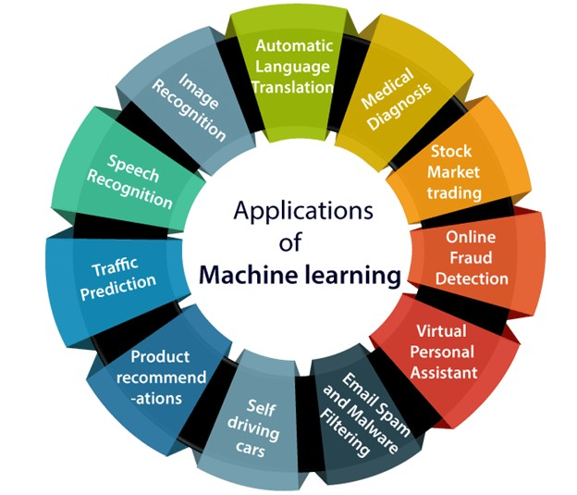
MAKE SKILLED
MS
APPLICATIONS OF ML

Slide 17
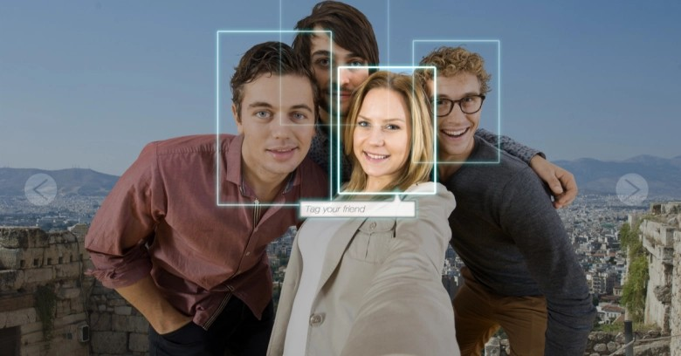







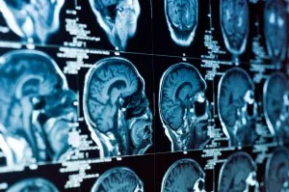
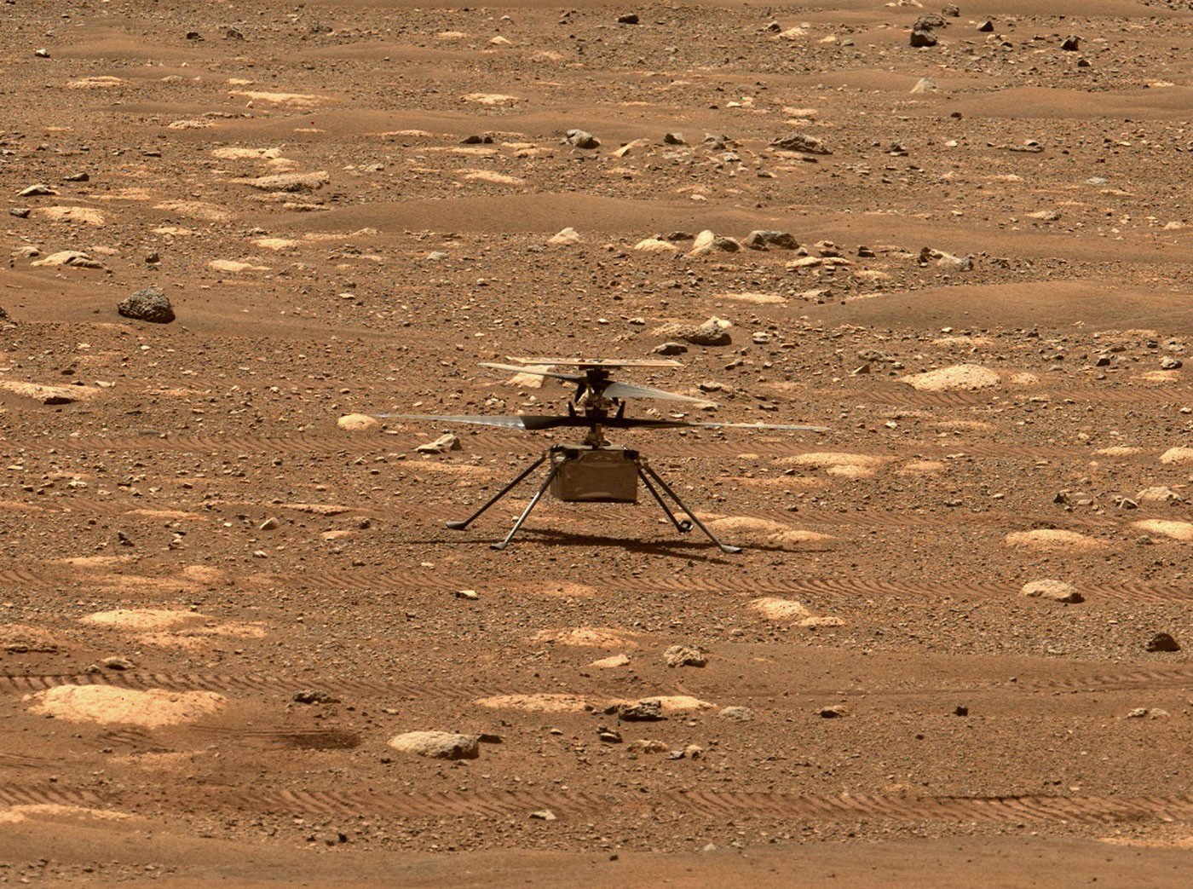

MAKE SKILLED
MS
APPLICATIONS OF ML
2
3
4
5
6
7
8
10
9

Slide 18
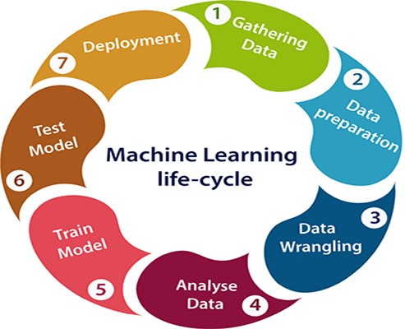
MAKE SKILLED
MS
MACHINE LEARNING LIFE CYCLE

Slide 19
WHAT IS DATASET
MAKE SKILLED
MS
▸ A dataset is a collection of data in which data is arranged in some order.
Country Age Salary Purchased
India 38 48000 No
France 43 45000 Yes
Germany 30 54000 No
France 48 65000 No
Germany 40 Yes
India 35 58000 Yes

Slide 20
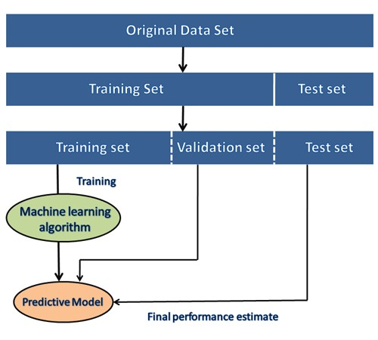
NEED OF DATASET
MAKE SKILLED
MS
▸ During the development of the ML project, the developers completely rely on the datasets.
▸ In building ML applications, datasets are divided into two parts
▸ Training dataset
▸ Test Dataset

