Slide 1
UPII
ELEVATE NxT
Deeptech — Stage 3
Sovereign Memory Engine
Application ID
ELNXT20260000020
DataFrontier Innovation Private Limited
Panel:
AI-ML / Health / Bio / Life Sciences
Presenter: Veenadhari Pola, Founder & CEO
Advisor: Madhusudhan Anand
Pitch: 3:40 PM | May 11, 2026
datafrontier.co | veena@datafrontier.co | +91 9866557800

Slide 2
DataFrontier Innovation Pvt Ltd
UPII — Sovereign Memory Engine
Company Overview
Company Introduction
Registered deeptech startup building foundational AI infrastructure
Company:
DataFrontier Innovation Private Limited
Directors / Partners
Website:
datafrontier.co
Name | DIN | Shares
Madhusudhan Anand | 07274579 | 5%
Veenadhari Pola | 10503140 | 95%
City:
Bangalore, Karnataka
Email:
veena@datafrontier.co
7+
TRL 4
Phone:
+91 9866557800
Team Members
Readiness Level
Incorporated:
11 / 02 / 2024
CIN:
As per MCA filing
v0.5
18
Shipped & Live
Test Suites
ELEVATE NxT Deeptech — Stage 3 | ELNXT20260000020 | DataFrontier Innovation Pvt Ltd
2 / 16

Slide 3
DataFrontier Innovation Pvt Ltd
UPII — Sovereign Memory Engine
Problem Statement
The AI Memory Crisis
Every AI system today has a critical blind spot — it cannot remember
"To make an AI truly useful, enterprises face a dangerous trade-off: upload your confidential data to the cloud — or settle for generic, amnesiac AI. For regulated industries, neither option works.
AI is Amnesiac
Privacy vs Intelligence
Zero Auditability
LLMs forget everything between sessions. No persistent memory means no institutional knowledge.
Cloud AI requires uploading sensitive data. Regulated sectors — healthcare, BFSI, govt — simply cannot comply.
AI decisions are unexplainable. No audit trail, no reversibility — blocking adoption in high-stakes domains.
ELEVATE NxT Deeptech — Stage 3 | ELNXT20260000020 | DataFrontier Innovation Pvt Ltd
3 / 16

Slide 4
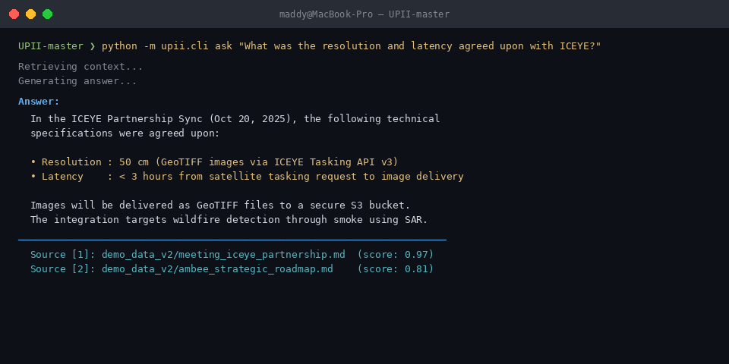
DataFrontier Innovation Pvt Ltd
UPII — Sovereign Memory Engine
Product & Innovation
UPII — Sovereign Memory Engine
A local-first, auditable, reversible memory substrate for AI systems
Zero Privacy Risk
Zero Latency
Zero Lock-In
Data never leaves the device
<300ms retrieval on-device
Works with any LLM backend
Core Innovations
Explicit memory approval — you control what AI remembers
Full audit trail — every memory access is logged
Explainable recall — AI explains WHY it retrieved context
Temporal + entity-aware — remembers WHO and WHEN
Reversible — wipe any memory without data loss
ELEVATE NxT Deeptech — Stage 3 | ELNXT20260000020 | DataFrontier Innovation Pvt Ltd
4 / 16

Slide 5
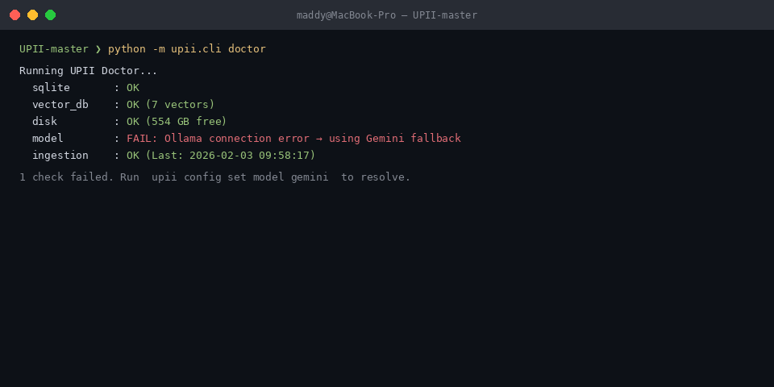
DataFrontier Innovation Pvt Ltd
UPII — Sovereign Memory Engine
Technology Readiness
Product Readiness Level
From concept to working prototype — on track for enterprise pilot
TRL 1-3
TRL 4
TRL 5
TRL 6
TRL 7-9
Research &
Concept
Lab
Validation
Pilot
Validation
Enterprise
Deploy
Commercial
Scale
WE ARE HERE
System Status
OK Staged ingestion with explicit approval
OK Temporal + entity-based retrieval
OK Explainable ranking with boost reasons
OK LanceDB vector store + SQLite hybrid
OK 18 automated test suites passing
-> TRL 5: Pilot deployment (Milestone 1)
-> TRL 6: Multi-tenant enterprise (Milestone 2)
ELEVATE NxT Deeptech — Stage 3 | ELNXT20260000020 | DataFrontier Innovation Pvt Ltd
5 / 16

Slide 6
DataFrontier Innovation Pvt Ltd
UPII — Sovereign Memory Engine
Socio-Economic Impact
Socio-Economic Impact
Enabling India's sovereign AI stack — private, auditable, accessible
Data Sovereignty
Democratising AI Access
SDG Alignment
Indian enterprise data stays on Indian soil
DPDP Act 2023 compliant by design
No foreign cloud dependency for AI intelligence
Critical for BFSI, healthcare, defence, govt bodies
Runs on CPU — no GPU required
Rs 40,000 laptop can run UPII
SMEs and govt offices can use AI privately
Reduces cost barrier for enterprise AI adoption
SDG 9: Industry, Innovation & Infrastructure
SDG 16: Peace, Justice, Strong Institutions
2-3 hrs/week saved per knowledge worker
AI risk reduction in high-stakes decisions
ELEVATE NxT Deeptech — Stage 3 | ELNXT20260000020 | DataFrontier Innovation Pvt Ltd
6 / 16

Slide 7
DataFrontier Innovation Pvt Ltd
UPII — Sovereign Memory Engine
Team
Team — Size, Background & Capability
7+ members with deep AI/ML, data infrastructure, and enterprise software expertise
Core Strengths
Team Composition
AI/ML engineering — RAG pipelines, embeddings, vector stores
Secure systems design — local-first, air-gapped architectures
Data infrastructure — large-scale ingestion and retrieval
Enterprise software — production-grade CLI, testing, CI/CD
Domain expertise — environmental intelligence, satellite data
Prior experience at: HPE, Dell, HackerEarth, Avaya, Ambee
Founder & CEO
Veenadhari Pola
Strategy, product, business development
Tech Advisor / CTO
Madhusudhan Anand
AI/ML architecture, data systems, research
ML Engineers (2)
Core team
Embedding pipelines, retrieval systems, testing
Backend Engineers (2)
Core team
Storage, CLI, API integrations
Intern / Research (1)
Junior team
Benchmarking, documentation, QA
ELEVATE NxT Deeptech — Stage 3 | ELNXT20260000020 | DataFrontier Innovation Pvt Ltd
7 / 16

Slide 8
DataFrontier Innovation Pvt Ltd
UPII — Sovereign Memory Engine
Founders
Founding Team
Built by practitioners who faced the problem themselves
Madhusudhan Anand
Veenadhari Pola
Advisor — AI Architecture & Strategy
Founder & CEO — Product & Business
Edu: MS Data Science, LJMU
Edu: Computer Applications, Symbiosis
CTO at Ambee (environmental intelligence, satellite data)
Prev: HackerEarth, Dell, Hewlett Packard Enterprise
Research papers on distributed data systems
Patent holder in data indexing
Built AI pipelines processing NASA & ESA satellite data
'Built UPII because I needed it — cannot paste confidential data into ChatGPT'
17+ years in enterprise technology
Prev: Hewlett Packard Enterprise, Avaya
Deep expertise in data, MIS, and operational systems
Led cross-functional teams in regulated enterprise environments
Bringing UPII to market with enterprise sales experience
Driving product vision: private, auditable AI for India
ELEVATE NxT Deeptech — Stage 3 | ELNXT20260000020 | DataFrontier Innovation Pvt Ltd
8 / 16

Slide 9
DataFrontier Innovation Pvt Ltd
UPII — Sovereign Memory Engine
Market Landscape
Market Landscape & Competitive Position
Targeting the fastest-growing segment of enterprise AI infrastructure
TAM
Competitive Gap
Global AI Infrastructure $200B+ by 2028
Mem.ai / Notion AI
Cloud-first — data leaves your machine
SAM
Microsoft Copilot
Requires Microsoft 365 cloud ecosystem
Trustworthy / Explainable AI Systems $18B by 2027
LlamaIndex / LangChain
Developer framework — not a product
SOM
Indian Regulated Enterprise AI Rs 500 Cr addressable Y1-3
Vector DBs (Pinecone)
Storage only — no governance layer
UPII (our solution)
Local-first + governed + explainable + auditable
ELEVATE NxT Deeptech — Stage 3 | ELNXT20260000020 | DataFrontier Innovation Pvt Ltd
9 / 16

Slide 10
DataFrontier Innovation Pvt Ltd
UPII — Sovereign Memory Engine
Business Model
Business Model & Go-To-Market Strategy
B2B enterprise-first — selling to regulated industries that cannot use cloud AI
Target Customers
Value Proposition
Go-To-Market Channels
BFSI — banks, insurance, NBFCs (DPDP compliance)
Healthcare systems, hospital networks, pharma
Government agencies and defence PSUs
AI-first startups building regulated applications
Safe, on-prem, private, explainable AI memory
Compliance-ready — no data egress, full audit logs
Drop-in SDK — integrates with any existing LLM stack
Reduces AI decision risk in regulated environments
Ambee network — 100+ enterprise clients (warm intro)
NASSCOM member co-selling partnerships
Open-source core — developer adoption funnel
System integrators serving BFSI and healthcare
ELEVATE NxT Deeptech — Stage 3 | ELNXT20260000020 | DataFrontier Innovation Pvt Ltd
10 / 16

Slide 11
DataFrontier Innovation Pvt Ltd
UPII — Sovereign Memory Engine
Business Model
Why UPII Becomes Sticky
This is risk infrastructure — not replaceable SaaS
Data Gravity
Customer LTV
As enterprises ingest more documents, meetings, and decisions into UPII, switching costs grow exponentially. Memory IS the moat.
Rs 7-10 Cr
Governance Lock-In
Compliance teams rely on UPII's audit logs. Replacing the memory layer means losing audit trail continuity — a compliance risk.
per enterprise customer
-> High switching cost once memory embedded
3-5 Year Contracts
-> Expansion via depts & use-cases
Multi-year enterprise contracts with expansion clauses. Every new use-case and department is an expansion opportunity.
-> Multi-year contract structure
-> Professional services on top
ELEVATE NxT Deeptech — Stage 3 | ELNXT20260000020 | DataFrontier Innovation Pvt Ltd
11 / 16

Slide 12
DataFrontier Innovation Pvt Ltd
UPII — Sovereign Memory Engine
Revenue Model
Revenue Model
Multiple streams, high LTV, sticky infrastructure positioning
Revenue Stream
Pricing
Description
Why Customers Pay
Enterprise License
Rs 10-50 L / year
Air-gapped on-prem deployment, SLA, audit logs, SSO
-> Prevents AI compliance failures
SDK / API Tier
Rs 499 / month per dev
For AI-first startups integrating UPII into their products
-> Audit-ready for regulators
-> Reduces organisational AI risk
Open Core
Free (community)
Core engine public — builds trust, developer adoption funnel
-> Not discretionary — it's risk infrastructure
Professional Services
Project-based
Custom connectors, integration, training, compliance support
-> ROI: 1 compliance breach > 5x UPII cost
ELEVATE NxT Deeptech — Stage 3 | ELNXT20260000020 | DataFrontier Innovation Pvt Ltd
12 / 16

Slide 13
DataFrontier Innovation Pvt Ltd
UPII — Sovereign Memory Engine
Financial Projections
Financial Projections (3-Year)
Conservative ramp targeting 5-7 enterprise customers; expansion via accounts
Key Assumptions
Year 1
Rs 40 L
2-3 pilot customers at Rs 10-15L/yr; grant period
Year 2
Rs 3.5 Cr
5-7 enterprises; account expansion + SDK
Year 3
Rs 10+ Cr
10-15 enterprises; full product suite
ELEVATE NxT Deeptech — Stage 3 | ELNXT20260000020 | DataFrontier Innovation Pvt Ltd
13 / 16

Slide 14
DataFrontier Innovation Pvt Ltd
UPII — Sovereign Memory Engine
Milestones
Project Milestones
Two-tranche delivery aligned with ELEVATE NxT grant structure
M1
M2
GO
Month 0-6
Month 6-12
Commercial Ready
Milestone 1 (0-6 months)
Milestone 2 (6-12 months)
TRL 4 to TRL 5 transition
Ambient memory (file watcher, inbox review)
Overlay UI — Cmd+Shift+K instant search
3 enterprise pilot deployments signed
Memory governance hardening
Enterprise connectors (email, Slack, Google Workspace)
TRL 5 to TRL 6 transition
Multi-tenant enterprise architecture
Formal benchmarking (NDCG, precision@k)
Research paper publication
Commercial launch readiness
5+ enterprise LOIs converted to contracts
ELEVATE NxT Deeptech — Stage 3 | ELNXT20260000020 | DataFrontier Innovation Pvt Ltd
14 / 16

Slide 15
DataFrontier Innovation Pvt Ltd
UPII — Sovereign Memory Engine
Grant Budget
Grant Utilization Plan — Rs 100 Lakhs (Max)
Budget structured per ELEVATE NxT guidelines; minimum 40% towards R&D
Category
Pct
Amount
R&D / Product Development
40%
Rs 40 L
Core memory engine, ambient ingestion, overlay UI, vector store
Salaries
20%
Rs 20 L
2 ML engineers + 1 backend engineer (12 months)
Outsourcing
15%
Rs 15 L
Security audit, penetration testing, UI/UX design
Marketing
10%
Rs 10 L
Enterprise pilots, conferences, content, NASSCOM
Admin & Infrastructure
10%
Rs 10 L
Office, cloud dev infra, CI/CD, compliance
Contingency / Research
5%
Rs 5 L
Research paper, benchmarking, travel
TOTAL
100%
Rs 100 L
ELEVATE NxT Deeptech — Stage 3 | ELNXT20260000020 | DataFrontier Innovation Pvt Ltd
15 / 16

Slide 16
THANK YOU
ELNXT20260000020
AI-ML / Health / Bio
Life Sciences Panel
DataFrontier Innovation
Private Limited
"The missing memory layer for India's AI stack — Private. Auditable. Sovereign."
Bangalore, Karnataka
Veenadhari Pola | veena@datafrontier.co | +91 9866557800
May 11, 2026
datafrontier.co
R&D Depth: 20 | Technical Foundation: 20 | Commercialisation: 20 | Socio-Economic: 20 | Team: 10 | Budget Plan: 10

