Slide 1
Smart Manufacturing Analytics Platform
PROJECT 5 | SNOWFLAKE CAPSTONE
Production, Quality & Asset Performance analytics on a Bronze–Silver–Gold Snowflake platform
PRESENTED BY
AM
AAKASH MADHAV B S
KG
KETKI GOKAKKAR
NR
NAMIEETHA R
RM
RICKY MARTIN A P
SV
SAI VISHAL P
Notes:
Cover: Project 5 Smart Manufacturing capstone. Team of five.

Slide 2

Why this platform?
PROJECT INTRODUCTION
THE PROBLEM
A multi-plant manufacturer cannot consistently reconcile planned vs actual production, explain rejection and rework, find downtime drivers, or link sensor conditions to machine performance.
WHAT WE BUILT
Production visibility
Quality control
Plan attainment, yield, runtime & downtime
Pass rate, defect severity, rework
Asset monitoring
Machine risk
Flattened sensor JSON, abnormal conditions
Transparent rule-based Snowpark score
7
6,680
5
5
source files
business records
team members
days
Notes:
Problem and objectives from the capstone brief. Visual on this slide was generated with Microsoft Copilot.

Slide 3
From raw files to business dashboards
END-TO-END ARCHITECTURE
01
02
03
04
05
06
07
Source files
Informatica IDMC
Internal stage
Bronze
Silver
Gold
Consumption
6 CSV + 1 JSON
Profile, cleanse, route clean / warning / reject
SnowSQL PUT / Snowsight
Raw + file, batch, ingestion metadata
Typed, deduplicated, JSON flattened
Dimensions, facts, KPI marts
Secure views, Snowpark score, Streamlit
CONTROL PLANE
RBAC
Masking
Audit
Quarantine
Reconciliation
Monitoring
Recovery
TECHNOLOGY STACK
Informatica IDMC
Snowflake
SnowSQL
Snowpark Python
Streamlit
Git · VS Code · Snowsight
Notes:
Seven-layer target architecture with a cross-cutting control plane, as defined in the capstone brief.

Slide 4

Seven sources, one trusted view
DATA & SCOPE
SOURCE DATASETS
KEY KPIs
products.csv
600
• Plan attainment %
• Yield, rejection & rework %
• Runtime, downtime, utilization %
• Inspection pass rate
• Defects per 1,000 units
• Avg temperature & vibration
• High-risk machine count
plants.csv
30
machines.csv
250
work_orders.csv
1,200
production_transactions.csv
2,500
quality_inspections.csv
900
DATA-QUALITY TRAPS HANDLED
machine_sensor_events.json
1,200
8
3
3
2
nulls
duplicates
anomalies
outliers
Notes:
Dataset inventory, KPIs and controlled data-quality conditions from the brief. Visual on this slide was generated with Microsoft Copilot.

Slide 5
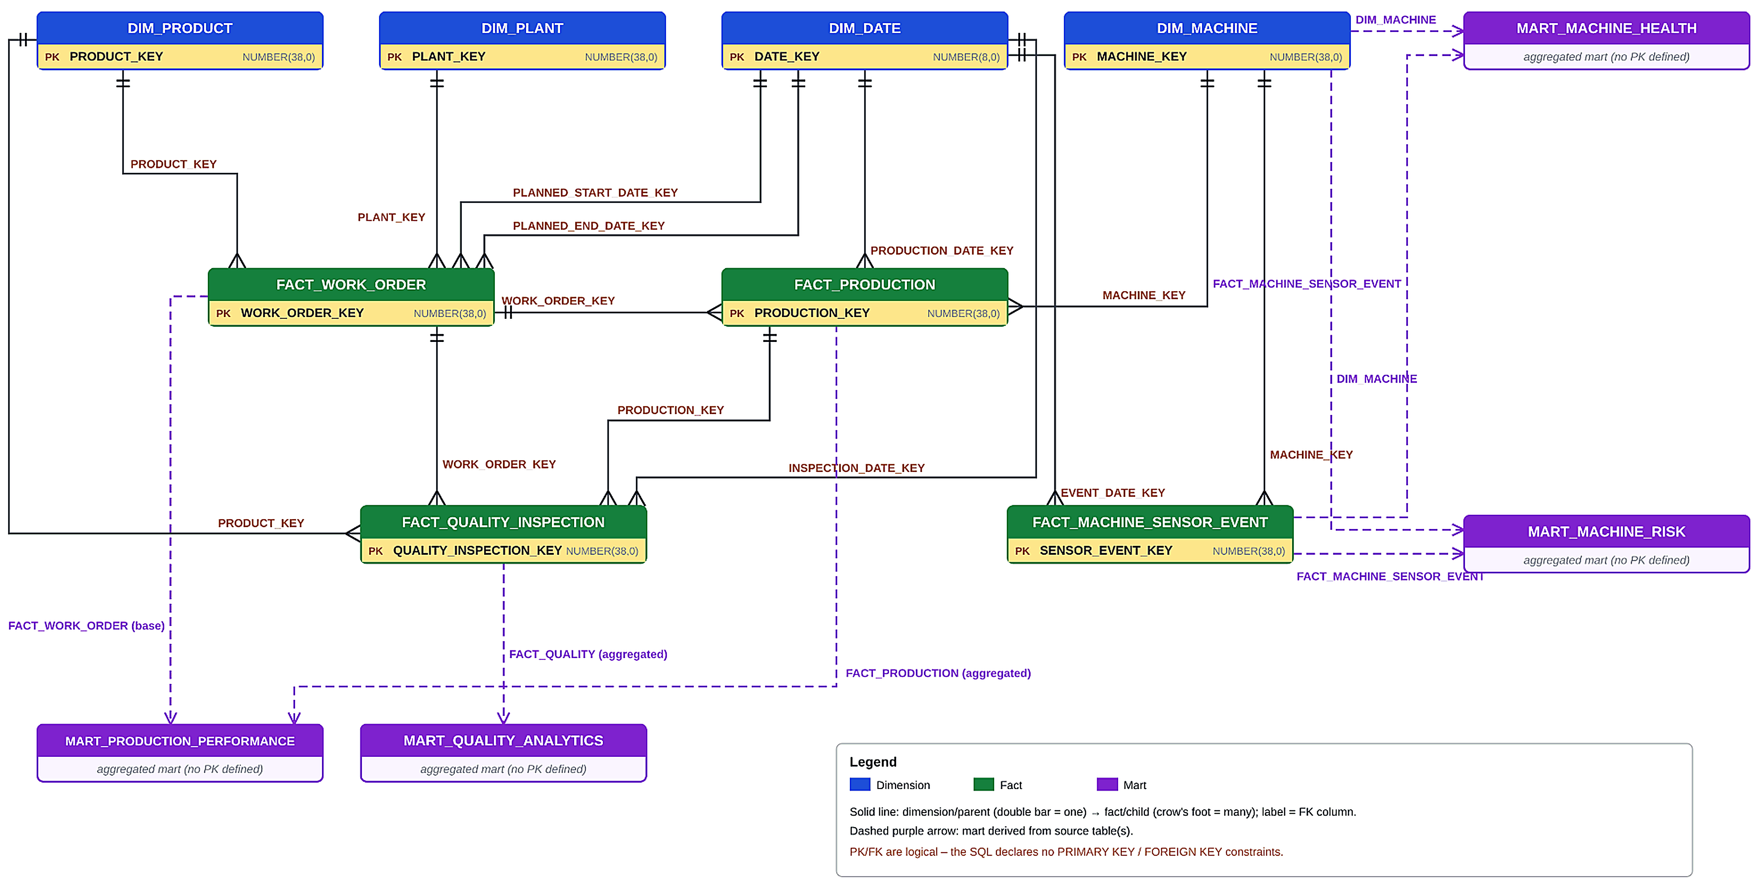
Fact Consolidation Schema – Gold layer star model
SOLUTION ARCHITECTURE
What the model contains
4 Dimensions
Product, plant, machine and date – conformed context
4 Facts
Work order, production, quality inspection, sensor event
4 Marts
Production performance, quality, machine health, machine risk
Change-aware: 1 SCD table tracks production changes; 2 dynamic tables auto-refresh FACT_PRODUCTION and its mart.
Notes:
Gold layer follows a star model: four dimensions feed four facts via surrogate keys; four marts aggregate the facts for dashboards. PK/FK are logical. The production path is change-aware via one SCD table and two dynamic tables.

Slide 6
SCD table captures every change in production transactions
INCREMENTAL LOAD
Incremental loads of production_transactions.csv land in Silver; a Stream exposes only the changed rows, and a MERGE writes them into the SCD table so history is kept and replays never create duplicates.
How the incremental flow runs
1 Land the delta
production_transactions.csv (new + corrected rows) loaded via stage and COPY INTO
2 Capture changes
Stream on the Silver table returns only inserted / updated rows since last run
3 MERGE on business key
Match on PRODUCTION_TRANSACTION_ID and compare a row hash to detect real changes
4 Write SCD history
Close the old version and insert the new current version with effective dates
How each record type is handled
New record
No match on key → inserted as current version (IS_CURRENT = TRUE)
Corrected record
Hash differs → old row gets EFFECTIVE_TO and IS_CURRENT = FALSE; new version inserted
Replayed file
Hash identical → no action, so Gold facts are never duplicated
Downstream use
Facts read only IS_CURRENT = TRUE rows; full history kept for audit
Notes:
One SCD table handles the incremental production pipeline. New rows insert, corrected rows version the history, replays are no-ops thanks to hash comparison.

Slide 7
Dynamic tables auto-refresh fact & mart
AUTOMATED REFRESH
Why dynamic tables
Without them, every SCD change would need a manually scheduled refresh of FACT_PRODUCTION and then MART_PRODUCTION_PERFORMANCE.
Dynamic tables are declared once as a SELECT; Snowflake tracks dependencies and refreshes them within the target lag.
Refresh chain
What happens when data changes
SCD table
DT 1 · FACT_PRODUCTION
DT 2 · MART_PROD_PERF
1
Change lands
IS_CURRENT = TRUE rows
Joins dims → surrogate keys
Aggregated KPIs
New or corrected row versioned in the SCD table
2
Fact refreshes
FACT_PRODUCTION picks up current rows automatically
Outcomes
3
Mart refreshes
Always current
Fact and mart reflect the latest SCD version automatically
Incremental refresh
Only changed data is reprocessed, saving compute
No orchestration
Dependency order handled by Snowflake, not manual tasks
KPIs re-aggregated within the target lag
4
Dashboards updated
Users see the latest numbers, no manual run
Notes:
FACT_PRODUCTION uses DOWNSTREAM lag so it refreshes when the mart needs it; the mart owns the business freshness target.

Slide 8
What the implementation delivers
END-TO-END SUMMARY
1 SCD + 2 Dynamic Tables
7
3
Change-aware, self-refreshing production analytics
source files
layers: Bronze · Silver · Gold
Silver deltas
Stream
MERGE → SCD
DT · FACT_PRODUCTION
DT · MART_PROD_PERF
Dashboards
4
Dimensions
4
Facts
4
Marts
0
Duplicates on replay
Product, plant, machine, date
Work order, production, quality, sensor
Production, quality, health, risk
Hash-based MERGE keeps reloads idempotent
Notes:
Summary: star model with 4 dims, 4 facts, 4 marts across Bronze/Silver/Gold from 7 sources. Incremental path is SCD-backed; dynamic tables remove manual refresh orchestration; replays create no duplicates.

