Slide 1
Smart Manufacturing Analytics Platform
PROJECT 5 | SNOWFLAKE CAPSTONE
OVERVIEW
Production, Quality & Asset Performance analytics on a Bronze–Silver–Gold Snowflake platform
PRESENTED BY
AM
AAKASH MADHAV B S
KG
KETKI GOKAKKAR
NR
NAMIEETHA R
RM
RICKY MARTIN A P
SV
SAI VISHAL P
01 / 25

Slide 2

Why this platform?
OVERVIEW
PROJECT INTRODUCTION
THE PROBLEM
A multi-plant manufacturer cannot consistently reconcile planned vs actual production, explain rejection and rework, find downtime drivers, or link sensor conditions to machine performance.
WHAT WE BUILT
Production visibility
Quality control
Plan attainment, yield, runtime & downtime
Pass rate, defect severity, rework
Asset monitoring
Machine risk
Flattened sensor JSON, abnormal conditions
Transparent rule-based Snowpark score
7
6,680
5
5
source files
business records
team members
days
02 / 25

Slide 3
From raw files to business dashboards
OVERVIEW
END-TO-END ARCHITECTURE
01
02
03
04
05
06
07
Source files
Informatica IDMC
Internal stage
Bronze
Silver
Gold
Consumption
6 CSV + 1 JSON
Profile, cleanse, route clean / warning / reject
SnowSQL PUT / Snowsight
Raw + file, batch, ingestion metadata
Typed, deduplicated, JSON flattened
Dimensions, facts, KPI marts
Secure views, Snowpark score, Streamlit
CONTROL PLANE
RBAC
Masking
Audit
Quarantine
Reconciliation
Monitoring
Recovery
TECHNOLOGY STACK
Informatica IDMC
Snowflake
SnowSQL
Snowpark Python
Streamlit
Git · VS Code · Snowsight
03 / 25

Slide 4

Seven sources, one trusted view
OVERVIEW
DATA & SCOPE
SOURCE DATASETS
KEY KPIs
products.csv
600
• Plan attainment %
• Yield, rejection & rework %
• Runtime, downtime, utilization %
• Inspection pass rate
• Defects per 1,000 units
• Avg temperature & vibration
• High-risk machine count
plants.csv
30
machines.csv
250
work_orders.csv
1,200
production_transactions.csv
2,500
quality_inspections.csv
900
DATA-QUALITY TRAPS HANDLED
machine_sensor_events.json
1,200
8
3
3
2
nulls
duplicates
anomalies
outliers
04 / 25

Slide 5
DATA QUALITY
| INFORMATICA IDMC
Data-quality layer before Snowflake
Profile, cleanse, validate and route seven source files so only governed data reaches Bronze
SOURCE INVENTORY
7
source files (6 CSV + 1 JSON)
File | Format | Records | Purpose
products.csv | CSV | 600 | Product master
plants.csv | CSV | 30 | Plant master
machines.csv | CSV | 250 | Machine and line assignment
work_orders.csv | CSV | 1,200 | Planned manufacturing work
production_transactions.csv | CSV | 2,500 | Shop-floor production output
quality_inspections.csv | CSV | 900 | Inspection and defect outcomes
machine_sensor_events.json | JSON | 1,200 | Nested machine telemetry
6,680
business records processed
20
controlled data-quality issues to catch
Source files
Informatica IDMC
Approved files
Internal stage
Bronze
6 CSV + 1 JSON
Profile, cleanse, route
Clean / warning / reject
SnowSQL PUT
Raw + audit metadata
LTM
Project 5 | Smart Manufacturing Analytics | IDMC
1
05 / 25

Slide 6
DATA QUALITY
MY PART | PROFILING AND STANDARDIZATION
What IDMC checked and fixed on every file
IDMC RESPONSIBILITIES
CONTROLLED DATA-QUALITY CONDITIONS
01
Profiling
Condition | Count | What IDMC looks for
Null values | 8 | Missing values in non-critical fields
Duplicate records | 3 | Exact duplicate rows across source files
Business anomalies | 3 | Production before planned start; rejected above produced; accepted + rejected above sample size
Outliers | 2 | 1,320 downtime minutes; 29.8 mm/s vibration
Varied date formats | 4 | Mixed date and timestamp formats to standardize
Total | 20 | Intentionally seeded issues across 6,680 records
Null %, distinct keys, formats and value ranges
02
Cleansing
Fix correctable issues, leave valid values untouched
03
Standardization
Unify mixed date and timestamp formats
04
Relationship checks
Product, plant, machine and work-order links
05
Duplicate handling
Detect exact duplicates and route them out
06
File generation
Write clean, warning and reject output files
LTM
Project 5 | Smart Manufacturing Analytics | IDMC
06 / 25

Slide 7
DATA QUALITY
| ROUTING LOGIC
Every record lands in exactly one of four streams
CLEAN
WARNING
DUPLICATE
REJECT
4
10
3
3
date-format fixes standardized and retained
expected: 8 nulls + 2 outliers
exact duplicates expected
business anomalies expected
RULE
RULE
RULE
RULE
Valid records and correctable formatting issues
Non-critical missing value, or an extreme but possible value kept for review
Exact duplicate of another record, held out of the clean file
Invalid relationship or impossible sequence
EXAMPLE
EXAMPLE
EXAMPLE
EXAMPLE
Mixed date formats converted to one standard
1,320 downtime minutes; 29.8 mm/s vibration
Duplicate rows seeded for data-quality testing
Rejected quantity greater than produced quantity
Nothing is silently dropped: every output file is reconciled back to its source. Counts above are the expected values from the project specification.
LTM
Project 5 | Smart Manufacturing Analytics | IDMC
07 / 25

Slide 8
DATA QUALITY
VALIDATION AND HANDOFF
Validated files handed to Snowflake Bronze
Validation rules
Handoff to Snowflake
Deliverables
RELATIONSHIPS
1
IDMC produces approved clean, warning and reject files
DELIVERABLES
Work orders → products, plants
Production → work orders, machines
Inspections → production, work orders, products
IDMC mappings and taskflow evidence
Clean, warning and reject output files
Source-to-target mapping
Data-quality and reconciliation reports
2
Files uploaded to the internal stage with SnowSQL PUT or Snowsight
BUSINESS SEQUENCE
3
Loaded into Bronze tables with file, batch and ingestion metadata
Production not before planned start
Rejected qty not above produced qty
Accepted + rejected not above sample size
ACCEPTANCE
All 7 files and 6,680 records processed
Controlled dirty records routed as specified
4
Warning and reject files kept for review and quarantine
LTM
Project 5 | Smart Manufacturing Analytics | IDMC
4
08 / 25

Slide 9
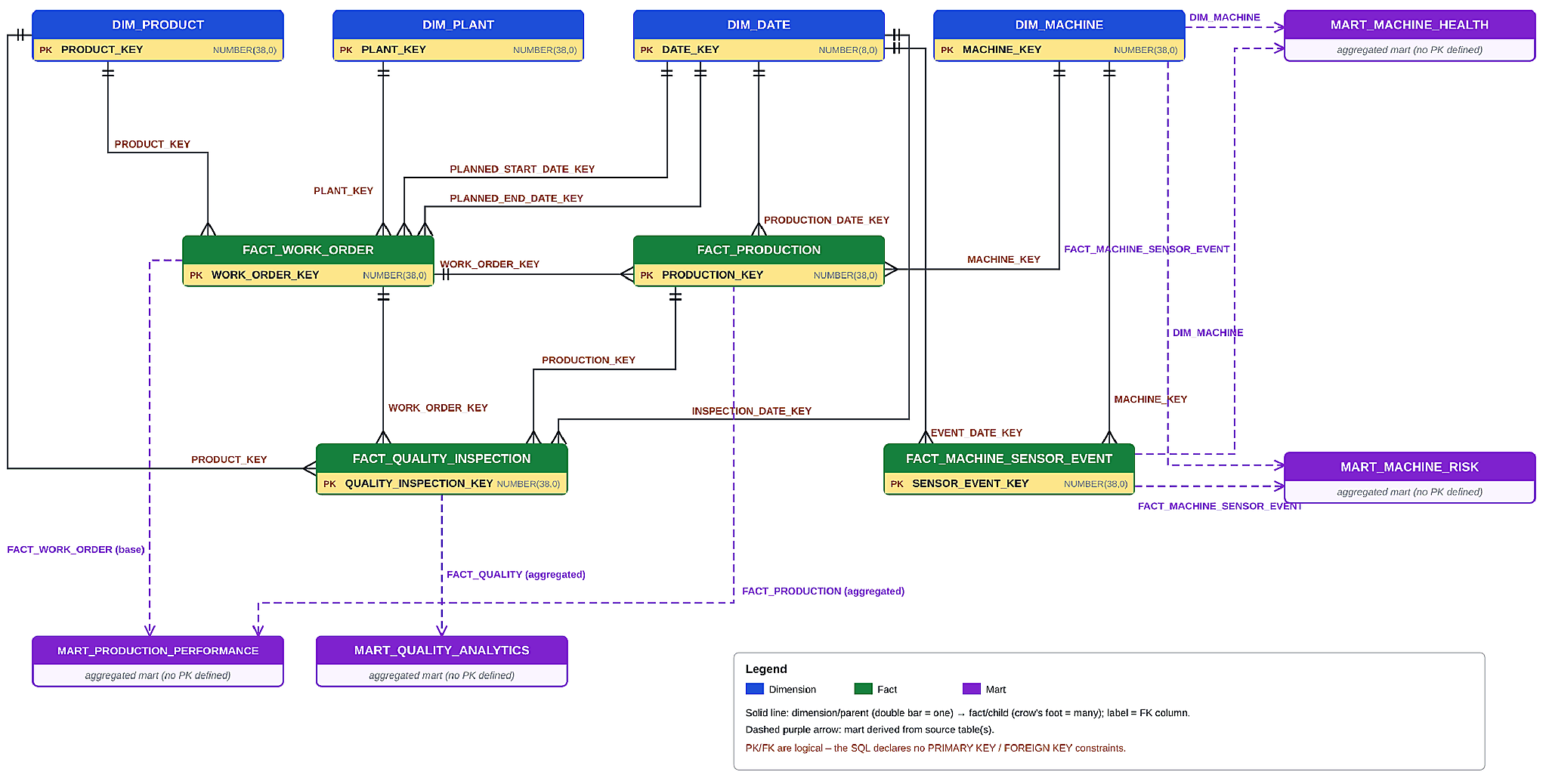
Fact Consolidation Schema – Gold layer star model
DATA PLATFORM
SOLUTION ARCHITECTURE
What the model contains
4 Dimensions
Product, plant, machine and date – conformed context
4 Facts
Work order, production, quality inspection, sensor event
4 Marts
Production performance, quality, machine health, machine risk
Change-aware: 1 SCD table tracks production changes; 2 dynamic tables auto-refresh FACT_PRODUCTION and its mart.
09 / 25

Slide 10
SCD table captures every change in production transactions
DATA PLATFORM
INCREMENTAL LOAD
Incremental loads of production_transactions.csv land in Silver; a Stream exposes only the changed rows, and a MERGE writes them into the SCD table so history is kept and replays never create duplicates.
How the incremental flow runs
1 Land the delta
production_transactions.csv (new + corrected rows) loaded via stage and COPY INTO
2 Capture changes
Stream on the Silver table returns only inserted / updated rows since last run
3 MERGE on business key
Match on PRODUCTION_TRANSACTION_ID and compare a row hash to detect real changes
4 Write SCD history
Close the old version and insert the new current version with effective dates
How each record type is handled
New record
No match on key → inserted as current version (IS_CURRENT = TRUE)
Corrected record
Hash differs → old row gets EFFECTIVE_TO and IS_CURRENT = FALSE; new version inserted
Replayed file
Hash identical → no action, so Gold facts are never duplicated
Downstream use
Facts read only IS_CURRENT = TRUE rows; full history kept for audit
10 / 25

Slide 11
Dynamic tables auto-refresh fact & mart
AUTOMATED REFRESH
DATA PLATFORM
Why dynamic tables
Without them, every SCD change would need a manually scheduled refresh of FACT_PRODUCTION and then MART_PRODUCTION_PERFORMANCE.
Dynamic tables are declared once as a SELECT; Snowflake tracks dependencies and refreshes them within the target lag.
Refresh chain
What happens when data changes
SCD table
DT 1 · FACT_PRODUCTION
DT 2 · MART_PROD_PERF
1
Change lands
IS_CURRENT = TRUE rows
Joins dims → surrogate keys
Aggregated KPIs
New or corrected row versioned in the SCD table
2
Fact refreshes
FACT_PRODUCTION picks up current rows automatically
Outcomes
3
Mart refreshes
Always current
Fact and mart reflect the latest SCD version automatically
Incremental refresh
Only changed data is reprocessed, saving compute
No orchestration
Dependency order handled by Snowflake, not manual tasks
KPIs re-aggregated within the target lag
4
Dashboards updated
Users see the latest numbers, no manual run
11 / 25

Slide 12
What the implementation delivers
DATA PLATFORM
END-TO-END SUMMARY
1 SCD + 2 Dynamic Tables
7
3
Change-aware, self-refreshing production analytics
source files
layers: Bronze · Silver · Gold
Silver deltas
Stream
MERGE → SCD
DT · FACT_PRODUCTION
DT · MART_PROD_PERF
Dashboards
4
Dimensions
4
Facts
4
Marts
0
Duplicates on replay
Product, plant, machine, date
Work order, production, quality, sensor
Production, quality, health, risk
Hash-based MERGE keeps reloads idempotent
12 / 25

Slide 13
Security requirements and how we met them
SECURITY
SECURITY REQUIREMENTS
1
Business roles
2
Bronze restricted
3
Secure views
Three roles created with SECURITYADMIN: engineer, quality analyst and plant manager, each linked to its own user.
Evidence: SHOW GRANTS TO ROLE
Only the engineer role gets schema USAGE and SELECT on current and future Bronze tables.
Evidence: Bronze query denied for other roles
Business data is exposed only through two Secure views in the secure schema, built on the Silver layer.
Evidence: view queries run per role
4
Masked operator ID
5
Minimal admin use
6
Access demonstrated
OPERATOR_ID is returned as OPERATOR_REFERENCE. Only engineers see the value; others see MASKED.
Evidence: engineer vs analyst output
SECURITYADMIN for roles and grants, USERADMIN for users, ACCOUNTADMIN only to create the secure schema and views.
Evidence: admin steps isolated in script
Each role tested with USE ROLE on COMPUTE_WH, with secondary roles off so one role applies at a time.
Evidence: role tests, Day 4 deliverable
13 / 25

Slide 14
Who can reach which data layer
SECURITY
ACCESS MODEL
Bronze
Raw, source-aligned tables; engineers only
Silver
Typed, deduplicated, validated data
Secure views
Business access layer with masking
Business roles
Query only the views granted to them
Role | Bronze (raw) | Silver (cleansed) | Secure view
MANUFACTURING_ENGINEER_ROLE | SELECT | Schema USAGE only | VW_QUALITY_PRODUCTION
QUALITY_ANALYST_ROLE | No access | Schema USAGE only | VW_QUALITY_PRODUCTION
PLANT_MANAGER_ROLE | No access | Schema USAGE only | VW_PLANT_PRODUCTION_SUMMARY
Business roles hold no table SELECT on Silver, so Silver is reached only through the Secure views.
Grants and administration
SECURITYADMIN
Creates roles and grants schema, view and warehouse access.
USERADMIN
Creates the three test users with a forced password change.
ACCOUNTADMIN
Only creates the secure schema and the two views.
All three roles
USAGE on CAPSTONE_DEV and on COMPUTE_WH.
14 / 25

Slide 15

Secure views and masking
DATA PROTECTION
SECURITY
Masked by default
OPERATOR_ID is visible to engineers only
CASE
WHEN IS_ROLE_IN_SESSION('MANUFACTURING_ENGINEER_ROLE')
THEN OPERATOR_ID ELSE 'MASKED'
END AS OPERATOR_REFERENCE
2
  Secure views: row-level quality data for engineers and analysts; totals by shift and status for managers
1
  Masked field: OPERATOR_ID becomes OPERATOR_REFERENCE; other roles see MASKED
0
  Direct table reads for analysts and managers; Bronze is closed and Silver is reached via views
15 / 25

Slide 16
Snowpark Python – Machine Risk Analysis & Data Processing
ANALYTICS
SNOWPARK PYTHON
Objective: Transform manufacturing data into machine-risk insights
Connect to Snowflake
Established a Snowpark session on CAPSTONE_DEV.CAPSTONE_DEV_SILVER
Calculate risk scores
Scored Downtime, Vibration, Temperature, Power and Maintenance against predefined thresholds
1
4
Integrate source tables
Combined DIM_MACHINE, FACT_PRODUCTION and FACT_MACHINE_SENSOR_EVENT
Classify machines
Applied weights of 25/25/20/15/15% to get an overall score and a LOW, MEDIUM or HIGH category
2
5
Aggregate and prepare
Summed runtime and downtime by MACHINE_ID, averaged sensor readings, joined data and handled missing values
Store, validate and connect
Saved timestamped results to MART_MACHINE_RISK, validated them and linked the output to Streamlit
3
6
Outcome
A Snowpark-based scoring process that turns manufacturing and sensor data into actionable insights for machine monitoring and maintenance prioritization.
16 / 25

Slide 17
Streamlit – Interactive Dashboard Development & Business Analytics
ANALYTICS
STREAMLIT
Objective: Bring production, quality and machine-risk insights into one dashboard
Connect and load data
Built the dashboard on the active Snowpark session using Snowflake mart tables
Show machine risk
Risk-category distribution chart and Top 10 high-risk machines from MART_MACHINE_RISK
1
4
Build KPI cards
Production KPIs (yield, plan attainment, rejection, rework, runtime, downtime, utilization) and quality KPIs
Enable drill-down and filters
Component-wise risk scores per machine and sidebar filters for date, plant, product and machine
2
5
Add work-order and asset health
Work-order status and performance, plus temperature and vibration visualizations
Visualize and analyse
Pandas for data handling, Plotly for interactive charts and tables for detailed records
3
6
Outcome
An interactive analytics dashboard combining production, quality, work-order, asset-health and machine-risk insights to support data-driven operational decisions.
17 / 25

Slide 18
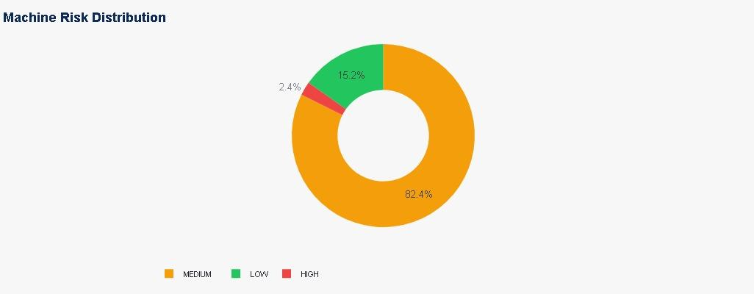
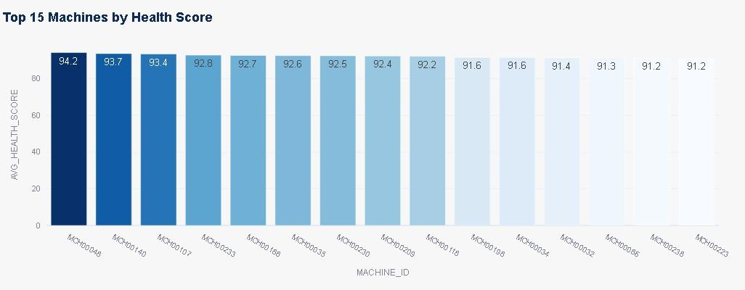
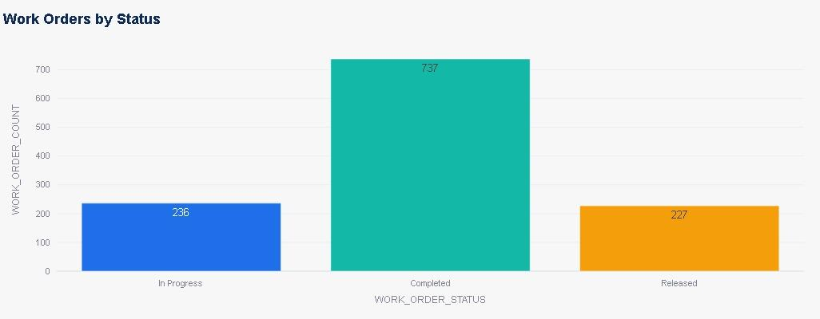
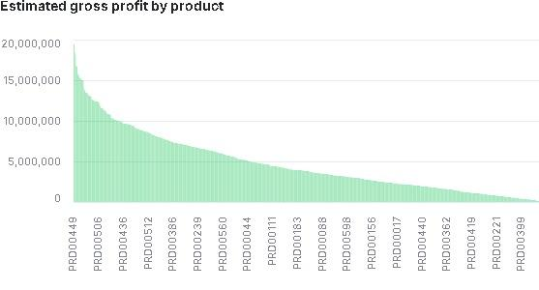
Machine Risk, Health, Work Orders & Profitability
ANALYTICS
MANUFACTURING ANALYTICS
18 / 25

Slide 19

Cortex Analyst for Manufacturing Analytics
PROJECT OVERVIEW
CORTEX AI
Business challenge
Manufacturing data is spread across production, quality, work-order and machine-sensor datasets.
Business users need a simpler way to ask operational questions.
Raw tables and SQL knowledge can create a barrier to self-service analysis.
CONNECTED MANUFACTURING OPERATIONS
Our Cortex Analyst solution
Technology & model
The semantic view gives business meaning to tables, columns, joins and metrics.
Cortex Analyst uses this context to interpret natural-language questions.
The user asks a question; the semantic model guides the data interpretation.
Snowflake Cortex Analyst
SV_MANUFACTURING_ANALYTICS semantic view
Source tables: CAPSTONE_DEV.CAPSTONE_DEV_SILVER
Deployment target:
CAPSTONE_DEV.CAPSTONE_DEV_GOLD.SV_MANUFACTURING_ANALYTICS
Artifacts: semantic-view YAML + cortex-project.yaml
Business outcomes
Natural-language access
Ask questions without writing SQL.
Consistent metrics
Reuse defined production and quality calculations.
Connected analysis
Explore operations across declared relationships.
19 / 25

Slide 20
Semantic View: Model at a Glance
CORTEX AI
DATA MODEL & MEASURES
15 TABLES
A business-facing model spanning manufacturing master data, operational events and analytical summaries.
The YAML declares 8 relationships between selected tables.
SOURCE DATA
SEMANTIC VIEW
CORTEX ANALYST
INSIGHT
4
DIMENSIONS
Date
• Machine
• Plant
• Product
4
FACT TABLES
Production
• Quality
• Sensor
• Work Order
6
ANALYTICS MARTS
Health
• Risk
• Production
• Quality
• Work-order views
8
DECLARED JOINS
Date, machine, product and production links
20 / 25

Slide 21

What the Semantic Model Enables
CORTEX AI
BUSINESS USE CASES
Users can explore manufacturing operations with questions grounded in the tables and metrics defined in the semantic view.
Explore manufacturing performance
ASK • ANALYSE • ACT
Production output
Units produced by machine, shift or date.
Downtime & runtime
Compare downtime and runtime efficiency.
Quality acceptance
Review acceptance and rejection rates.
Defect analysis
Explore defects by code, severity or product.
Ask operational questions in plain language
Machine health
Find machines in HEALTHY or WARNING categories.
Sensor readings
Compare temperature, vibration, pressure and RPM.
Machine risk
Rank assets by overall risk score and category.
Work orders
Review order counts, planned quantities and status.
21 / 25

Slide 22
Challenges Faced
PROJECT 5 / SMART MANUFACTURING
DELIVERY
Key technical and delivery obstacles across the data engineering lifecycle
1
DATA QUALITY & CLEANSING
2
MULTI-SOURCE INTEGRATION
3
DATA MODELLING & RELATIONSHIPS
Handling nulls, duplicates and business anomalies while standardising inconsistent date formats and routing outliers.
Combining 6 CSV files and 1 nested JSON source, then flattening sensor events without losing source metadata.
Maintaining accurate keys and relationships across products, plants, machines, work orders, production and quality.
4
INCREMENTAL PROCESSING
5
SECURITY & GOVERNANCE
6
KPI RECONCILIATION
Capturing new and corrected production records while preventing duplicate loads during file replay.
Validating role-based access, secure views and masking so each business role sees the right data.
Keeping production, quality and machine-health metrics consistent from source through Bronze, Silver and Gold.
22 / 25

Slide 23
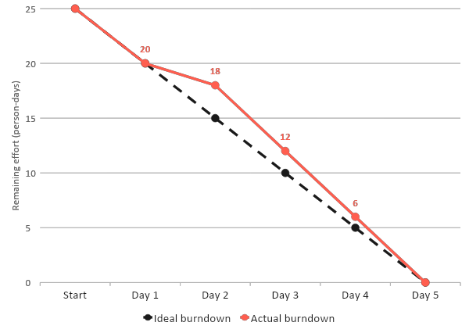
Burndown chart: 5-day project
DELIVERY
PROJECT PROGRESS
Data profiling
Remaining 20 (ideal 20): on plan
1
Cleaning in IDMC
Remaining 18 (ideal 15): 3 behind
2
Bronze and Silver loads, dimensions and facts
Remaining 12 (ideal 10): 2 behind
3
Snowpark
Remaining 6 (ideal 5): 1 behind
4
Streamlit, validations and Cortex AI
Remaining 0 (ideal 0): finished on time
5
23 / 25

Slide 24
DELIVERY
PROJECT 5 | SMART MANUFACTURING ANALYTICS
Kanban board: all 26 project tasks completed
Backlog 0
In progress 0
Review 0
Done 26
Design
IDMC
Snowflake
Snowpark
Security
Streamlit
Testing
DAY 1 | 4 DONE
DAY 2 | 6 DONE
DAY 3 | 6 DONE
DAY 4 | 6 DONE
DAY 5 | 4 DONE
Discovery and design
IDMC and Bronze
Silver and Gold
Security and Snowpark
Streamlit and handover
Profile the 7 source files
Build cleansing and standardization mapping
Build Silver typed, deduplicated tables
Stream and Task on production data
Build production, quality, asset dashboards
Confirm grain, keys and relationships
Route clean, warning, duplicate, reject
Flatten JSON sensor events
Test correction and replay loads
Run positive, negative, security tests
Define KPI catalogue and data model
Validate relationships and sequences
Build 4 conformed dimensions
Create 3 roles and Secure views
Close critical defects, complete UAT
Document architecture and acceptance criteria
Create stages and file formats
Build 4 fact tables
Apply masking, demonstrate USE ROLE
Write runbook and final presentation
Load CSV and JSON into Bronze
Build production, quality, machine marts
Build rule-based machine risk score
Reconcile source to Bronze
Reconcile Silver to Gold, check KPIs
Review performance, prove recovery
Project 5 | Smart Manufacturing Analytics | IDMC
24 / 25

Slide 25
CLOSE
THANK YOU
LTM
Project 5 | Smart Manufacturing Analytics | IDMC
1
25 / 25

