Slide 1



Slide 2
SER502-Spring2019-Team11
Team 11 – bumpy
Bharat Goel
Madhukar Raj
Palak Chugh
Yuti Desai

Slide 3
Feature Of The Language
Bumpy Language is developed in Prolog Completely
We are using Top- down parsing technique
Data structures used by the parser and interpreter: List
Interpreter: Our interpreter is based on Reduction machine.
It is an Imperative language and Statically typed
It provides data types such as Integer and Boolean
Looping construct – while loop
Decision control statement – if-else statement
inspired by C language

Slide 4
Operators and Constructs For BUMPY
Operators: +,-,*,/,%,<,>,<=,>=, ~=, :=:, = ,and, or,
Arithmetic Operator: +,-,*,/,%
Assignment Operator: =
Comparison Operator: <,>,<=,>=, ~=, :=:
Boolean Operator : and, or
Primitive types: bool, var
Decision Constructs: incase do otherwise endcase
Iterative Constructs: when repeat endrepeat

Slide 5
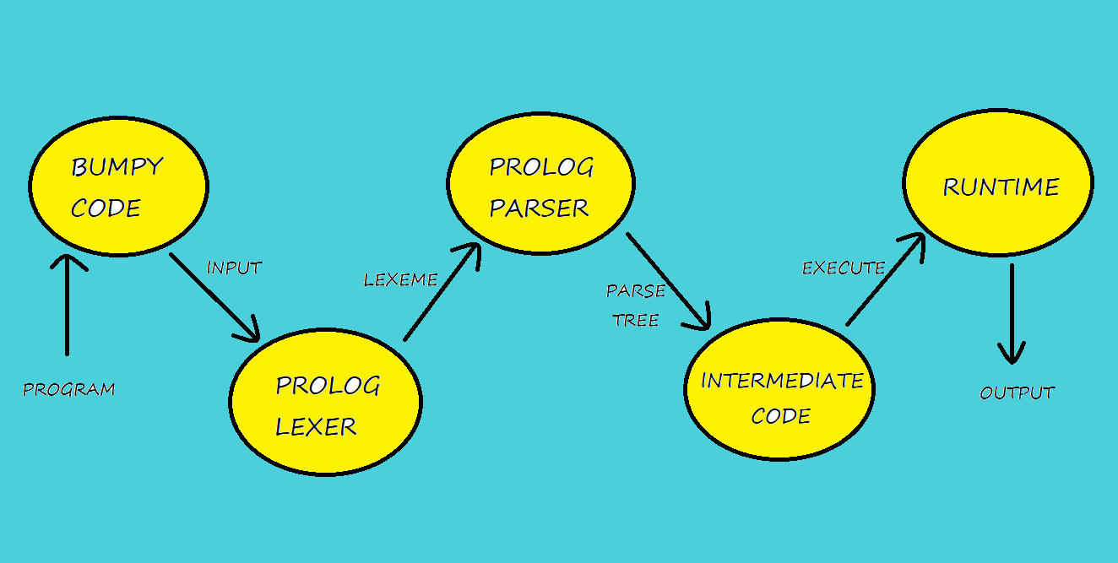

Design Flow

Slide 6
Lexical Analyzer and Parser
Lexical Analyzer and Parser written in Prolog Definite Clause Grammar.
Once the program is fed to the Lexar, it generates a list of lexemes for program by identifying keywords, eliminating spaces, tabs and new lines.
After getting the tokens, tokens are passed through the parser which is a prolog DCG code with the grammar defined for the language using prolog predicates and it generates the parse tree for the given code.
It Parses in a top-down fashion.

Slide 7
Intermediate Code
Parse tree is itself the intermediate code as we are using Prolog for creating language.
It gives Intermediate code as output to a separate file.
Intermediate Code is generated using DCG as well.
Used interpreter to evaluate the intermediate code.

Slide 8
Runtime/Interpreter
Programmed in Prolog.
The Interpreter is implemented by traversing node by node through the generated parse tree. Each node denotes an evaluation step that needs to be performed
The environment at each node is looked up or updated via a list data structure in prolog.
Used reduction rules to evaluate the code.

Slide 9
Language Grammar
Parser → Program
Program → Comment Block
Program → Block
Comment → @ Words @
Words → Identifier Words | Numb Words
Words → Identifier| Numb.
Block → start Declaration Process stop

Slide 10
Language Grammar
Datatype → var | bool
Declaration → Datatype Identifier ; Declaration
Declaration → Datatype Identifier ;
Process → Assignvalue ; Process | Control Process | Iterate Process | Print Process |ReadValue Process
Process → Assignvalue ; | Control | Iterate | Print | ReadValue
ReadValue → input Identifier ;

Slide 11
Language Grammar
Print → show Expression ;
Print → show $ Value $ ;
Assignvalue → Identifier = expression| Identifier is Boolexp
Control → incase Condition do Process otherwise Process endcase
Iterate → when Condition repeat Process endrepeat
Condition → Boolexp and Boolexp
Condition → Boolexp or Boolexp
Condition → ~ Boolexp
Condition → Boolexp

Slide 12
Language Grammar
Boolexp → Expression :=: Expression |Expression ~= Expression| Expression <= Expression| Expression >= Expression|Expression < Expression| Expression > Expression |Expression :=: Boolexp|Expression ~= Boolexp|yes | no
Expression → Term + Expression |Term – Expression |Term
Term → Identifier * Term| Numb * Term|Numbneg * Term
Term → Identifier / Term|Numb /Term|Numbneg /Term
Term → Identifier mod Term|Numb mod Term|Numbneg mod Term
Term → Identifier|Numb|Numbneg
Identifier →
Number →

Slide 13
Demonstration: Runtime

Slide 14
Demonstration: Executing Prolog Files

