Slide 1
NEED TO RUN TEST

Slide 2

Predicting USA Share of Total Box Office Revenue
Maddy O’Brien Jones

Slide 3

The Question
What influences whether a movie is more successful in the USA or abroad?

Slide 4

Selenium
Scraping genre pages of IMDB
Collecting movie-specific codes

Slide 5

BeautifulSoup
IMDB
Basic information
Budget and revenue
The Numbers (supplementary)
Budget and revenue

Slide 6
Feature Selection
Numerical
USA gross box office revenue
International box office revenue
Budget
Year
Runtime
User rating
Ratings count
Categorical
MPAA rating
Director
Country
Language
Genre
Notes:
NO LINEAR RELATIONSHIPS FOUND IN EDA

Slide 7
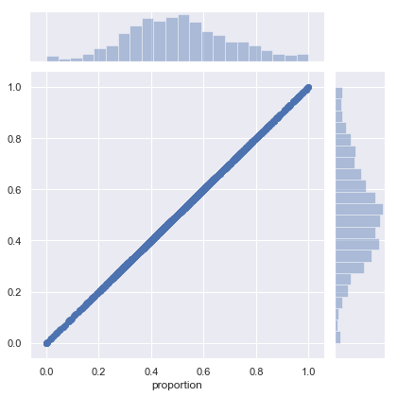
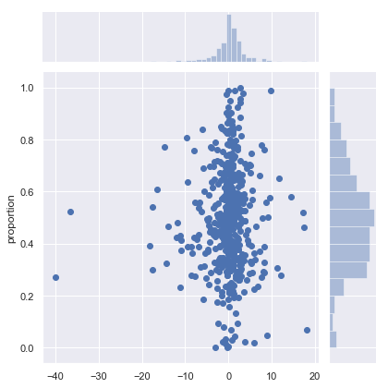
Linear and Polynomial Regression
Best performing model was simple linear regression
Overfitting problems
Residuals for each were evenly distributed
Notes:
3rd degree polynomial unregularized – initial R2 was 1.0

Slide 8
Decision Tree Models

Slide 9
Predictors
Linear/polynomial
Year
Crime
R rating
War
Animation
Decision tree models
Worldwide gross
Budget
Ratings count
Year
Runtime
User rating

Slide 10
Looking Forward
More features
More data
Data is mostly American/English-language movies
Data is likely incomplete

